Slide 1
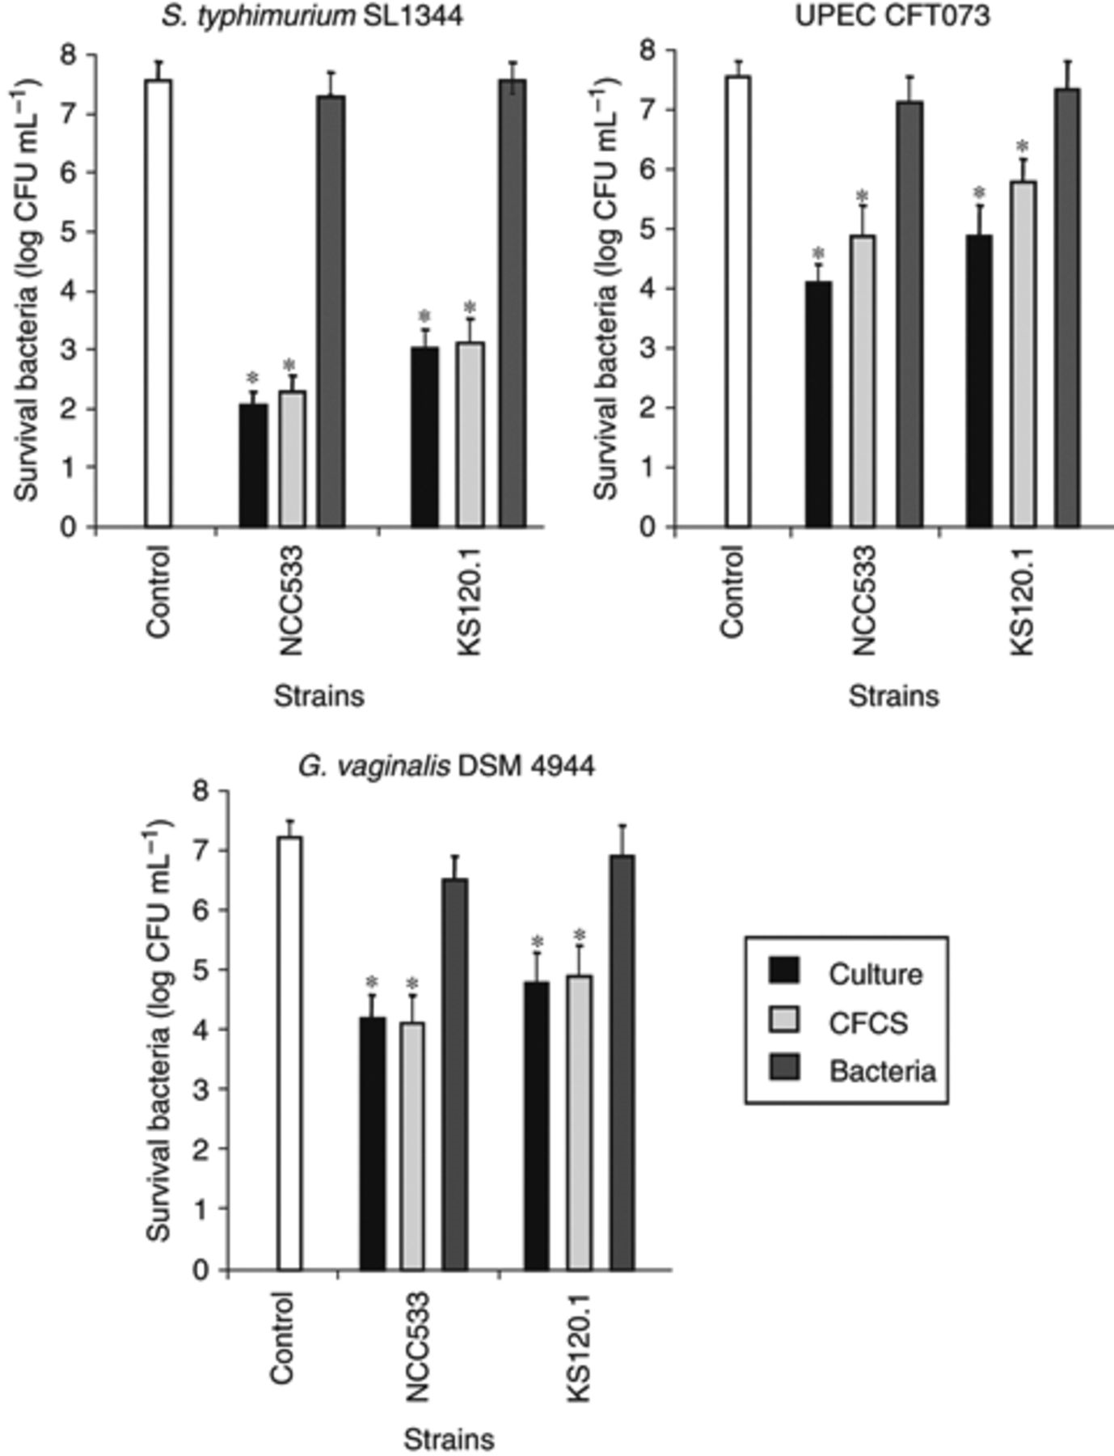
1 Effect of cultures, bacteria and CFCSs of the enteric and vaginal strains Lactobacillus johnsonii NCC533 and ...
Notes:
1 Effect of cultures, bacteria and CFCSs of the enteric and vaginal strains Lactobacillus johnsonii NCC533 and Lactobacillus gasseri KS120.1 on the viability of Gardnerella vaginalis DSM 4944, Salmonella typhimurium SL1344 and UPEC CFT073. Control represents the bacterial concentration at the end of the experiment. Each value shown is the mean±SD from three experiments. *P <0.01 compared with control.
Unless provided in the caption above, the following copyright applies to the content of this slide: © 2009 Federation of European Microbiological Societies Published by Blackwell Publishing Ltd. All rights reserved

Slide 2
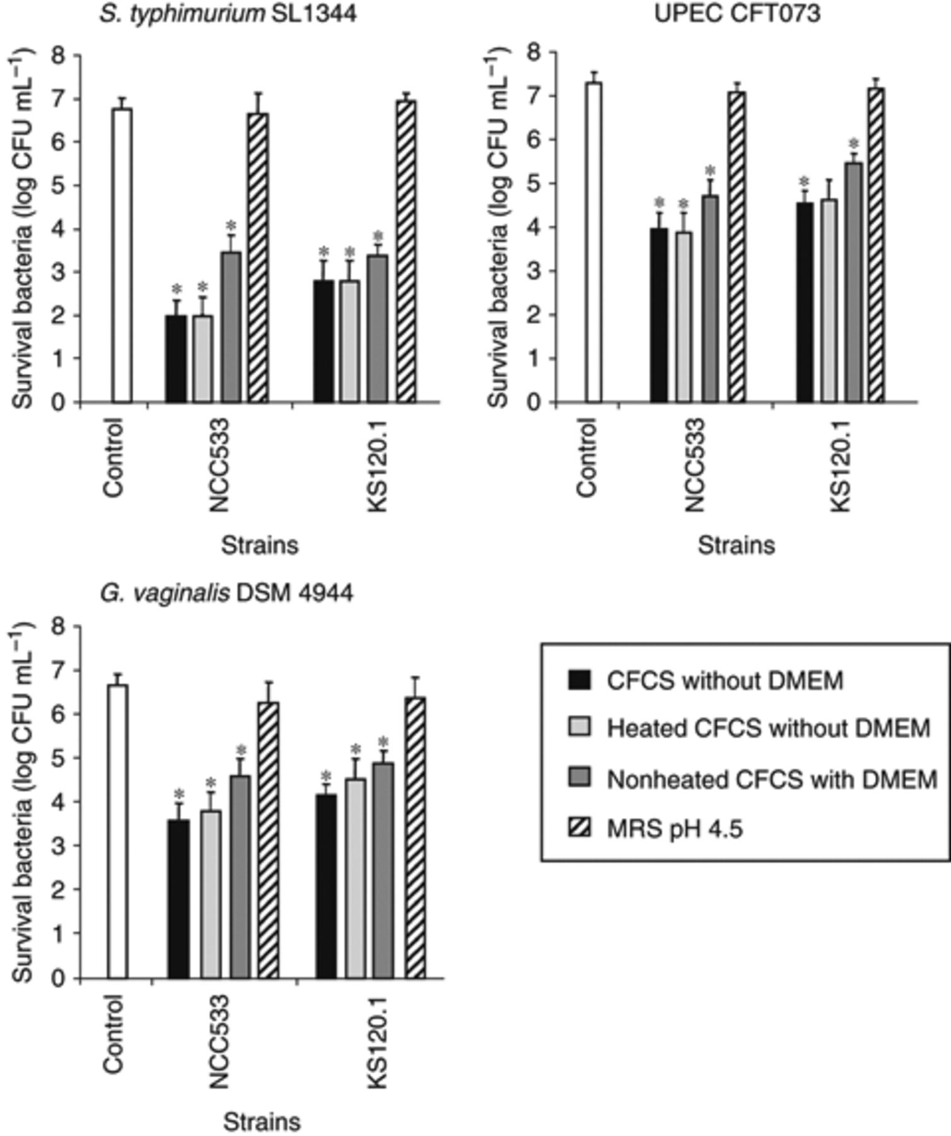
2 Characteristics of the killing activity of CFCSs of the enteric and vaginal strains Lactobacillus johnsonii ...
Notes:
2 Characteristics of the killing activity of CFCSs of the enteric and vaginal strains Lactobacillus johnsonii NCC533 and Lactobacillus gasseri KS120.1 against Salmonella typhimurium SL1344, UPEC CFT073, and Gardnerella vaginalis DSM 4944. MRS at pH 4.5 was included for comparison. Control represents the bacterial concentration at the end of the experiment. Each value shown is the mean±SD from three experiments. *P <0.01 compared with control.
Unless provided in the caption above, the following copyright applies to the content of this slide: © 2009 Federation of European Microbiological Societies Published by Blackwell Publishing Ltd. All rights reserved

Slide 3
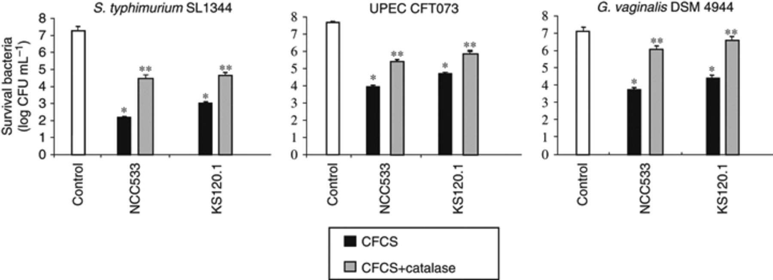
3 Effect of catalase treatment on the killing activity of CFCSs of the enteric and vaginal strains ...
Notes:
3 Effect of catalase treatment on the killing activity of CFCSs of the enteric and vaginal strains Lactobacillus johnsonii NCC533 and Lactobacillus gasseri KS120.1 against Salmonella typhimurium SL1344, UPEC CFT073, and Gardnerella vaginalis DSM 4944. Control represents the bacterial concentration at the end of the experiment. Each value shown is the mean±SD from three experiments. *P <0.01 compared with control. **P <0.01 vs. CFCS.
Unless provided in the caption above, the following copyright applies to the content of this slide: © 2009 Federation of European Microbiological Societies Published by Blackwell Publishing Ltd. All rights reserved

Slide 4
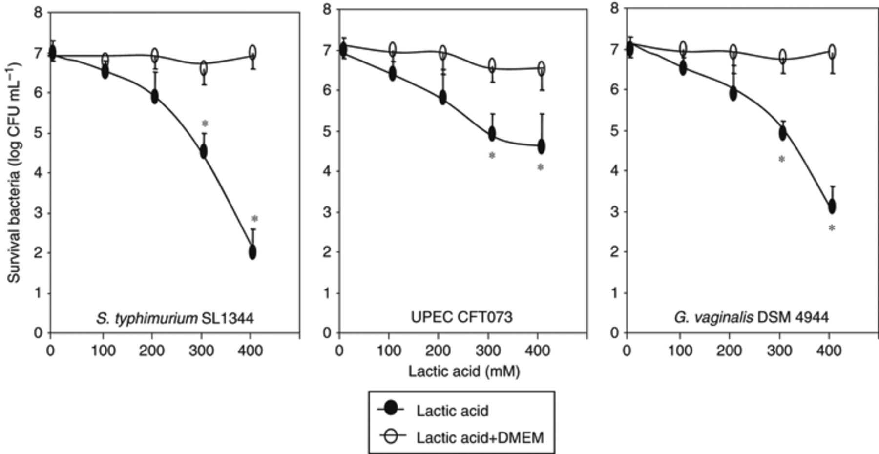
4 Concentration-dependent effect of lactic acid on the viability of Salmonella typhimurium SL1344, UPEC CFT073 ...
Notes:
4 Concentration-dependent effect of lactic acid on the viability of Salmonella typhimurium SL1344, UPEC CFT073 and Gardnerella vaginalis DSM 4944. Each value shown is the mean±SD from three experiments. *P <0.01 vs. incubation without lactic acid.
Unless provided in the caption above, the following copyright applies to the content of this slide: © 2009 Federation of European Microbiological Societies Published by Blackwell Publishing Ltd. All rights reserved

Slide 5
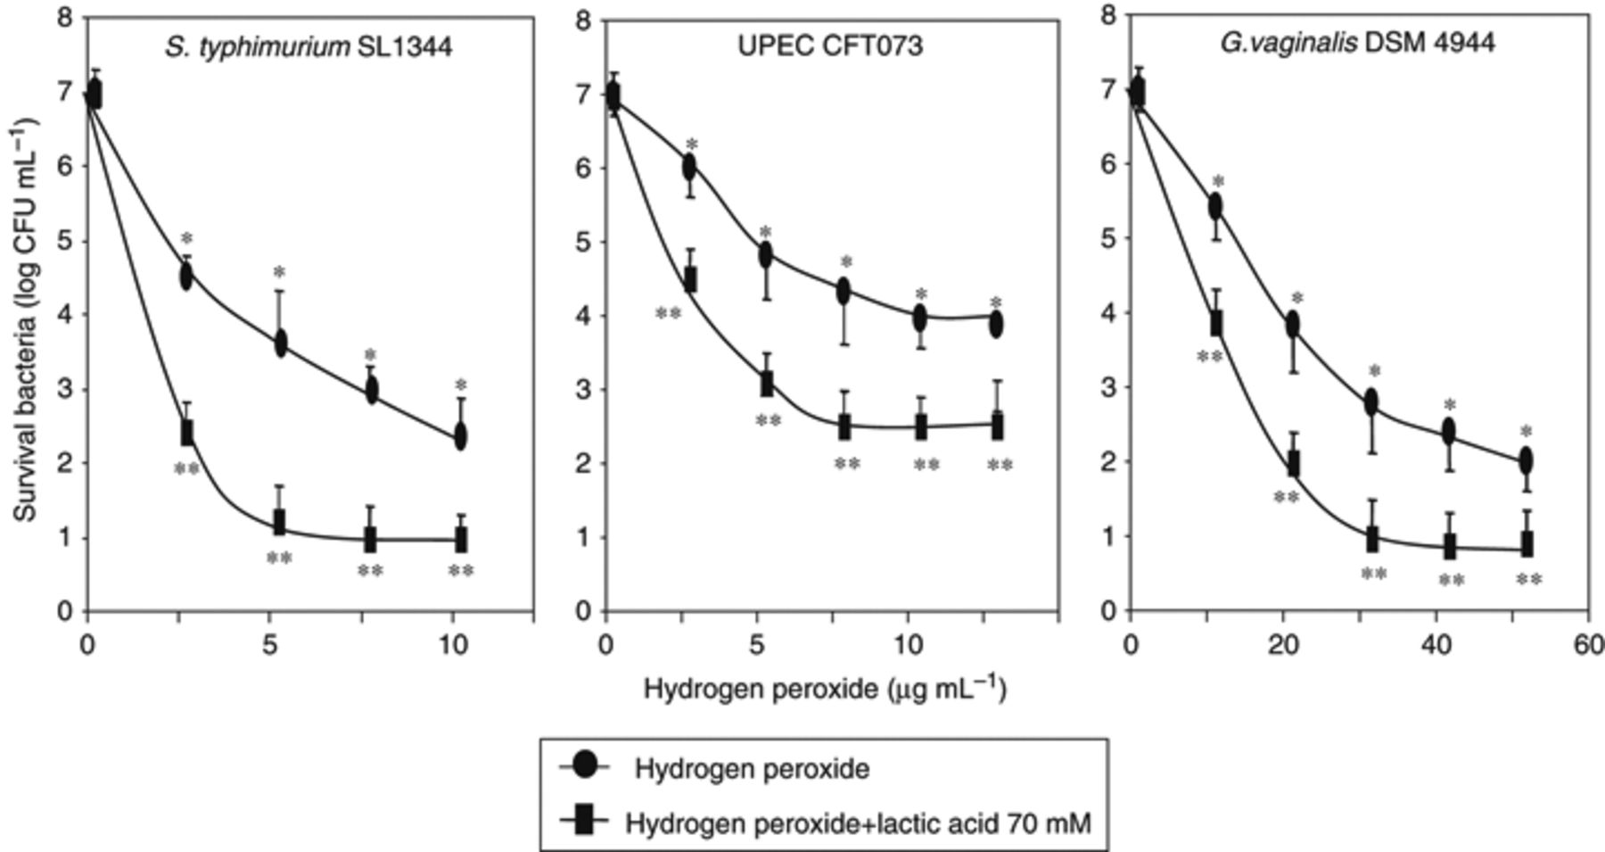
5 Lactic acid increases the killing activity of hydrogen peroxide against Salmonella typhimurium SL1344, UPEC ...
Notes:
5 Lactic acid increases the killing activity of hydrogen peroxide against Salmonella typhimurium SL1344, UPEC CFT073 and Gardnerella vaginalis DSM 4944. Each value shown is the mean±SD from three experiments. *P <0.01 vs. incubation without hydrogen peroxide. **P <0.01 vs. incubation without lactic acid.
Unless provided in the caption above, the following copyright applies to the content of this slide: © 2009 Federation of European Microbiological Societies Published by Blackwell Publishing Ltd. All rights reserved

