Slide 1
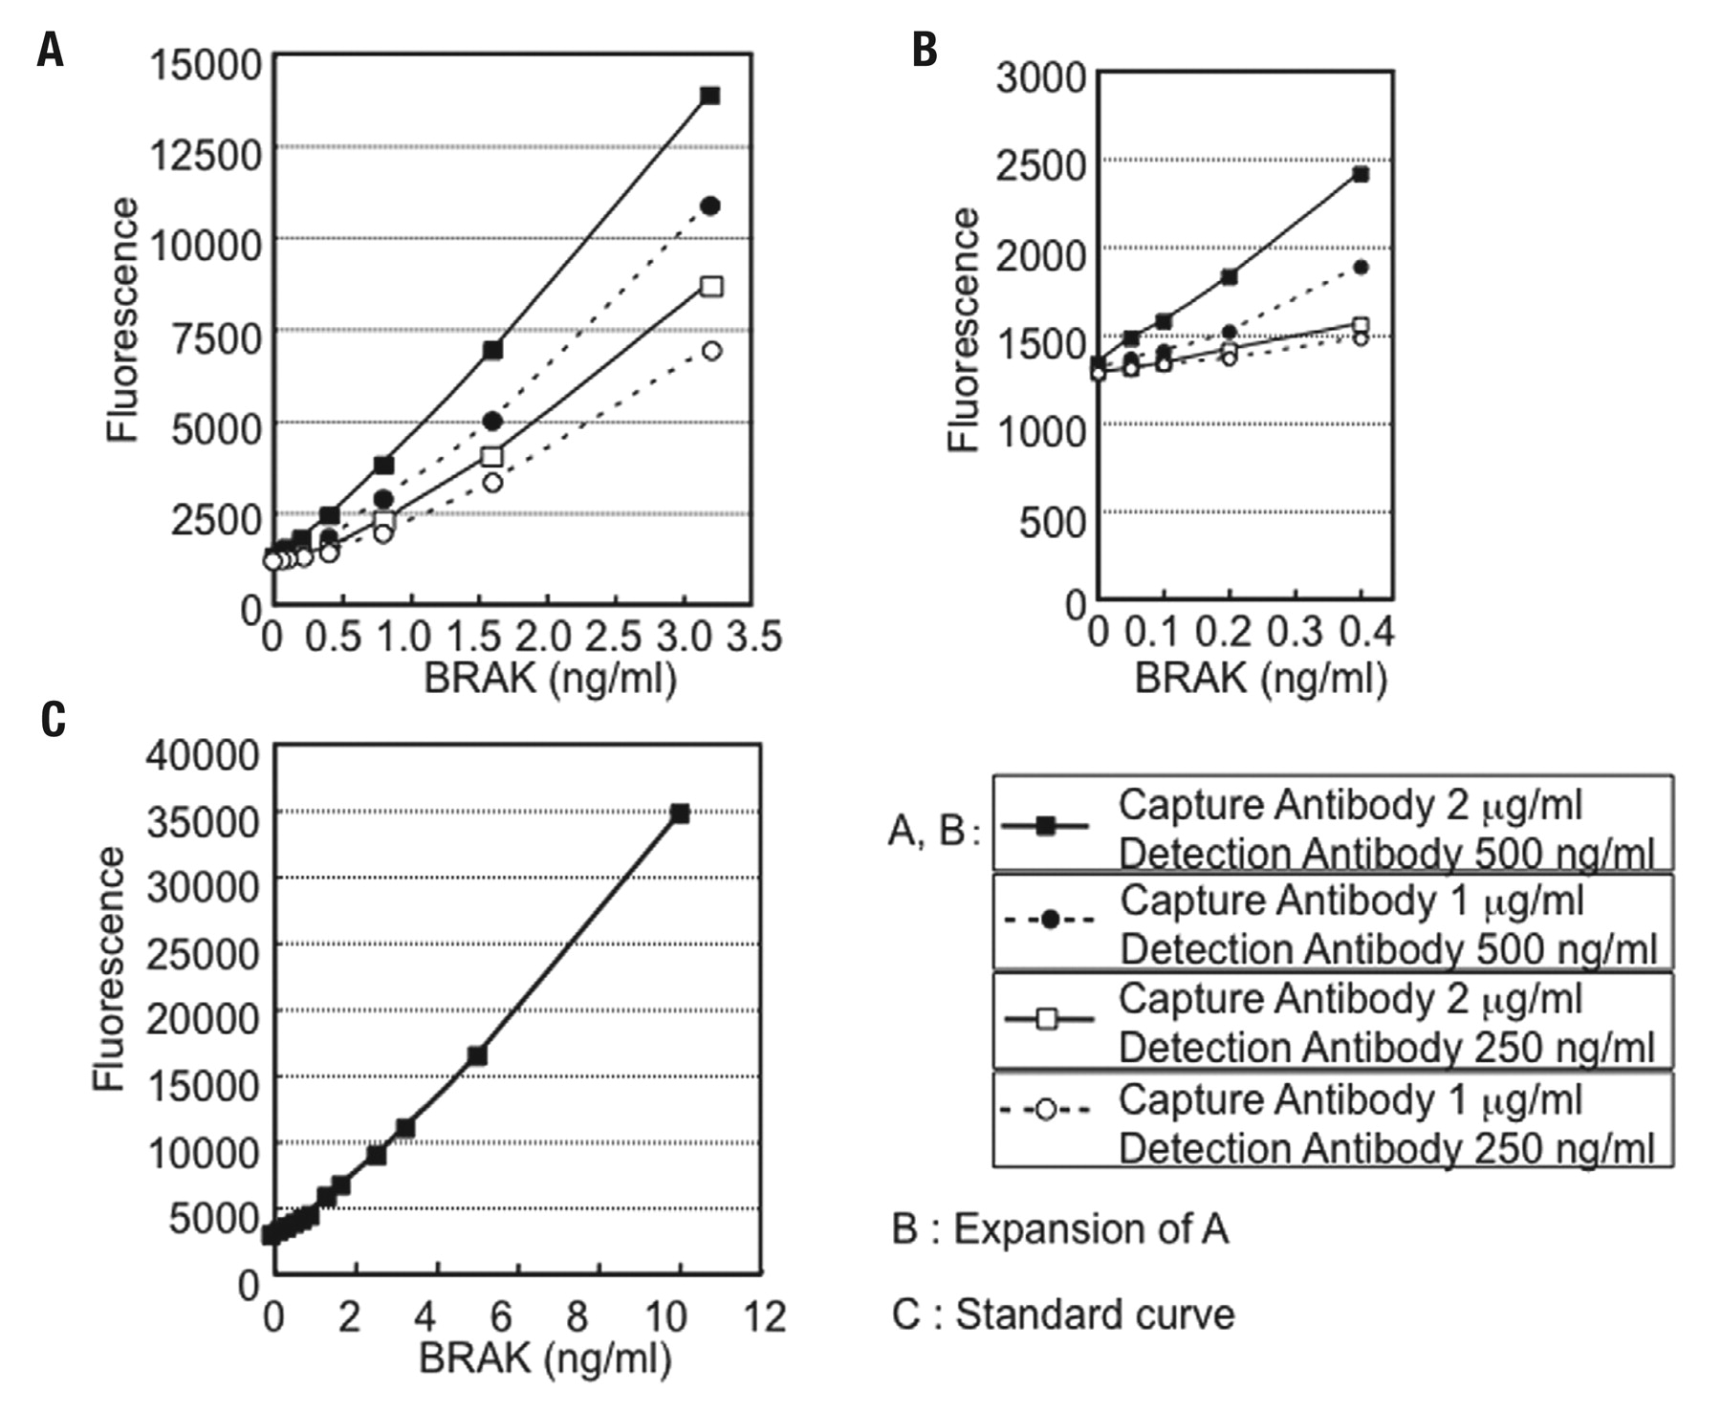
Figure 1 Effects of concentration of capture and detection antibodies on the intensity of fluorescence. (A) BRAK ...
Notes:
Figure 1 Effects of concentration of capture and detection antibodies on the intensity of fluorescence. (A) BRAK concentration was determined by use of the QuantaBlu fluorogenic peroxidase substrate and a DuoSet ELISA Development kit (R&D). A standard curve with linearity from 0.5 to 3 ng/mL was obtained. (B) Lower limit of detection of BRAK/CXCL14. The standard curve with linearity from 0.05 to 0.4 ng/mL is shown. (C) Relationship between concentrations of BRAK/CXCL14 (1 to 10 ng) and fluorescence intensity. The meaning of each symbol is given in the figure.
Unless provided in the caption above, the following copyright applies to the content of this slide: © American Society of Clinical Pathologists

Slide 2
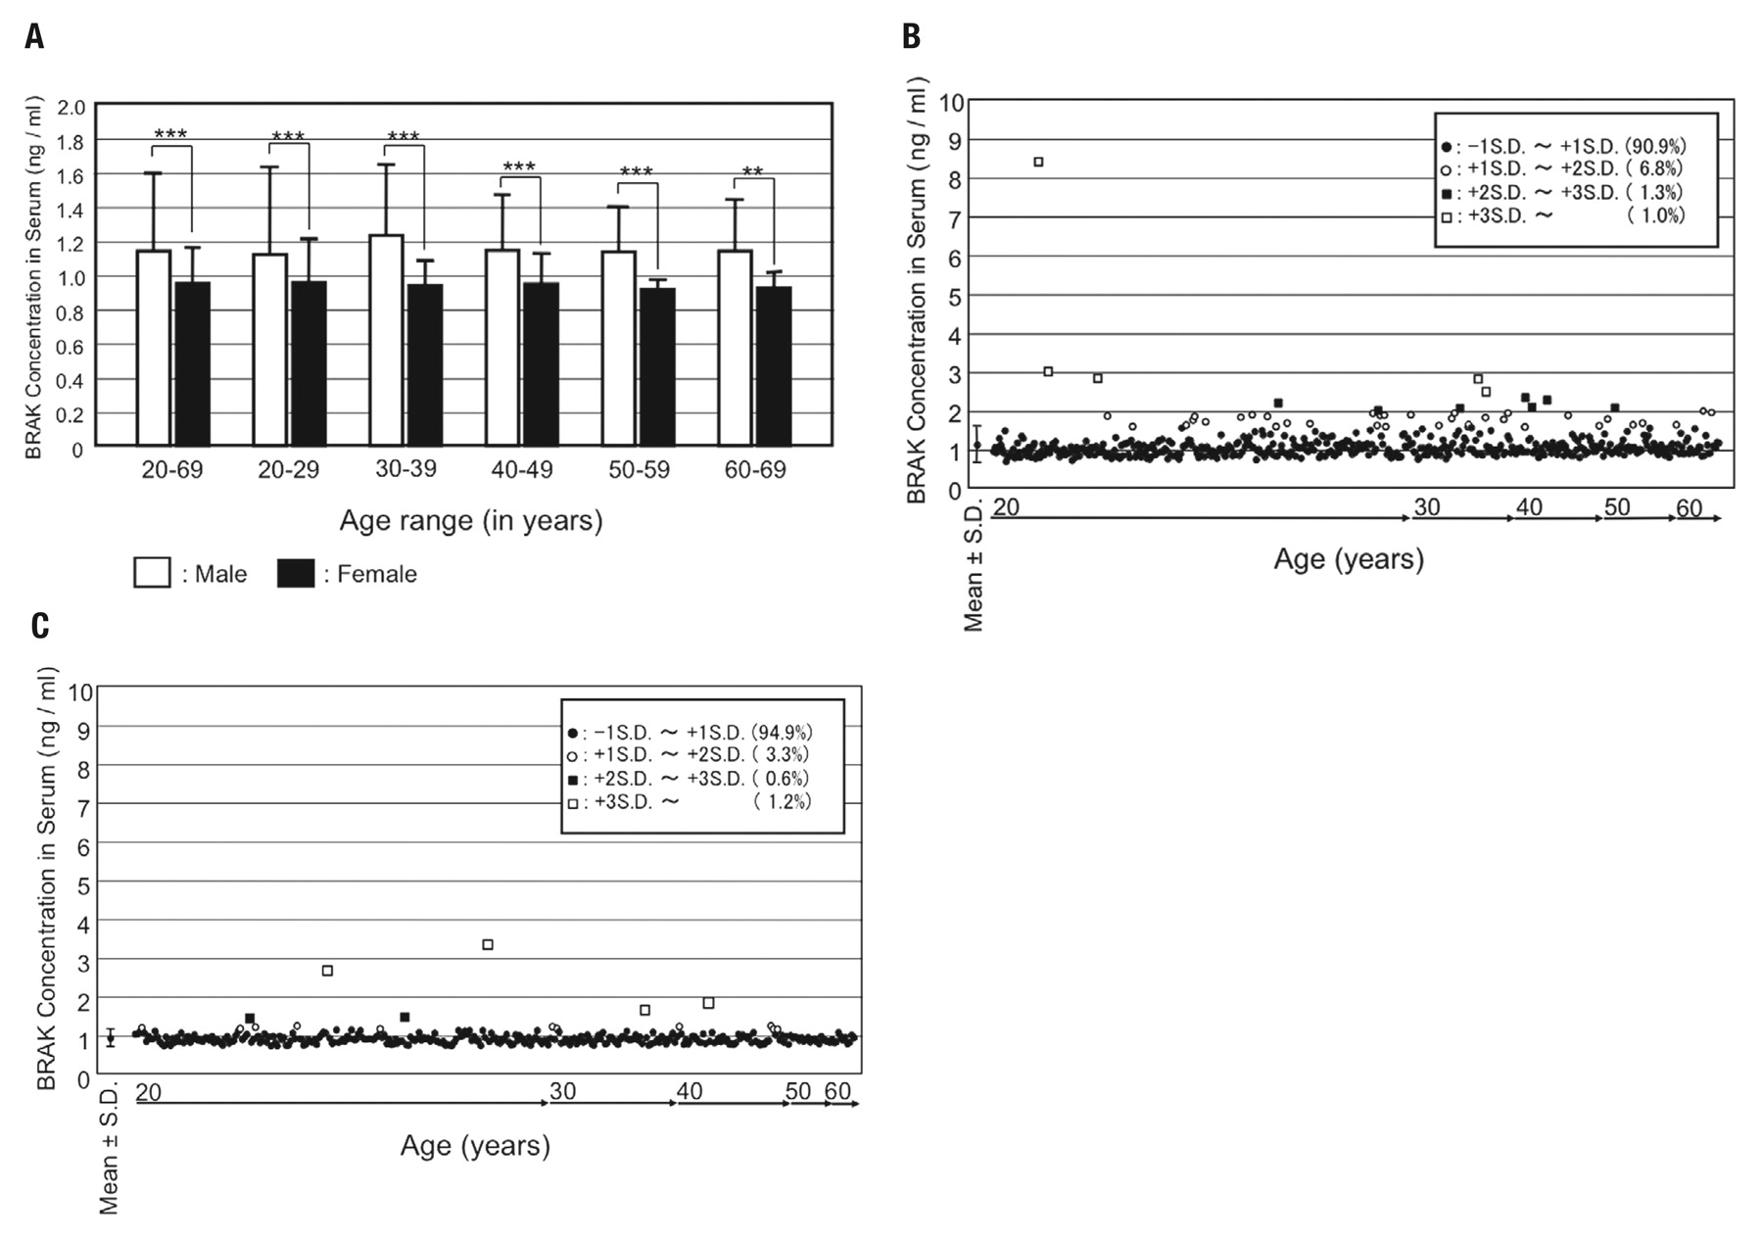
Figure 2 Distribution of serum BRAK/CXCL14 levels in male and female subjects. (A) Differences in serum BRAK/CXCL14 ...
Notes:
Figure 2 Distribution of serum BRAK/CXCL14 levels in male and female subjects. (A) Differences in serum BRAK/CXCL14 levels between male and female subjects according to age. (B) Distribution of individual serum BRAK/CXCL14 levels in male subjects. (C) Distribution of individual serum BRAK/CXCL14 levels in female subjects. **P<0.01 ***P<0.001
Unless provided in the caption above, the following copyright applies to the content of this slide: © American Society of Clinical Pathologists

Slide 3
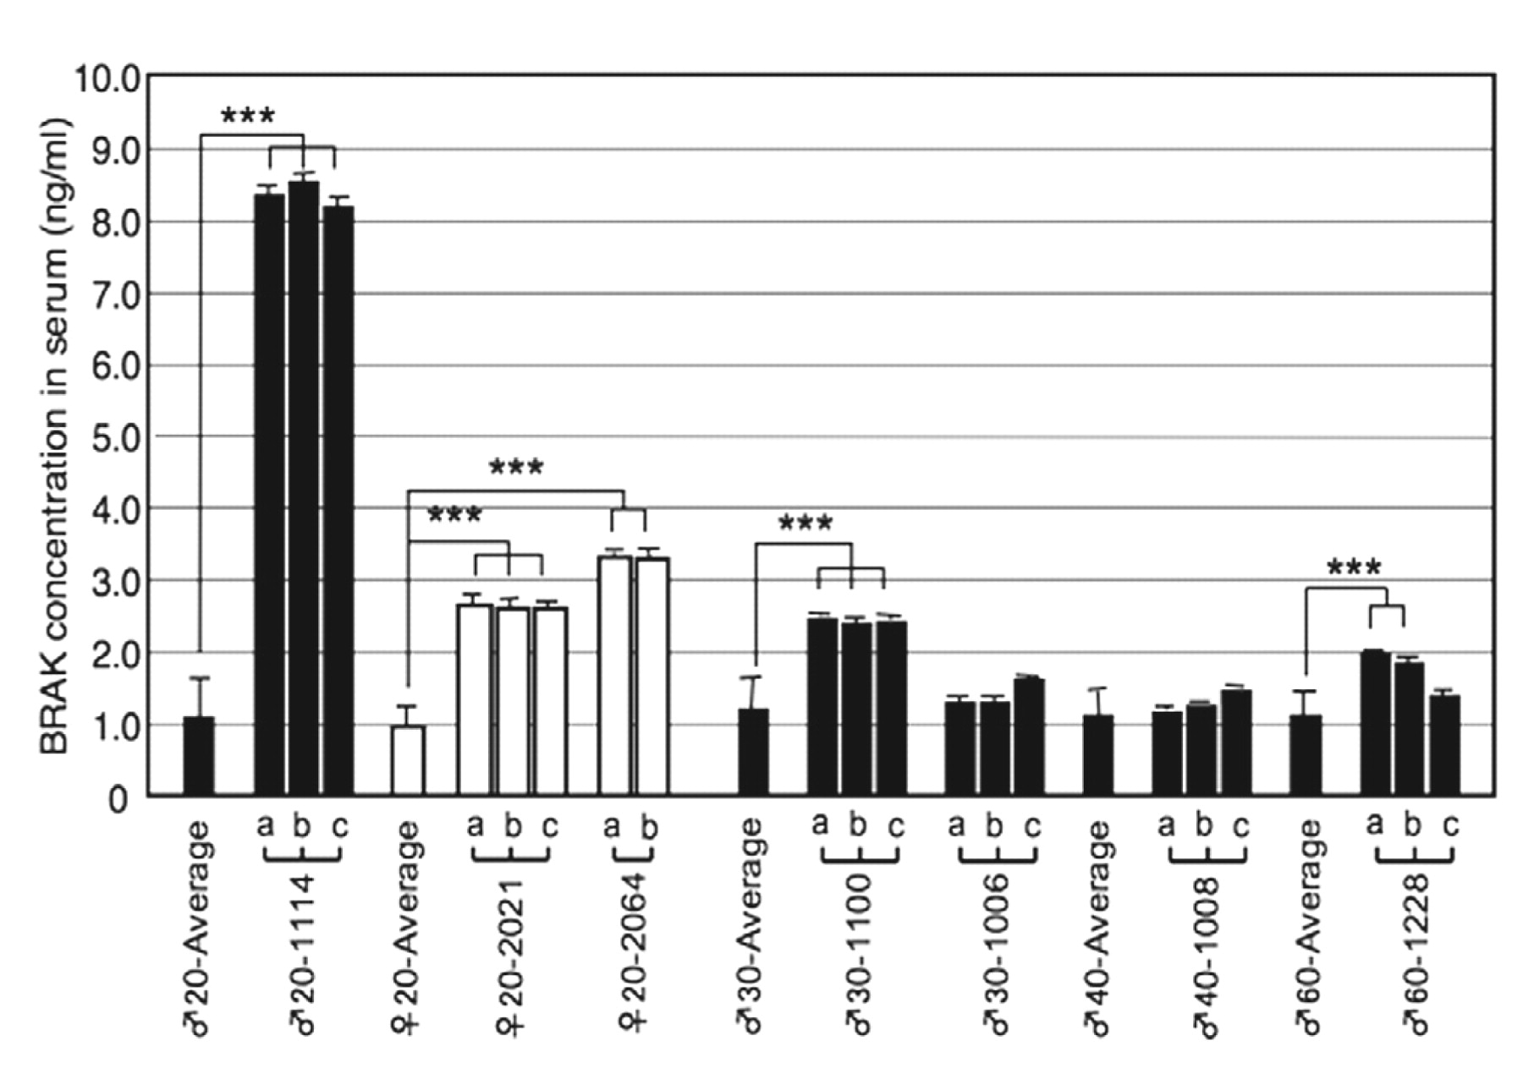
Figure 3 Reproducibility and constancy of the serum BRAK/CXCL14 levels. a, the first determination; b, samples ...
Notes:
Figure 3 Reproducibility and constancy of the serum BRAK/CXCL14 levels. a, the first determination; b, samples re-collected 3 months after the first collection; c, samples re-collected 6 months after the first collection. Reasonably constant values were obtained for the respective subjects, especially for those in the high-concentration group. ***P<0.001
Unless provided in the caption above, the following copyright applies to the content of this slide: © American Society of Clinical Pathologists

