Slide 1
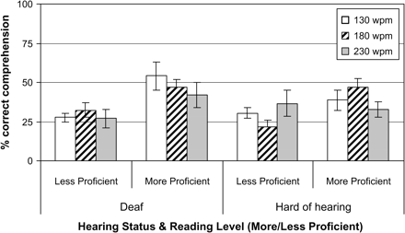
Figure 1 Mean comprehension at different caption rates, by hearing status and reading level. (Error bars represent ...
Notes:
Figure 1 Mean comprehension at different caption rates, by hearing status and reading level. (Error bars represent SEs.)
Unless provided in the caption above, the following copyright applies to the content of this slide: © The Author 2008. Published by Oxford University Press. All rights reserved. For Permissions, please email: journals.permissions@oxfordjournals.org

Slide 2
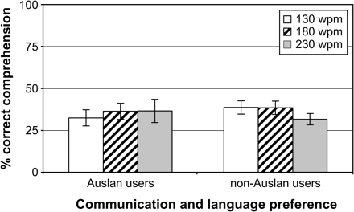
Figure 2 Mean comprehension at different caption rates, by communication and language preference. (Error bars ...
Notes:
Figure 2 Mean comprehension at different caption rates, by communication and language preference. (Error bars represent SEs.)
Unless provided in the caption above, the following copyright applies to the content of this slide: © The Author 2008. Published by Oxford University Press. All rights reserved. For Permissions, please email: journals.permissions@oxfordjournals.org

Slide 3
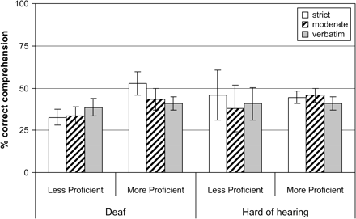
Figure 3 Mean comprehension with different text reduction, by hearing status and reading level. (Error bars represent ...
Notes:
Figure 3 Mean comprehension with different text reduction, by hearing status and reading level. (Error bars represent SEs.)
Unless provided in the caption above, the following copyright applies to the content of this slide: © The Author 2008. Published by Oxford University Press. All rights reserved. For Permissions, please email: journals.permissions@oxfordjournals.org

Slide 4
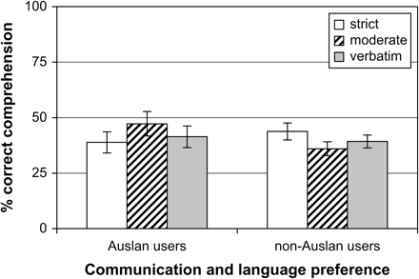
Figure 4 Mean comprehension with different text reduction, by communication and language preference. (Error bars ...
Notes:
Figure 4 Mean comprehension with different text reduction, by communication and language preference. (Error bars represent SEs.)
Unless provided in the caption above, the following copyright applies to the content of this slide: © The Author 2008. Published by Oxford University Press. All rights reserved. For Permissions, please email: journals.permissions@oxfordjournals.org

