Slide 1
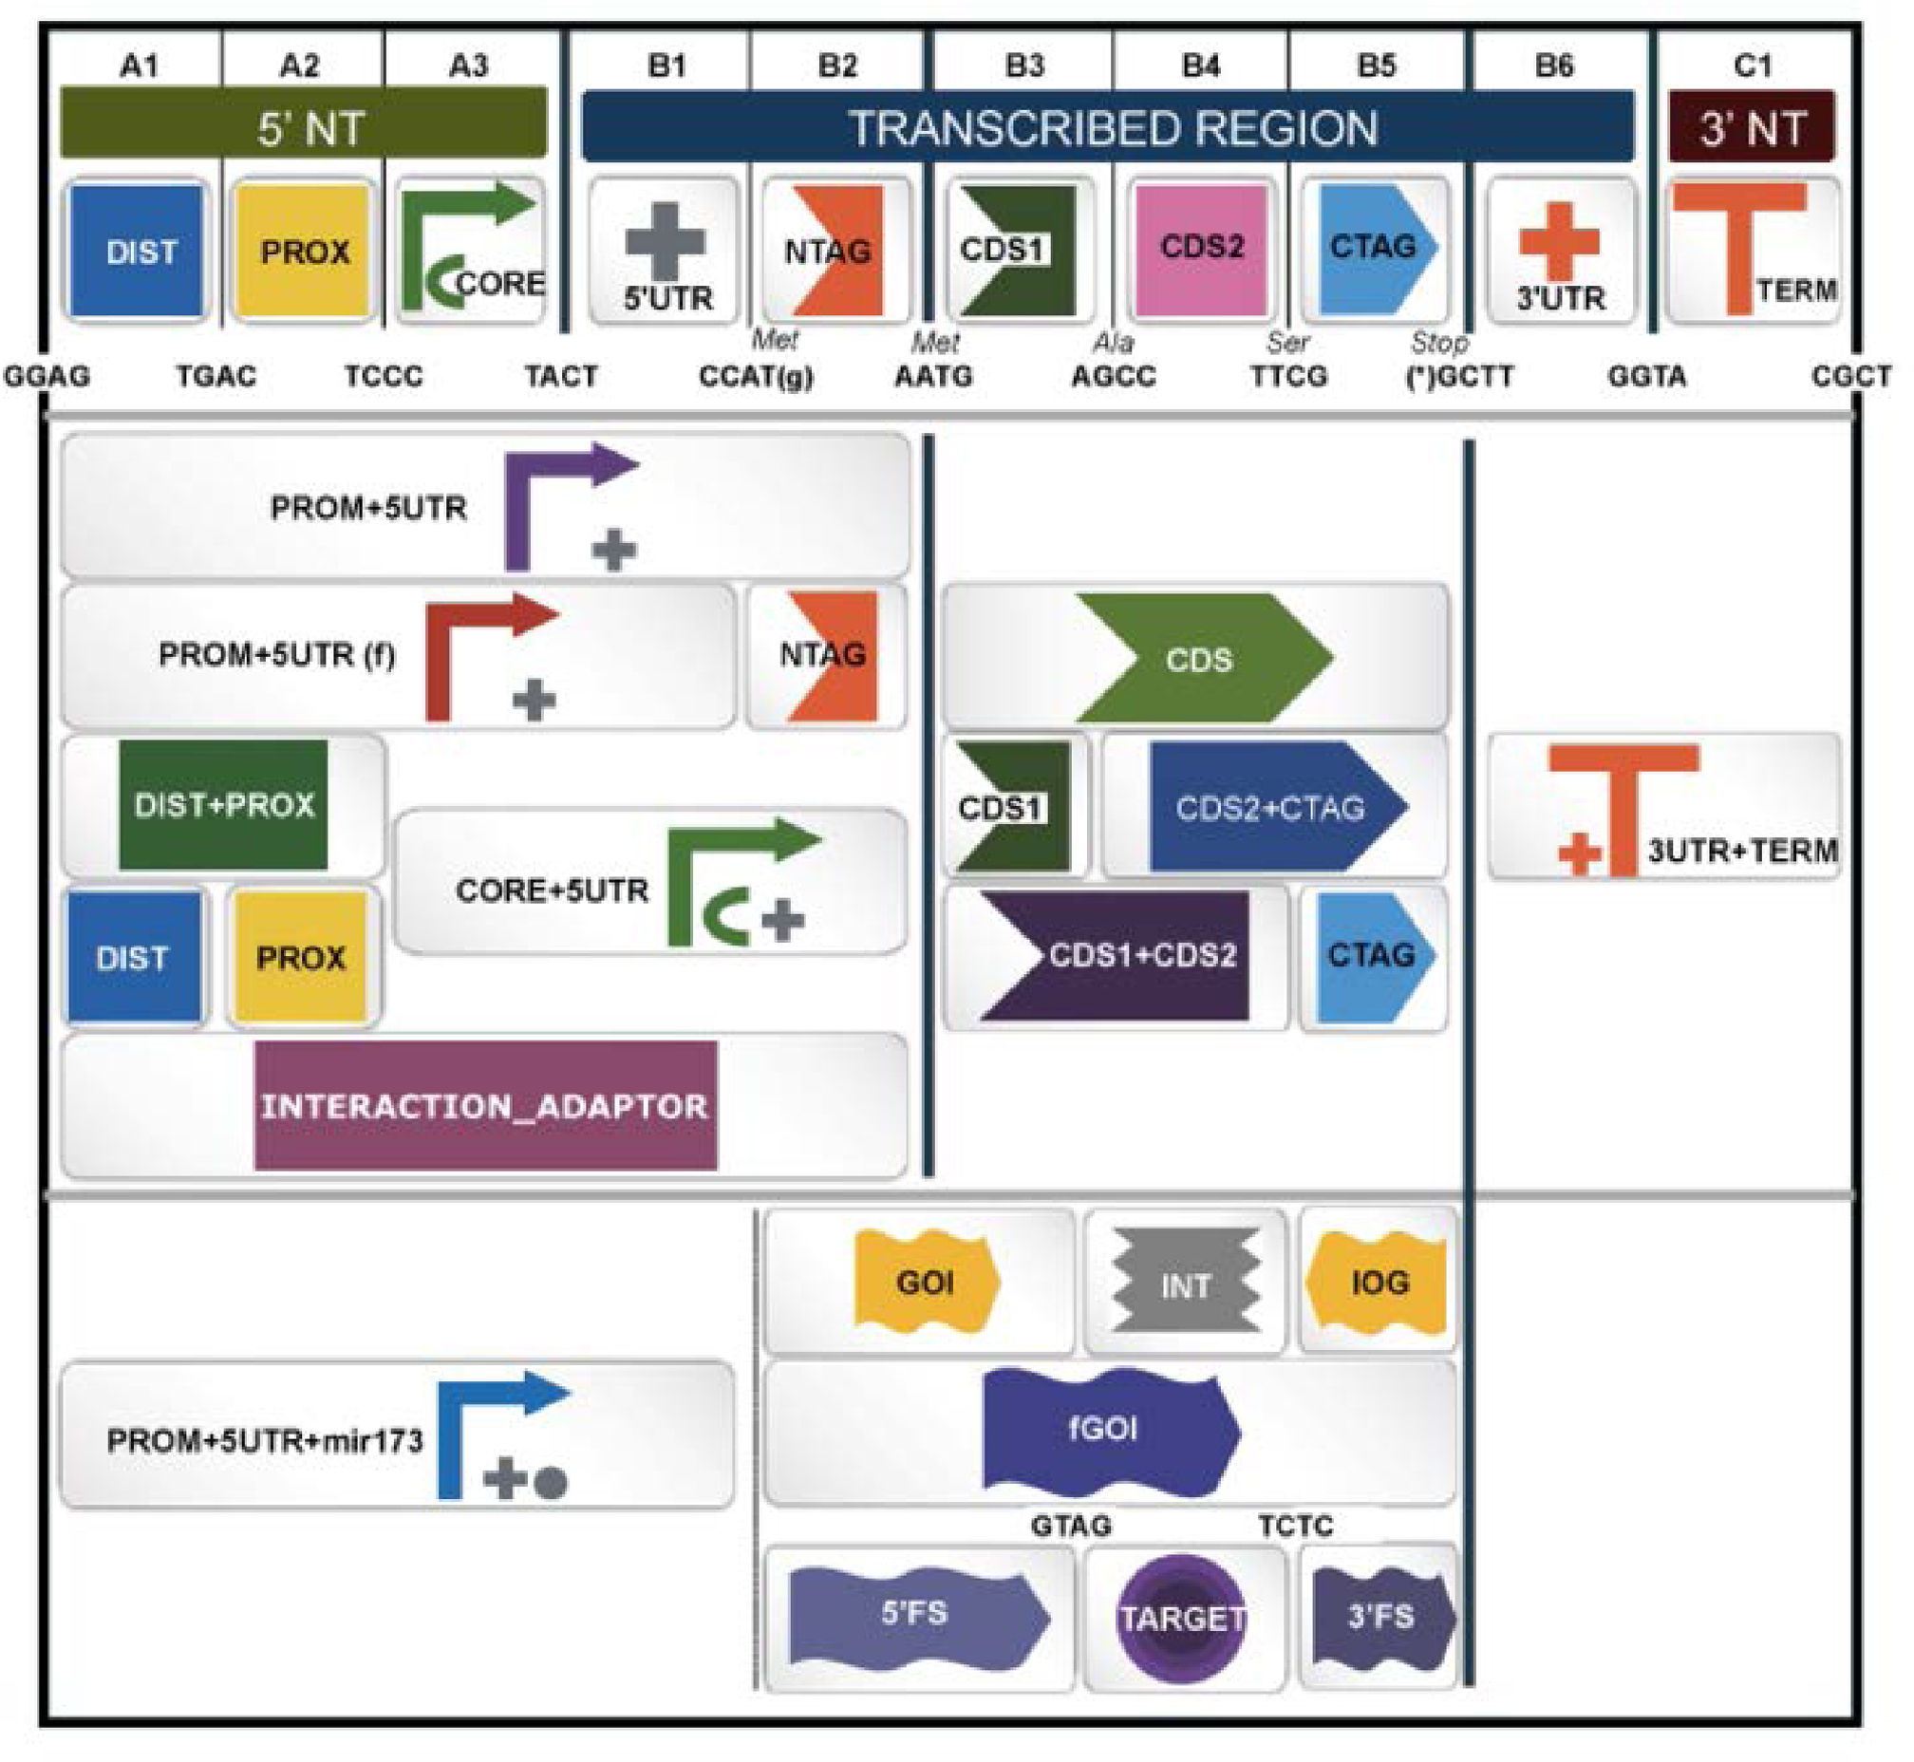
Figure 1. Browser page displaying the Standard Plant Syntax for Parts database. The figure shows a screenshot of the ...
Notes:
Figure 1. Browser page displaying the Standard Plant Syntax for Parts database. The figure shows a screenshot of the parts database search browser including specific synthetic biology open language (SBOL)-based images as shortlinks to the different part categories.
Unless provided in the caption above, the following copyright applies to the content of this slide: © The Author(s) 2017. Published by Oxford University Press on behalf of Nucleic Acids Research.This is an Open Access article distributed under the terms of the Creative Commons Attribution License (http://creativecommons.org/licenses/by-nc/4.0/), which permits non-commercial re-use, distribution, and reproduction in any medium, provided the original work is properly cited. For commercial re-use, please contact journals.permissions@oup.com

Slide 2
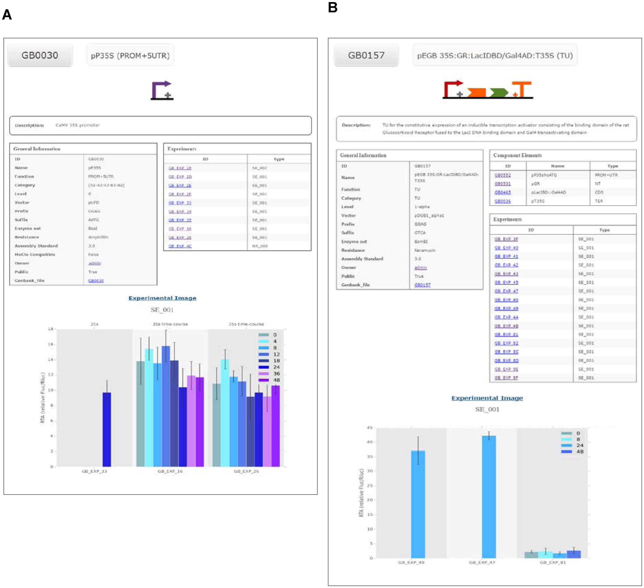
Figure 2. Examples of two GB3.0 datasheets. (A) Datasheet of the level 0 phytobrick derived from CaMV35S promoter ...
Notes:
Figure 2. Examples of two GB3.0 datasheets. (A) Datasheet of the level 0 phytobrick derived from CaMV35S promoter (GB0030). The datasheet includes a SBOL-inspired symbol (top), assembly information such as part category, vector or information of compatibility with the MoClo standard (general information table) and experimental information with links to all experiments performed with devices including this phytobrick (experiments table) and graphs of three experiments (bottom). (B) Datasheet of the composite part GB0157 including a compilation of the SBOL-inspired symbols describing each of its components (top) a list of these components with links to each of them facilitating the traceability of the assembly (component elements table), assembly information such as the vector and phytobrick category (general information table) and experimental information with links to all experiments performed with devices including this element (experiments table) and the graphs of three representative experiments (bottom).
Unless provided in the caption above, the following copyright applies to the content of this slide: © The Author(s) 2017. Published by Oxford University Press on behalf of Nucleic Acids Research.This is an Open Access article distributed under the terms of the Creative Commons Attribution License (http://creativecommons.org/licenses/by-nc/4.0/), which permits non-commercial re-use, distribution, and reproduction in any medium, provided the original work is properly cited. For commercial re-use, please contact journals.permissions@oup.com

Slide 3
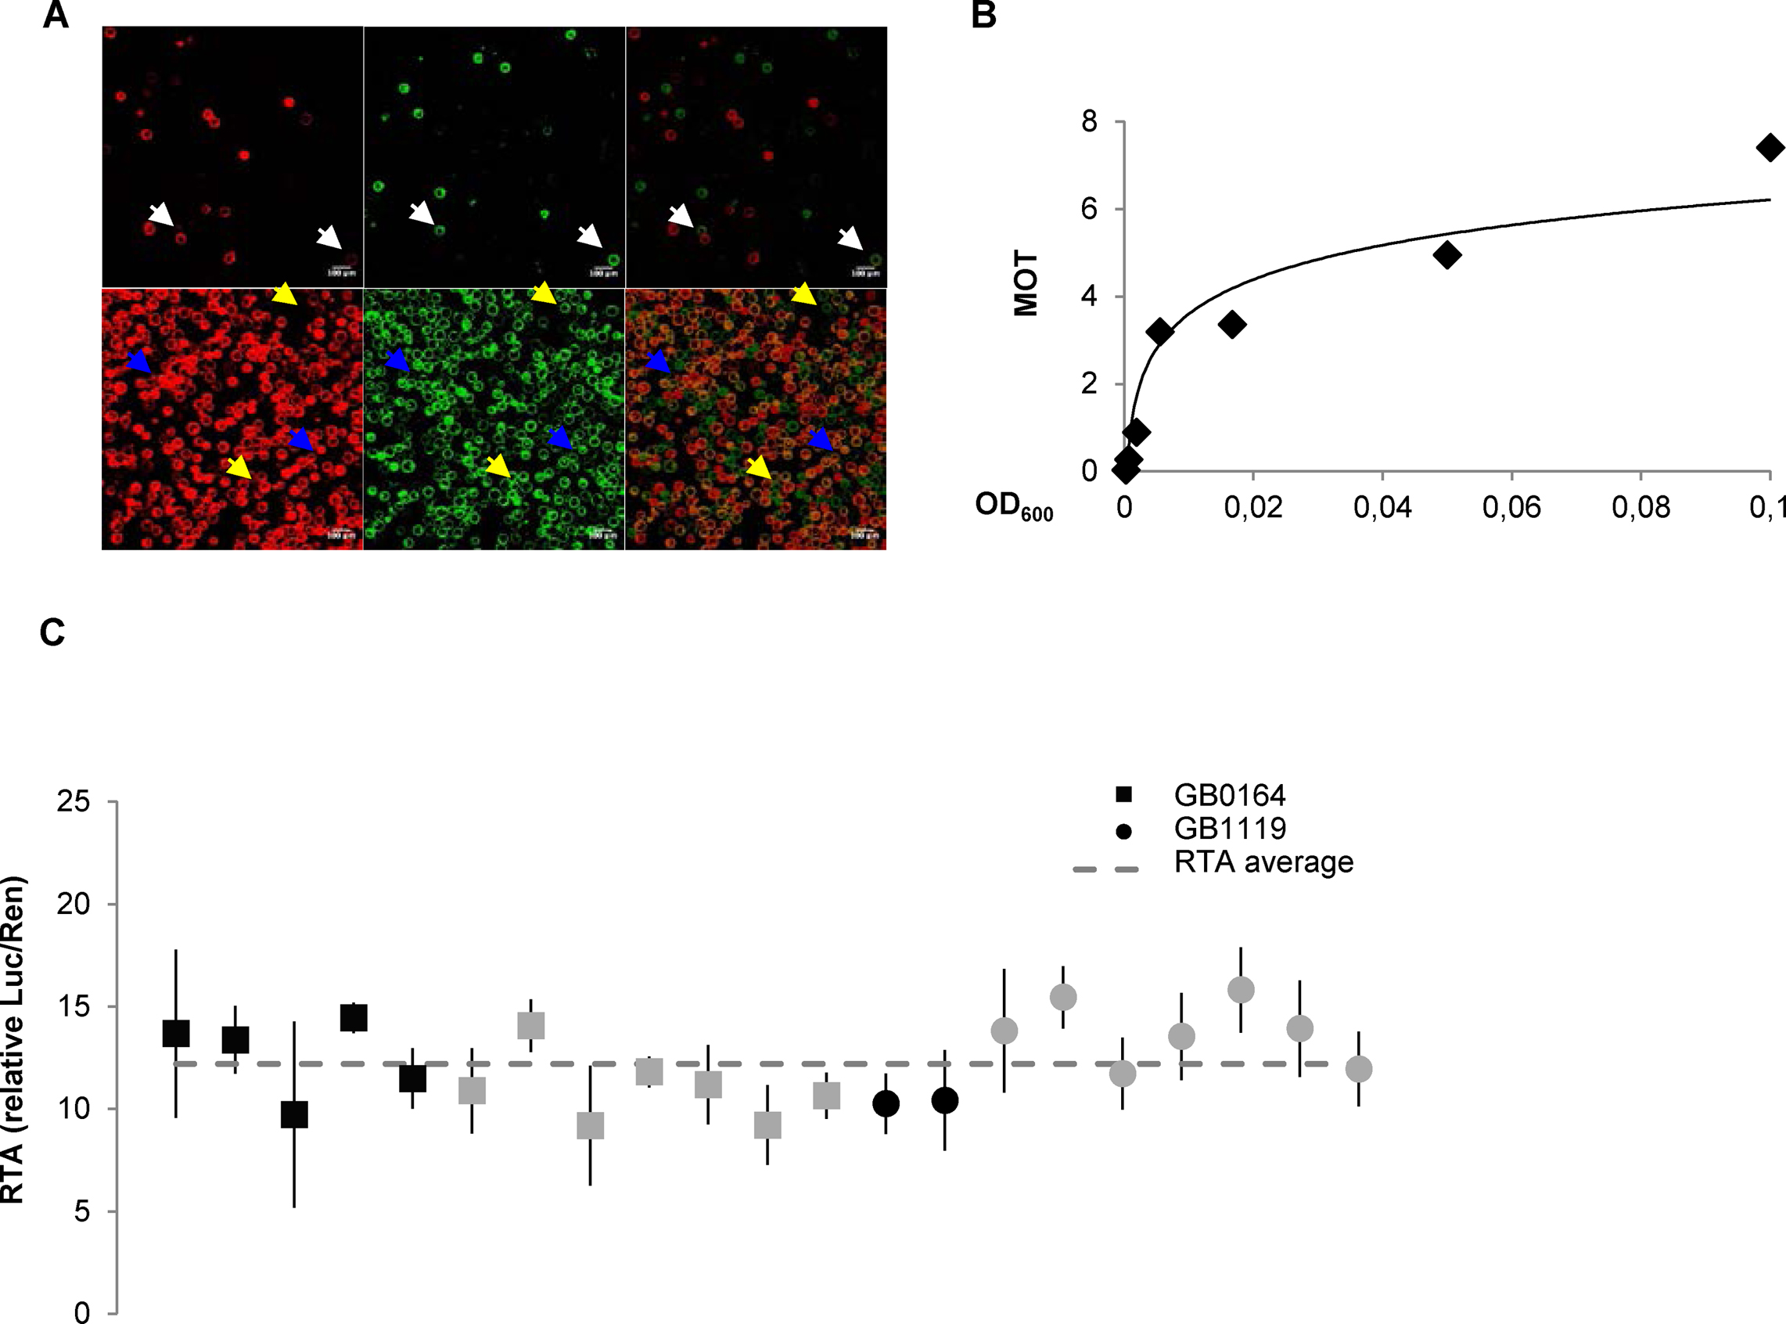
Figure 3. Refinement of experimental conditions for Plant DNA part characterization in transient expression assays and ...
Notes:
Figure 3. Refinement of experimental conditions for Plant DNA part characterization in transient expression assays and behaviour of the CaMV35s promoter among experiments. (A) Images of protoplasts co-transformed with GB1287 and GB1288 at OD600 = 0.000617 (top) and OD600 = 0.05 (down). From left to right Red channel, YFP channel and overlay of the two previous pictures. White arrows point to co-transformed protoplasts, blue arrows to protoplasts showing only red fluorescence and yellow arrows to protoplasts showing only yellow fluorescence. (B) Relationship between the OD600 and the multiplicity of transformation (MOT). MOT values were estimated based on the percentage of co-transformed protoplasts (see Materials and Methods for details). (C) Reproducibility of relative transcriptional activity (RTA) measurements in standard experiments. Relative transcriptional activity of the CaMV35S promoter (GB0030), tested as part of devices GB0164 and GB1119 over different experiments. GB0164 has a pGreen backbone while GB1119 has a pCAMBIA backbone. Black squares and circles correspond to measurements at 4dpi while grey squares and circles are measurements determined at different time points. Error bars represent standard deviations of three different leaves expressing the same GBelement on the same experiment.
Unless provided in the caption above, the following copyright applies to the content of this slide: © The Author(s) 2017. Published by Oxford University Press on behalf of Nucleic Acids Research.This is an Open Access article distributed under the terms of the Creative Commons Attribution License (http://creativecommons.org/licenses/by-nc/4.0/), which permits non-commercial re-use, distribution, and reproduction in any medium, provided the original work is properly cited. For commercial re-use, please contact journals.permissions@oup.com

Slide 4
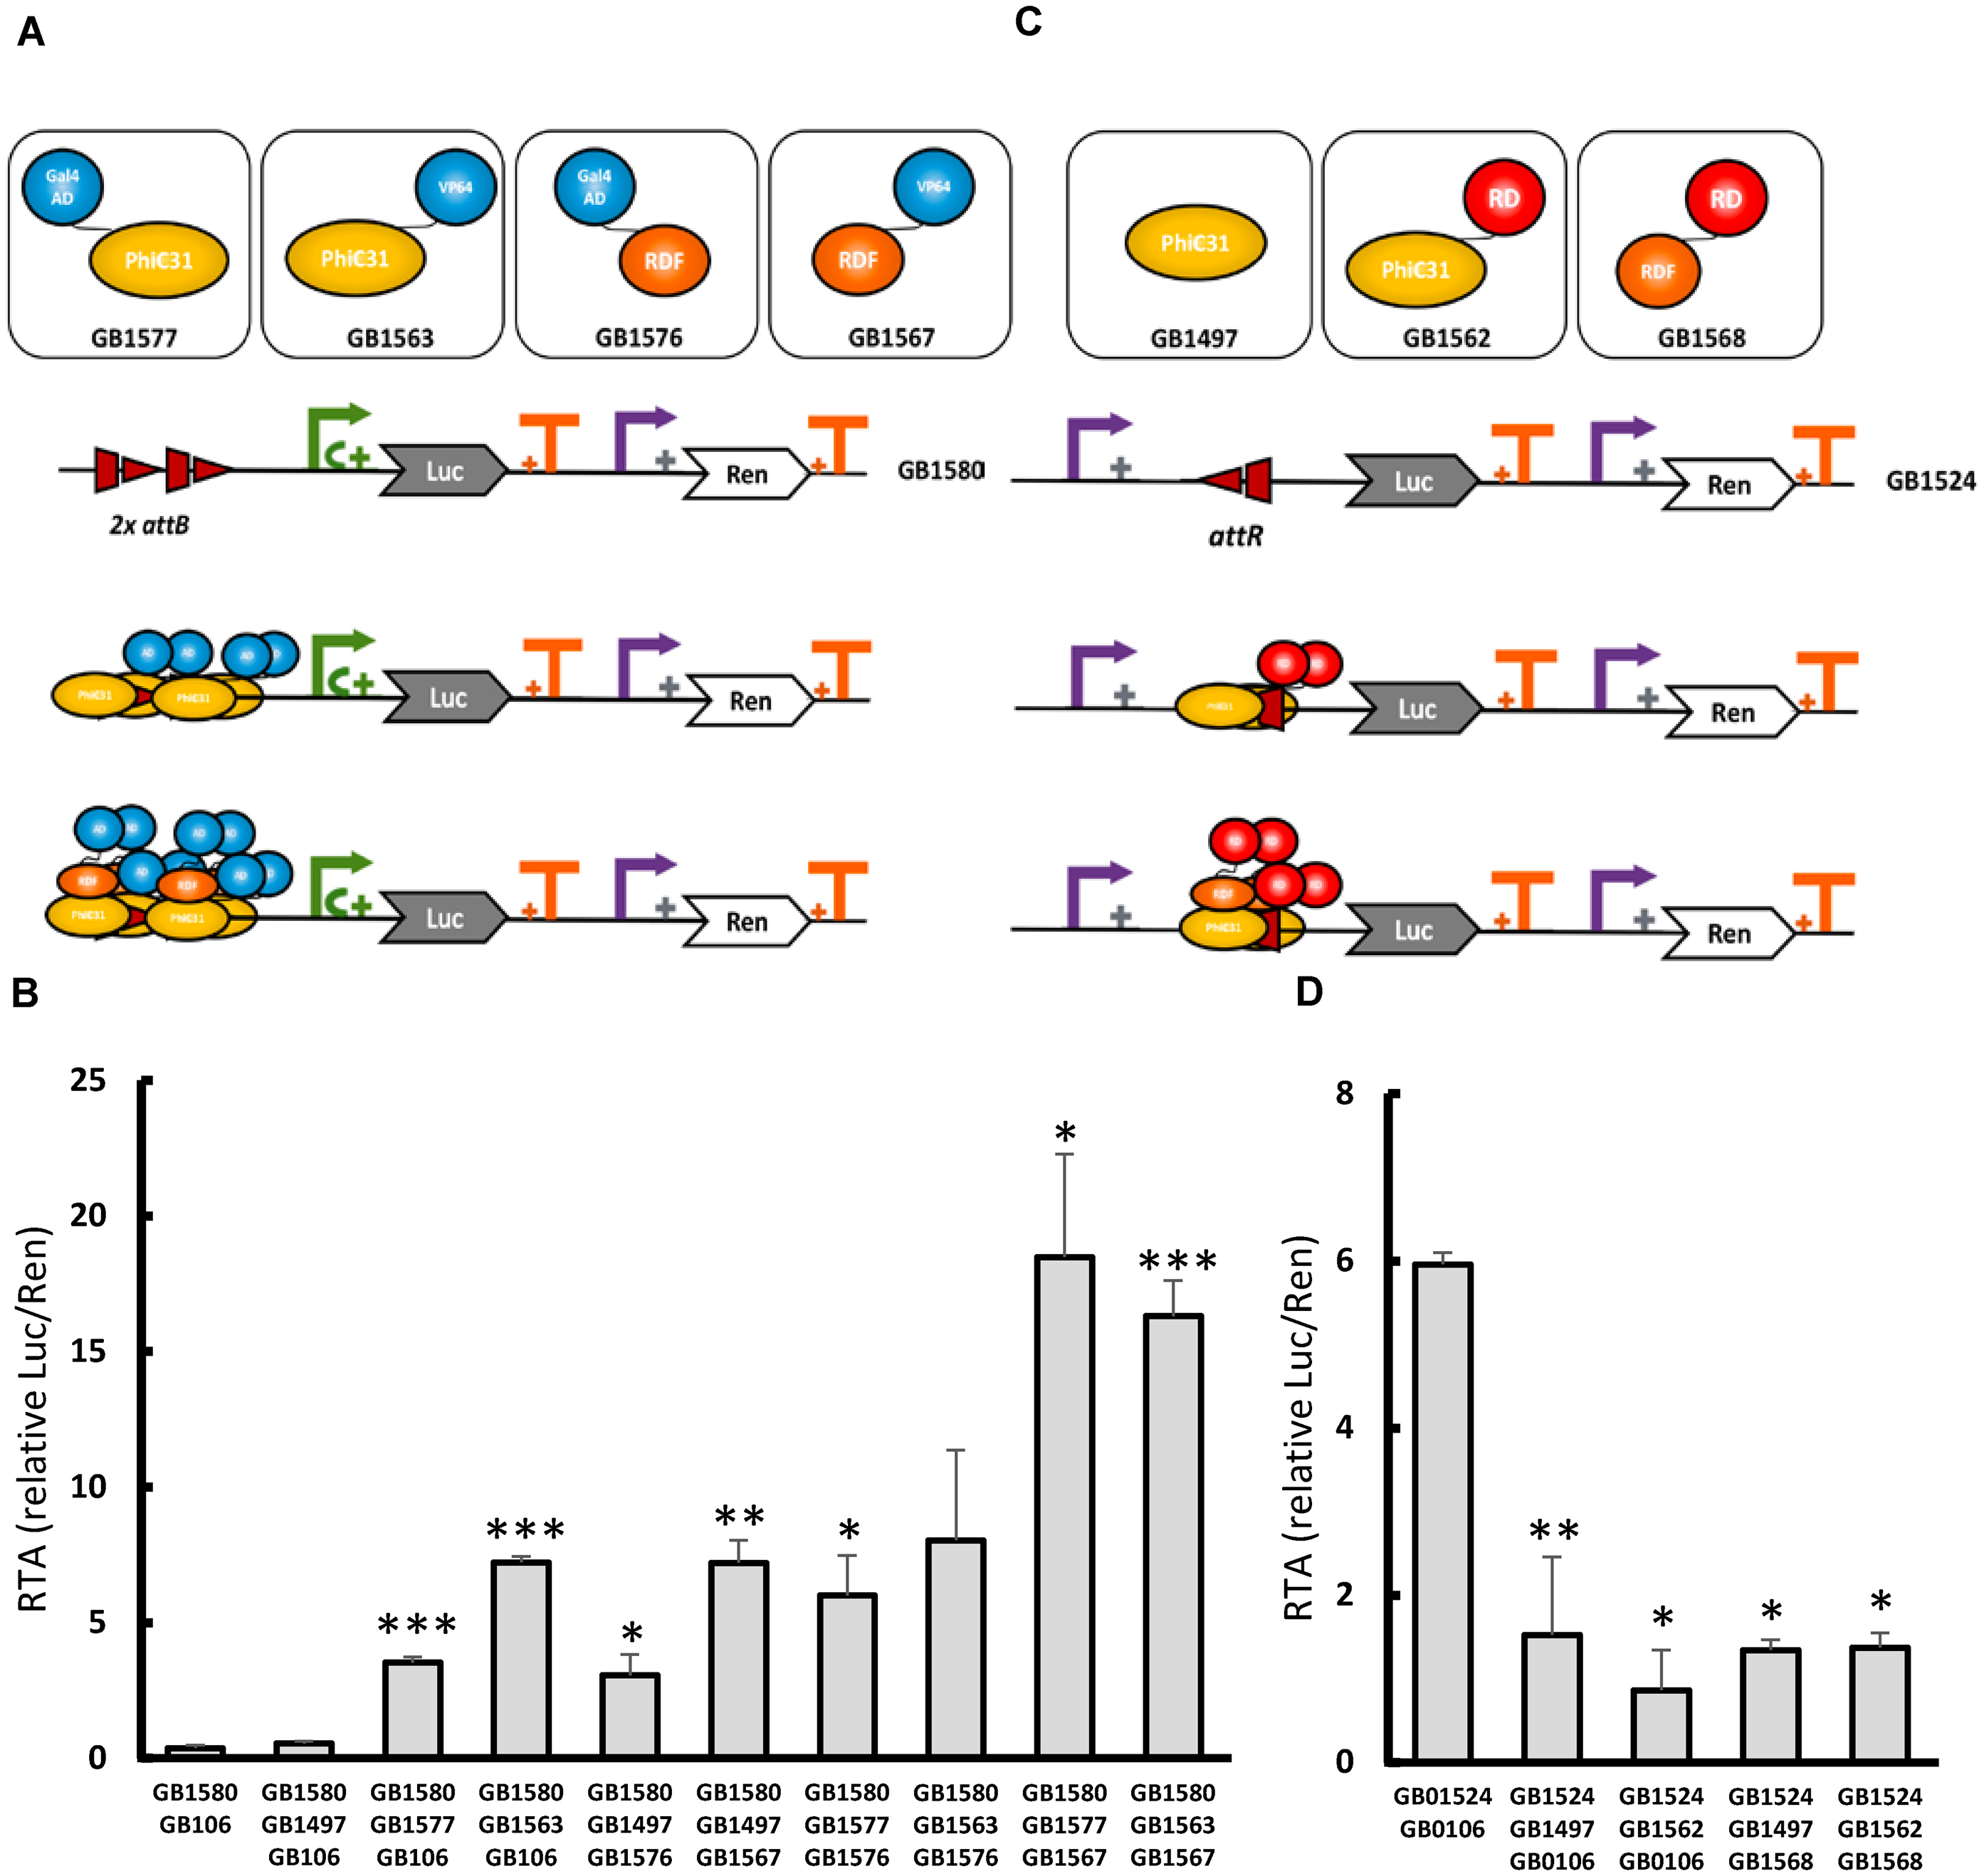
Figure 4. New orthogonal TFs toolbox based on phage phiC31 site-specific recombination elements. (A) Schematic ...
Notes:
Figure 4. New orthogonal TFs toolbox based on phage phiC31 site-specific recombination elements. (A) Schematic representation of orthogonal elements employed in recombinase-based transcriptional activation and their interactions. PhiC31 integrase can bind to attB sites. After binding, activation domains (ADs) (blue) close to the minimal 35S promoter (green arrow) perform transcriptional activation. Interaction between PhiC31 integrase and recombination directionality factor (RDF) increase the number of activator domains (ADs) available, resulting in higher activation. (B) SE_002 assays involving different combinations of the transcriptional activators shown in (A) GB0106 represents a stuffer fragment used to equalize Agrobacterium culture concentrations. GB1497 contains a constitutive PhiC31 TU without AD. (C) Schematic representation of the orthogonal elements employed in recombinase-based transcriptional repression. PhiC31 integrase binds to attR resulting in repression of 35S promoter (purple arrow). Interaction between PhiC31 integrase and RDF increase the number of effective repression domains. (D) SE_002 assays involving different combinations of the transcriptional repressors shown in C. GB0106 represents a stuffer fragment used to equalize Agrobacterium culture concentrations. All relative transcriptional activities are expressed as relative promoter units calculated normalizing Luc/Ren ratios to GB1116. Error bars represent standard deviation of Luc/Ren ratios determined on 3 independent samples. Asterisks indicate significant differences in a T-Test with a *P-value < 0.05, **P-value < 0.01, ***P-value < 0.005.
Unless provided in the caption above, the following copyright applies to the content of this slide: © The Author(s) 2017. Published by Oxford University Press on behalf of Nucleic Acids Research.This is an Open Access article distributed under the terms of the Creative Commons Attribution License (http://creativecommons.org/licenses/by-nc/4.0/), which permits non-commercial re-use, distribution, and reproduction in any medium, provided the original work is properly cited. For commercial re-use, please contact journals.permissions@oup.com

Slide 5
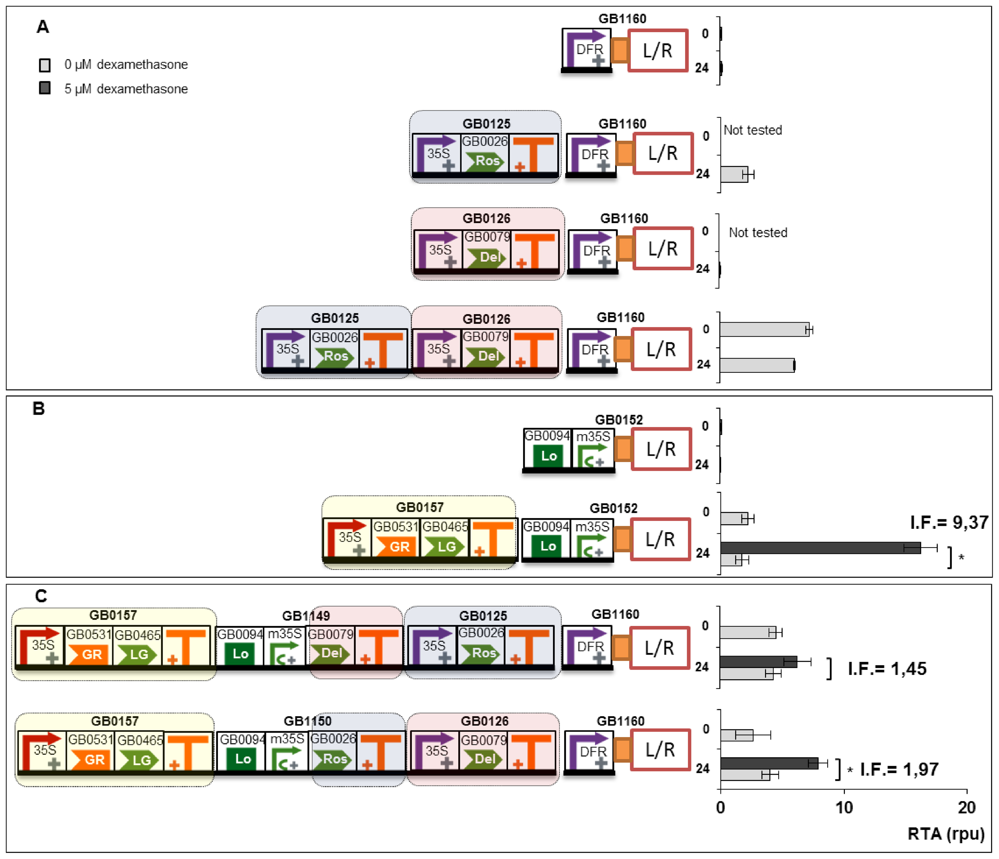
Figure 5. Connection of two transcriptional modules for conferring dexamethasone regulation to the DFR promoter. (A) ...
Notes:
Figure 5. Connection of two transcriptional modules for conferring dexamethasone regulation to the DFR promoter. (A) Relative transcriptional activity of the DFR promoter by Ros1 and Del, either alone or in combination at 0 h or 24 h post-induction (corresponding to 72 h and 96 h post-infiltration, respectively). (B) Dexamethasone-dependent transcriptional activity conferred by GB0157 to a reporter device (GB1052) containing a LacI binding domain (GB0094) next to minimal CaMV35S promoter. (C) Effect of the combination of gene modules in A and B, with Ros1 and Del turning the DFR promoter responsive to dexamethasone. All relative transcriptional activities are expressed as rpu calculated normalizing Luc/Ren ratios to GB0166. Error bars represent standard deviation of Luc/Ren ratios determined on at least two independent leaves. I.F. represent the induction factors calculated by dividing RTA values obtained with and without chemical inducer. Asterisks indicate significant differences in a T-Test with a P-value < 0.05.
Unless provided in the caption above, the following copyright applies to the content of this slide: © The Author(s) 2017. Published by Oxford University Press on behalf of Nucleic Acids Research.This is an Open Access article distributed under the terms of the Creative Commons Attribution License (http://creativecommons.org/licenses/by-nc/4.0/), which permits non-commercial re-use, distribution, and reproduction in any medium, provided the original work is properly cited. For commercial re-use, please contact journals.permissions@oup.com

