Slide 1
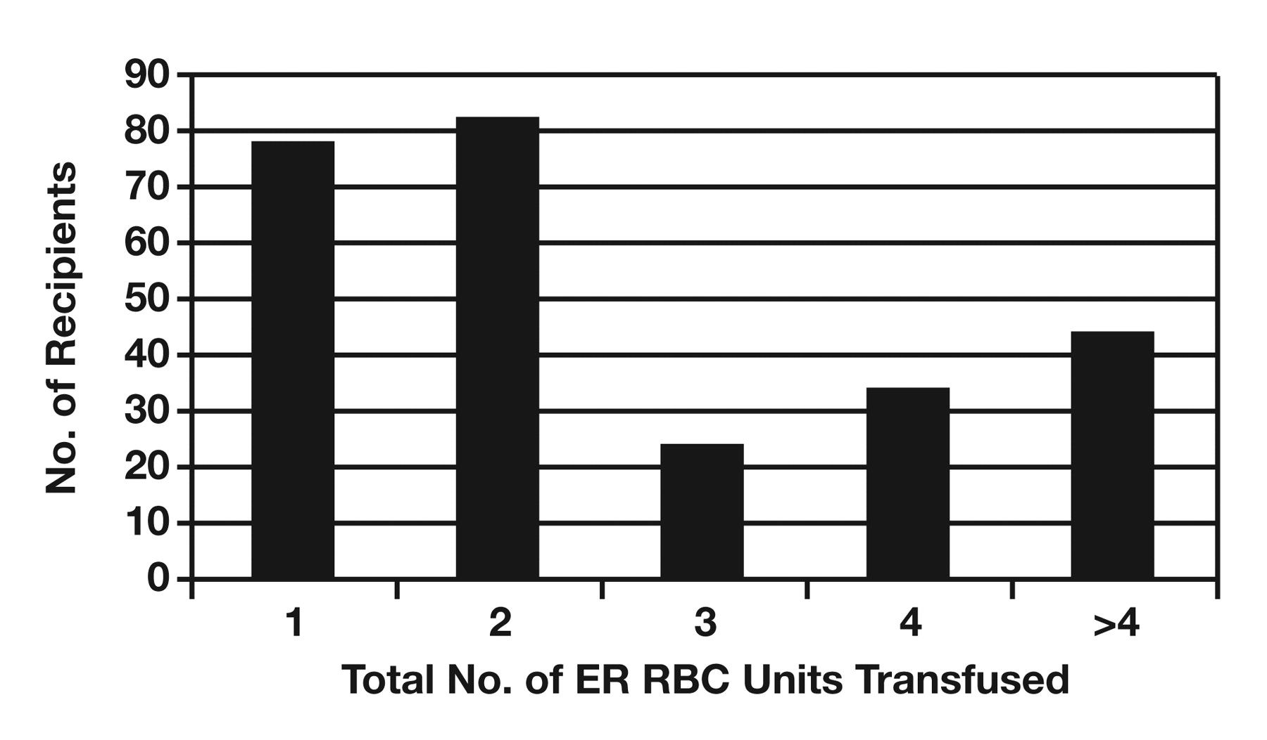
Figure 1 Distribution of transfused emergency-release (ER) RBC units. Of 262 total recipients, 78 (29.8%), 82 (31.3%), ...
Notes:
Figure 1 Distribution of transfused emergency-release (ER) RBC units. Of 262 total recipients, 78 (29.8%), 82 (31.3%), 24 (9.2%), 34 (13.0%), and 44 (16.8%) received 1, 2, 3, 4, and >4 total ER RBC units, respectively.
Unless provided in the caption above, the following copyright applies to the content of this slide: © American Society for Clinical Pathology

Slide 2
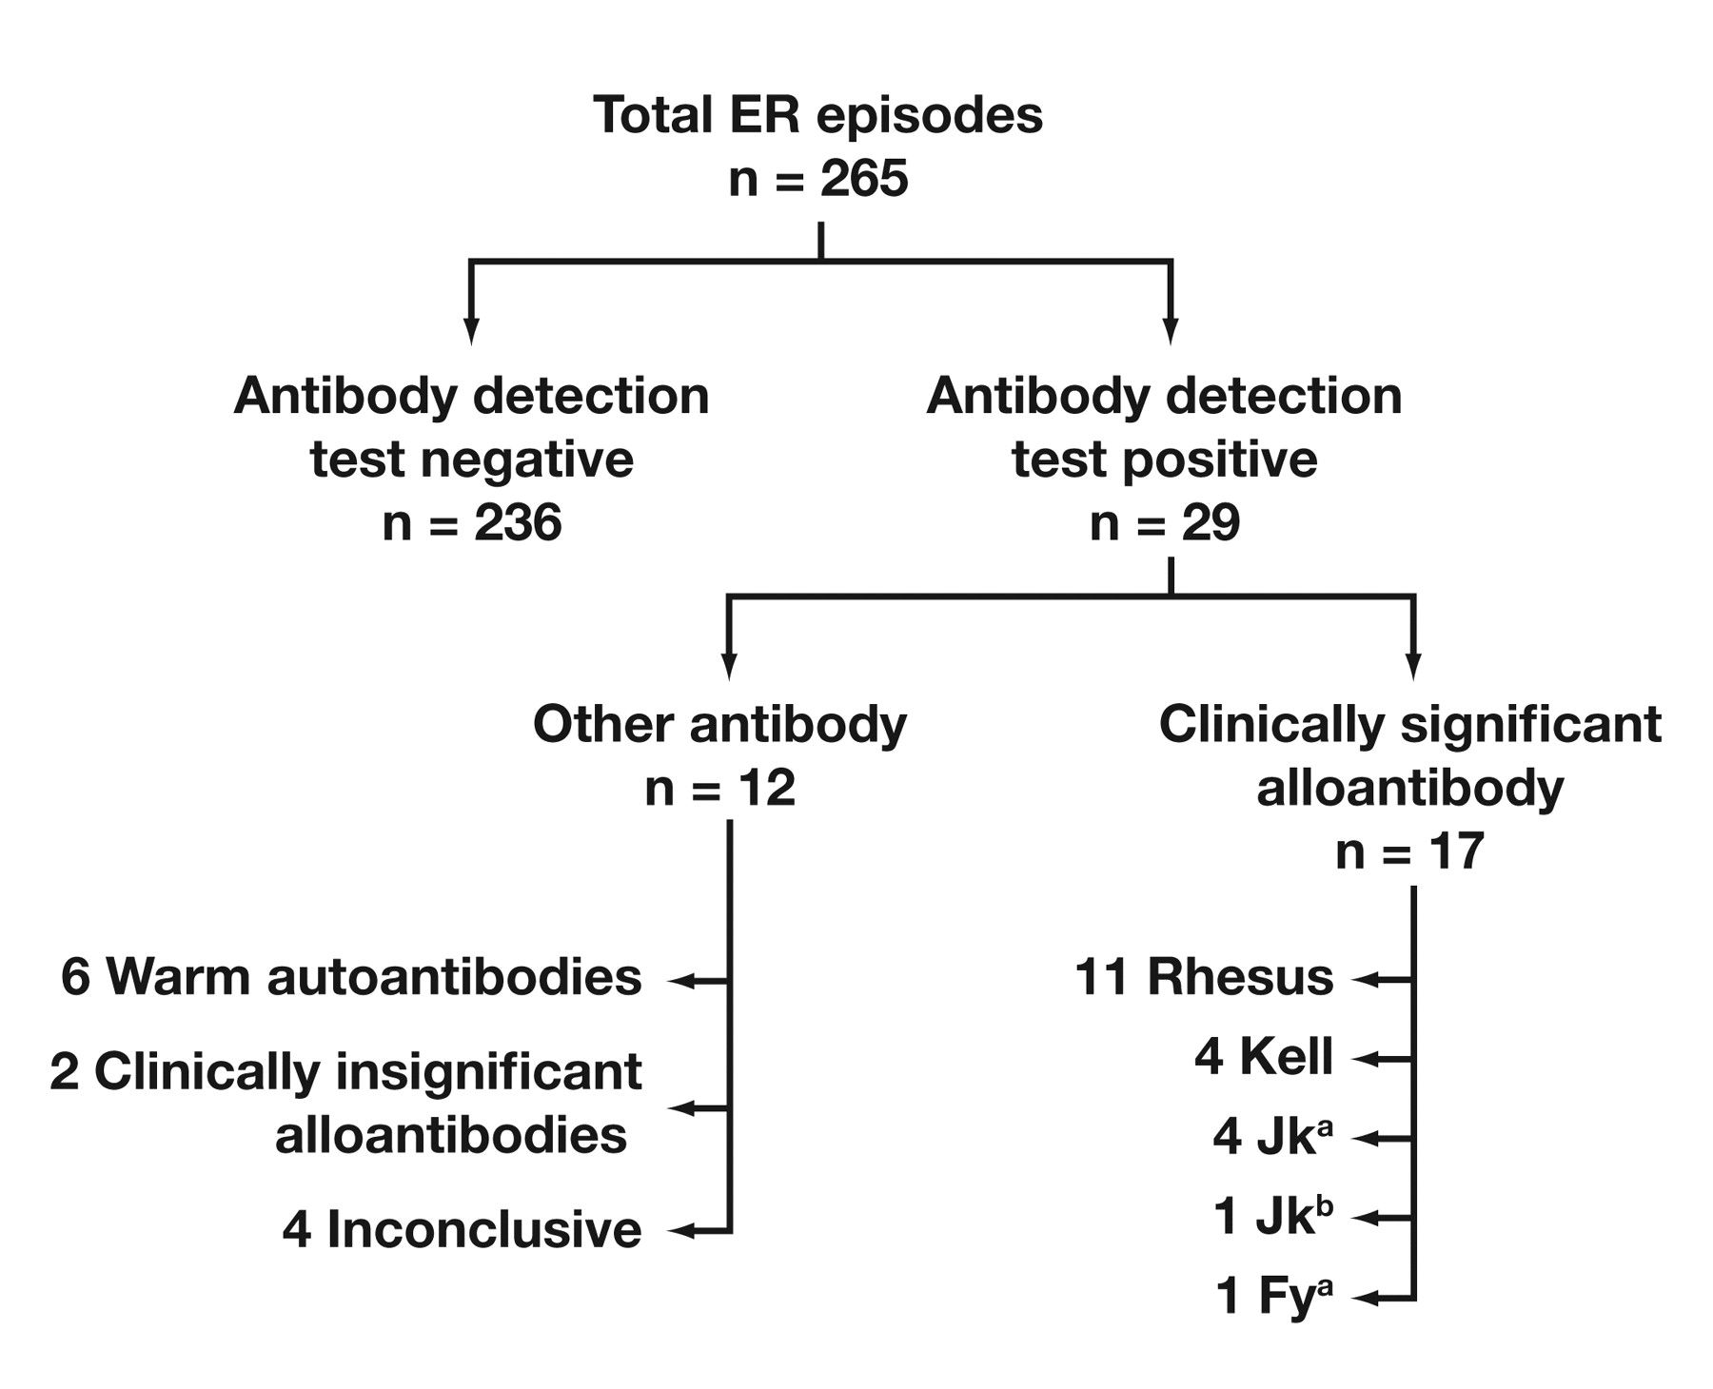
Figure 2 Antibody identification results for emergency-release (ER) episodes. A clinically significant alloantibody ...
Notes:
Figure 2 Antibody identification results for emergency-release (ER) episodes. A clinically significant alloantibody was detected in 17 (6.4%) of 265 ER transfusion episodes. Antibody specificities detected were as follows: 11 antibodies (6 anti-D, 4 anti-E, and 1 anti-c) belonged to the Rhesus blood group; 4 anti-K; 4 anti-Jka; 1 anti-Jkb; and 1 anti-Fya. Three recipients had multiple antibodies. Recipients having multiple antibodies included 1 patient with anti-K and anti-E; 1 with anti-Jka and anti-K; and 1 with anti-c, anti-E, and anti-Jka. In addition, 6 warm autoantibodies, 2 clinically insignificant antibodies (anti-M and passive anti-D [RhoGAM]), and 4 inconclusive cases were identified.
Unless provided in the caption above, the following copyright applies to the content of this slide: © American Society for Clinical Pathology

