Slide 1
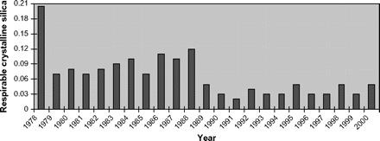
Figure 1. Changes in RCS levels in UK industrial silica sand quarries 1978–2000 Source: Brown and Rushton [71].
Notes:
Figure 1. Changes in RCS levels in UK industrial silica sand quarries 1978–2000 Source: Brown and Rushton [71].
Unless provided in the caption above, the following copyright applies to the content of this slide: © The Author 2009. Published by Oxford University Press on behalf of the Society of Occupational Medicine. All rights reserved. For Permissions, please email: journals.permissions@oxfordjournals.org

