Slide 1
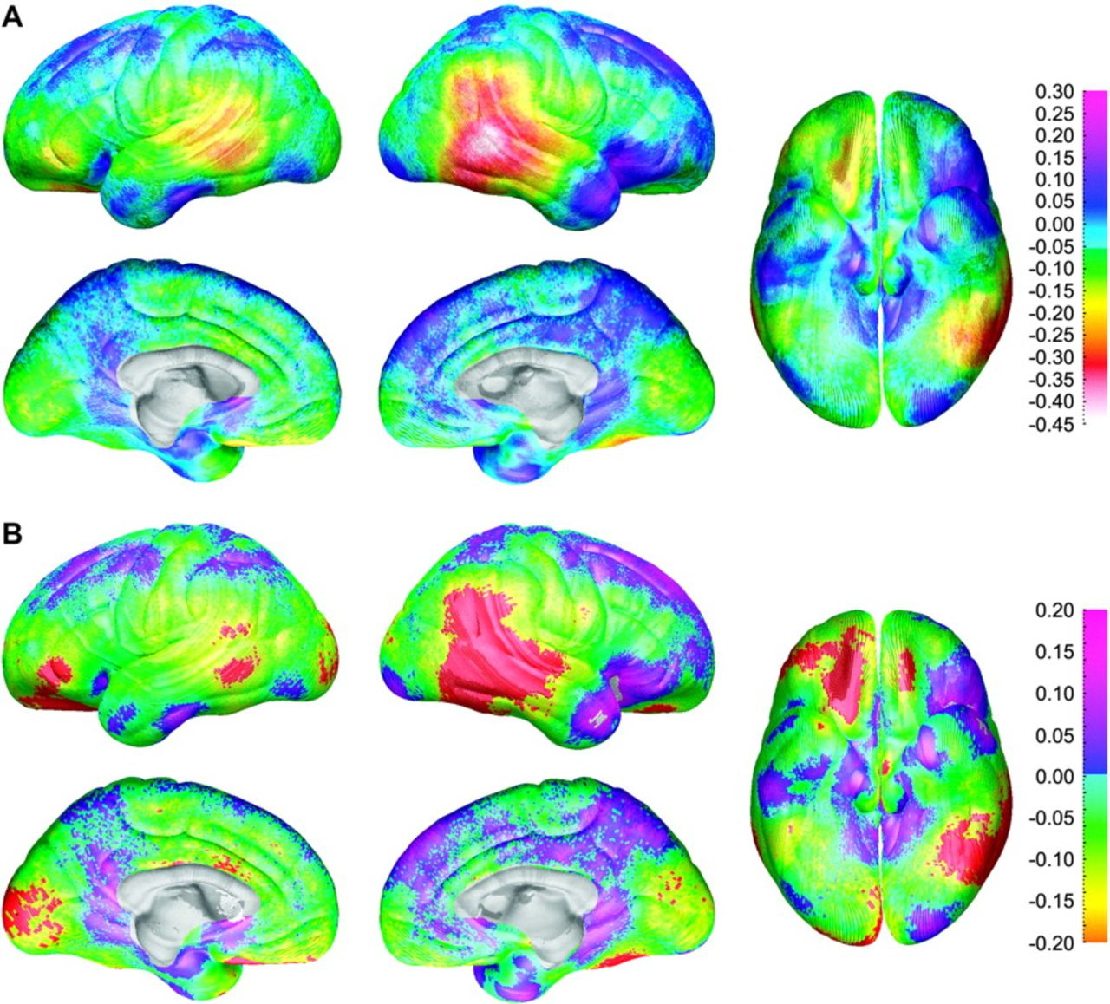
Figure 1. (A) Maps of differences between the sexes in thickness of gray matter (males coded 1, females coded 0 for all ...
Notes:
Figure 1. (A) Maps of differences between the sexes in thickness of gray matter (males coded 1, females coded 0 for all maps displayed) for the entire group of 176 subjects showing differences in gray matter (in millimeters) between the male and female subjects according to the color bar on the right. Warmer colors (0) are regions where the males have greater gray matter thickness than the female subjects. Note the approximately 0.45 mm increase in cortical thickness in females in the right posterior temporal lobe. These maps are constructed without any brain scaling, so represent absolute thickness increases in women. (B) Maps of statistically significant differences in gray matter thickness between the sexes for the entire group of 176 subjects according to the color bar on the right (Pearson's correlation coefficients ranging from −0.2 to 0.2 ranging from orange on the negative end to pink on the positive end). Regions in red correspond to correlation coefficients that show significant increase in gray matter thickness in the female subjects at a threshold of P = 0.05 and those in white correspond to significant increase in the male subjects at a threshold of P = 0.05.
Unless provided in the caption above, the following copyright applies to the content of this slide: © The Author 2006. Published by Oxford University Press. All rights reserved. For permissions, please e-mail: journals.permissions@oxfordjournals.org

Slide 2
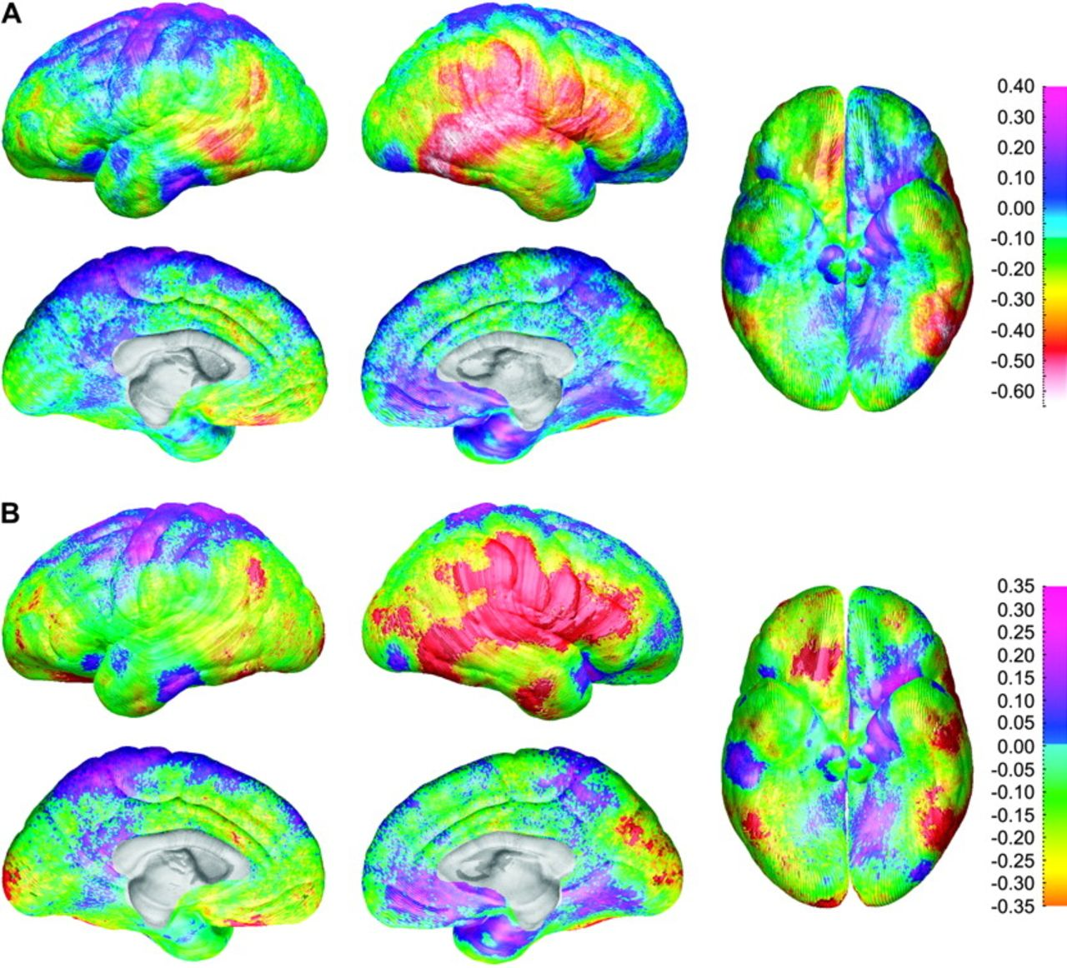
Figure 2. (A) Gray matter thickness sex difference maps for the subgroup of 36 age- and brain volume–matched subjects ...
Notes:
Figure 2. (A) Gray matter thickness sex difference maps for the subgroup of 36 age- and brain volume–matched subjects showing differences in gray matter (in millimeters) between the male and female subjects according to the color bar on the right. Warmer colors (<0 on the color bar) are regions where females have thicker gray matter than the males, and cooler colors (<0) are regions where the males have thicker gray matter than the females. Note the approximately 0.6-mm thicker cortices in females in the right posterior temporal lobe. (B) Statistical differences between the sexes in gray matter thickness for the subgroup of 36 age- and brain volume–matched subjects showing the significance of gray matter thickness differences between the male and female subjects according to the color bar on the right (Pearson's correlation coefficients ranging from −0.2 to 0.2). Regions overlaid in red correspond to correlation coefficients that show significant increase in gray matter thickness in the female subjects at a threshold of P = 0.05. There were no regions where the male subjects had thicker cortex than the females at a threshold of P = 0.05.
Unless provided in the caption above, the following copyright applies to the content of this slide: © The Author 2006. Published by Oxford University Press. All rights reserved. For permissions, please e-mail: journals.permissions@oxfordjournals.org

Slide 3
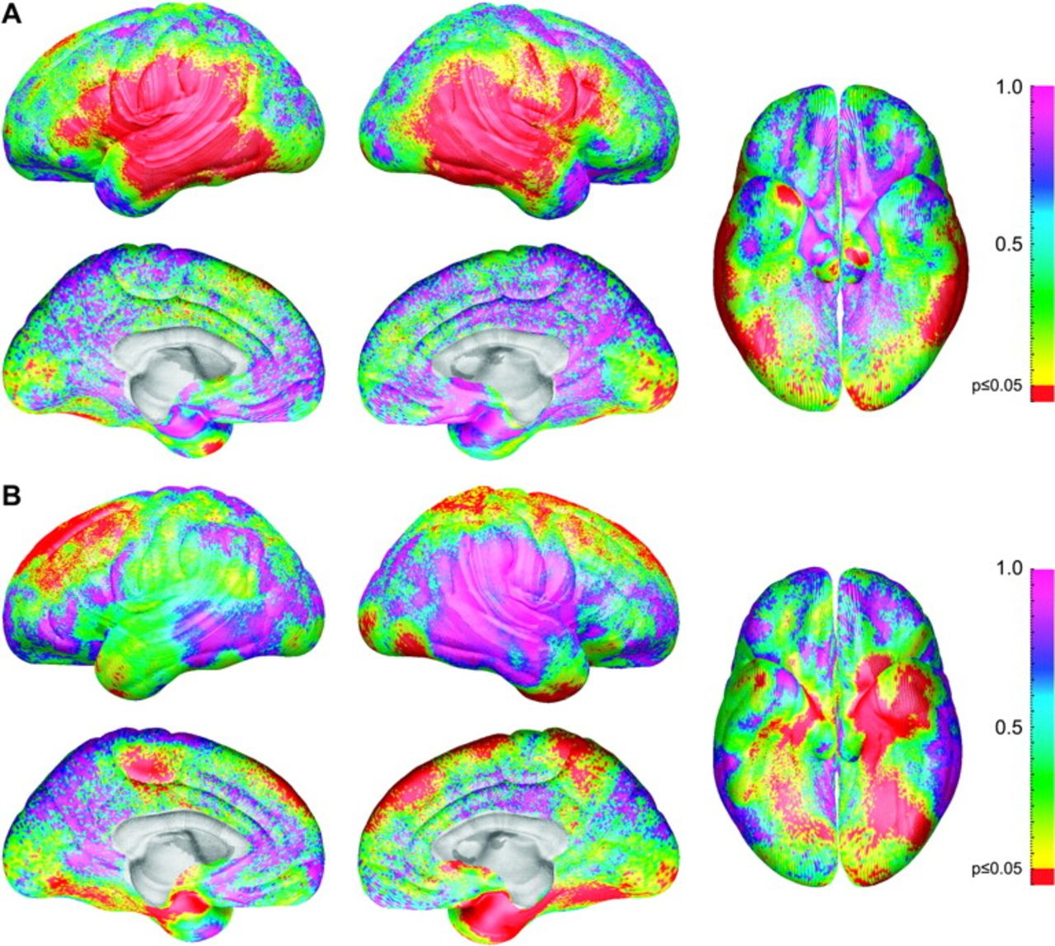
Figure 3. (A) Statistical P maps of the sex difference in cortical thickness in adults (aged >20 years) with height ...
Notes:
Figure 3. (A) Statistical P maps of the sex difference in cortical thickness in adults (aged >20 years) with height differences partialled out. The map is color coded according to the bar, and regions in red are statistically significant at a P value of 0.05 or less. Regions in pink and blue (i.e., on the dorsal and medial surfaces of the brain) do not approach significance with P values between 0.5 and 1.0. (B) Statistical P maps of the combined interaction terms age by sex and age2 by sex. The map is color coded according to the bar, and regions in red are statistically significant at a P value of 0.05 or less. Regions in pink (i.e., on the lateral surface of the right temporal and parietal lobes) do not approach significance with P values near 1.0.
Unless provided in the caption above, the following copyright applies to the content of this slide: © The Author 2006. Published by Oxford University Press. All rights reserved. For permissions, please e-mail: journals.permissions@oxfordjournals.org

Slide 4
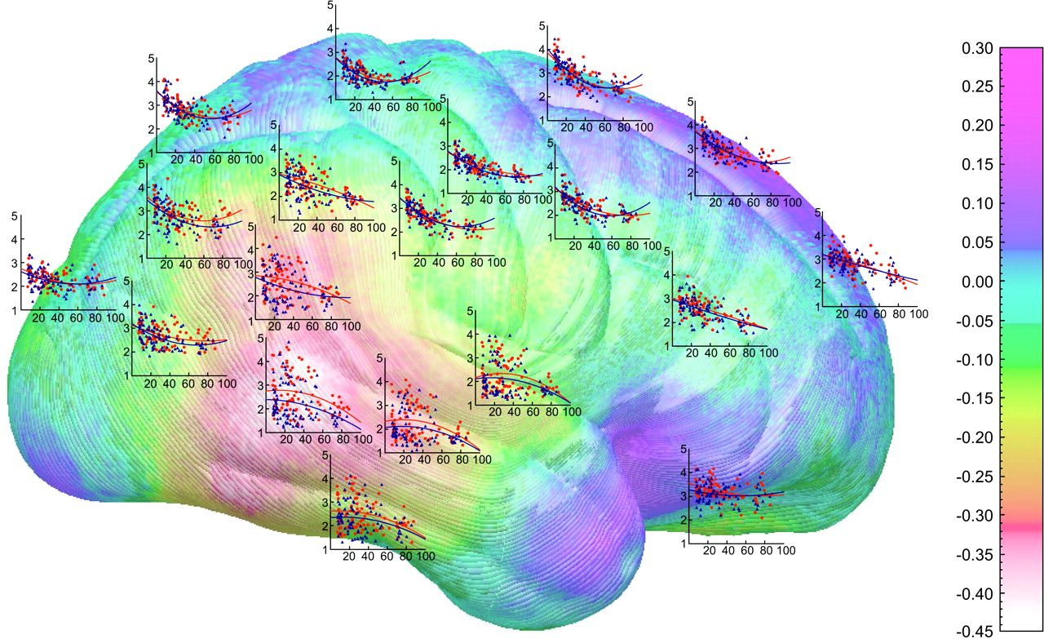
Figure 4. Shown here is the same map as in Figure 1A (right hemisphere) with scatterplots that show how gray matter ...
Notes:
Figure 4. Shown here is the same map as in Figure 1A (right hemisphere) with scatterplots that show how gray matter thickness depends on age, in men and women separately, at various points over the brain surface situated approximately where the measurements were taken. On each of the y axes, cortical thickness is displayed in millimeters and age (7–87 years) is represented on the x axes. The axes are identical for all graphs. Male subjects are represented by blue points and the blue regression lines, and females are represented by the red points and the red regression lines.
Unless provided in the caption above, the following copyright applies to the content of this slide: © The Author 2006. Published by Oxford University Press. All rights reserved. For permissions, please e-mail: journals.permissions@oxfordjournals.org

Slide 5
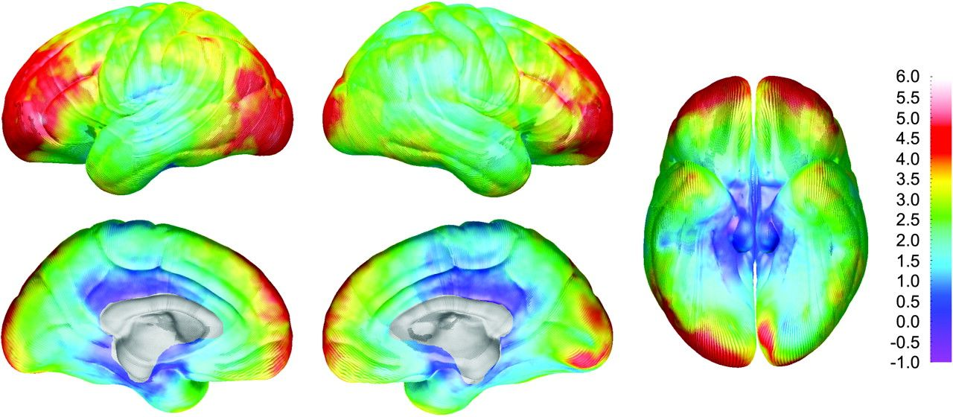
Figure 5. DFC-H sex difference maps showing mean differences in DFC-H (in millimeters) between the male and female ...
Notes:
Figure 5. DFC-H sex difference maps showing mean differences in DFC-H (in millimeters) between the male and female subjects according to the color bar on the right. Note the brain size increases up to 6 mm in the male subjects at the frontal and occipital poles bilaterally.
Unless provided in the caption above, the following copyright applies to the content of this slide: © The Author 2006. Published by Oxford University Press. All rights reserved. For permissions, please e-mail: journals.permissions@oxfordjournals.org

