Slide 1
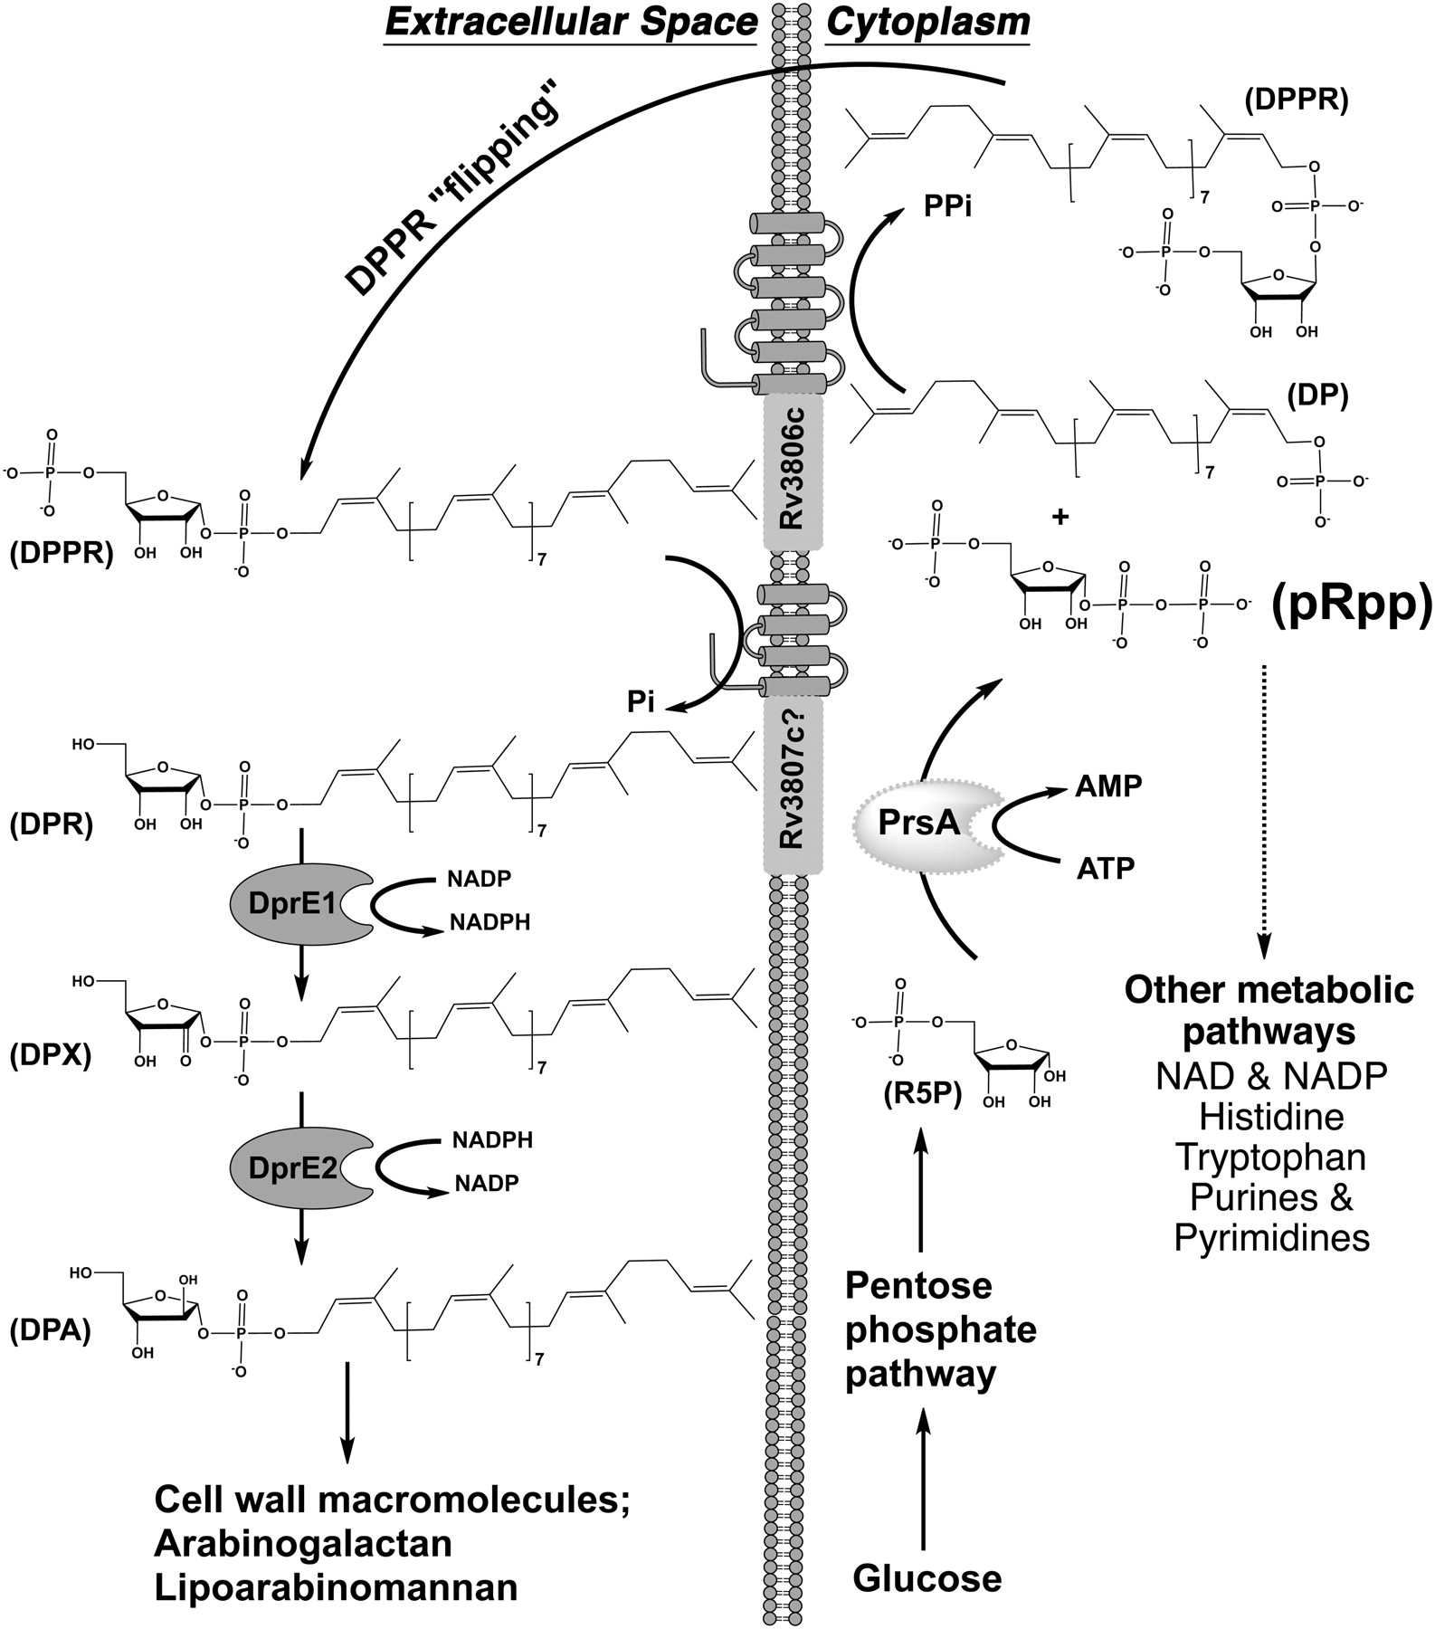
Fig. 1. Proposed metabolic pathway depicting the importance of Mt-PrsA for the generation of pRpp in M. tuberculosis. ...
Notes:
Fig. 1. Proposed metabolic pathway depicting the importance of Mt-PrsA for the generation of pRpp in M. tuberculosis. R5P is generated via the catabolism of glucose through the pentose phosphate pathway, a process ubiquitous throughout nature. Like all pRpp synthetase enzymes, Mt-PrsA catalyses the transfer of pyrophosphate from ATP to the C1–OH group of R5P forming pRpp and AMP. In a process unique to members belonging to the Corynebacteriaceae, such as M. tuberculosis, pRpp is utilized as the sole metabolic intermediate in the formation of DPA, which is a crucial substrate required for mycobacterial cell wall assembly. DP, decaprenol-1-monophosphate; DPA, decaprenol-1-monophosphoarabinose; DPR, decaprenol-1-monophosphoribose; DPPR, decaprenol-1-monophosphoribose-5-phosphate; DPX, decaprenol-1-monophosphoryl-2-keto-β-erythro-pentofuranose; pRpp, phosphoribosyl-1-pyrophosphate; R5P, ribose -5-phosphate.
Unless provided in the caption above, the following copyright applies to the content of this slide: © The Author 2010. Published by Oxford University Press.This is an Open Access article distributed under the terms of the Creative Commons Attribution Non-Commercial License (http://creativecommons.org/licenses/by-nc/2.5/), which permits unrestricted non-commercial use, distribution, and reproduction in any medium, provided the original work is properly cited. For permissions, please e-mail: journals.permissions@oup.com.

Slide 2
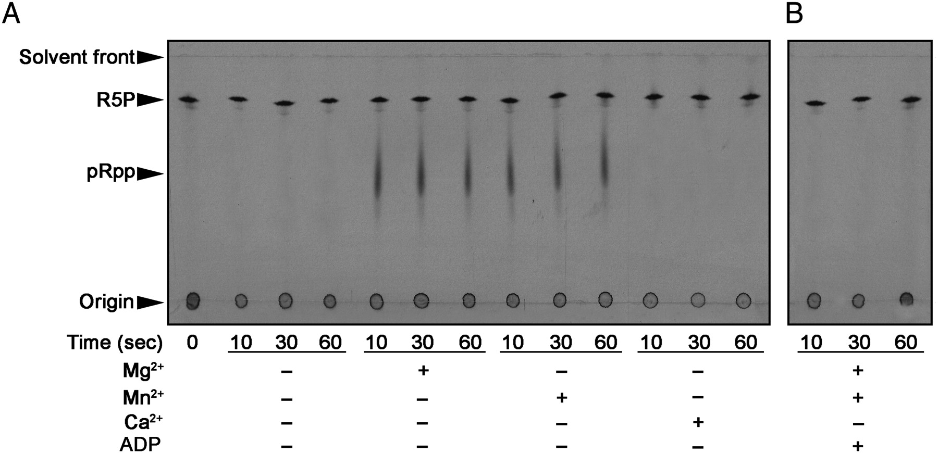
Fig. 2. Time course assay showing the Mt-PrsA catalyzed formation of p[¹⁴C]Rpp from [¹⁴C]R5P ...
Notes:
Fig. 2. Time course assay showing the Mt-PrsA catalyzed formation of p[14C]Rpp from [14C]R5P and ATP. Assays contained Mt-PrsA, 50 mM Pi, 2 mM ATP supplemented with either 2 mM Mg2+, Mn2+ or Ca2+ as illustrated in (A), and in the presence of ADP at a final concentration of 2 mM in (B). Assays were incubated at 37°C, and aliquots were removed from the assay mix at 0, 10, 30 and 60 s and the reactions halted by quenching with the addition of formic acid. Samples were applied to a glass-backed PEI-cellulose TLC plate and developed in 0.85 M KH2PO4 (pH 3.4). The plate was inspected for radioactive spots relating to p[14C]Rpp and [14C]R5P by autoradiography through the exposure of TLCs to X-ray film (Kodak X-Omat).
Unless provided in the caption above, the following copyright applies to the content of this slide: © The Author 2010. Published by Oxford University Press.This is an Open Access article distributed under the terms of the Creative Commons Attribution Non-Commercial License (http://creativecommons.org/licenses/by-nc/2.5/), which permits unrestricted non-commercial use, distribution, and reproduction in any medium, provided the original work is properly cited. For permissions, please e-mail: journals.permissions@oup.com.

Slide 3
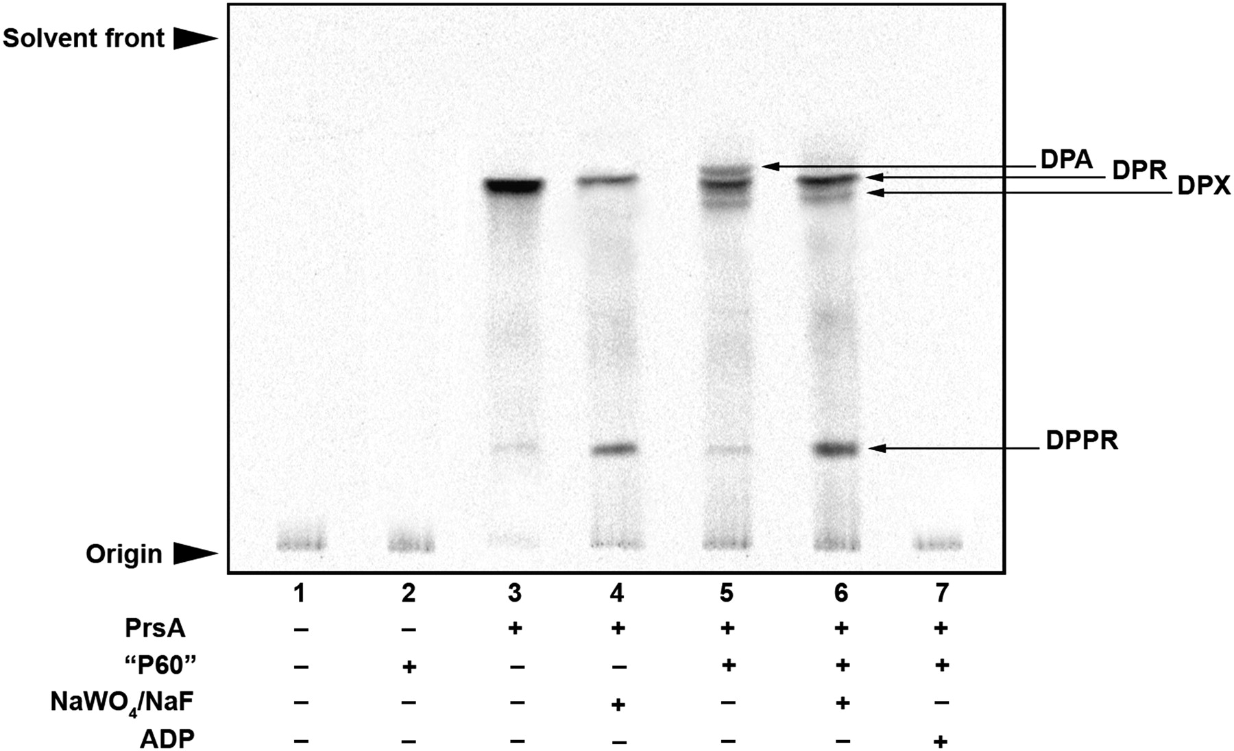
Fig. 3. Analysis of Mt-PrsA-dependent [¹⁴C]-R5P incorporation into the M. smegmatis AraT substrate DPA via ...
Notes:
Fig. 3. Analysis of Mt-PrsA-dependent [14C]-R5P incorporation into the M. smegmatis AraT substrate DPA via p[14C]Rpp. The basic assays mixture contained (amongst other components described in the Materials and methods section) membranes prepared from M. smegmatis, 100,000 cpm [14C]-R5P, 50 µg of DP and 2 mM ATP. Individual assays were carried out at 37°C and included the addition of no further additive; lane 1, M. smegmatis P60; lane 2, Mt-PrsA; lane 3, Mt-PrsA and NaWO4 and NaF both at a final concentration of 2 mM; lane 4, Mt-PrsA and M. smegmatis P60; lane 5, Mt-PrsA, M. smegmatis P60 and 2 mM of both NaWO4 and NaF; lane 6 and finally Mt-PrsA, M. smegmatis P60 and 2 mM ADP in lane 7. After an incubation at 37°C for 30 min, assays were quenched and products extracted from the assay mix by organic solvent extraction as described in the Materials and methods section. Samples relating to each assay were loaded onto a silica gel TLC plates, developed in CHCl3/CH3OH/CH3COONH4/NH4OH/H2O (180:140:9:9:23 v/v/v/v/v) and bands migrating to the position of DPA, DPR, DPX and DPPR were visualized by autoradiography, exposure of TLCs to X-ray film (Kodak X-Omat) and compared to previously isolated known standards (Mikusova et al. 2005; Alderwick et al. 2006a).
Unless provided in the caption above, the following copyright applies to the content of this slide: © The Author 2010. Published by Oxford University Press.This is an Open Access article distributed under the terms of the Creative Commons Attribution Non-Commercial License (http://creativecommons.org/licenses/by-nc/2.5/), which permits unrestricted non-commercial use, distribution, and reproduction in any medium, provided the original work is properly cited. For permissions, please e-mail: journals.permissions@oup.com.

Slide 4
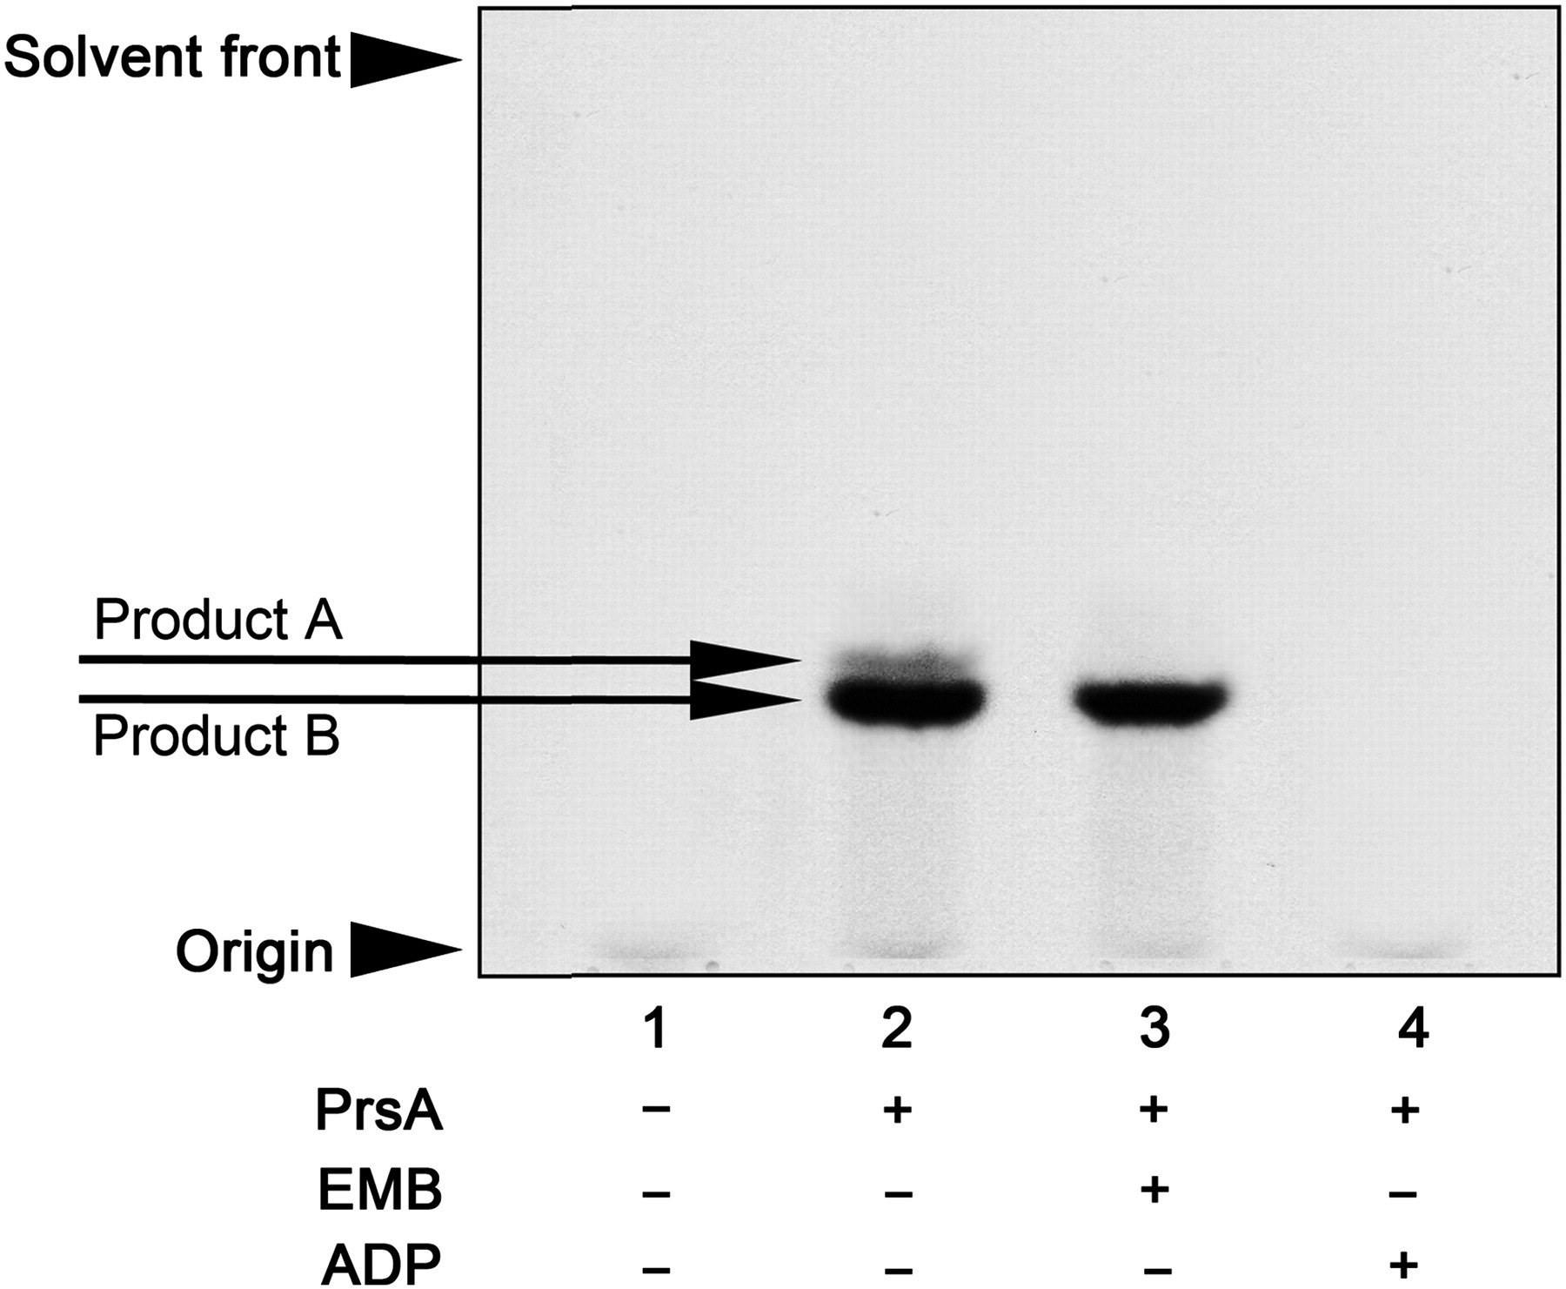
Fig. 4. AraT assays carried out via the Mt-PrsA-dependent conversion of [¹⁴C]-R5P to p[¹⁴C]Rpp ...
Notes:
Fig. 4. AraT assays carried out via the Mt-PrsA-dependent conversion of [14C]-R5P to p[14C]Rpp and subsequent chase into a neoglycolipid acceptor. The absolute dependence of the cell wall AraT enzymes on the availability of pRpp was investigated using the neoglycolipid acceptor Ara2. The basic assay contained (amongst other components described in the Materials and methods section) 0.5 mg of membranes and P60 from M. smegmatis, 2 mM α-d-Araf-(1 → 5)-α-d-Araf-O-(CH2)7CH3, 100,000 cpm [14C]-R5P, 50 µg of DP and 2 mM ATP. Assays were initiated by the addition of [14C]-R5P and incubated for 1 h at 37°C. Individual assays carried out contained the addition of no Mt-PrsA, lane 1; 30 µg of Mt-PrsA, lane 2; 30 µg of Mt-PrsA and 100 µg/mL of EMB, lane 3 and 30 µg of Mt-PrsA and 2 mM ADP, lane 4. [14C]-Araf-linked products were extracted from the assay mix as described in the Materials and methods section and subsequently applied to a silica gel TLC plates, developed in CHCl3:CH2OH:H2O:NH4OH (65:25:3.6:0.5, v/v/v/v) and visualized by autoradiography from exposure of TLCs to X-ray film (Kodak X-Omat; Lee et al. 1997; Seidel et al. 2007).
Unless provided in the caption above, the following copyright applies to the content of this slide: © The Author 2010. Published by Oxford University Press.This is an Open Access article distributed under the terms of the Creative Commons Attribution Non-Commercial License (http://creativecommons.org/licenses/by-nc/2.5/), which permits unrestricted non-commercial use, distribution, and reproduction in any medium, provided the original work is properly cited. For permissions, please e-mail: journals.permissions@oup.com.

Slide 5
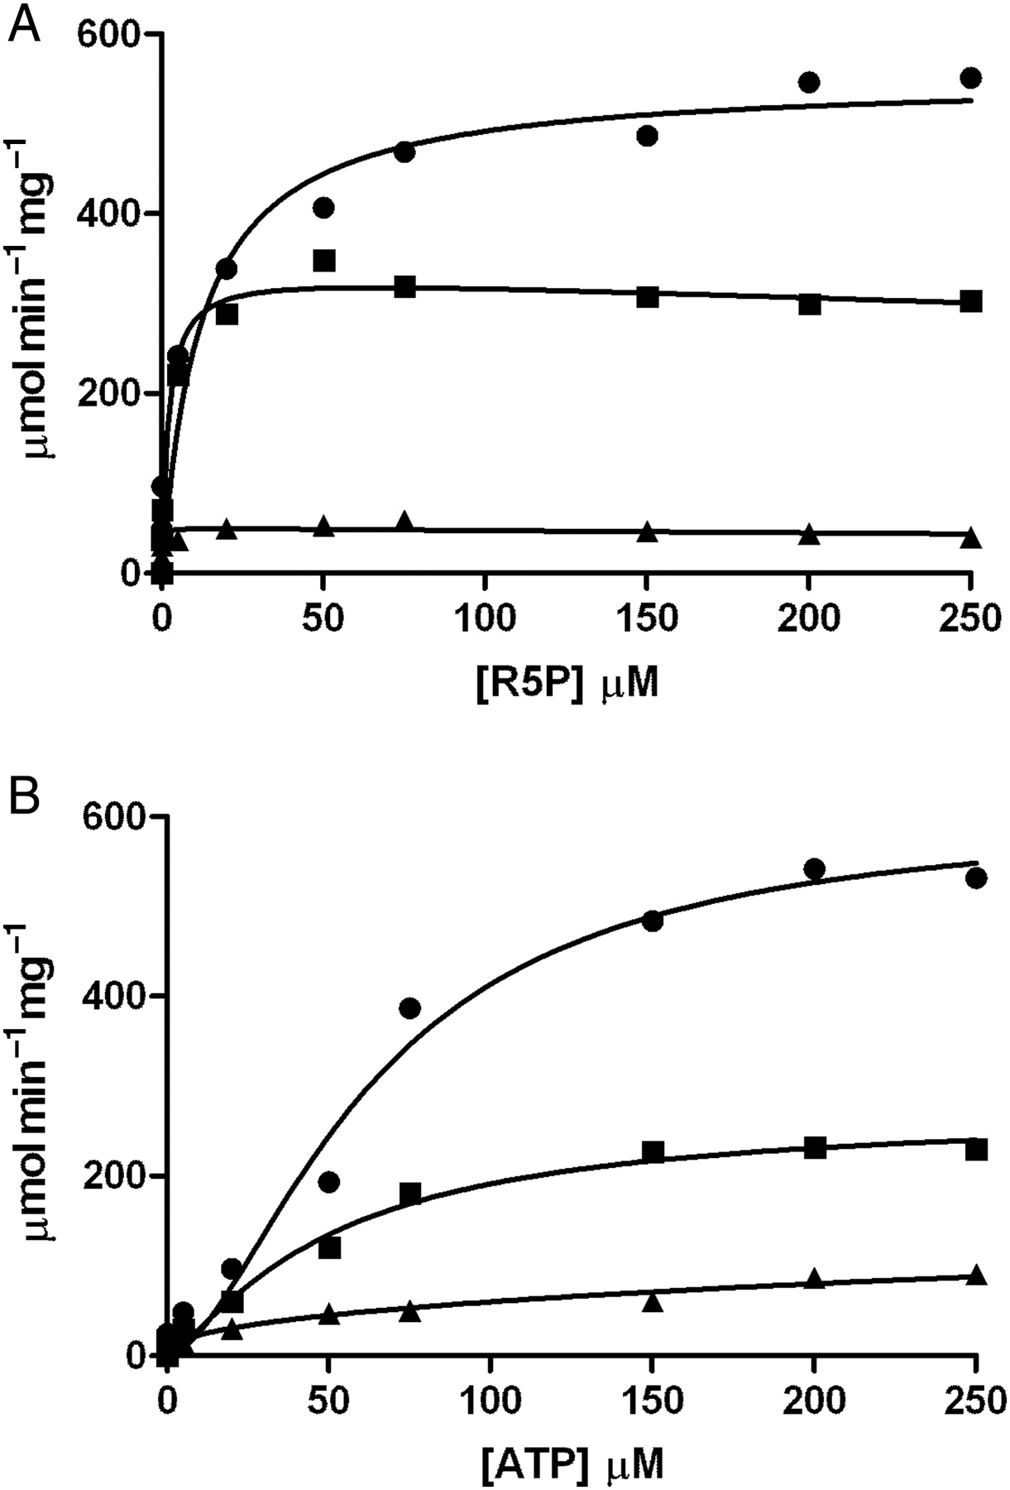
Fig. 5. Enzyme activity of Mt-PrsA and kinetic characterization of R5P (A) and ATP (B) using a continuous ...
Notes:
Fig. 5. Enzyme activity of Mt-PrsA and kinetic characterization of R5P (A) and ATP (B) using a continuous enzyme-coupled spectrophotometric assay. (A) A plot of velocity (ν) of Mt-PrsA to increasing [R5P] in the presence of 50 mM Pi (filled circles), 5 mM Pi (filled squares) and no Pi (filled triangle). Data for 50 mM Pi fitted to Eq. (2), and data obtained for 5 mM Pi and no Pi were fitted to Eq. (3). (B) A plot of velocity (ν) of Mt-PrsA to increasing [ATP] in the presence of 50 mM Pi (filled circles), 5 mM Pi (filled squares) and no Pi (filled triangle), all of which were fitted to Eq. (4) using nonlinear regression analysis. All data points plotted (calculated mean) represent experiments performed in triplicate using three independent preparations of recombinant Mt-PrsA. Calculated standard errors (±SE) for kinetic constants are reported in the manuscript where appropriate.
Unless provided in the caption above, the following copyright applies to the content of this slide: © The Author 2010. Published by Oxford University Press.This is an Open Access article distributed under the terms of the Creative Commons Attribution Non-Commercial License (http://creativecommons.org/licenses/by-nc/2.5/), which permits unrestricted non-commercial use, distribution, and reproduction in any medium, provided the original work is properly cited. For permissions, please e-mail: journals.permissions@oup.com.

Slide 6
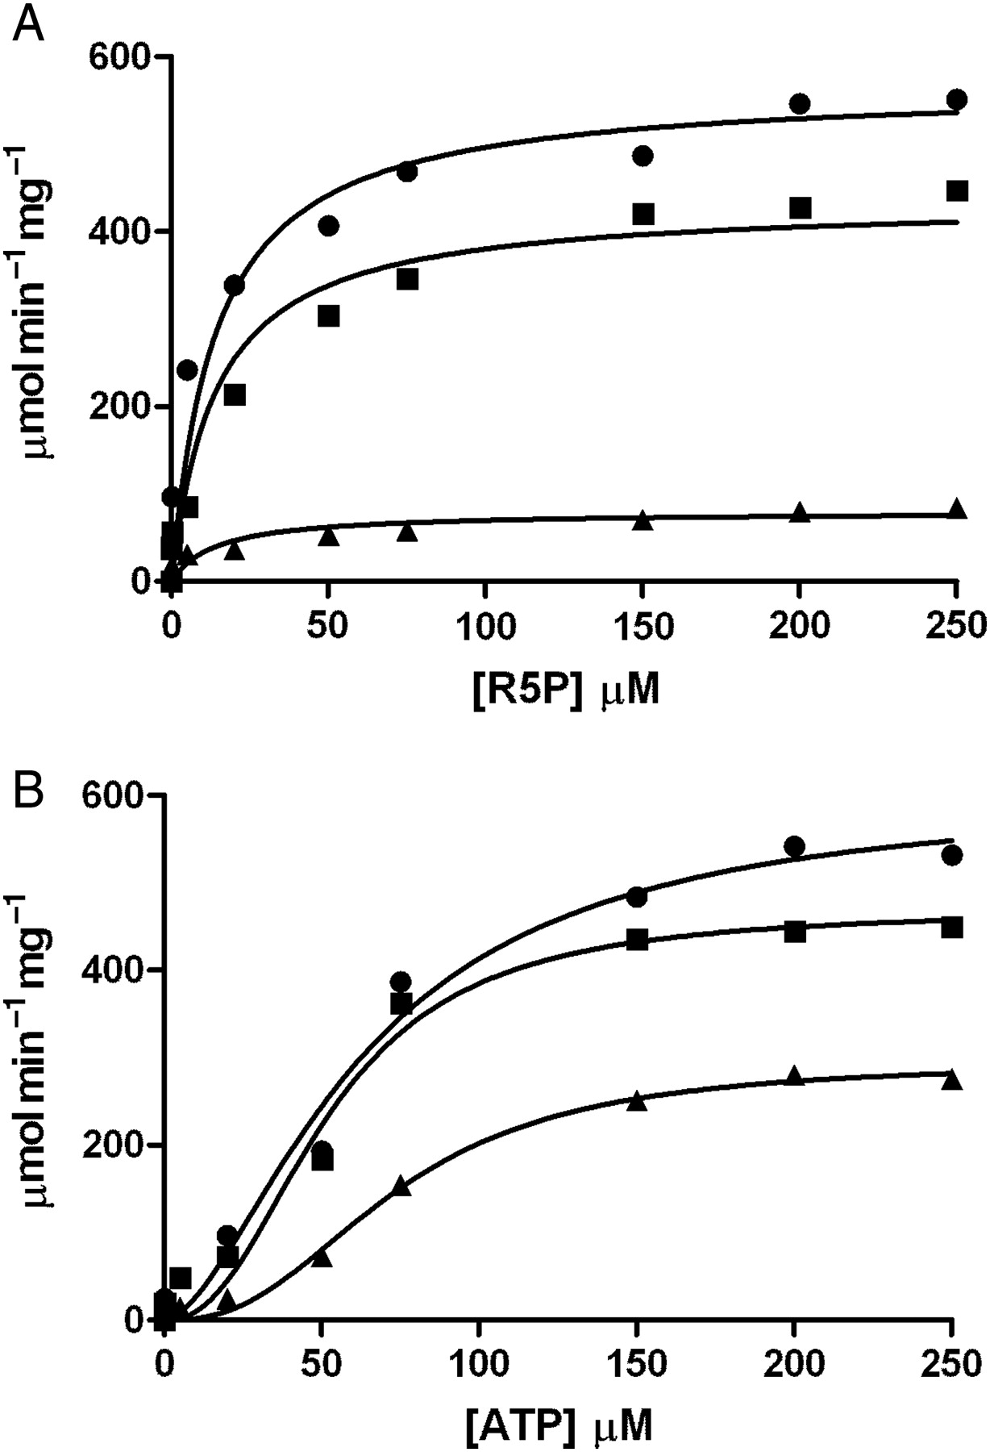
Fig. 6. Inhibition of Mt-PrsA activity by the addition of ADP when titrated with R5P (A) and ATP (B) using a ...
Notes:
Fig. 6. Inhibition of Mt-PrsA activity by the addition of ADP when titrated with R5P (A) and ATP (B) using a continuous enzyme-coupled spectrophotometric assay. (A) A plot of velocity (ν) of Mt-PrsA response to increasing [R5P] in the presence of no ADP (filled circles), 0.1 mM ADP (filled squares) and 2 mM ADP (filled triangle). Data were fitted to Eq. (5) using nonlinear regression analysis. (B) A plot of velocity (ν) of Mt-PrsA response to increasing [ATP] in the presence of no ADP (filled circles), 0.1 mM ADP (filled squares) and 2 mM ADP (filled triangles). Data were fitted to Eq. (6) using nonlinear regression analysis. All data points plotted (calculated mean) represent experiments performed in triplicate using three independent preparations of recombinant Mt-PrsA. Calculated standard errors (±SE) for kinetic constants are reported in the manuscript where appropriate.
Unless provided in the caption above, the following copyright applies to the content of this slide: © The Author 2010. Published by Oxford University Press.This is an Open Access article distributed under the terms of the Creative Commons Attribution Non-Commercial License (http://creativecommons.org/licenses/by-nc/2.5/), which permits unrestricted non-commercial use, distribution, and reproduction in any medium, provided the original work is properly cited. For permissions, please e-mail: journals.permissions@oup.com.

Slide 7
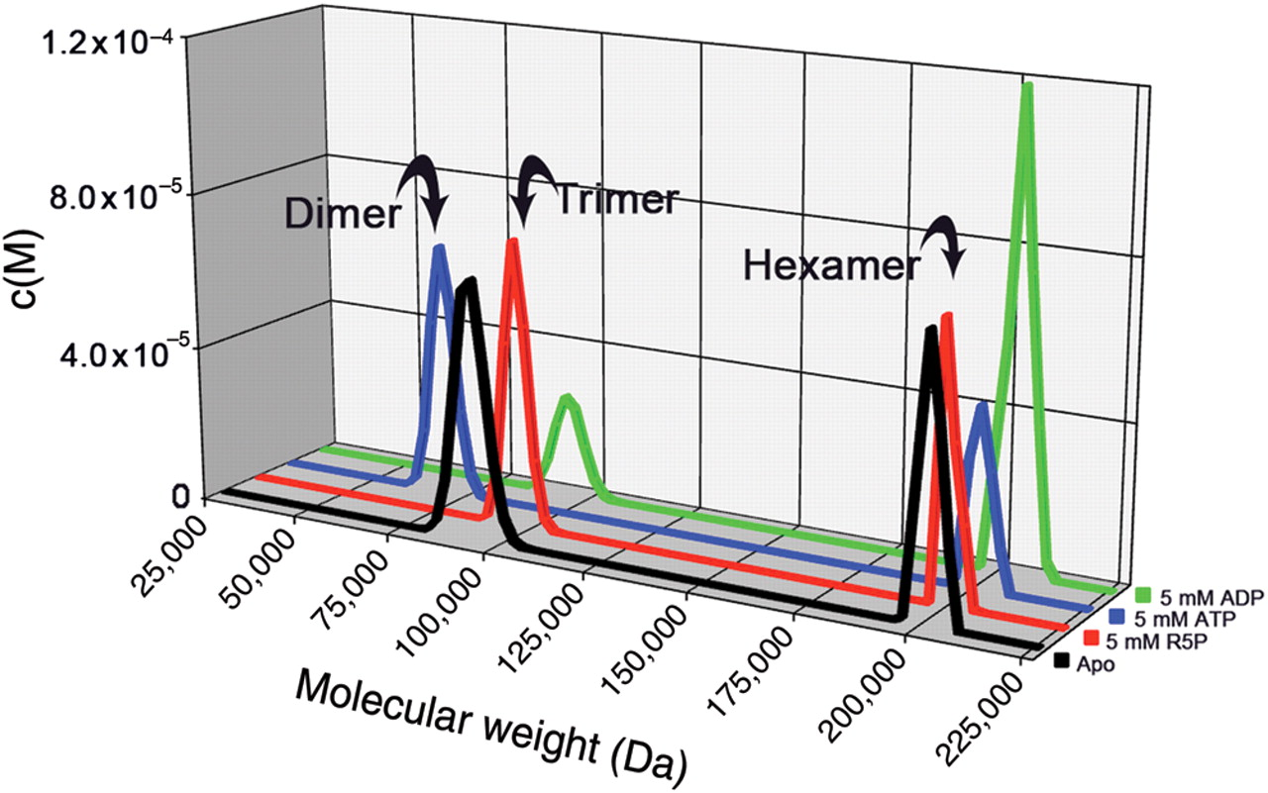
Fig. 7. Mt-PrsA self-assembly analysis using analytical ultracentrifugation. Sedimentation velocity experiments were ...
Notes:
Fig. 7. Mt-PrsA self-assembly analysis using analytical ultracentrifugation. Sedimentation velocity experiments were conducted to investigate the oligomeric state of Mt-PrsA in solution in the presence of no additional ligands (black line), 5 mM R5P (red line), 5 mM ATP (blue line) and 5 mM ADP (green line). Individual plots represent the molar mass distribution c(M) vs. the apparent molecular weight (Da). Arrows indicate the calculated oligomeric state of Mt-PrsA in each sedimentation velocity experiment.
Unless provided in the caption above, the following copyright applies to the content of this slide: © The Author 2010. Published by Oxford University Press.This is an Open Access article distributed under the terms of the Creative Commons Attribution Non-Commercial License (http://creativecommons.org/licenses/by-nc/2.5/), which permits unrestricted non-commercial use, distribution, and reproduction in any medium, provided the original work is properly cited. For permissions, please e-mail: journals.permissions@oup.com.

Slide 8
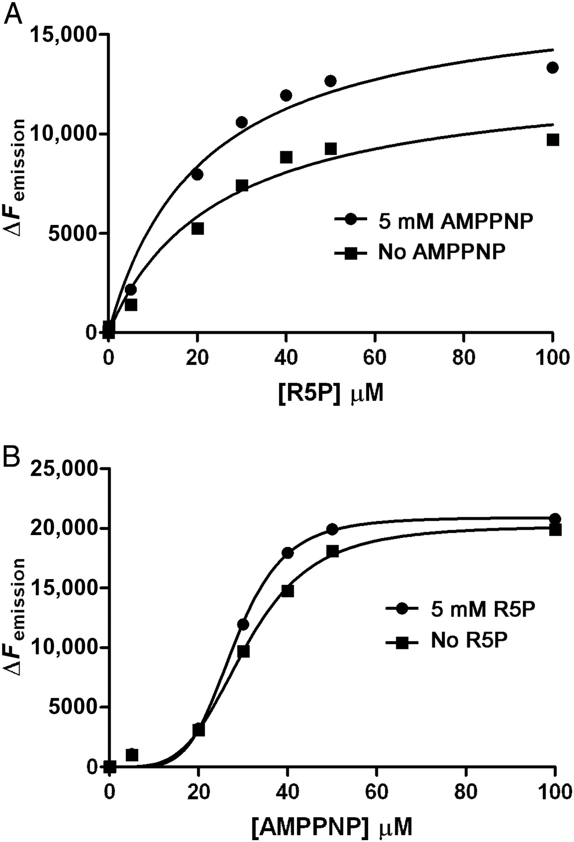
Fig. 8. Binding kinetics of R5P (A) and the ATP analog (AMPPNP) (B) to Mt-PrsA using ITF spectroscopy. ITF ...
Notes:
Fig. 8. Binding kinetics of R5P (A) and the ATP analog (AMPPNP) (B) to Mt-PrsA using ITF spectroscopy. ITF spectroscopy was used to determine the binding properties of Mt-PrsA for its substrates R5P and ATP. Ligand-binding assays were carried out as described in the Materials and methods section. (A) A plot of ΔFemission vs. [R5P] in the presence of no AMPPNP (filled squares) and 5 mM AMPPNP (filled circles) which was fitted to Eq. (7). (B) A plot of ΔFemission vs. [AMPPNP] in the presence of no R5P (filled squares) and 5 mM R5P (filled circles) which was fitted to Eq. (9).
Unless provided in the caption above, the following copyright applies to the content of this slide: © The Author 2010. Published by Oxford University Press.This is an Open Access article distributed under the terms of the Creative Commons Attribution Non-Commercial License (http://creativecommons.org/licenses/by-nc/2.5/), which permits unrestricted non-commercial use, distribution, and reproduction in any medium, provided the original work is properly cited. For permissions, please e-mail: journals.permissions@oup.com.

Slide 9
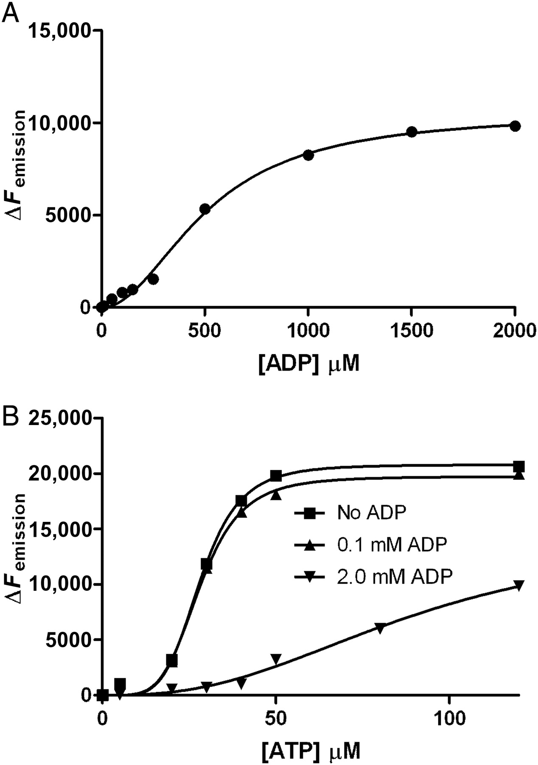
Fig. 9. Binding kinetics of ADP and ATP to Mt-PrsA using ITF spectroscopy. ITF spectroscopy was used to determine the ...
Notes:
Fig. 9. Binding kinetics of ADP and ATP to Mt-PrsA using ITF spectroscopy. ITF spectroscopy was used to determine the binding properties of Mt-PrsA for it's allosteric inhibitor ADP in competition with ATP. Ligand-binding assays were carried out as described in the Materials and methods section. (A) A plot of ΔFemission vs. [ADP] (filled circles) which was fitted to Eq. (8). (B) A plot of ΔFemission vs. [ATP] in the presence of no ADP (filled squares), 0.1 mM ADP (filled triangles) and 2.0 mM ADP (filled inverted triangles) which was fitted to Eq. (10).
Unless provided in the caption above, the following copyright applies to the content of this slide: © The Author 2010. Published by Oxford University Press.This is an Open Access article distributed under the terms of the Creative Commons Attribution Non-Commercial License (http://creativecommons.org/licenses/by-nc/2.5/), which permits unrestricted non-commercial use, distribution, and reproduction in any medium, provided the original work is properly cited. For permissions, please e-mail: journals.permissions@oup.com.

Slide 10
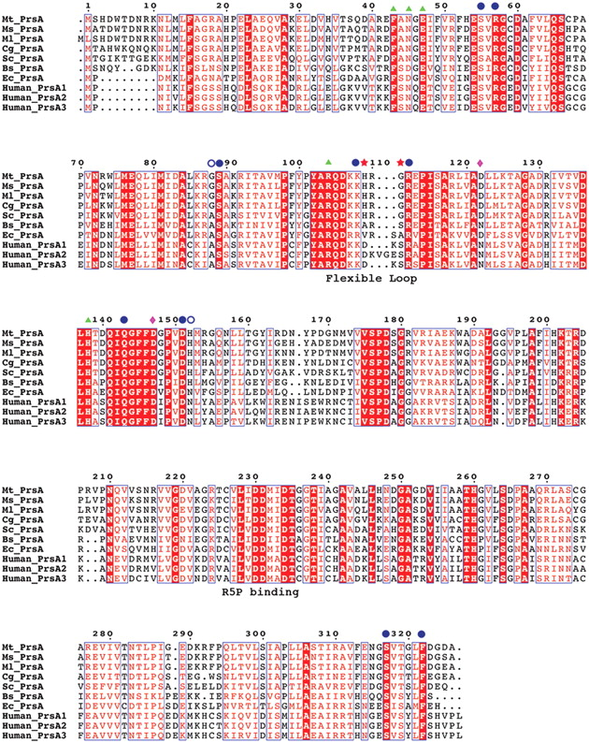
Fig. 10. Sequence alignment of various prokaryotic pRpp synthetases. Protein sequences from M. tuberculosis (Mt_PrsA), ...
Notes:
Fig. 10. Sequence alignment of various prokaryotic pRpp synthetases. Protein sequences from M. tuberculosis (Mt_PrsA), M. smegmatis (Ms_PrsA), M. leprae (Ml_PrsA), C. glutamicum (Cg_PrsA), S. coleicolor (Sc_PrsA), B. subtilis (Bs_PrsA), E. coli (Ec-PrsA) and the three PrsA isoforms (Human_PrsA1–3) were aligned using CLUSTALW and annotated with ESPRIPT. Triangles represent residues involved in catalysis. Filled circles indicate conserved and open circles highlight nonconserved residues involved in allosteric regulation. His109 and Gly111 are highlighted with stars, indicating two residues only found in the flexible loop region of Corynebacterianeae PrsA homologs. The diamonds indentify the location of the residues involved in the formation of a salt bridge in Bs-PrsA and Human-PrsA1.
Unless provided in the caption above, the following copyright applies to the content of this slide: © The Author 2010. Published by Oxford University Press.This is an Open Access article distributed under the terms of the Creative Commons Attribution Non-Commercial License (http://creativecommons.org/licenses/by-nc/2.5/), which permits unrestricted non-commercial use, distribution, and reproduction in any medium, provided the original work is properly cited. For permissions, please e-mail: journals.permissions@oup.com.

Slide 11
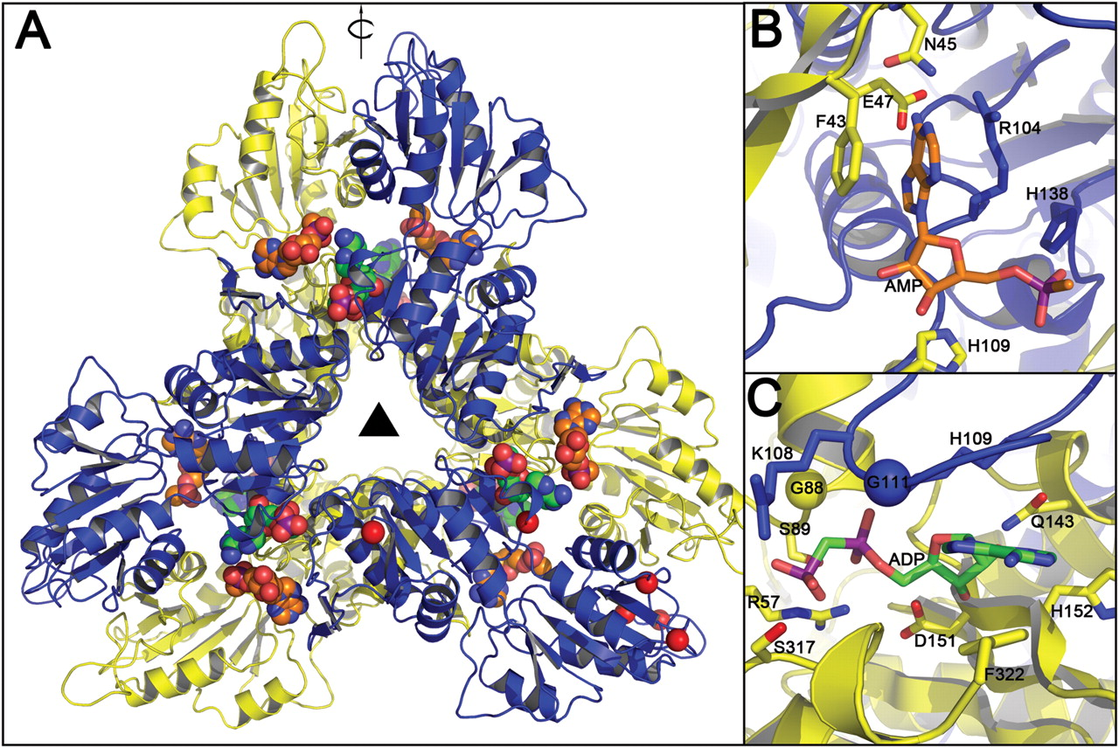
Fig. 11. Homology model of Mt-PrsA. (A) Mt-PrsA arranged into its hexameric quaternary conformation. Carbon atoms of ...
Notes:
Fig. 11. Homology model of Mt-PrsA. (A) Mt-PrsA arranged into its hexameric quaternary conformation. Carbon atoms of the ADP ligands located at the catalytic and regulatory sites of the Mt-PrsA hexamer are colored in orange and green, respectively. Red spheres located at K10, D169, G194, D205-V208 and F322 indicate regions of the Mt-PrsA dimmer that include insertions or deletions with respect to the Bs-Prs structure. The triangle in the middle represents 3-fold symmetry, where as the arrow parallel to the plane indicates 2-fold rotational symmetry. Catalytic (B) and regulatory (C) sites of the Mt-PrsA homology model. The yellow and the blue spheres indicate A85/G88 and S109/G111 substitution between the Bs-Prs and Mt-PrsA structures, respectively.
Unless provided in the caption above, the following copyright applies to the content of this slide: © The Author 2010. Published by Oxford University Press.This is an Open Access article distributed under the terms of the Creative Commons Attribution Non-Commercial License (http://creativecommons.org/licenses/by-nc/2.5/), which permits unrestricted non-commercial use, distribution, and reproduction in any medium, provided the original work is properly cited. For permissions, please e-mail: journals.permissions@oup.com.

