Slide 1
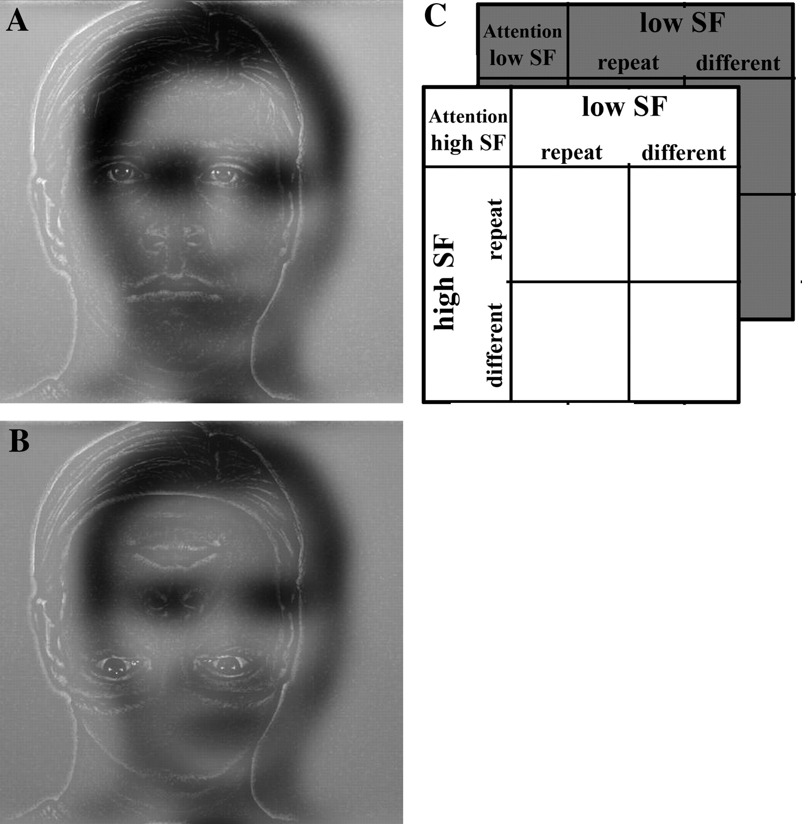
Figure 1. Stimuli and experimental design. (A) Example of a hybrid stimulus used in the experiment. Each hybrid ...
Notes:
Figure 1. Stimuli and experimental design. (A) Example of a hybrid stimulus used in the experiment. Each hybrid contained 2 partly overlapping filtered faces. In this example, the face offset to the right is the low SF face, and the face on the left is the high SF face. The offset direction for each SF-filtered face was randomized and counterbalanced across conditions. In this example, the high and low SF faces were scaled to match in contrast. (B) Example for oddball inverted target stimulus in the high SF attention condition. Note that only the inner features are inverted. In this example, the contrast of the high SF face was maximized, whereas the contrast of the low SF had its original values. (C) Experimental design. There were 2 (attention: to Low SF or high SF) × 2 (low SF: repeat or differ) × 2 (high SF: repeat or differ) factors.
Unless provided in the caption above, the following copyright applies to the content of this slide: © 2007 The AuthorsThis is an Open Access article distributed under the terms of the Creative Commons Attribution Non-Commercial License (http://creativecommons.org/licenses/by-nc/2.0/uk/) which permits unrestricted non-commercial use, distribution, and reproduction in any medium, provided the original work is properly cited.

Slide 2
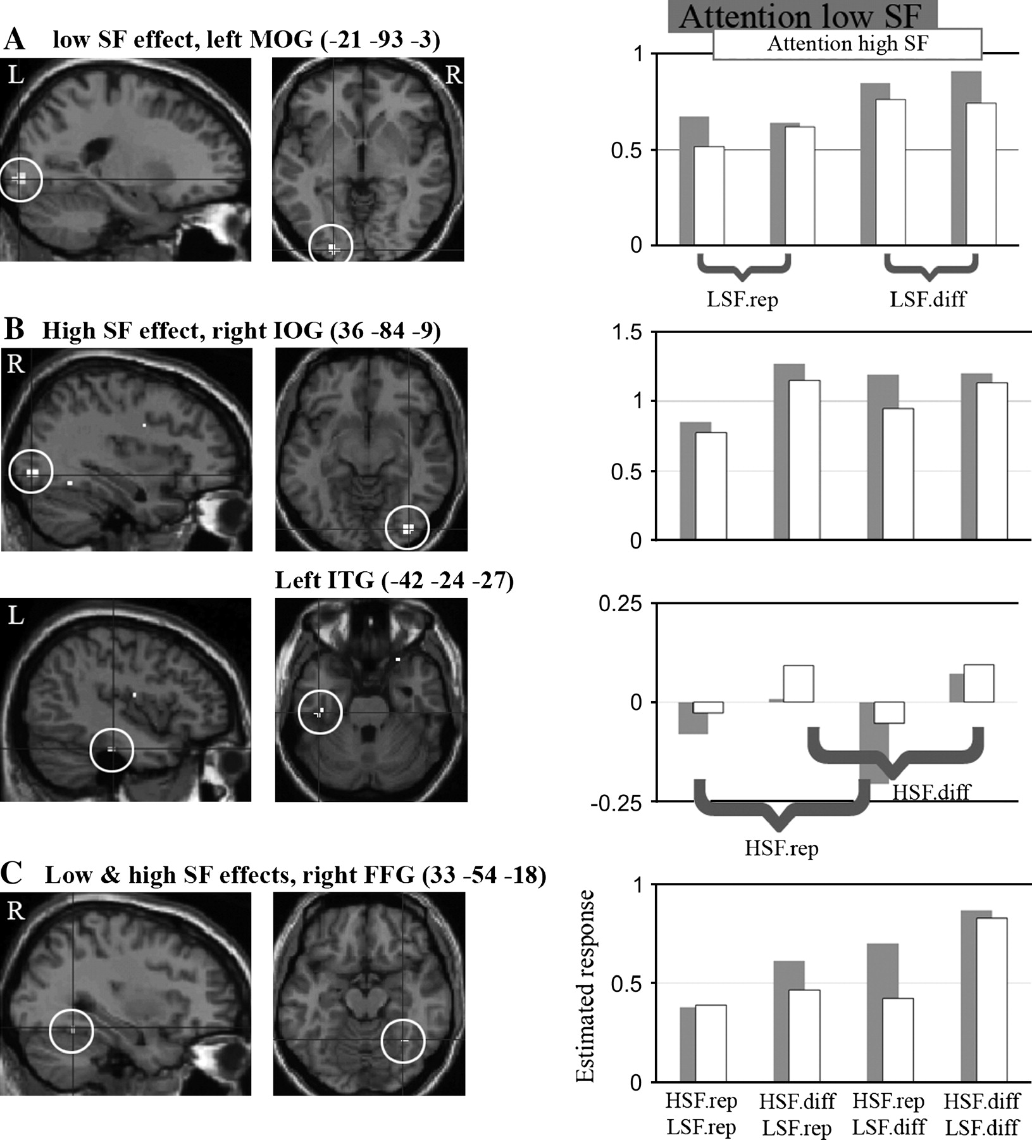
Figure 2. Voxel-based SPM analysis results. On the left, statistical parametric maps (SPMs) depicting regions sensitive ...
Notes:
Figure 2. Voxel-based SPM analysis results. On the left, statistical parametric maps (SPMs) depicting regions sensitive to (A) low SF changes versus repetition (LSF diff minus LSF rep), (B) high SF change versus repetition (HSF diff minus HSF rep), and (C) both high and low SF information in faces (conjunction of the 2 former contrasts). The SPMs are shown at a conventional threshold of P < 0.001, uncorrected, and overlaid on sagital and axial T1 images of one of our participants. The histograms show the parameter estimates for the different experimental conditions, taken from the maxima voxel marked within the circle (exact coordinates are given above each axial slice, in MNI space); x axis depicts the 8 experimental conditions, gray bars for attending low SF and white bars for attending high SF, the full condition labeling can be found at the bottom of the last plot; y axis depicts the estimated response size (SPM “beta values”), averaged standard error mean for all plots was 0.11, ranging from 0.06 to 0.17. LSF/HSF, low/high SF; rep, repeat; diff, different.
Unless provided in the caption above, the following copyright applies to the content of this slide: © 2007 The AuthorsThis is an Open Access article distributed under the terms of the Creative Commons Attribution Non-Commercial License (http://creativecommons.org/licenses/by-nc/2.0/uk/) which permits unrestricted non-commercial use, distribution, and reproduction in any medium, provided the original work is properly cited.

Slide 3
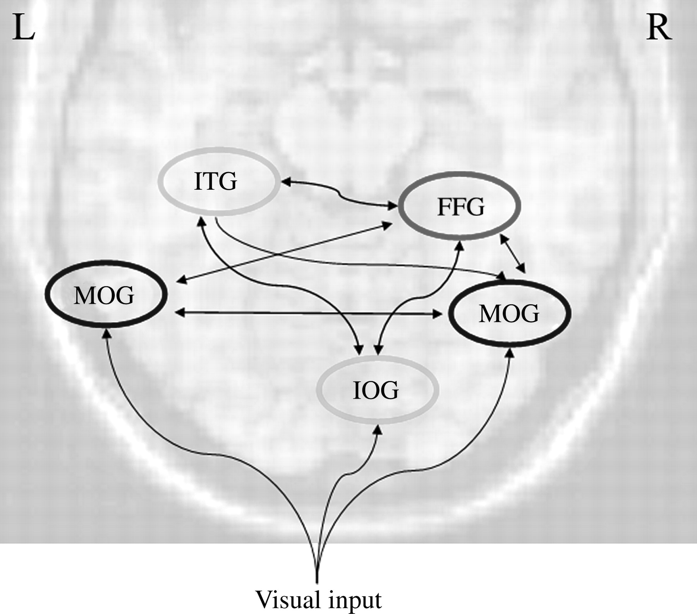
Figure 3. DCM results. The 5 ROIs that were used in the DCM are schematically overlaid on an axial slice of occipital ...
Notes:
Figure 3. DCM results. The 5 ROIs that were used in the DCM are schematically overlaid on an axial slice of occipital cortex. ROIs primarily sensitive to low SF face repetitions are marked in black, those sensitive to high SF face repetitions are marked in light grey, and those processing both high and low SF are marked in grey. Black arrows describe intrinsic connections that were observed throughout the experiment (independent of repetition and attention manipulations; see text for statistical values). All these connections were excitatory, that is, positive.
Unless provided in the caption above, the following copyright applies to the content of this slide: © 2007 The AuthorsThis is an Open Access article distributed under the terms of the Creative Commons Attribution Non-Commercial License (http://creativecommons.org/licenses/by-nc/2.0/uk/) which permits unrestricted non-commercial use, distribution, and reproduction in any medium, provided the original work is properly cited.

