Slide 1
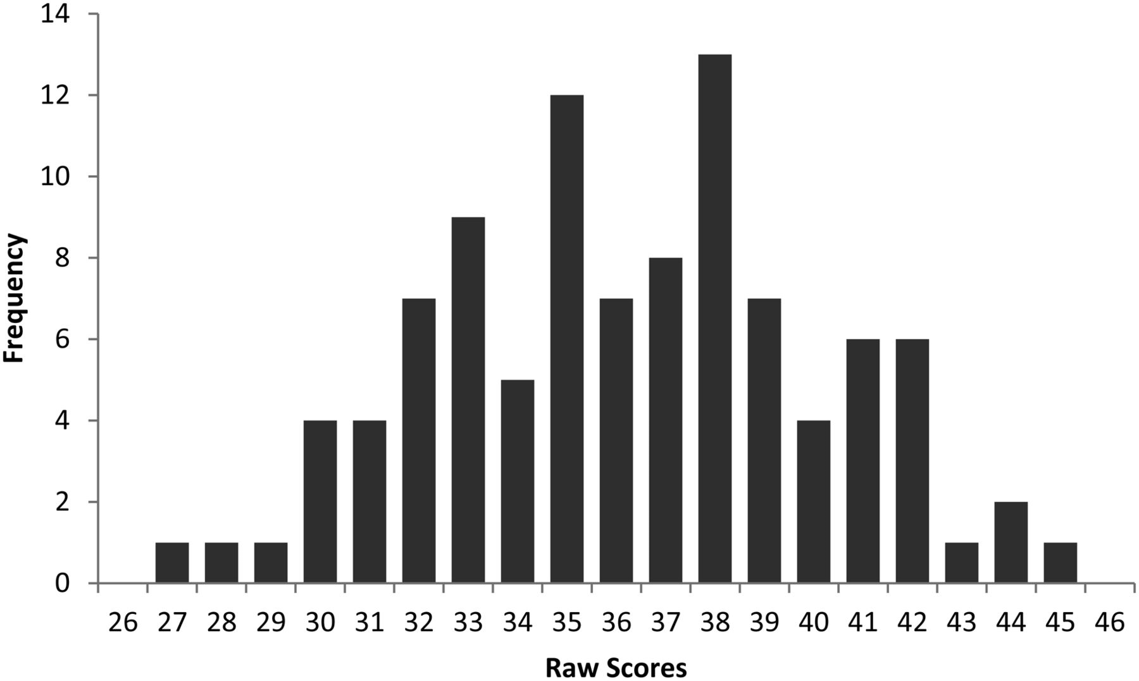
Table 1. Distribution of randomly generated raw scores Distribution of Designs raw score for 100 randomly generated ...
Notes:
Table 1. Distribution of randomly generated raw scores Distribution of Designs raw score for 100 randomly generated performances.
Unless provided in the caption above, the following copyright applies to the content of this slide: © The Author 2014. Published by Oxford University Press. All rights reserved. For permissions, please e-mail: journals.permissions@oup.com

Slide 2
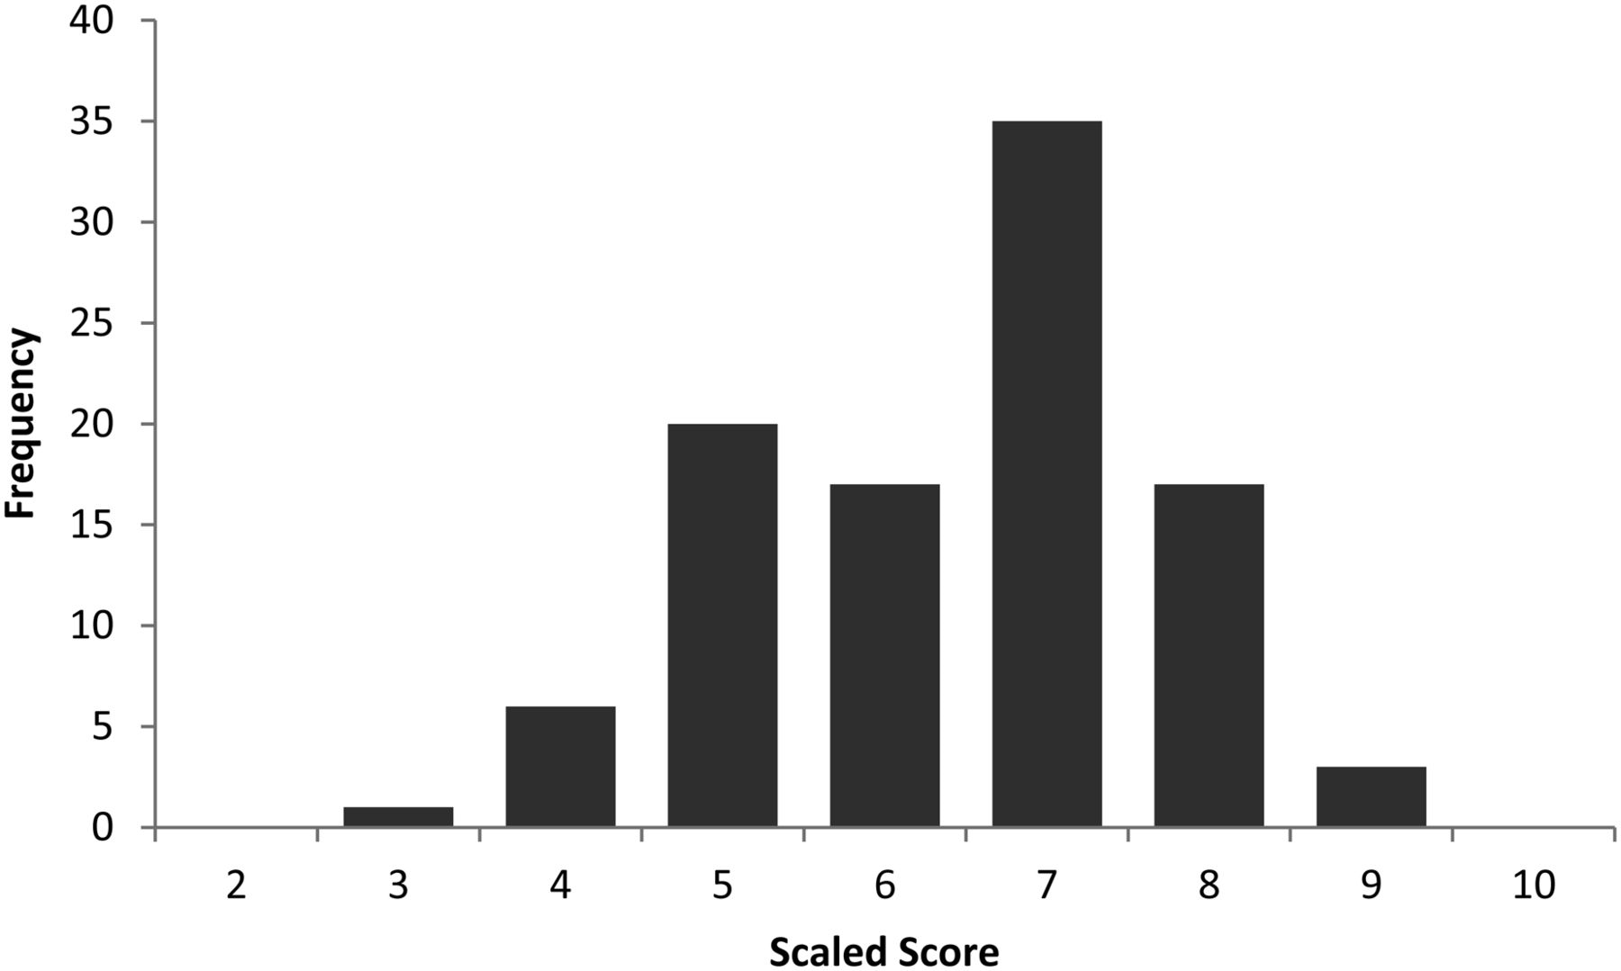
Table 2. Scaled score equivalents on Designs I for randomly generated performances by age group Scaled score ...
Notes:
Table 2. Scaled score equivalents on Designs I for randomly generated performances by age group Scaled score equivalents on Designs II for randomly generated performances by age group Raw16–1718–1920–2425–2930–3435–4445–5455–6465–69−2 SD28.6233333444−1 SD32.4333444455Mean36.3444555667+ 1 SD40.1555666778+ 2 SD44.0566677789Fig. 2.Designs II scaled score equivalents of randomly generated performances for the 65- to 69-year-old age group.
Unless provided in the caption above, the following copyright applies to the content of this slide: © The Author 2014. Published by Oxford University Press. All rights reserved. For permissions, please e-mail: journals.permissions@oup.com

