Slide 1
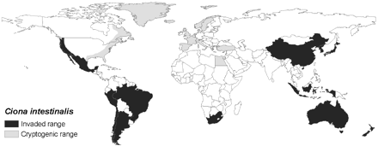
Figure 1. Global distribution of Ciona intestinalis, showing countries where the species should be considered ...
Notes:
Figure 1. Global distribution of Ciona intestinalis, showing countries where the species should be considered cryptogenic (grey) and countries where the species has invaded (black).
Unless provided in the caption above, the following copyright applies to the content of this slide: © 2008 International Council for the Exploration of the Sea. Published by Oxford Journals. All rights reserved. For Permissions, please email: journals.permissions@oxfordjournals.org

Slide 2
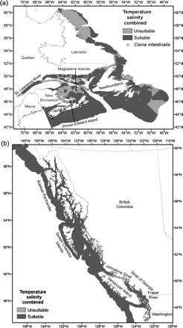
Figure 2. Simple ecological niche models based on combined seasonal temperature and salinity data used to identify ...
Notes:
Figure 2. Simple ecological niche models based on combined seasonal temperature and salinity data used to identify suitable (dark grey) and unsuitable (light grey) environments, based on reported tolerances for (a) the Atlantic coast, and (b) the Pacific coast.
Unless provided in the caption above, the following copyright applies to the content of this slide: © 2008 International Council for the Exploration of the Sea. Published by Oxford Journals. All rights reserved. For Permissions, please email: journals.permissions@oxfordjournals.org

Slide 3
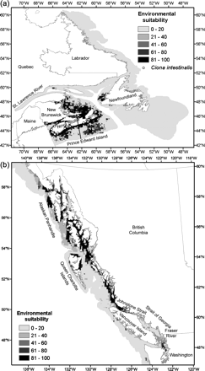
Figure 3. Environmental suitability predicted by GARP ecological niche models for (a) the Atlantic coast, and (b) the ...
Notes:
Figure 3. Environmental suitability predicted by GARP ecological niche models for (a) the Atlantic coast, and (b) the Pacific coast. Environmental suitability is displayed as the number (out of 100) of models that predicted a particular location to be suitable.
Unless provided in the caption above, the following copyright applies to the content of this slide: © 2008 International Council for the Exploration of the Sea. Published by Oxford Journals. All rights reserved. For Permissions, please email: journals.permissions@oxfordjournals.org

