Slide 1
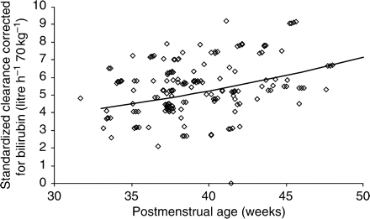
Fig 1 The relationship between PMA and individual Bayesian acetaminophen CL estimates.
Notes:
Fig 1 The relationship between PMA and individual Bayesian acetaminophen CL estimates.
Unless provided in the caption above, the following copyright applies to the content of this slide: © The Board of Management and Trustees of the British Journal of Anaesthesia 2008. All rights reserved. For Permissions, please e-mail: journals.permissions@oxfordjournals.org

Slide 2
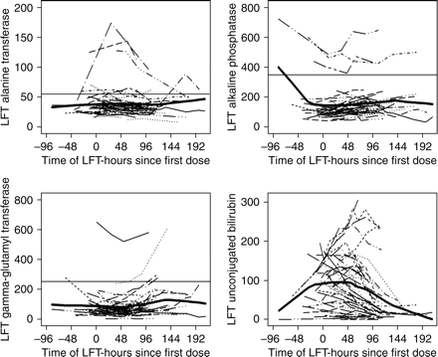
Fig 5 Graphs depicting changes in patients' LFTs in relation to the time of their first dose of i.v. acetaminophen. ...
Notes:
Fig 5 Graphs depicting changes in patients' LFTs in relation to the time of their first dose of i.v. acetaminophen. The thick line represents the 80% bandwidth lowess curve fitted to each plot. Normal values for these LFTs (except unconjugated bilirubin) are indicated by the thin horizontal line.
Unless provided in the caption above, the following copyright applies to the content of this slide: © The Board of Management and Trustees of the British Journal of Anaesthesia 2008. All rights reserved. For Permissions, please e-mail: journals.permissions@oxfordjournals.org

Slide 3
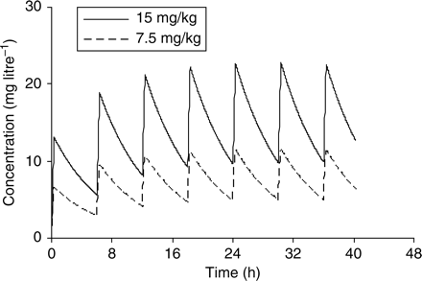
Fig 4 Predicted time–concentration profiles in neonates at 40 weeks PMA with two regular 6 h dosing regimens of 7.5 ...
Notes:
Fig 4 Predicted time–concentration profiles in neonates at 40 weeks PMA with two regular 6 h dosing regimens of 7.5 and 15 mg kg−1.
Unless provided in the caption above, the following copyright applies to the content of this slide: © The Board of Management and Trustees of the British Journal of Anaesthesia 2008. All rights reserved. For Permissions, please e-mail: journals.permissions@oxfordjournals.org

Slide 4
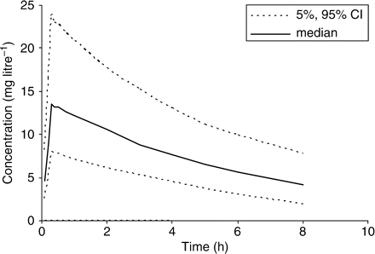
Fig 3 Median time–concentration profile for neonates 34–46 weeks PMA without hyperbilirubinaemia given a single ...
Notes:
Fig 3 Median time–concentration profile for neonates 34–46 weeks PMA without hyperbilirubinaemia given a single dose 15 mg kg−1. The 95% prediction interval is also shown.
Unless provided in the caption above, the following copyright applies to the content of this slide: © The Board of Management and Trustees of the British Journal of Anaesthesia 2008. All rights reserved. For Permissions, please e-mail: journals.permissions@oxfordjournals.org

Slide 5
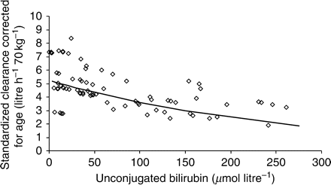
Fig 2 The relationship between unconjugated bilirubin and CL. CL was reduced in the presence of unconjugated ...
Notes:
Fig 2 The relationship between unconjugated bilirubin and CL. CL was reduced in the presence of unconjugated bilirubin.
Unless provided in the caption above, the following copyright applies to the content of this slide: © The Board of Management and Trustees of the British Journal of Anaesthesia 2008. All rights reserved. For Permissions, please e-mail: journals.permissions@oxfordjournals.org

