Slide 1
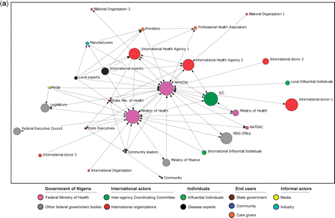
Figure 1a Interaction of actors involved in decision-making on vaccine introduction
Notes:
Figure 1a Interaction of actors involved in decision-making on vaccine introduction
Unless provided in the caption above, the following copyright applies to the content of this slide: Published by Oxford University Press in association with The London School of Hygiene and Tropical Medicine © The Author 2012; all rights reserved.

Slide 2
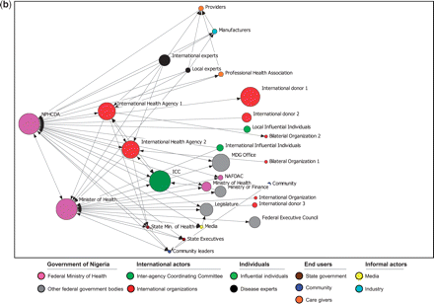
Figure 1b Interaction of actors involved in decision-making on vaccine introduction: ordered by centrality
Notes:
Figure 1b Interaction of actors involved in decision-making on vaccine introduction: ordered by centrality
Unless provided in the caption above, the following copyright applies to the content of this slide: Published by Oxford University Press in association with The London School of Hygiene and Tropical Medicine © The Author 2012; all rights reserved.

Slide 3
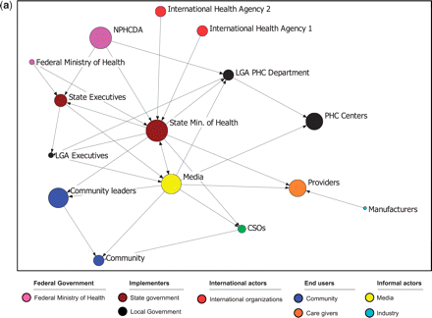
Figure 2a Interaction of actors involved in decision-making on vaccine programme implementation.
Notes:
Figure 2a Interaction of actors involved in decision-making on vaccine programme implementation.
Unless provided in the caption above, the following copyright applies to the content of this slide: Published by Oxford University Press in association with The London School of Hygiene and Tropical Medicine © The Author 2012; all rights reserved.

Slide 4
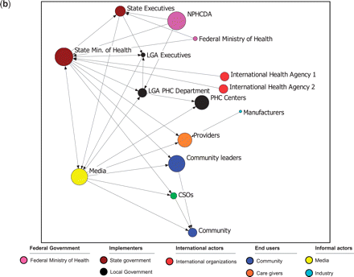
Figure 2b Interaction of actors involved in decision-making on vaccine programme implementation: ordered by centrality
Notes:
Figure 2b Interaction of actors involved in decision-making on vaccine programme implementation: ordered by centrality
Unless provided in the caption above, the following copyright applies to the content of this slide: Published by Oxford University Press in association with The London School of Hygiene and Tropical Medicine © The Author 2012; all rights reserved.

