Slide 1
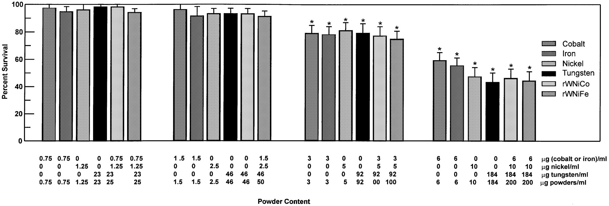
Fig. 1. Effect of various metals (tungsten, nickel, cobalt, iron, tungsten + nickel + cobalt mixture and tungsten + ...
Notes:
Fig. 1. Effect of various metals (tungsten, nickel, cobalt, iron, tungsten + nickel + cobalt mixture and tungsten + nickel + iron mixture) on HOS cell survival following a 24 h exposure. Data are means ± SD from three experiments.
Unless provided in the caption above, the following copyright applies to the content of this slide: © Oxford University Press

Slide 2
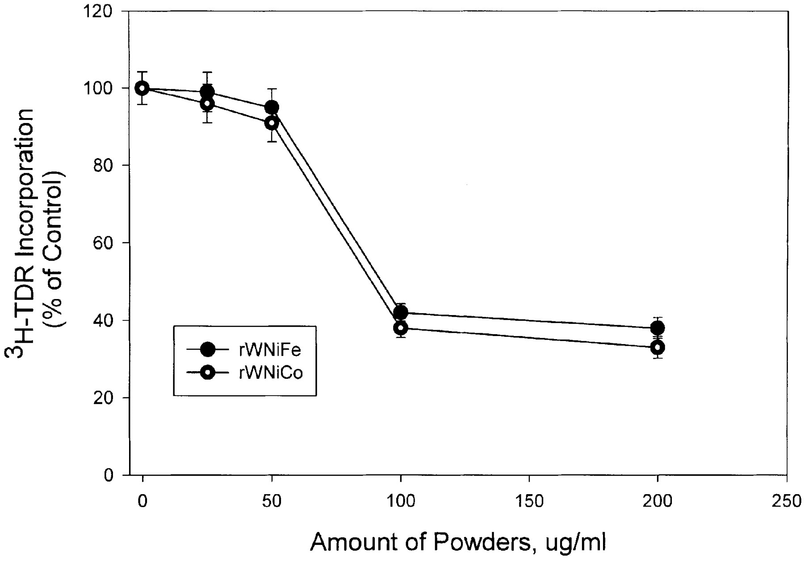
Fig. 2. Effect of the tungsten alloy mixtures (rWNiCo and rWNiFe) on DNA synthesis. HOS cells were incubated for 24 h ...
Notes:
Fig. 2. Effect of the tungsten alloy mixtures (rWNiCo and rWNiFe) on DNA synthesis. HOS cells were incubated for 24 h with rWNiCo or rWNiFe (0–200 μg powder/ml). During the last 4 h of incubation [3H]thymidine was added to the medium. Each point corresponds to the mean of three estimations of acid-precipitable radioactivity at each amount of metal mixture powder, expressed as a percentage of the untreated control. Error bars denote SD. P < 0.001 relative to untreated control in Student's t-test.
Unless provided in the caption above, the following copyright applies to the content of this slide: © Oxford University Press

Slide 3
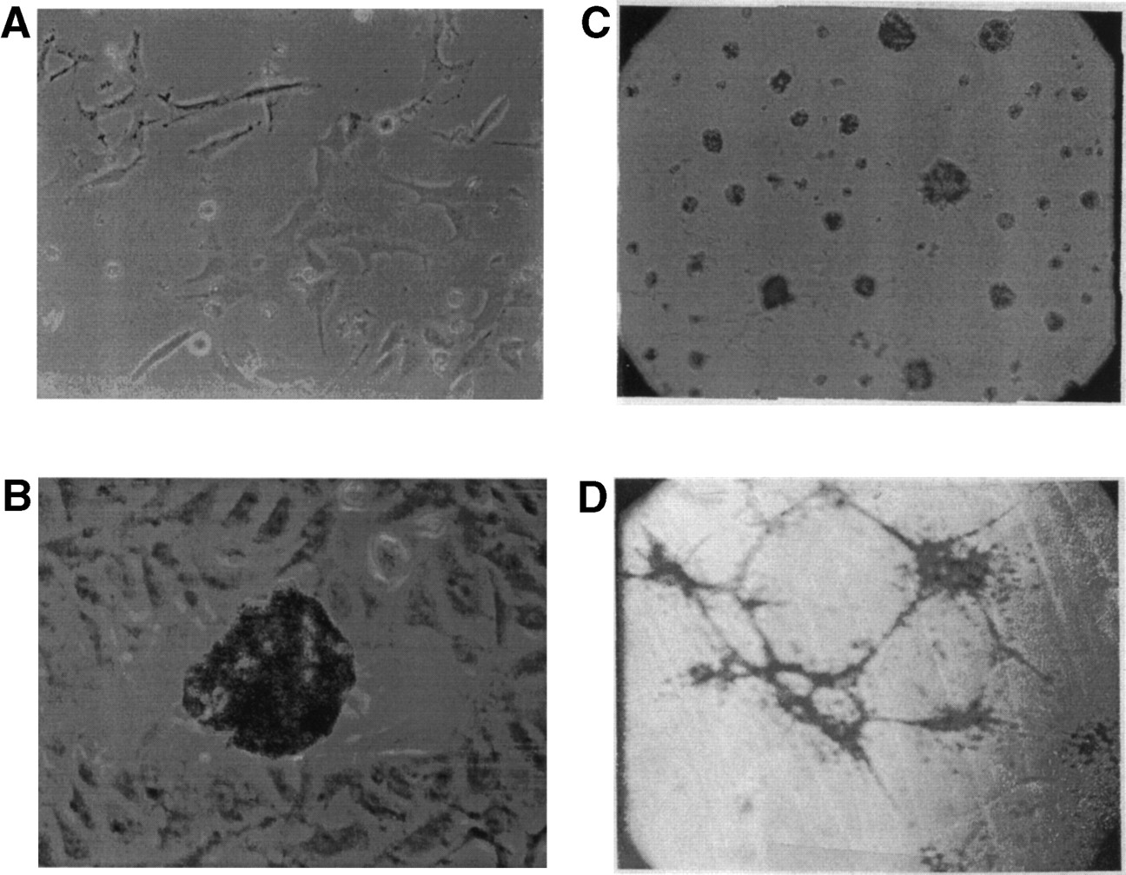
Fig. 3. Morphology of HOS cells and focus formation following rWNiCo exposure and growth of cells in matrigel. Phase ...
Notes:
Fig. 3. Morphology of HOS cells and focus formation following rWNiCo exposure and growth of cells in matrigel. Phase contrast micrograph, magnification ×40. (A) Morphology of control HOS cells. (B) Focus formation in HOS cells. The edge of a focus of transformed cells is seen against a background of parental HOS cells with normal morphology. (C) Growth of control HOS cells in matrigel. (D) Growth of rWNiCo transformants in matrigel.
Unless provided in the caption above, the following copyright applies to the content of this slide: © Oxford University Press

Slide 4
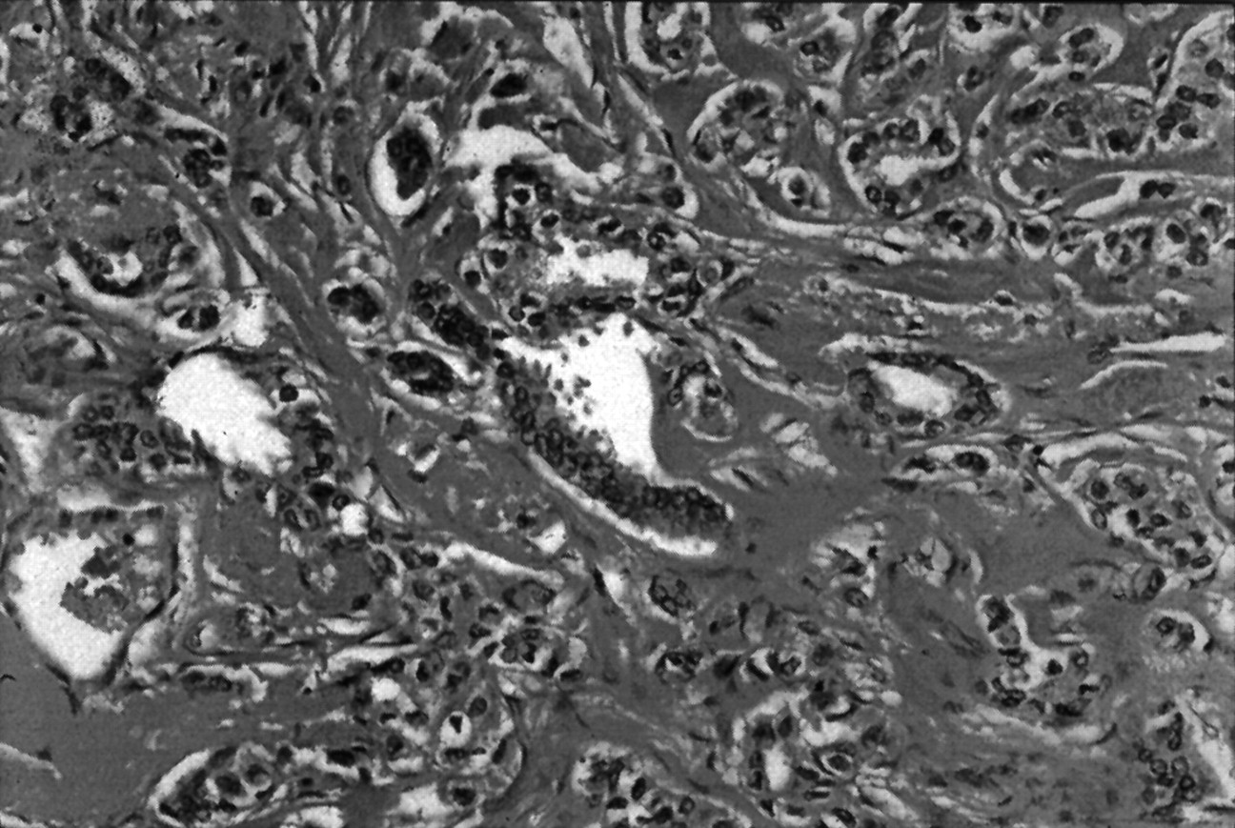
Fig. 4. Histopathology of tumors growing in nude mice following injection of rWNiCo-transformed cells. H&E, original ...
Notes:
Fig. 4. Histopathology of tumors growing in nude mice following injection of rWNiCo-transformed cells. H&E, original magnification ×212.
Unless provided in the caption above, the following copyright applies to the content of this slide: © Oxford University Press

Slide 5
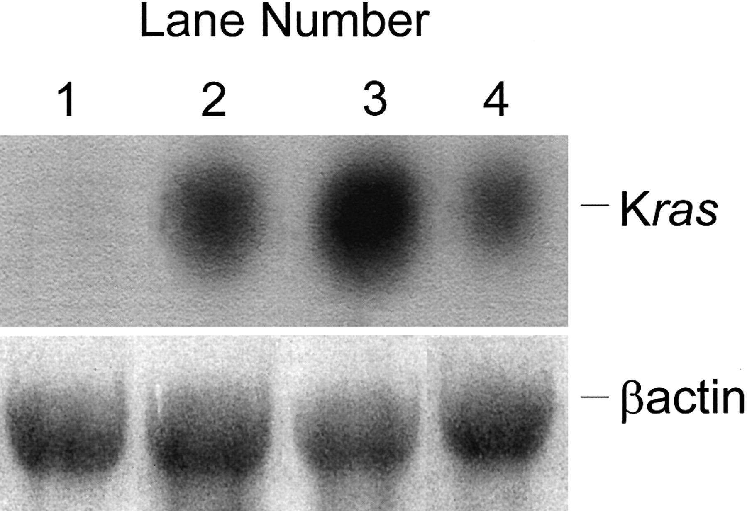
Fig. 5. Analysis of ras oncogene expression in parental HOS, rWNiCo-, rWNiFe- and EJ-ras-transformed clones. Data are ...
Notes:
Fig. 5. Analysis of ras oncogene expression in parental HOS, rWNiCo-, rWNiFe- and EJ-ras-transformed clones. Data are representative of three separate experiments. Northern blot analysis of cytoplasmic RNA (20 μg): lane 1, HOS; lane 2, rWNiCo-transformed cells; lane 3, rWNiFe-transformed cells; lane 4, EJ-ras-transformed cells. (Upper) Hybridization with a 32P-labeled K-ras probe (ras transcripts were undetectable in HOS cells). A SacI 2.9 kb fragment of the human ras gene and a 1.8 kb fragment of the human β-actin gene were used. (Lower) Hybridization with 32P-labeled actin was used to indicate that the relative amounts of RNA loaded into each lane were the same.
Unless provided in the caption above, the following copyright applies to the content of this slide: © Oxford University Press

Slide 6
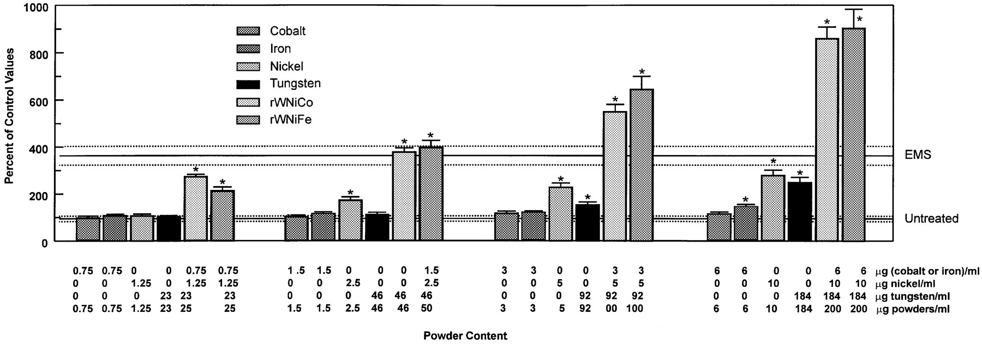
Fig. 6. DNA single-strand break analysis using alkaline elution of HOS cells exposed to various metals (tungsten, ...
Notes:
Fig. 6. DNA single-strand break analysis using alkaline elution of HOS cells exposed to various metals (tungsten, nickel, cobalt, iron, tungsten + nickel + cobalt mixture and tungsten + nickel + iron mixture) for 1 h. Results are the means ± SD from three determinations. The control (unexposed HOS cells) and the positive control (100 mM ethyl methyl sulfonate) are represented by three horizontal lines (mean ± SD). Error bars denote SD. P < 0.001 relative to untreated control in Student's t-test.
Unless provided in the caption above, the following copyright applies to the content of this slide: © Oxford University Press

