Slide 1
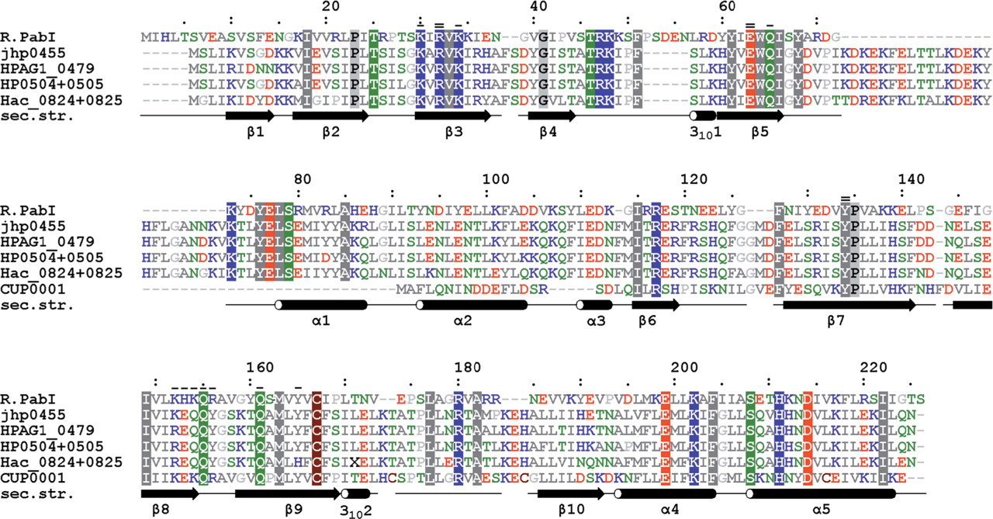
Figure 1. Sequence alignment between R.PabI and its homologs identified in protein sequence databases. jhp0455 and ...
Notes:
Figure 1. Sequence alignment between R.PabI and its homologs identified in protein sequence databases. jhp0455 and HPAG1_0479 are putative translation products of open reading frames (ORFs) from Helicobacter pylori strains J99 and HPAG1. HP0504 + 0505 and Hac_0824 + 0825 are reconstructed translation products of pseudogenes disrupted by frameshift mutations in H. pylori 26695 and H. acinonychis str. Sheeba. CUP0001 is a product of an incomplete ORF from Campylobacter upsaliensis RM3195. Amino acid residues with similar physico-chemical properties are indicated by color (hydrophobic—gray, negative—red, positive—blue, polar—green, cysteine—brown). Identical residues are highlighted. Residues analyzed by alanine mutagenesis in this work are indicated in the top by ‘-’ (mutant is partially active) or ‘=’ (mutant's activity is undetectable). The bottom panel shows secondary structure determined for R.PabI.
Unless provided in the caption above, the following copyright applies to the content of this slide: © 2007 The Author(s)This is an Open Access article distributed under the terms of the Creative Commons Attribution Non-Commercial License (http://creativecommons.org/licenses/by-nc/2.0/uk/) which permits unrestricted non-commercial use, distribution, and reproduction in any medium, provided the original work is properly cited.

Slide 2
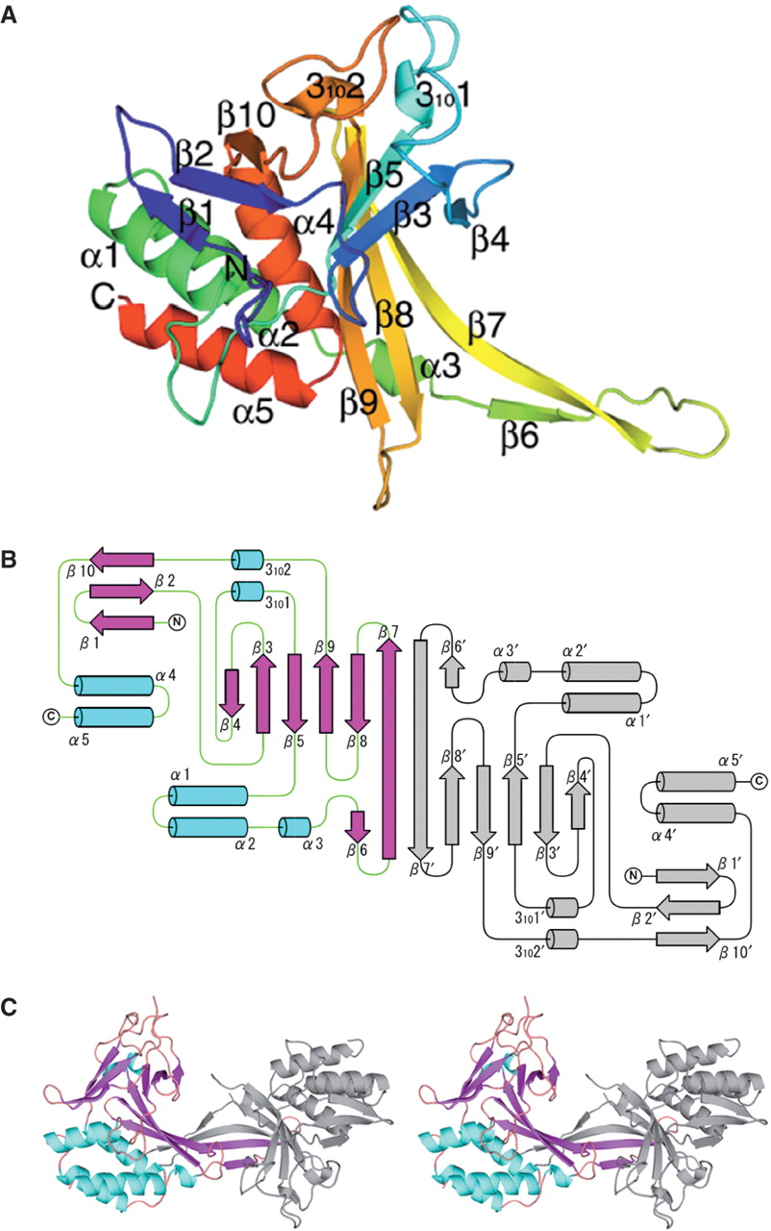
Figure 2. Structure of R.PabI. (A) The protomer structure of R.PabI (subunit A). Color coding runs from blue at the ...
Notes:
Figure 2. Structure of R.PabI. (A) The protomer structure of R.PabI (subunit A). Color coding runs from blue at the N-terminal region to red at the C-terminal region. Secondary structure assignments are labeled on the ribbon model. (B) Topology diagram of R.PabI dimer. Helices and strands are shown as cylinders and arrows, respectively. Antiparallel β-sheets consisting of β4–β3–β5–β9–β8–β7–β7′–β6′ and β6–β7–β7′–β8′–β9′–β5′–β3′–β4′ form two half-pipe structures. (C) Stereo diagram of the dimer structure of R.PabI. One protomer is colored in light blue (α and 310 helices) and pink (β strands), and the other is colored in gray.
Unless provided in the caption above, the following copyright applies to the content of this slide: © 2007 The Author(s)This is an Open Access article distributed under the terms of the Creative Commons Attribution Non-Commercial License (http://creativecommons.org/licenses/by-nc/2.0/uk/) which permits unrestricted non-commercial use, distribution, and reproduction in any medium, provided the original work is properly cited.

Slide 3
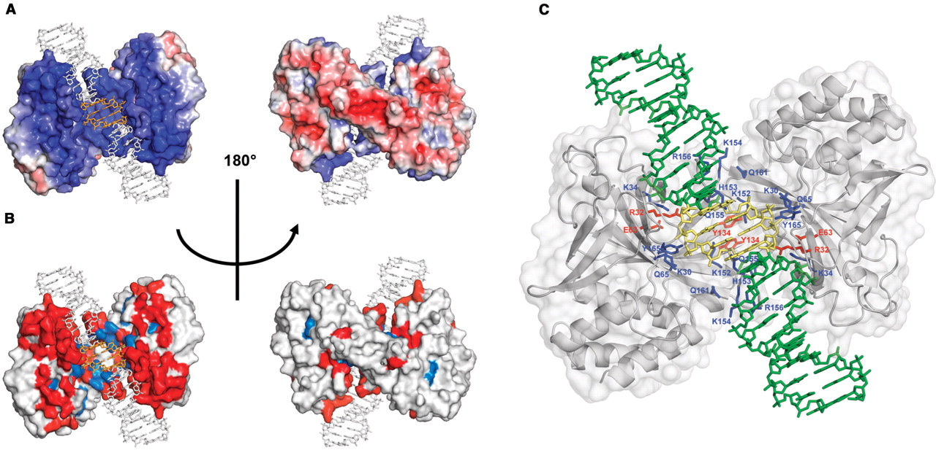
Figure 3. A model of R.PabI complexed with DNA. (A) Mapping of the electrostatic potential (as calculated by APBS ...
Notes:
Figure 3. A model of R.PabI complexed with DNA. (A) Mapping of the electrostatic potential (as calculated by APBS tools) onto the surface of the R.PabI structure in a low-resolution model of a complex with DNA. The blue color indicates a positive charge and the red color indicates a negative charge. The DNA is shown in gray, with specifically recognized nucleotides in light orange. (B) DNA-binding residues (predicted by PreDs) mapped onto the surface of R.PabI structure in a low-resolution model of a complex with DNA. The residues that are predicted to bind DNA are shown in red, whereas the residues that are predicted not to be involved in DNA binding are shown in light gray. The DNA is shown in green, with specifically recognized nucleotides in light orange. (C) Functionally important residues of R.PabI. The protein is shown as gray ribbons together with the transparent surface of a space-filling view. The DNA is shown in green, with specifically recognized nucleotides in yellow. Residues in which a mutation abolished cleavage activity of R.PabI are shown as red sticks. Residues in which a mutation decreased cleavage activity of R.PabI are represented as blue sticks.
Unless provided in the caption above, the following copyright applies to the content of this slide: © 2007 The Author(s)This is an Open Access article distributed under the terms of the Creative Commons Attribution Non-Commercial License (http://creativecommons.org/licenses/by-nc/2.0/uk/) which permits unrestricted non-commercial use, distribution, and reproduction in any medium, provided the original work is properly cited.

Slide 4
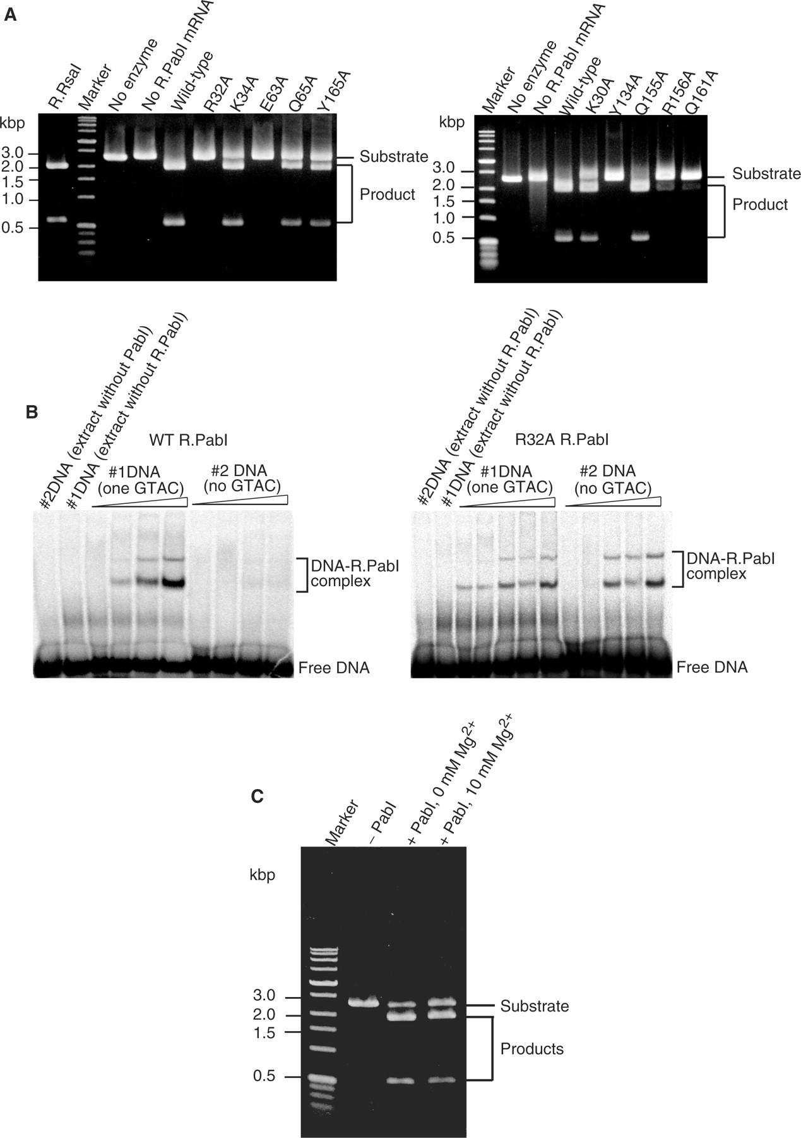
Figure 4. Functional analysis. (A) DNA cleavage. A linear DNA substrate was cleaved with approximately the same amount ...
Notes:
Figure 4. Functional analysis. (A) DNA cleavage. A linear DNA substrate was cleaved with approximately the same amount of each mutant R.PabI enzyme at 75°C for 1 h. Marker: Perfect DNA™ Markers, 0.1–12 kb (Novagen). R.RsaI: cut with R.RsaI, a neoschizomer of R.PabI. No enzyme: only the substrate DNA was incubated. No R.PabI mRNA: the substrate DNA was incubated with wheat germ extract that had not been treated with R.PabI mRNA. After electrophoresis through 1% agarose gel, DNA was visualized under ultraviolet light after ethidium bromide staining. (B) Binding to DNA with and without a recognition sequence. The DNA binding reactions were carried out with 5 nM of a duplex oligonucleotide either with one (#1) or no (#2) R.PabI site (Materials and methods section) with increasing amounts of each enzyme preparation (1.3, 2.6, 4.0, 5.3, 6.6 µl). The ‘no enzyme’ controls contain 5.3 µl of wheat-germ extract processed without mRNA. The shift of electrophoretic mobility was examined with 8% native polyacrylamide gel. (C) R.PabI DNA cleavage in the absence of divalent cation. The reaction mixture was incubated for 1 h at 85°C. Marker: Perfect DNA™ Markers, 0.1–12 kb (Novagen). Substrate: a linear DNA substrate with a single recognition site for R.PabI. +R.PabI, 0 mM Mg2+: the substrate DNA was cleaved with a suboptimal concentration of R.PabI in buffer A containing 1 mM EDTA. +R.PabI, 10 mM Mg2+: the substrate DNA was cleaved with the same concentration of R.PabI in buffer A containing 10 mM Mg2+ (the same as for Figure 4A).
Unless provided in the caption above, the following copyright applies to the content of this slide: © 2007 The Author(s)This is an Open Access article distributed under the terms of the Creative Commons Attribution Non-Commercial License (http://creativecommons.org/licenses/by-nc/2.0/uk/) which permits unrestricted non-commercial use, distribution, and reproduction in any medium, provided the original work is properly cited.

