Slide 1
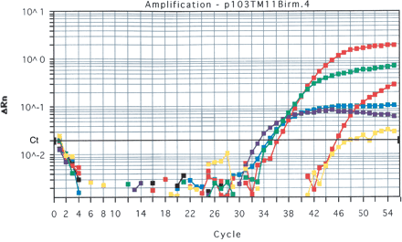
Figure 1. PCR amplification curves with Taqman primers and probe for C. burnetii 16S rRNA gene sequences in ...
Notes:
Figure 1. PCR amplification curves with Taqman primers and probe for C. burnetii 16S rRNA gene sequences in Com1-sequence positive bone marrow samples from Birmingham Q fever patients. Red, positive Q Vax control, standard exponential curves/positive. Green/blue, patient 37, truncated exponential curves/positive. Purple, patient 122, truncated exponential curves/positive. Yellow, patient 117, ambiguous curve/negative. Black, non-template control/negative.
Unless provided in the caption above, the following copyright applies to the content of this slide: QJM vol. 98 no. 1 © Association of Physicians 2005; all rights reserved.

