Slide 1
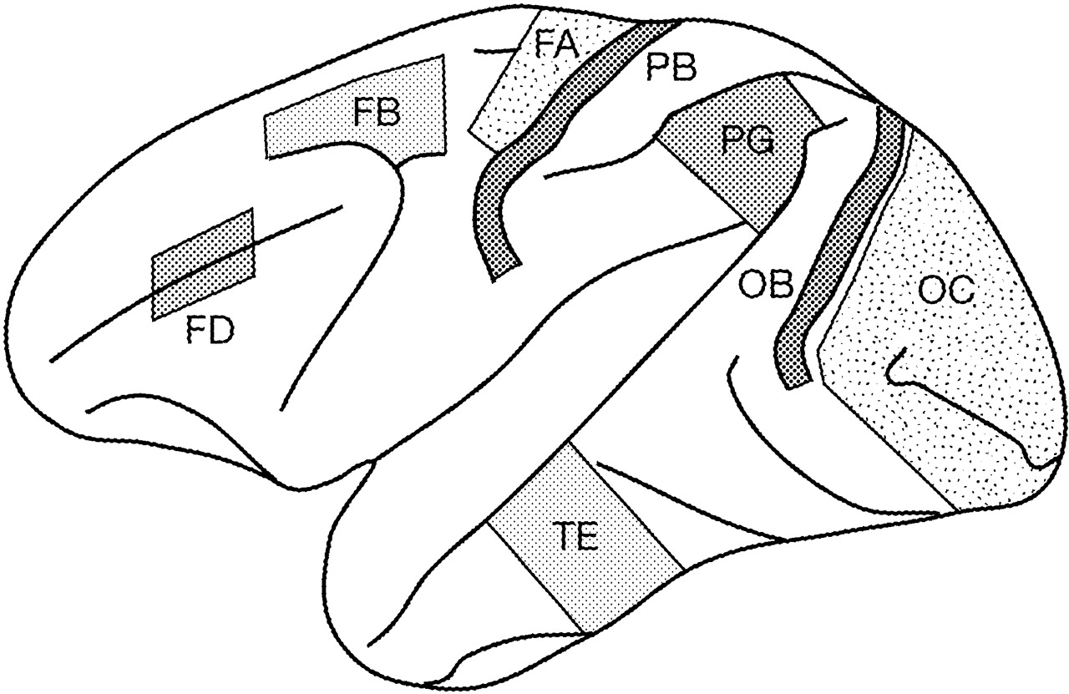
Figure 1. Dissected neocortical regions for Northern blot analysis are shown on the left hemisphere of the cerebral ...
Notes:
Figure 1. Dissected neocortical regions for Northern blot analysis are shown on the left hemisphere of the cerebral cortex. The indicated regions correspond to the FD (prefrontal area), FB (premotor area), FA (primary motor area), PB (primary somatosensory area), TE (temporal association area), PG (parietal association area), OB (secondary visual area) and OC (primary visual area), named according to von Bonin and Bailey (von Bonin and Bailey, 1947).
Unless provided in the caption above, the following copyright applies to the content of this slide: © Oxford University Press

Slide 2
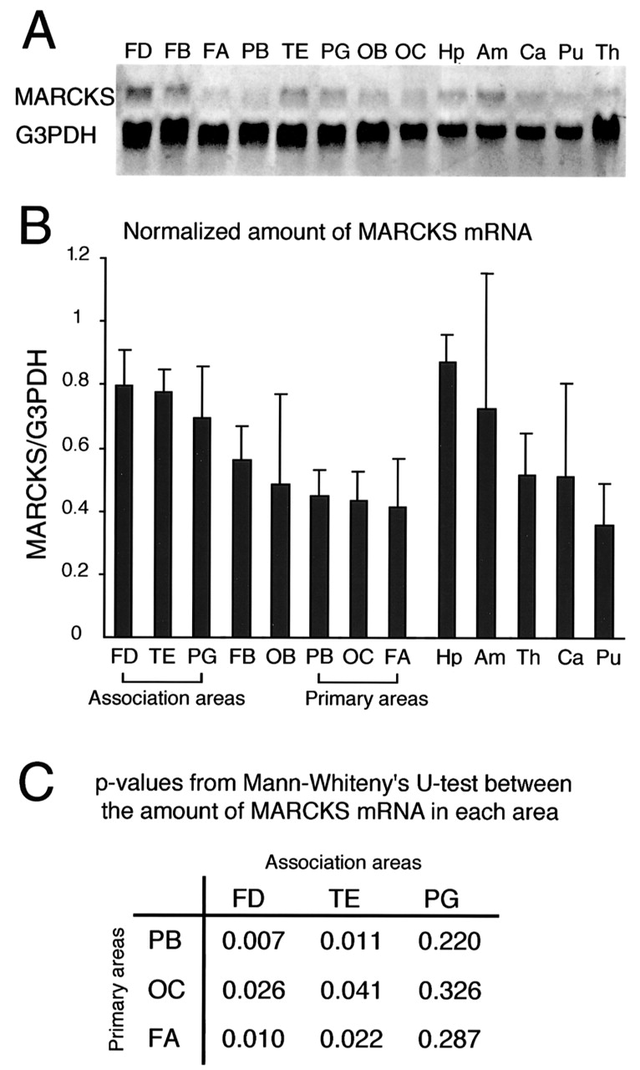
Figure 2. (A) MARCKS mRNA was detected in all regions of the monkey brain, but the signal level differed among the ...
Notes:
Figure 2. (A) MARCKS mRNA was detected in all regions of the monkey brain, but the signal level differed among the regions. The differences in the amount of G3PDH mRNA may be due to an error in the amount of total RNA applied. (B) The normalized amount of MARCKS mRNA is shown as a multiple of the ratio of MARCKS mRNA to G3PDH mRNA in the standard total RNA from brain homogenate (See Materials and Methods for details). The average value of five monkey brains is shown with the standard error. In the cerebral neocortex, the amount of MARCKS mRNA was higher in the association areas (FD, TE and PG) than in the primary areas (PB, OC and FA). The expression levels in the hippocampus and amygdala were as high as those in the association areas of the neocortex. (C) The amount of MARCKS mRNA in each association area was compared with that in each primary area. The amount of MARCKS mRNA in FD and TE was significantly higher than that in each primary area (Mann–Whitney U-test, P < 0.05).
Unless provided in the caption above, the following copyright applies to the content of this slide: © Oxford University Press

Slide 3
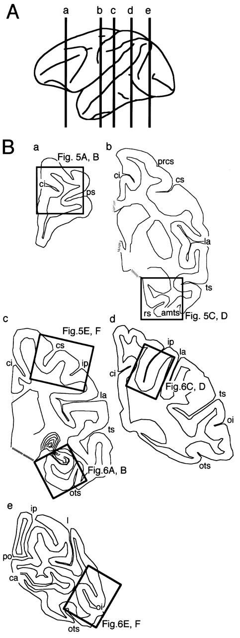
Figure 3. (A) The coronal sectioning levels shown in (B) are indicated by lowercase letters. (B) Line drawings of ...
Notes:
Figure 3. (A) The coronal sectioning levels shown in (B) are indicated by lowercase letters. (B) Line drawings of coronal sections through the anterior to the posterior levels of monkey brain. The regions that included the representative association areas (FD, TE and PG), the representative primary sensory (PB and OC) and motor areas (FA), the hippocampus, and the entorhinal cortex were selected for in situ hybridization histochemistry (boxes), and the results are shown in Figures 5 and 6. amts, anterior middle temporal sulcus; ca, calcarine sulcus; ci, cingulate sulcus; cs, central sulcus; ip, intraparietal sulcus; l, lunate sulcus; la, lateral fissure; oi, inferior occipital sulcus; ots, occipitotemporal sulcus; po, parieto-occipital sulcus; prcs, precentral sulcus; ps, principal sulcus; rs, rhinal sulcus; ts, temporal sulcus.
Unless provided in the caption above, the following copyright applies to the content of this slide: © Oxford University Press

Slide 4
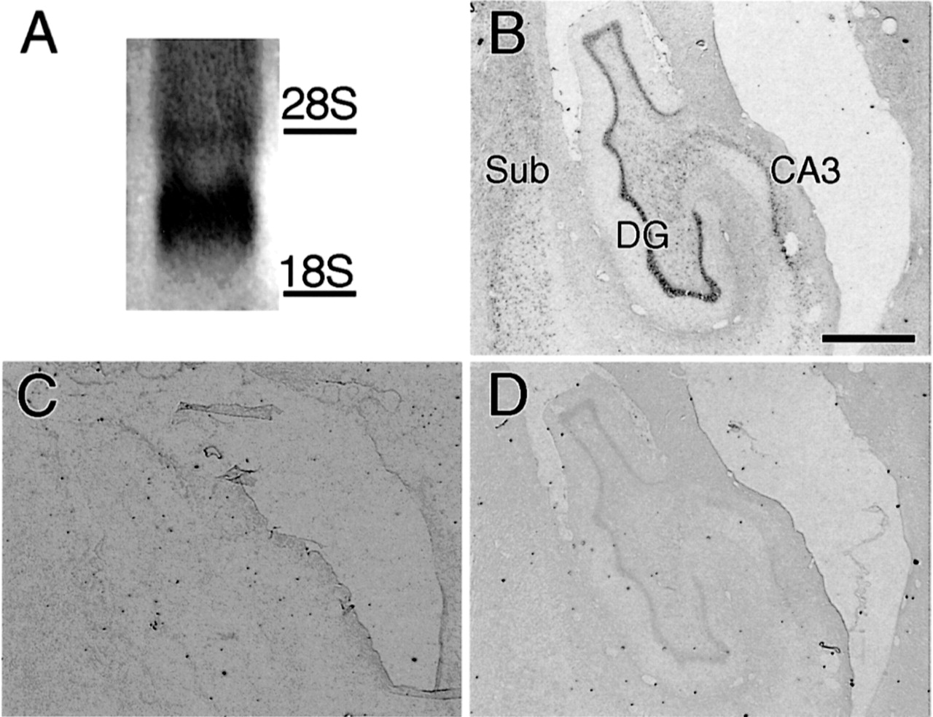
Figure 4. (A) Northern hybridization study to confirm probe specificity. The probe was hybridized to specific (2.6 and ...
Notes:
Figure 4. (A) Northern hybridization study to confirm probe specificity. The probe was hybridized to specific (2.6 and 4.7 kb) RNA transcripts. (B–D) Control experiments to confirm the specificity of the signals for MARCKS mRNA. Three adjacent coronal sections including the hippocampus are shown. Normal reactivities for MARCKS mRNA (B) produced positive hybridization signals. Only background signal levels were observed in the sections pretreated with ribonuclease A (C), and signals were dramatically reduced in the competition-control sections (D). Scale bar = 1 mm.
Unless provided in the caption above, the following copyright applies to the content of this slide: © Oxford University Press

Slide 5
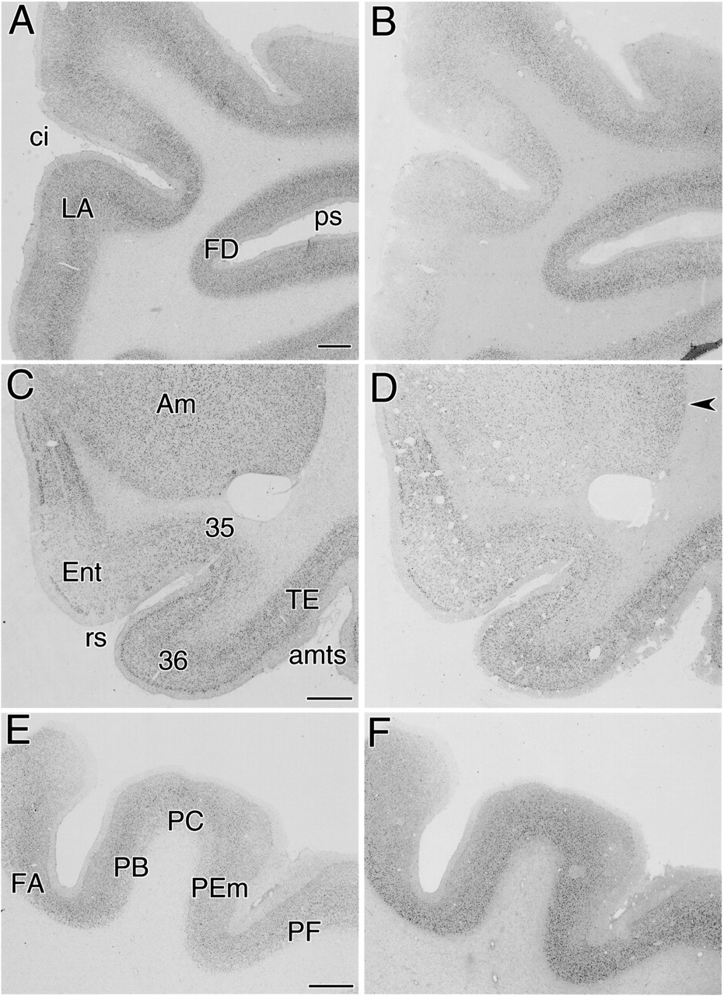
Figure 5. Photographs of Nissl-stained (A, C, E) and in situ hybridized sections (B, D, F) for the detection of MARCKS ...
Notes:
Figure 5. Photographs of Nissl-stained (A, C, E) and in situ hybridized sections (B, D, F) for the detection of MARCKS mRNA. (A, B) Sections including FD and LA (the cingulate area). (C, D) Sections including the amygdala, the entorhinal cortex, areas 35 and 36 (the perirhinal cortex), and TE. The arrowhead in (D) indicates hybridization signals in the lateral nucleus of the amygdala. (E, F) Sections including FA, PB, PC, PEm and PF. Abbreviations are the same as those in Figure 3. Scale bar = 1 mm.
Unless provided in the caption above, the following copyright applies to the content of this slide: © Oxford University Press

Slide 6
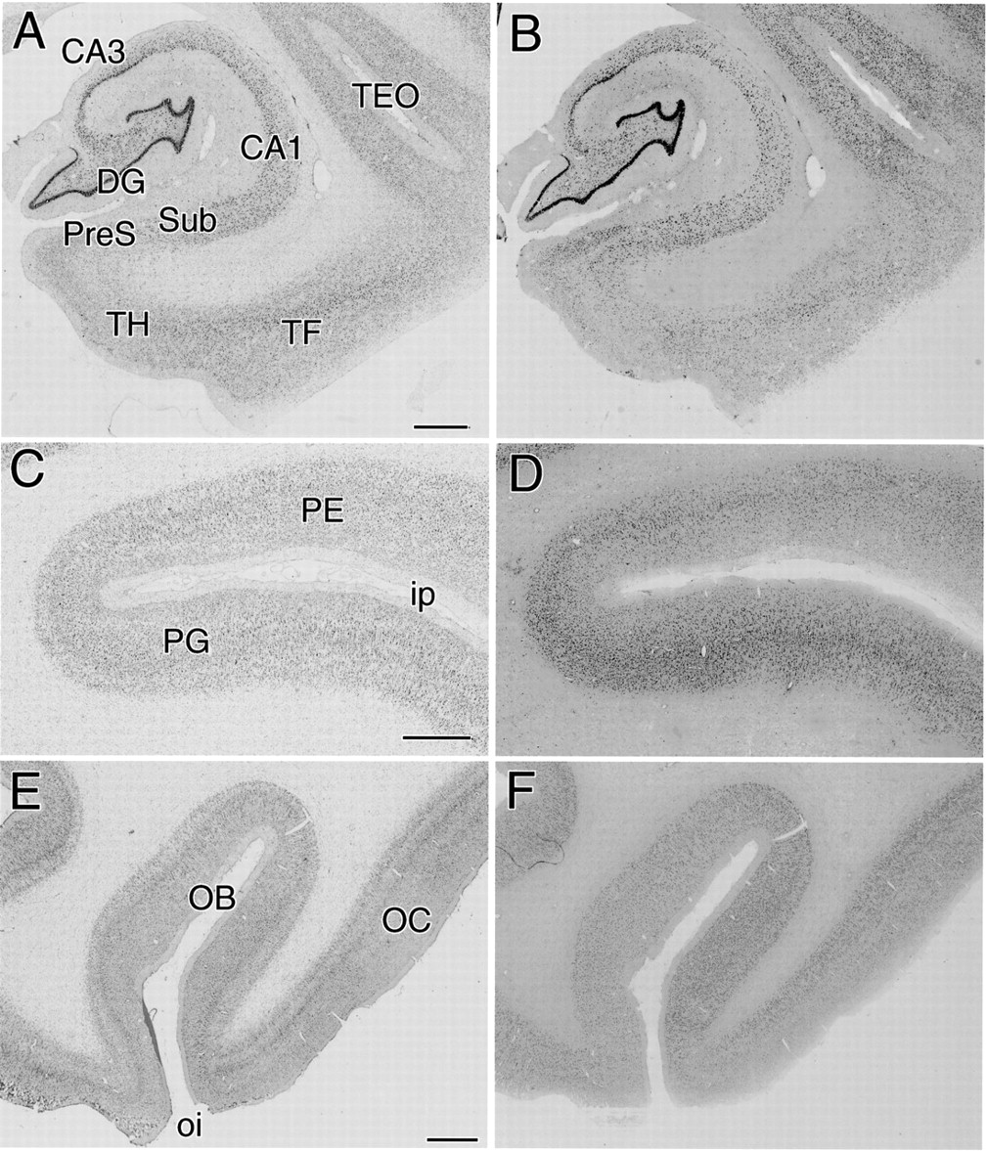
Figure 6. Photographs of Nissl-stained (A, C, E) and in situ hybridized (B, D, F) sections for the detection of MARCKS ...
Notes:
Figure 6. Photographs of Nissl-stained (A, C, E) and in situ hybridized (B, D, F) sections for the detection of MARCKS mRNA. (A, B) Sections including the dentate gyrus, Ammon's horn, subiculum, presubiculum, TF and TH (the parahippocampal cortex), and TEO. (C, D) Sections including PE and PG. (E, F) Sections including OB and OC. Abbreviations are the same as those in Figure 3. Scale bar = 1 mm.
Unless provided in the caption above, the following copyright applies to the content of this slide: © Oxford University Press

Slide 7
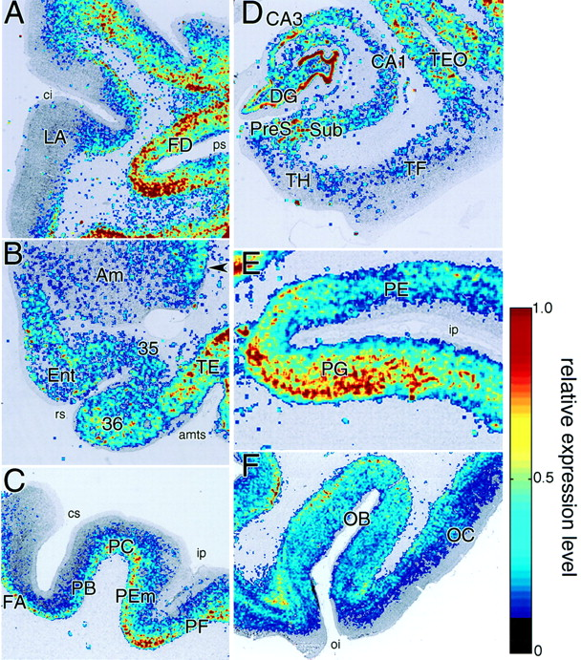
Figure 7. The relative expression levels of MARCKS mRNA in each coronal section of the cerebral cortex. The relative ...
Notes:
Figure 7. The relative expression levels of MARCKS mRNA in each coronal section of the cerebral cortex. The relative expression levels (0.1–1) of MARCKS mRNA were superimposed in pseudocolor on the digitized images of Nissl-stained sections (see Materials and Methods for details). (A) A section including FD and LA. (B) A section including the amygdala, entorhinal cortex, areas 35 and 36, and TE. The arrowhead indicates hybridization signals in the lateral nucleus of the amygdala. (C) A section including FA, PB, PC, PEm and PF. (D) A section including the dentate gyrus, Ammon's horn, subiculum, presubiculum, TF and TH, and TEO. (E) A section including PE and PG. (F) A section including both OB and OC. Abbreviations are the same as those in Figure 3. Scale bar = 1 mm.
Unless provided in the caption above, the following copyright applies to the content of this slide: © Oxford University Press

Slide 8
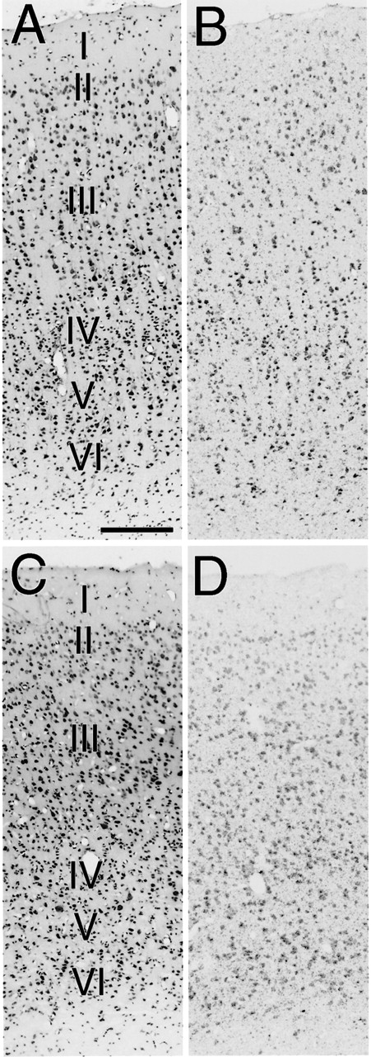
Figure 8. Photomicrographs of the association (FD, A, B) and primary (PB, C, D) areas. (A, C) Nissl-stained sections. ...
Notes:
Figure 8. Photomicrographs of the association (FD, A, B) and primary (PB, C, D) areas. (A, C) Nissl-stained sections. (B, D) Localization of MARCKS mRNA. In the association area, cells with intense hybridization signals were scattered almost equally in layers II–VI. In the primary area, cells with intense hybridization signals were more abundant in layers IV–VI than in layers I–III. Scale bar = 200 μm.
Unless provided in the caption above, the following copyright applies to the content of this slide: © Oxford University Press

Slide 9
Figure 9. (A) OD_{signal} – OD_{background} plotted against cortical depth in the association area ...
Notes:
Figure 9. (A) ODsignal – ODbackground plotted against cortical depth in the association area (FD). The measurements were performed on the same sections as in Figure 8A,B. (B) ODsignal – ODbackground plotted against cortical depth in the primary area (PB). The measurements were performed on the same sections as in Figure 8C,D. (C) The IIIOD/VOD ratios indicate the relative expression level of MARCKS mRNA between the outer pyramidal layer (layer III) and the inner pyramidal layer (layer V) (see Materials and Methods for detail). A Mann–Whitney U-test revealed a significant difference (P < 0.01) between the IIIOD/VOD ratio in the association area (FD) and that in the primary area (PB).
Unless provided in the caption above, the following copyright applies to the content of this slide: © Oxford University Press

Slide 10
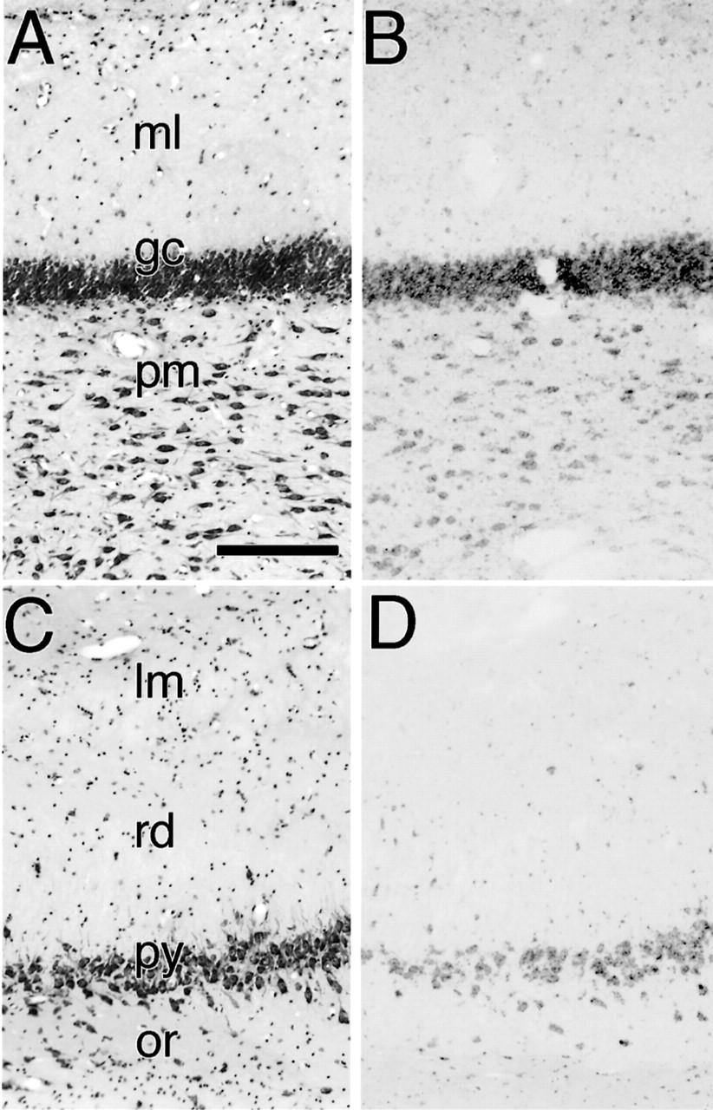
Figure 10. Photomicrographs of the dentate gyrus (A, B) and CA1 subfield of Ammon's horn (C, D). (A, C) Nissl-stained ...
Notes:
Figure 10. Photomicrographs of the dentate gyrus (A, B) and CA1 subfield of Ammon's horn (C, D). (A, C) Nissl-stained sections. (B, D) Localization of MARCKS mRNA. The most intense hybridization signals were observed in the granule cell layer of the dentate gyrus. gc, granule cell layer; lm, stratum lacunosum-moleculare; ml, molecular layer; or, stratum oriens; pm, polymorphic layer; py, pyramidal cell layer; rd, stratum radiatum. Scale bar = 100 μm.
Unless provided in the caption above, the following copyright applies to the content of this slide: © Oxford University Press

Slide 11
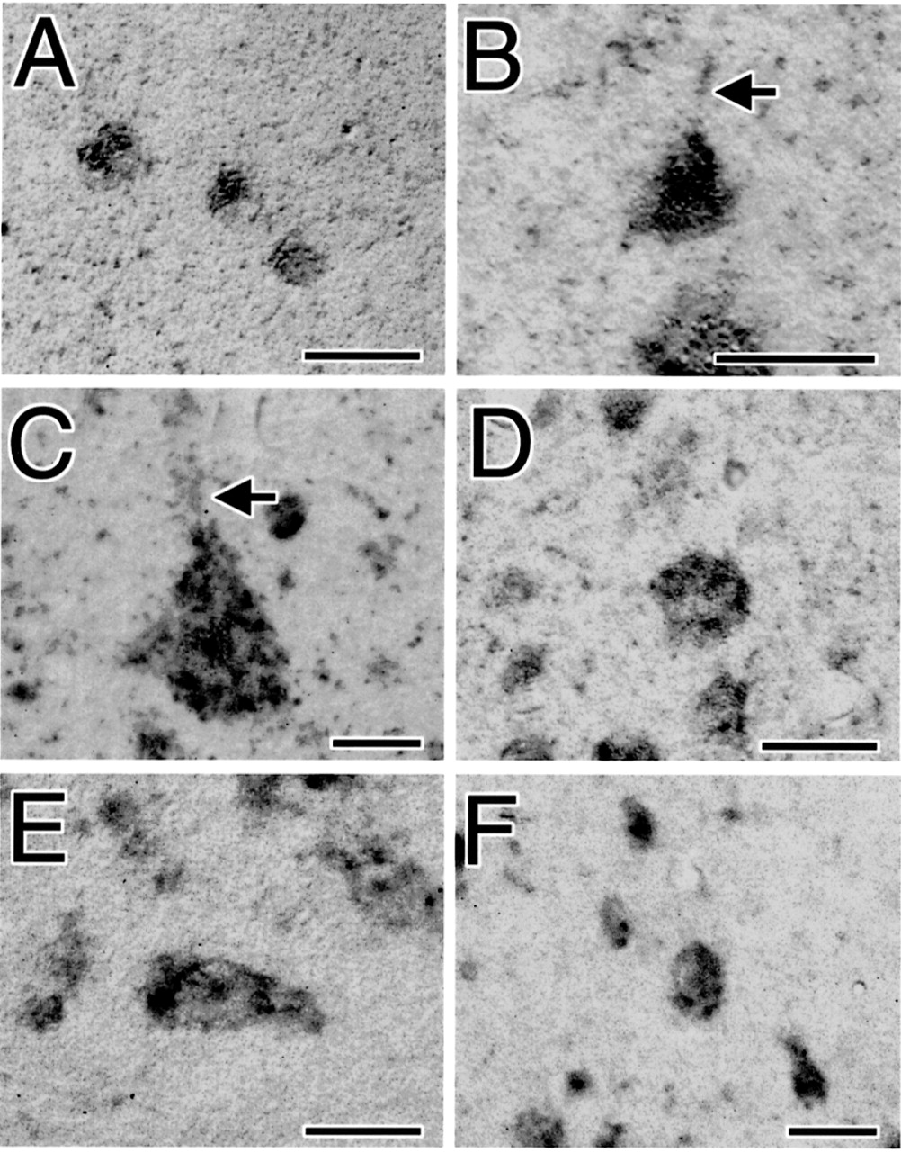
Figure 11. Nomarski-contrast photomicrographs of neurons with hybridization signals for MARCKS mRNA. (A) The small ...
Notes:
Figure 11. Nomarski-contrast photomicrographs of neurons with hybridization signals for MARCKS mRNA. (A) The small neurons in layer I of TE. (B) Pyramidal cell in layer V of TE. (C) Betz cell in layer V of FA. (D) Meynert cell in layer VI of OC. (E) The fusiform-shaped neuron in the stratum oriens of the CA3 subfield of Ammon's horn. (F) The small neurons in the stratum radiatum of the CA3 subfield of Ammon's horn. Arrows in (B) and (C) show the apical dendrites of the pyramidal cells. Scale bar = 20 μm.
Unless provided in the caption above, the following copyright applies to the content of this slide: © Oxford University Press

