Slide 1
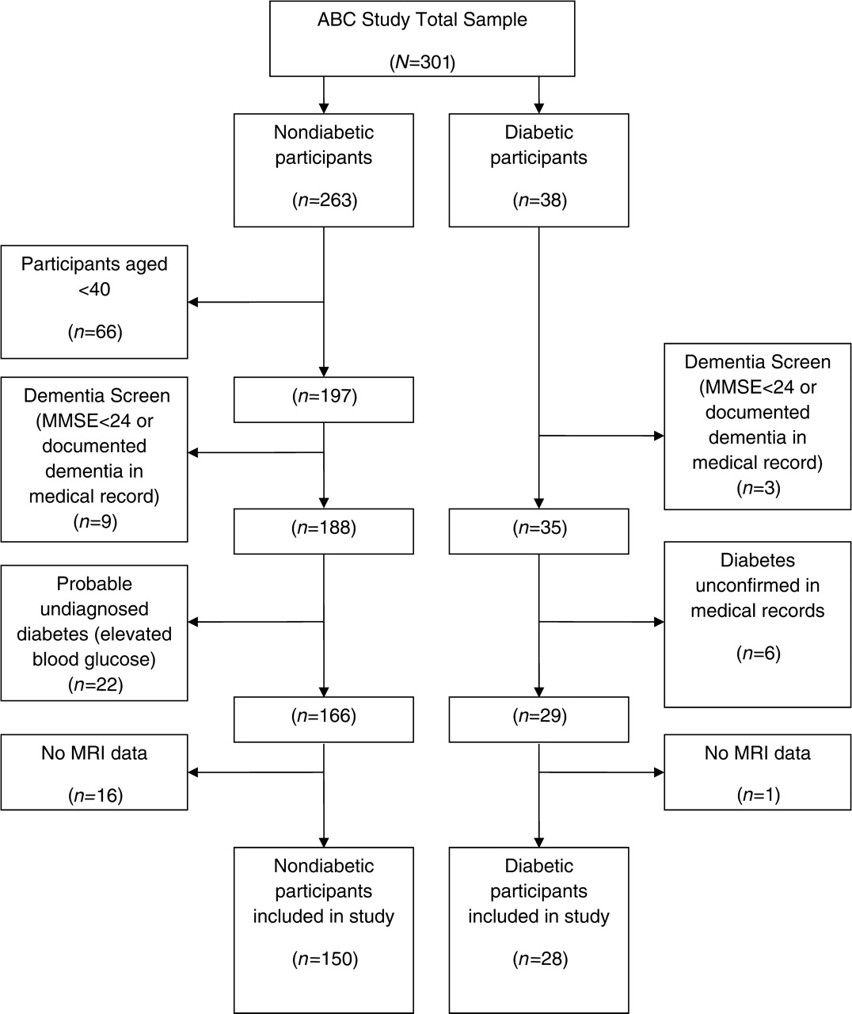
Fig. 1. Participant selection.
Notes:
Fig. 1. Participant selection.
Unless provided in the caption above, the following copyright applies to the content of this slide: © The Author 2009. Published by Oxford University Press. All rights reserved. For permissions, please e-mail: journals.permissions@oxfordjournals.org

