Slide 1
Figure 1. Example of a phenotype that includes other concepts nested within it.
Notes:
Figure 1. Example of a phenotype that includes other concepts nested within it.
Unless provided in the caption above, the following copyright applies to the content of this slide: © The Author(s) 2019. Published by Oxford University Press on behalf of the American Medical Informatics Association.This is an Open Access article distributed under the terms of the Creative Commons Attribution License (http://creativecommons.org/licenses/by/4.0/), which permits unrestricted reuse, distribution, and reproduction in any medium, provided the original work is properly cited.

Slide 2
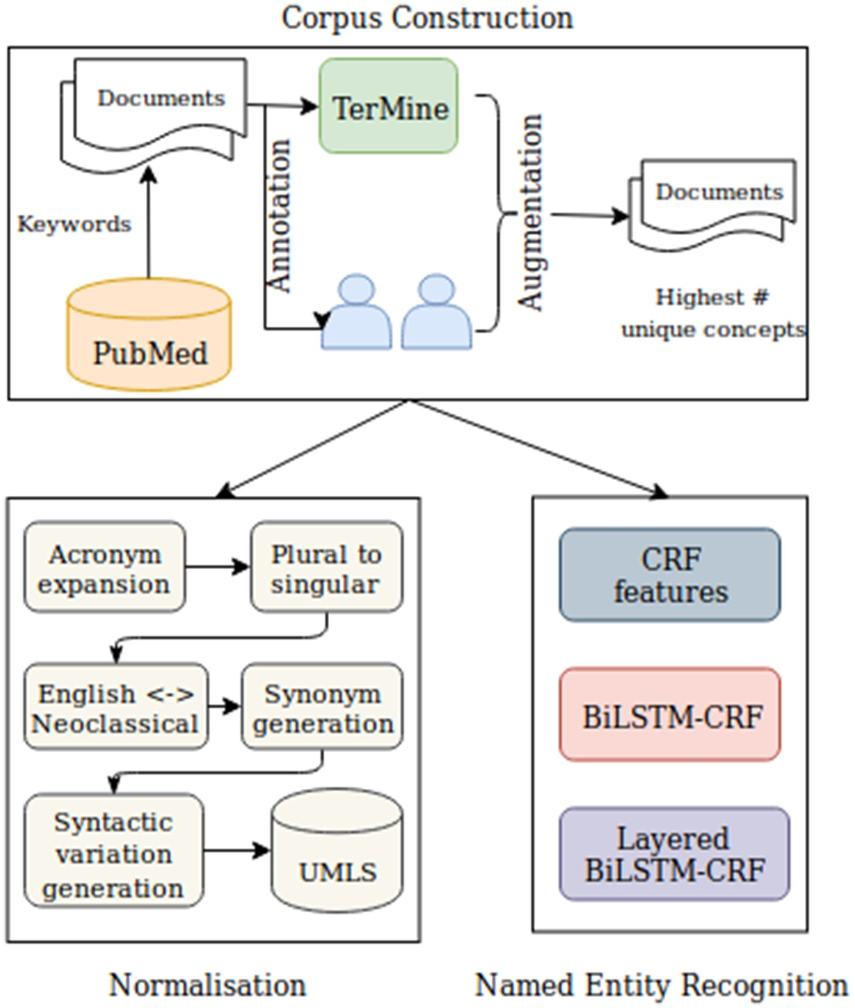
Figure 2. Workflow for annotation and detection of information relating to COPD phenotypes. COPD: chronic obstructive ...
Notes:
Figure 2. Workflow for annotation and detection of information relating to COPD phenotypes. COPD: chronic obstructive pulmonary disease; CRF: conditional random field.
Unless provided in the caption above, the following copyright applies to the content of this slide: © The Author(s) 2019. Published by Oxford University Press on behalf of the American Medical Informatics Association.This is an Open Access article distributed under the terms of the Creative Commons Attribution License (http://creativecommons.org/licenses/by/4.0/), which permits unrestricted reuse, distribution, and reproduction in any medium, provided the original work is properly cited.

Slide 3
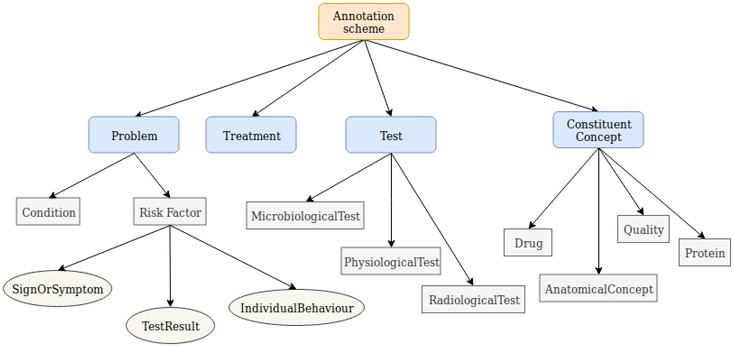
Figure 3. Hierarchical entity annotation scheme for COPD phenotypic information. COPD: chronic obstructive pulmonary ...
Notes:
Figure 3. Hierarchical entity annotation scheme for COPD phenotypic information. COPD: chronic obstructive pulmonary disease.
Unless provided in the caption above, the following copyright applies to the content of this slide: © The Author(s) 2019. Published by Oxford University Press on behalf of the American Medical Informatics Association.This is an Open Access article distributed under the terms of the Creative Commons Attribution License (http://creativecommons.org/licenses/by/4.0/), which permits unrestricted reuse, distribution, and reproduction in any medium, provided the original work is properly cited.

Slide 4
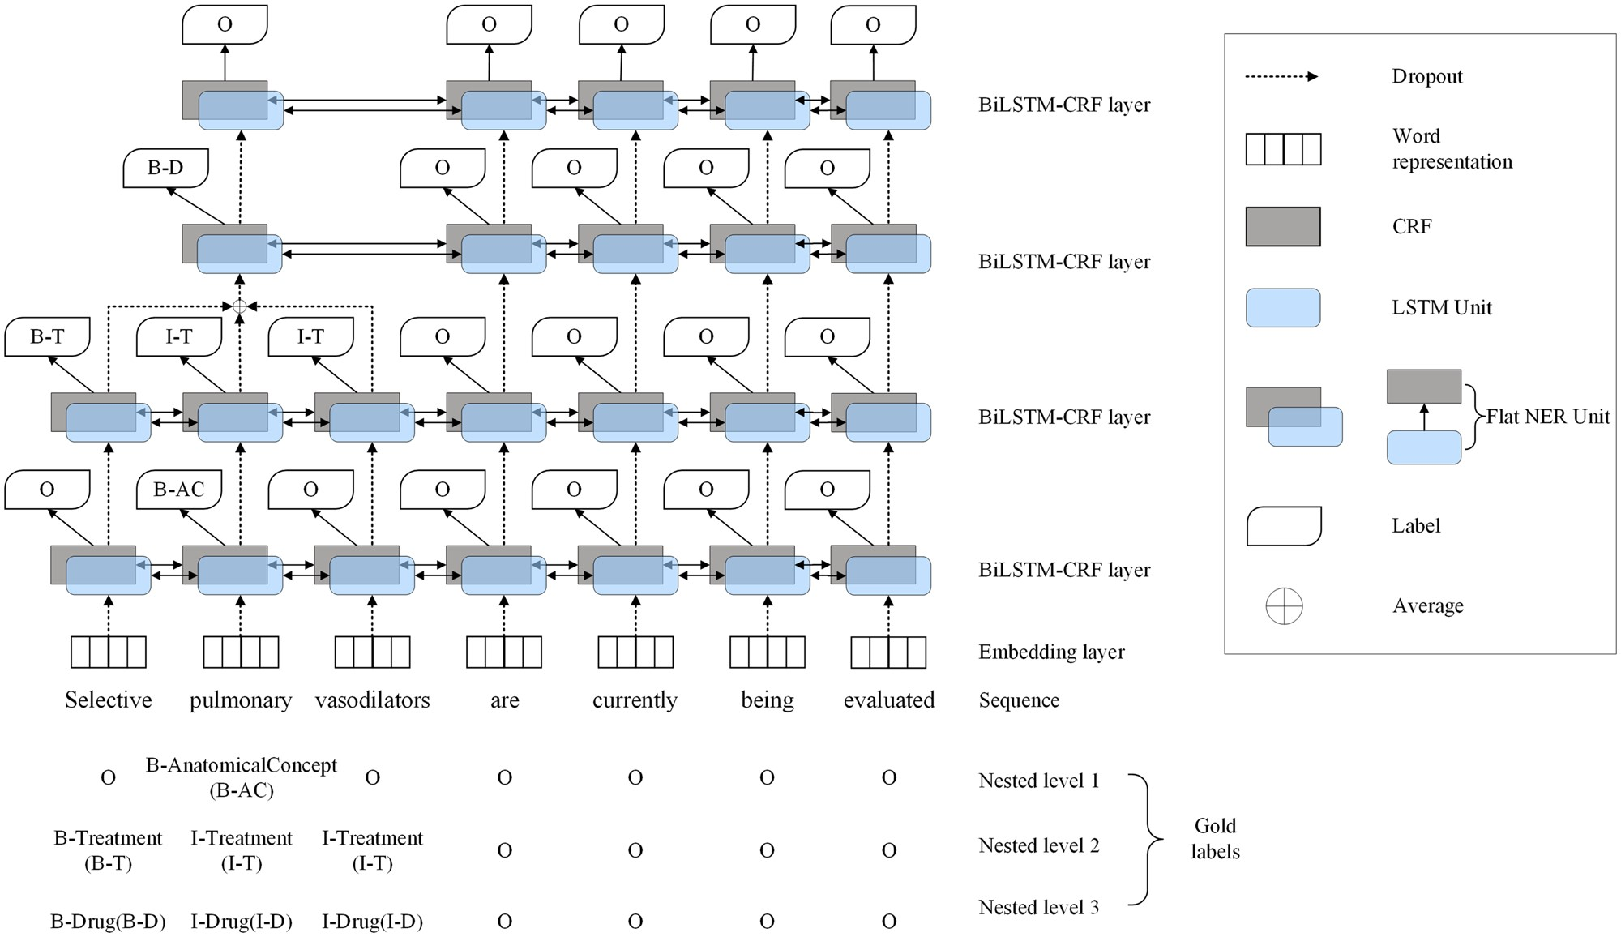
Figure 4. Overview of the layered-BiLSTM-CRF model architecture. B-AC: B-AnatomicalConcept; B-T: B-treatment; I-T: ...
Notes:
Figure 4. Overview of the layered-BiLSTM-CRF model architecture. B-AC: B-AnatomicalConcept; B-T: B-treatment; I-T: I-treatment; B-D: B-drug; I-D: I-drug.
Unless provided in the caption above, the following copyright applies to the content of this slide: © The Author(s) 2019. Published by Oxford University Press on behalf of the American Medical Informatics Association.This is an Open Access article distributed under the terms of the Creative Commons Attribution License (http://creativecommons.org/licenses/by/4.0/), which permits unrestricted reuse, distribution, and reproduction in any medium, provided the original work is properly cited.

Slide 5
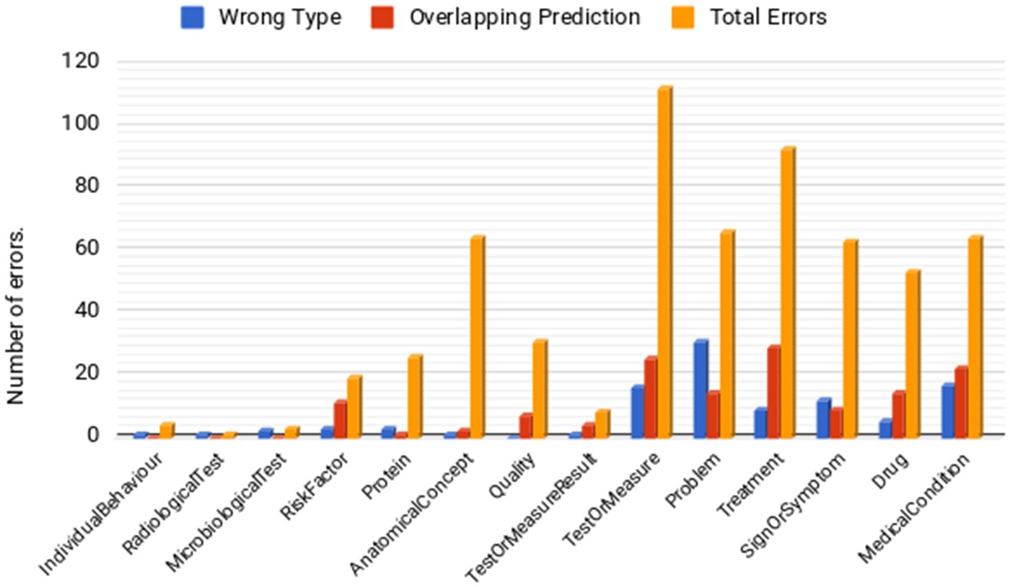
Figure 5. Counts of different types of errors for each semantic type.
Notes:
Figure 5. Counts of different types of errors for each semantic type.
Unless provided in the caption above, the following copyright applies to the content of this slide: © The Author(s) 2019. Published by Oxford University Press on behalf of the American Medical Informatics Association.This is an Open Access article distributed under the terms of the Creative Commons Attribution License (http://creativecommons.org/licenses/by/4.0/), which permits unrestricted reuse, distribution, and reproduction in any medium, provided the original work is properly cited.

