Slide 1
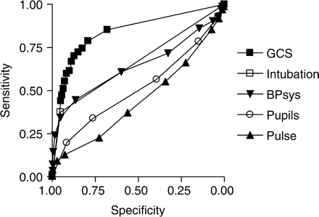
Figure 1. ROC plot for all OPs comparing the predictive value of GCS, pulse, blood pressure, pupil size and ...
Notes:
Figure 1. ROC plot for all OPs comparing the predictive value of GCS, pulse, blood pressure, pupil size and intubation.
Unless provided in the caption above, the following copyright applies to the content of this slide: © 2008 The AuthorsThis is an Open Access article distributed under the terms of the Creative Commons Attribution Non-Commercial License (<http://creativecommons.org/licenses/by-nc/2.0/uk/>) which permits unrestricted non-commercial use, distribution, and reproduction in any medium, provided the original work is properly cited.

Slide 2
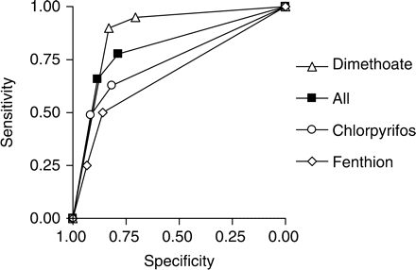
Figure 2. ROC plot of the IPCS PSS's variable ability to predict death for different OPs.
Notes:
Figure 2. ROC plot of the IPCS PSS's variable ability to predict death for different OPs.
Unless provided in the caption above, the following copyright applies to the content of this slide: © 2008 The AuthorsThis is an Open Access article distributed under the terms of the Creative Commons Attribution Non-Commercial License (<http://creativecommons.org/licenses/by-nc/2.0/uk/>) which permits unrestricted non-commercial use, distribution, and reproduction in any medium, provided the original work is properly cited.

Slide 3
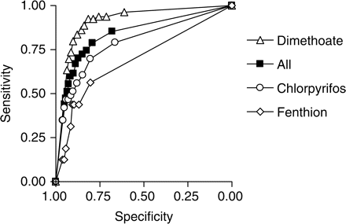
Figure 3. ROC plot comparing the ability of GCS to predict outcome for different OPs.
Notes:
Figure 3. ROC plot comparing the ability of GCS to predict outcome for different OPs.
Unless provided in the caption above, the following copyright applies to the content of this slide: © 2008 The AuthorsThis is an Open Access article distributed under the terms of the Creative Commons Attribution Non-Commercial License (<http://creativecommons.org/licenses/by-nc/2.0/uk/>) which permits unrestricted non-commercial use, distribution, and reproduction in any medium, provided the original work is properly cited.

Slide 4
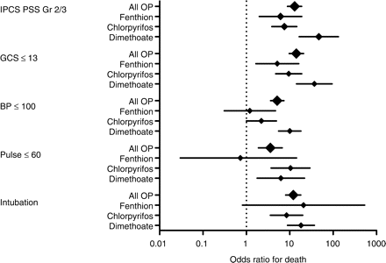
Figure 4. Plot of the odds ratios for the best cut offs for the IPCS PSS, GCS, systolic BP, pulse and intubation in the ...
Notes:
Figure 4. Plot of the odds ratios for the best cut offs for the IPCS PSS, GCS, systolic BP, pulse and intubation in the different OPs.
Unless provided in the caption above, the following copyright applies to the content of this slide: © 2008 The AuthorsThis is an Open Access article distributed under the terms of the Creative Commons Attribution Non-Commercial License (<http://creativecommons.org/licenses/by-nc/2.0/uk/>) which permits unrestricted non-commercial use, distribution, and reproduction in any medium, provided the original work is properly cited.

Slide 5
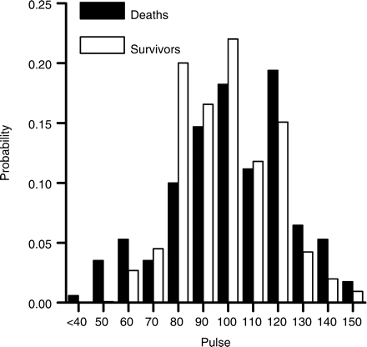
Figure 5. Histogram of the pulse on admission in survivors and deaths.
Notes:
Figure 5. Histogram of the pulse on admission in survivors and deaths.
Unless provided in the caption above, the following copyright applies to the content of this slide: © 2008 The AuthorsThis is an Open Access article distributed under the terms of the Creative Commons Attribution Non-Commercial License (<http://creativecommons.org/licenses/by-nc/2.0/uk/>) which permits unrestricted non-commercial use, distribution, and reproduction in any medium, provided the original work is properly cited.

