Slide 1
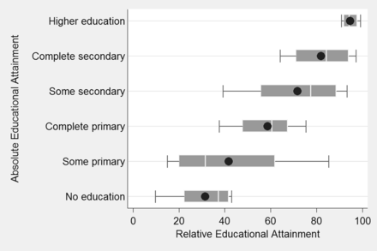
Figure 1 Box plots of the distribution of immigrants’ relative educational attainment in each category of absolute ...
Notes:
Figure 1 Box plots of the distribution of immigrants’ relative educational attainment in each category of absolute educational attainment. Sources: Barro-Lee (2010) and TeO (INED, 2008-2009); calculations by the author. Note: Box plots represent the 10th, 25th, 50th 75th, and 90th percentiles and the mean (black circle) of immigrants’ relative educational attainment in each category of absolute educational attainment.
Unless provided in the caption above, the following copyright applies to the content of this slide: © The Author 2014. Published by Oxford University Press. All rights reserved. For permissions, please e-mail: journals.permissions@oup.com

Slide 2
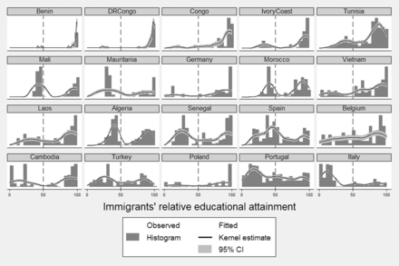
Figure 2 Immigrants’ relative educational attainment distributions in each country of origin. Sources: Barro-Lee ...
Notes:
Figure 2 Immigrants’ relative educational attainment distributions in each country of origin. Sources: Barro-Lee (2010) and TeO (INED, 2008–2009); calculations by the author. Note: In each country graph, the space from 0 to 50, on the left of the dashed vertical bar, represents negative educational selectivity (from 0 to 50 per cent of the population of the same age and gender is less educated than the immigrant) and the space from 50 to 100, on the right of the dashed vertical bar, represents positive educational selectivity (from 50 to 100 per cent of the population of the same age and gender is less educated than the immigrant).
Unless provided in the caption above, the following copyright applies to the content of this slide: © The Author 2014. Published by Oxford University Press. All rights reserved. For permissions, please e-mail: journals.permissions@oup.com

Slide 3
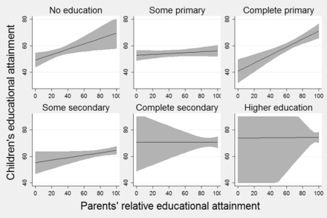
Figure 3 Adjusted predictions of children’s educational attainment at varying values of parents’ relative educational ...
Notes:
Figure 3 Adjusted predictions of children’s educational attainment at varying values of parents’ relative educational attainment in each category of parents’ absolute educational attainment (from Model 6, in Table 2). Sources: Barro and Lee (2010) and TeO (INED, 2008–2009); calculations by the author. Note: All the other covariates are held at their mean.
Unless provided in the caption above, the following copyright applies to the content of this slide: © The Author 2014. Published by Oxford University Press. All rights reserved. For permissions, please e-mail: journals.permissions@oup.com

