Slide 1
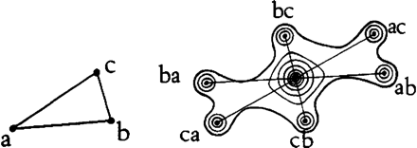
Figure 1 Patterson map (right) of a simple triangular structure (left). The letter pairs in the Patterson map ...
Notes:
Figure 1 Patterson map (right) of a simple triangular structure (left). The letter pairs in the Patterson map correspond to the respective interatomic distances in the original structure. Notice that, although the Patterson contains information about the interatomic distances, the positional information is entirely removed in the Patterson map: all vectors relate to the origin. By kind permission reprinted from Taylor ([1967]).
Unless provided in the caption above, the following copyright applies to the content of this slide: © Oxford University Press 2008

Slide 2
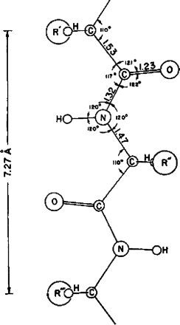
Figure 2 PCB's alpha helix including bond angles and distances. To be discussed in the next section. Reproduced with ...
Notes:
Figure 2 PCB's alpha helix including bond angles and distances. To be discussed in the next section. Reproduced with kind permission from R. B. Corey, L. Pauling, “Fundamental Dimensions of Polypeptide Chains”, Proceedings of the Royal Society of London. Series B, Biological Sciences (1934–1990), Volume 141, Number 902/March 11, 1953, pp. 10–20.
Unless provided in the caption above, the following copyright applies to the content of this slide: © Oxford University Press 2008

Slide 3
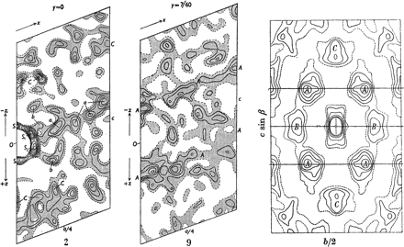
Figure 3 Rod-like structures of high vector density in the Patterson maps of Haemoglobin. Map 2 exhibits a shell-like ...
Notes:
Figure 3 Rod-like structures of high vector density in the Patterson maps of Haemoglobin. Map 2 exhibits a shell-like structure at the origin marked S and an attached rod parallel to the x-axis with high vector peaks separated by 5.1 Å denoted by a. Map 9 shows a pair of rod-like structures (A–A). Reproduced with kind permission from Fig 2, p. 480; Fig. 9, p. 481; Fig 21, p. 485 of Perutz, M.F., “An X-Ray Study of Horse Methaemoglobin. II”, Proceedings of the Royal Society of London. Series A, Mathematical and Physical Sciences (1934–1990), Volume 195, Number 1043/February 03, 1949, pp. 474–99.
Unless provided in the caption above, the following copyright applies to the content of this slide: © Oxford University Press 2008

Slide 4
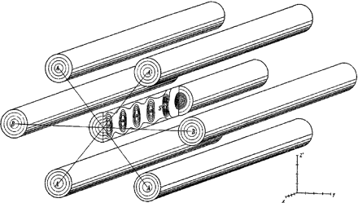
Figure 4 Inferred underlying structure from the Patterson maps in Figure 3, also known as the ‘hat-box’ model. ...
Notes:
Figure 4 Inferred underlying structure from the Patterson maps in Figure 3, also known as the ‘hat-box’ model. Reproduced with kind permission from Fig. 22, p. 487 of Perutz, M.F., “An X-Ray Study of Horse Methaemoglobin. II”, Proceedings of the Royal Society of London. Series A, Mathematical and Physical Sciences (1934–1990), Volume 195, Number 1043/February 03, 1949, pp. 474–99.
Unless provided in the caption above, the following copyright applies to the content of this slide: © Oxford University Press 2008

Slide 5
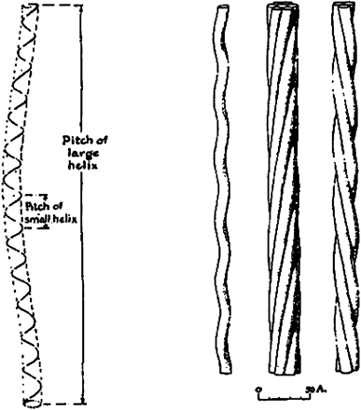
Figure 5 The coiled coil. Single helices (left) are packed together into superhelical cables and ropes (right). ...
Notes:
Figure 5 The coiled coil. Single helices (left) are packed together into superhelical cables and ropes (right). Reprinted by permission from Macmillan Publishers Ltd: Nature (vol. 171, no. 4341; pp. 59–61), copyright (1953).
Unless provided in the caption above, the following copyright applies to the content of this slide: © Oxford University Press 2008

Slide 6
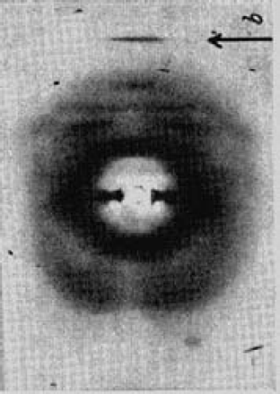
Figure 6 Perutz's recording of the 1.5 Å spot (marked by a reversed b at the top of the picture).³⁸ Due to ...
Notes:
Figure 6 Perutz's recording of the 1.5 Å spot (marked by a reversed b at the top of the picture).38 Due to the tilting of the specimen the reflection appears only on one side (here: the upper side) of the photograph. Reprinted by permission from Macmillan Publishers Ltd: Nature (no. 4276; pp. 653–4), copyright (1951).
Unless provided in the caption above, the following copyright applies to the content of this slide: © Oxford University Press 2008

Slide 7
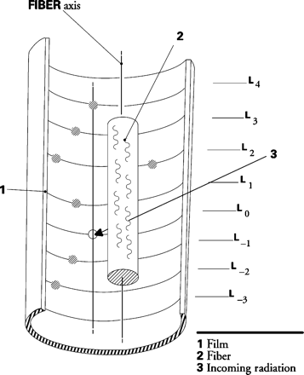
Figure 7 Rotation photograph. The specimen is mounted vertically. The spots fall onto the layer lines of the film ...
Notes:
Figure 7 Rotation photograph. The specimen is mounted vertically. The spots fall onto the layer lines of the film marked by Li. Figure adapted from (Mathews et al. [2000]).
Unless provided in the caption above, the following copyright applies to the content of this slide: © Oxford University Press 2008

Slide 8
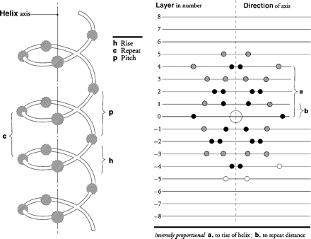
Figure 8 Schematic drawing of a helix (left) and CCV's x-ray pattern prediction of such a helix (right). Notice the ...
Notes:
Figure 8 Schematic drawing of a helix (left) and CCV's x-ray pattern prediction of such a helix (right). Notice the reciprocal relationship between the parameters of the helix (repeat, rise, pitch) and the predicted x-ray pattern. Also, compare the prediction with the B form in Figure 9. Figure adapted from (Mathews et al. [2000]).
Unless provided in the caption above, the following copyright applies to the content of this slide: © Oxford University Press 2008

Slide 9
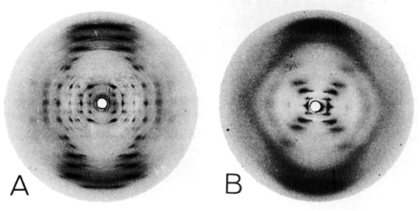
Figure 9 X-ray photographs of the A (‘crystalline’) and the B (‘wet’) form of DNA (see Franklin and Gosling [1953a], ...
Notes:
Figure 9 X-ray photographs of the A (‘crystalline’) and the B (‘wet’) form of DNA (see Franklin and Gosling [1953a], Figures 1 and 4). Whereas the A form contains sharp spots the B form exhibits a cross of smudges. Both forms display meridional absences of reflections and strong black arcs on the top and the bottom of the photograph (A: 2.8 Å; B: 3.4 Å). Reproduced from Franklin, R. and R. Gosling (1953a), ‘The Structure of Sodium-Thymonucleate Fibres I. The Influence of water content', Acta Crystallographica, 6, p. 673.
Unless provided in the caption above, the following copyright applies to the content of this slide: © Oxford University Press 2008

Slide 10
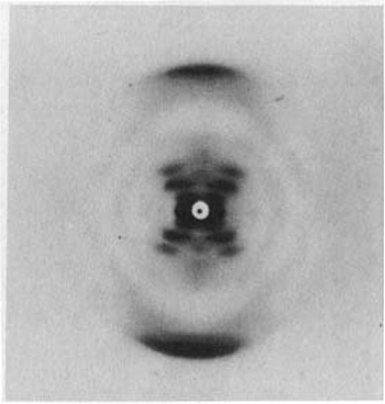
Figure 10 Beighton's B form pattern.⁴⁴ Compare with pattern B in Figure 9. From (Olby [1994]).
Notes:
Figure 10 Beighton's B form pattern.44 Compare with pattern B in Figure 9. From (Olby [1994]).
Unless provided in the caption above, the following copyright applies to the content of this slide: © Oxford University Press 2008

