Slide 1
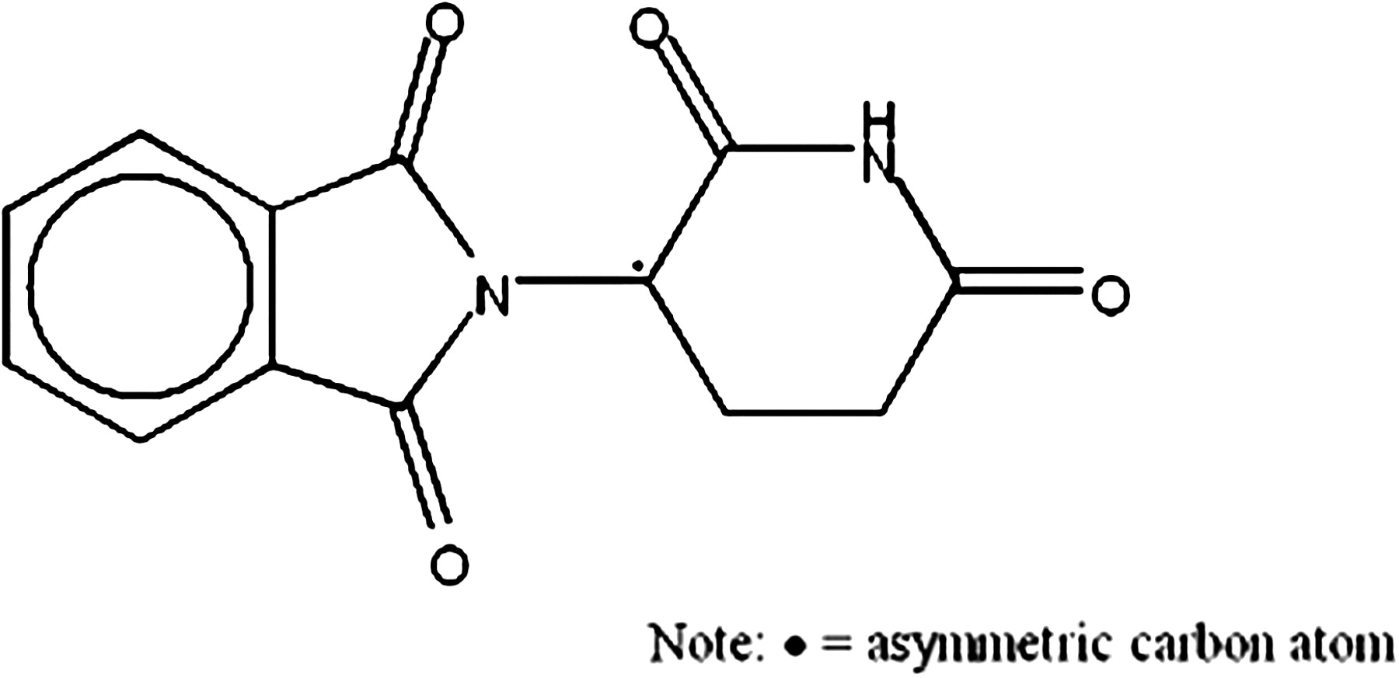
FIG. 1. Structure of thalidomide.
Notes:
FIG. 1. Structure of thalidomide.
Unless provided in the caption above, the following copyright applies to the content of this slide: © The Author 2011. Published by Oxford University Press on behalf of the Society of Toxicology. All rights reserved. For permissions, please email: journals.permissions@oup.com

Slide 2
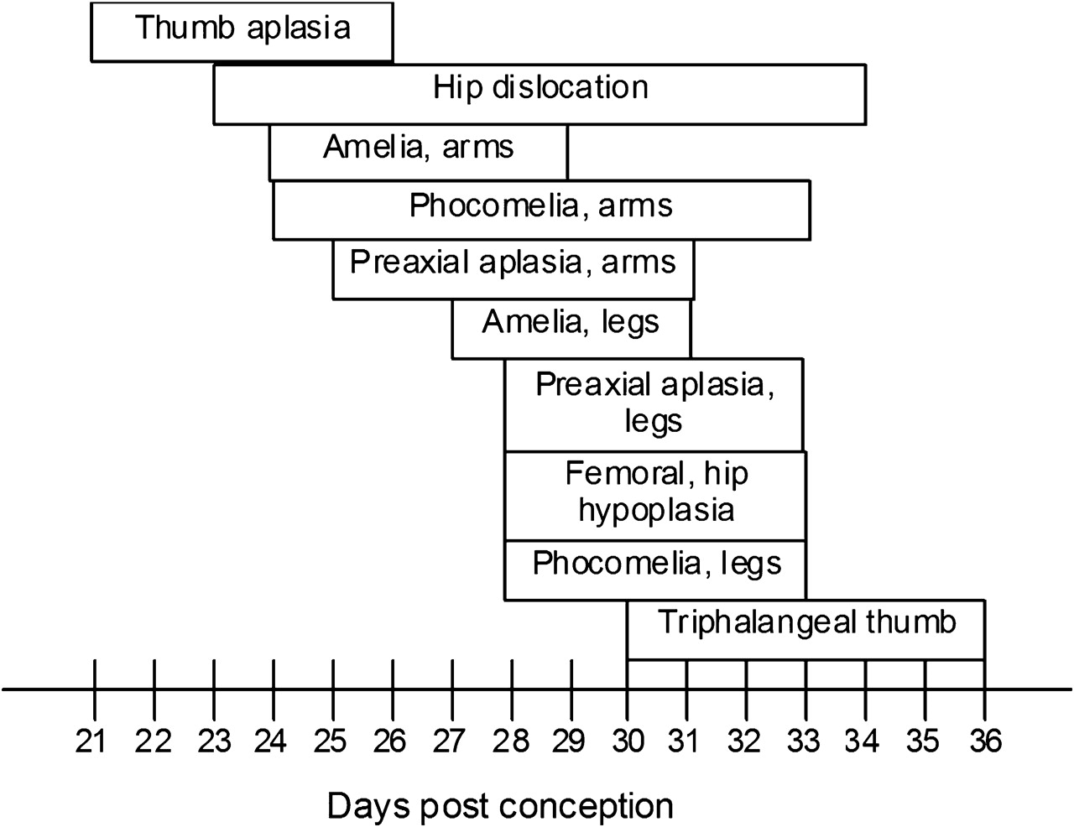
FIG. 3. Critical exposure periods for thalidomide embryopathy during human development.
Notes:
FIG. 3. Critical exposure periods for thalidomide embryopathy during human development.
Unless provided in the caption above, the following copyright applies to the content of this slide: © The Author 2011. Published by Oxford University Press on behalf of the Society of Toxicology. All rights reserved. For permissions, please email: journals.permissions@oup.com

Slide 3
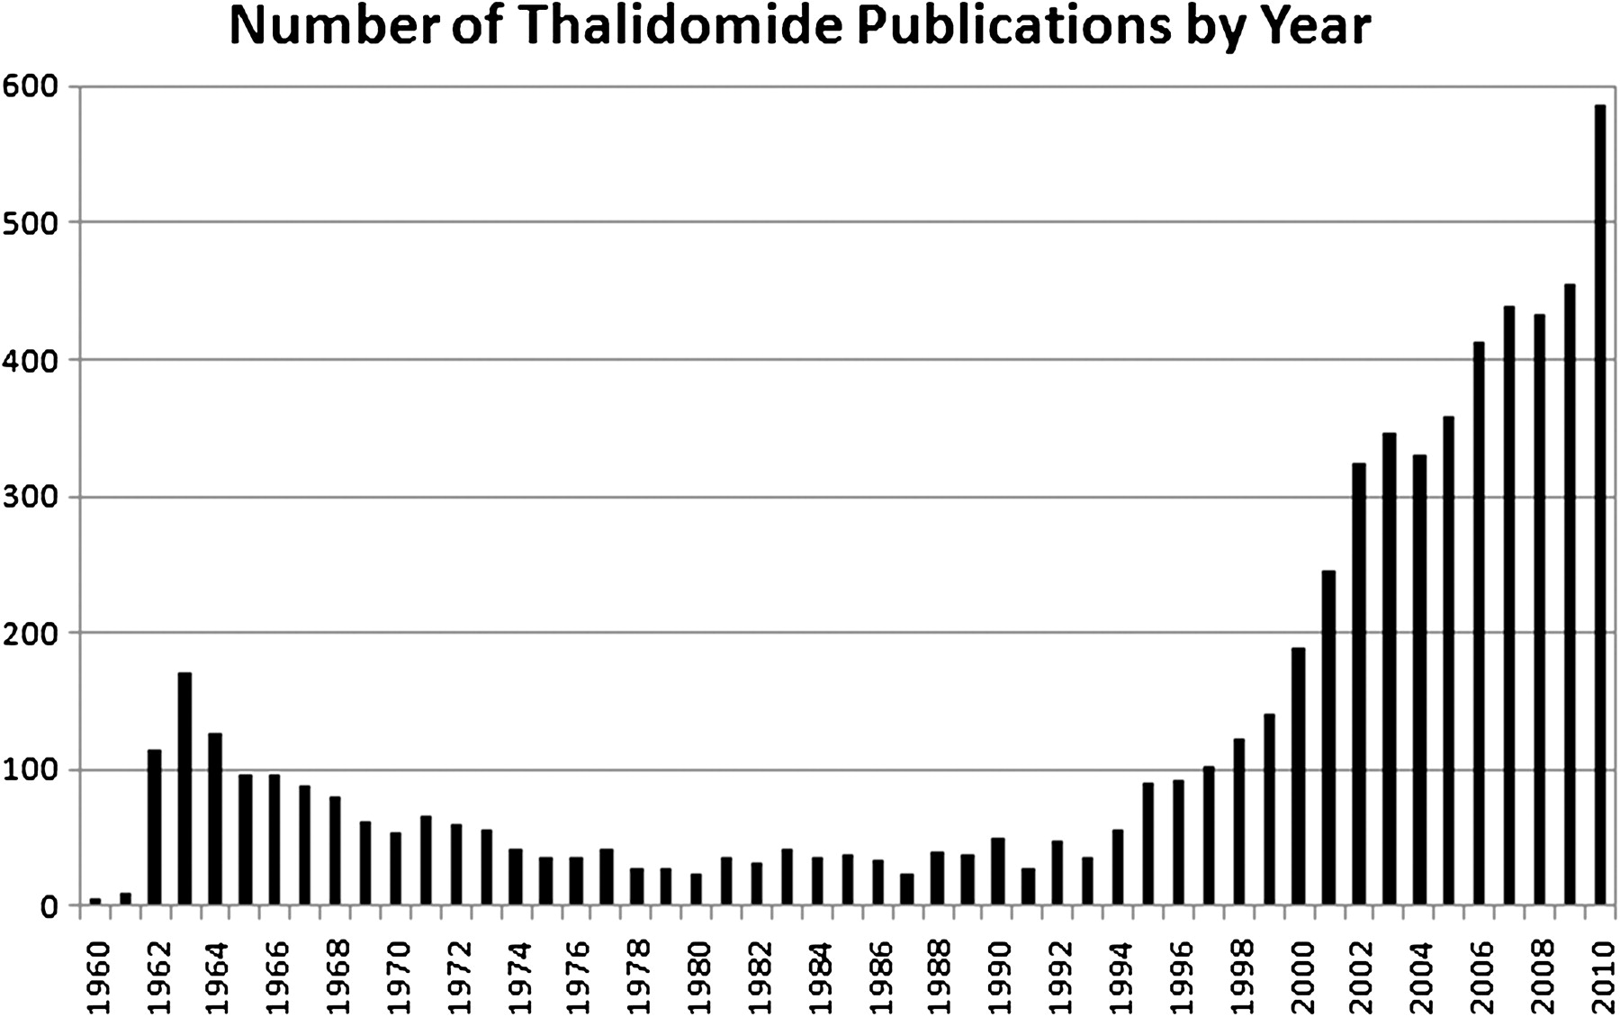
FIG. 2. Number of PubMed entries for thalidomide publications by year (searched on 12/27/2010).
Notes:
FIG. 2. Number of PubMed entries for thalidomide publications by year (searched on 12/27/2010).
Unless provided in the caption above, the following copyright applies to the content of this slide: © The Author 2011. Published by Oxford University Press on behalf of the Society of Toxicology. All rights reserved. For permissions, please email: journals.permissions@oup.com

