Slide 1
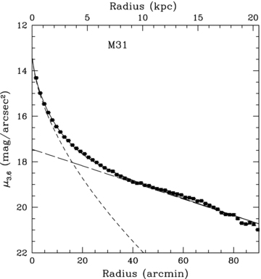
Figure 1 The Spitzer 3.6-μm surface brightness profile of M31 (without correction for inclination) with decomposition ...
Notes:
Figure 1 The Spitzer 3.6-μm surface brightness profile of M31 (without correction for inclination) with decomposition into bulge and disc components. The bulge has been fitted with a Sérsic model (short-dashed line) and the disc has been fitted with an exponential model (long-dashed line).
Unless provided in the caption above, the following copyright applies to the content of this slide: © 2008 The Authors. Journal compilation © 2008 RAS

Slide 2
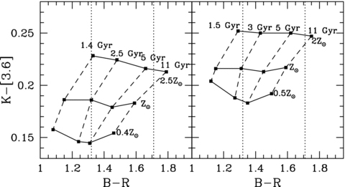
Figure 2 K-[3.6] colour as a function of B−R colour for BC03 population synthesis models (left-hand panel) and M05 ...
Notes:
Figure 2 K-[3.6] colour as a function of B−R colour for BC03 population synthesis models (left-hand panel) and M05 population synthesis models (right-hand panel). In both the cases, dashed lines represent a constant age stellar population and solid lines represent constant metallicity. The dotted lines represent the typical B−R colour of the inner disc (B−R= 1.79) and the outer disc (B−R= 1.40) from Walterbos & Kennicutt (1987).
Unless provided in the caption above, the following copyright applies to the content of this slide: © 2008 The Authors. Journal compilation © 2008 RAS

Slide 3
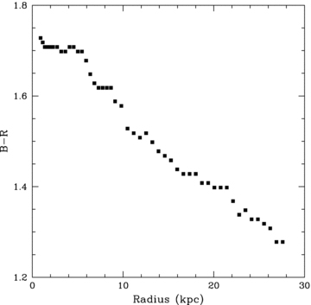
Figure 3 B−R colour profile for M31 from Walterbos & Kennicutt (1987) corrected for foreground Galactic extinction.
Notes:
Figure 3 B−R colour profile for M31 from Walterbos & Kennicutt (1987) corrected for foreground Galactic extinction.
Unless provided in the caption above, the following copyright applies to the content of this slide: © 2008 The Authors. Journal compilation © 2008 RAS

Slide 4
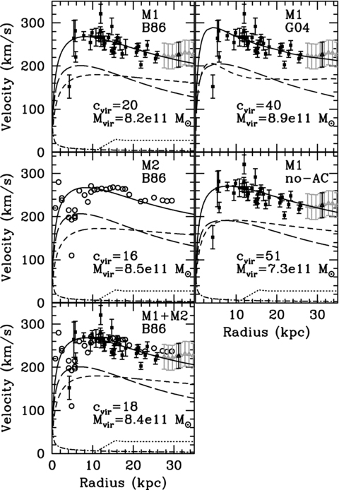
Figure 4 Top left-hand panel: rotation curve data (solid square points) from Rubin & Ford (1970) with the best-fitting ...
Notes:
Figure 4 Top left-hand panel: rotation curve data (solid square points) from Rubin & Ford (1970) with the best-fitting model, with AC (M1 B86 model), overlaid (solid line). For comparison, the H i rotation velocities (grey open triangles) from Carignan et al. (2006) are shown (the black point corresponds to the average velocity and radius of the Carignan data that we make use of). The best-fitting rotation curve is decomposed into four components, the contribution from dark matter (short-dashed line), the contribution from baryonic matter (long-dashed line), the H i contribution (dotted line) from Carignan et al. (2006) and the contribution from the central 108M⊙ black hole (dot–dashed line) from Bender et al. (2005). Middle left-hand panel: rotation curve CO and H i data (solid square points) from Loinard et al. (1995) and Brinks & Burton (1984), respectively, as used by Klypin et al. (2002). The best-fitting model with AC (M2 B86 model) is overlaid (solid line). It is decomposed into four components as in the top left-hand panel. Bottom left-hand panel: rotation curve data from Rubin & Ford (1970, solid points) and Carignan et al. (2006, triangles) and the data as used by Klypin et al. (2002, hollow circles), with AC model (M1+M2 B86), overlaid. Top right-hand panel: the same as the top left-hand panel, but with the best-fitting model using a modified version of AC (M1 G04 model) as in G04. The long-dashed curve includes the total baryonic mass, including the H i mass and the central black hole. Middle right-hand panel: the same as the top left-hand panel, but with the best-fitting model without an adiabatically contracted halo (M1 no-AC model). In all five cases, the NFW concentration, cvir, and virial mass, Mvir, are shown.
Unless provided in the caption above, the following copyright applies to the content of this slide: © 2008 The Authors. Journal compilation © 2008 RAS

Slide 5
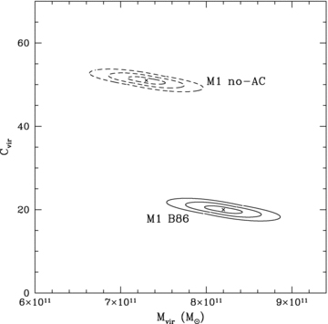
Figure 5 Virial mass as a function of NFW concentration from our modelling with our 1, 2 and 3σ confidence contours ...
Notes:
Figure 5 Virial mass as a function of NFW concentration from our modelling with our 1, 2 and 3σ confidence contours shown as solid lines for our ‘M1 B86’ model and as dashed lines for our ‘M1 no-AC’.
Unless provided in the caption above, the following copyright applies to the content of this slide: © 2008 The Authors. Journal compilation © 2008 RAS

Slide 6
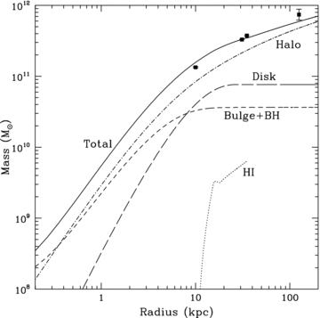
Figure 6 Enclosed mass as a function of radius for model M1 B86. The solid line indicates the total mass. Also ...
Notes:
Figure 6 Enclosed mass as a function of radius for model M1 B86. The solid line indicates the total mass. Also indicated are the H i mass out to a 35 kpc radius (dotted line), the bulge + BH mass (short-dashed line), the disc mass (long-dashed line) and the halo mass (dot–dashed line). The data points indicate masses derived using other observational methods at fixed radii of 10, 31, 35 and 125 kpc from Rubin & Ford (1970), Evans & Wilkinson (2000), Carignan et al. (2006) and Fardal et al. (2006), respectively.
Unless provided in the caption above, the following copyright applies to the content of this slide: © 2008 The Authors. Journal compilation © 2008 RAS

Slide 7
Figure 1 Left-hand panel: a two-armed spiral viewed face-on with pitch angle P=24°.7, as predicted for M31. Centre ...
Notes:
Figure 1 Left-hand panel: a two-armed spiral viewed face-on with pitch angle P=24°.7, as predicted for M31. Centre panel: a spiral with pitch angle P=24°.7, viewed with the inclination and position angle of M31. Right-hand panel: 24-μm Spitzer image of M31 from Gordon et al. (2006).
Unless provided in the caption above, the following copyright applies to the content of this slide: © 2008 The Authors. Journal compilation © 2008 RAS

