Slide 1
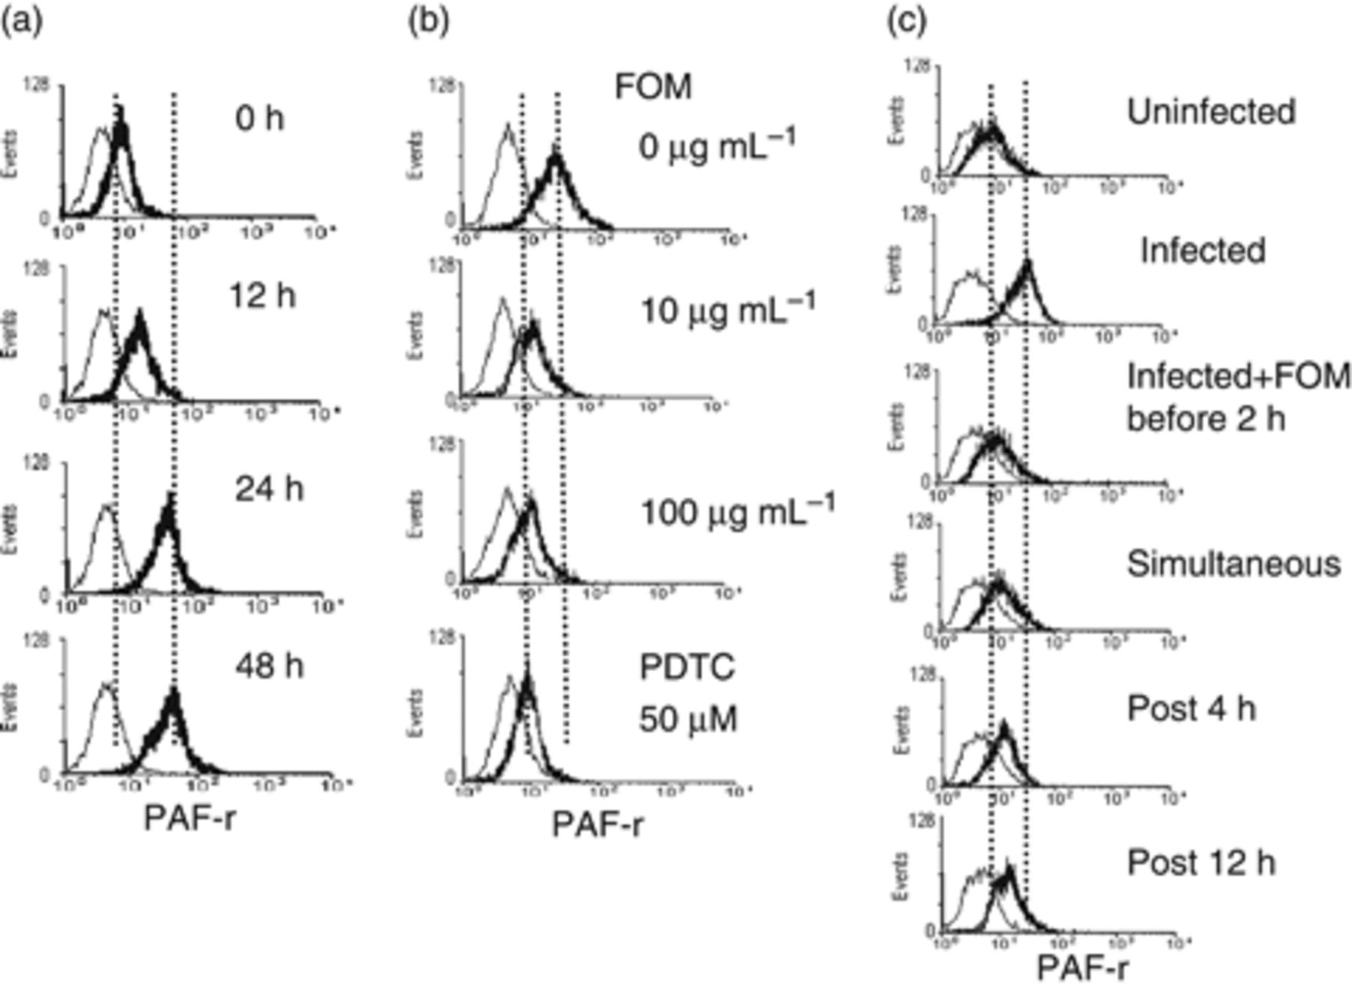
1 Upregulation of the PAF receptor (PAF-r) by RSV infection in A549 cells, as determined by flow cytometry (a). ...
Notes:
1 Upregulation of the PAF receptor (PAF-r) by RSV infection in A549 cells, as determined by flow cytometry (a). Suppression of RSV-induced PAF-r expression by fosfomycin (b and c). (a) A549 cells were infected with the RSV strain Long at MOI 1. After infection at the time indicated, the cells were collected and then stained with an anti-PAF-r antibody and a phycoerythrin-labeled anti-mouse IgG antibody (thick lines). The stained cells were analyzed by flow cytometry. Thin lines indicate cells stained with an unrelated isotype control antibody instead of the anti-PAF-r antibody. (b) Dose dependence of fosfomycin. Two hours before RSV infection, fosfomycin or PDTC was added at the indicated concentration. After a 24-h infection, the expression levels of the PAF-r were determined by flow cytometry as in (a). PDTC, an NF-κB inhibitor, was used as a control. (c) Fosfomycin treatment schedule. Two hours before, simultaneously with, or 4 or 12 h after RSV infection, fosfomycin was added at a concentration of 100 μg mL−1. After 24 h of infection, the expression level of the PAF-r was analyzed by flow cytometry as in (a).
Unless provided in the caption above, the following copyright applies to the content of this slide: © 2010 Federation of European Microbiological Societies Published by Blackwell Publishing Ltd. All rights reserved

Slide 2
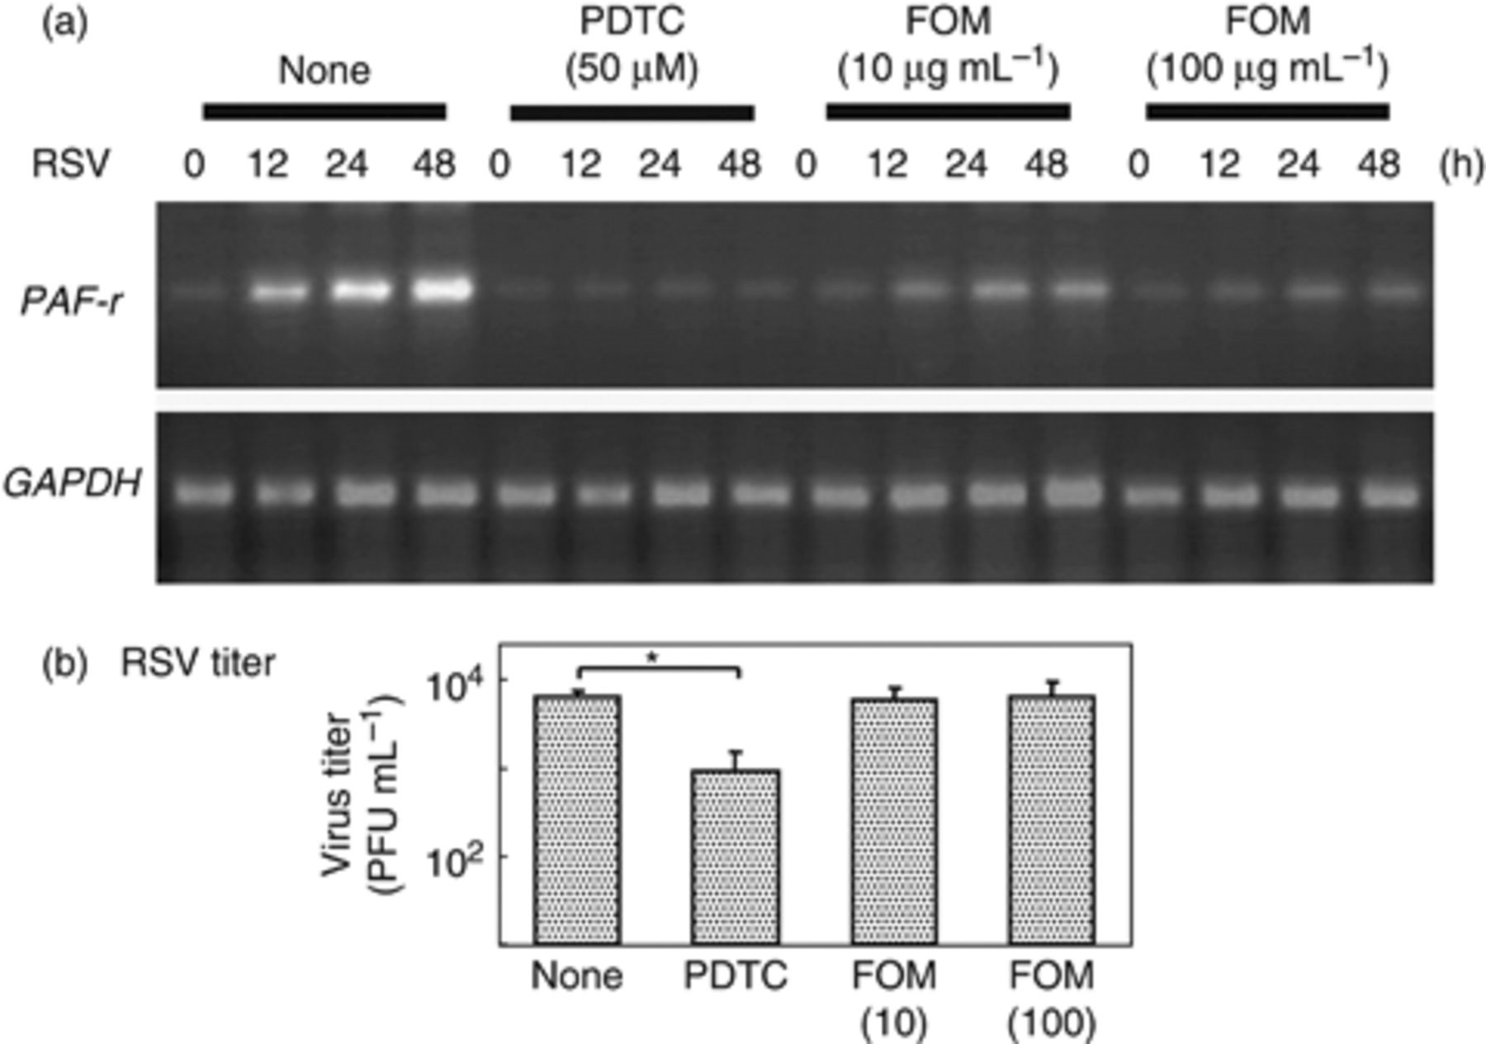
2 Suppression of RSV-induced PAF receptor mRNA expression by fosfomycin (FOM) in A549 cells, as determined by ...
Notes:
2 Suppression of RSV-induced PAF receptor mRNA expression by fosfomycin (FOM) in A549 cells, as determined by RT-PCR. (a) RT-PCR. Two hours before RSV infection, FOM or PDTC was added to cultured A549 cells. PDTC, an NF-κB inhibitor, was used as a positive control for suppression. The cells were infected with RSV strain Long at MOI 1. Total RNA was isolated from cells collected at the indicated times after infection. PAF receptor mRNA (PAF-r) levels were determined by RT-PCR. Glyceraldehyde-3-phosphate dehydrogenase (GAPDH) mRNA levels were determined as controls. (b) Virus titer of RSV. Culture supernatants were collected at 24 h after RSV infection as above. The RSV titer in the culture supernatant was determined by a plaque-forming assay.
Unless provided in the caption above, the following copyright applies to the content of this slide: © 2010 Federation of European Microbiological Societies Published by Blackwell Publishing Ltd. All rights reserved

Slide 3
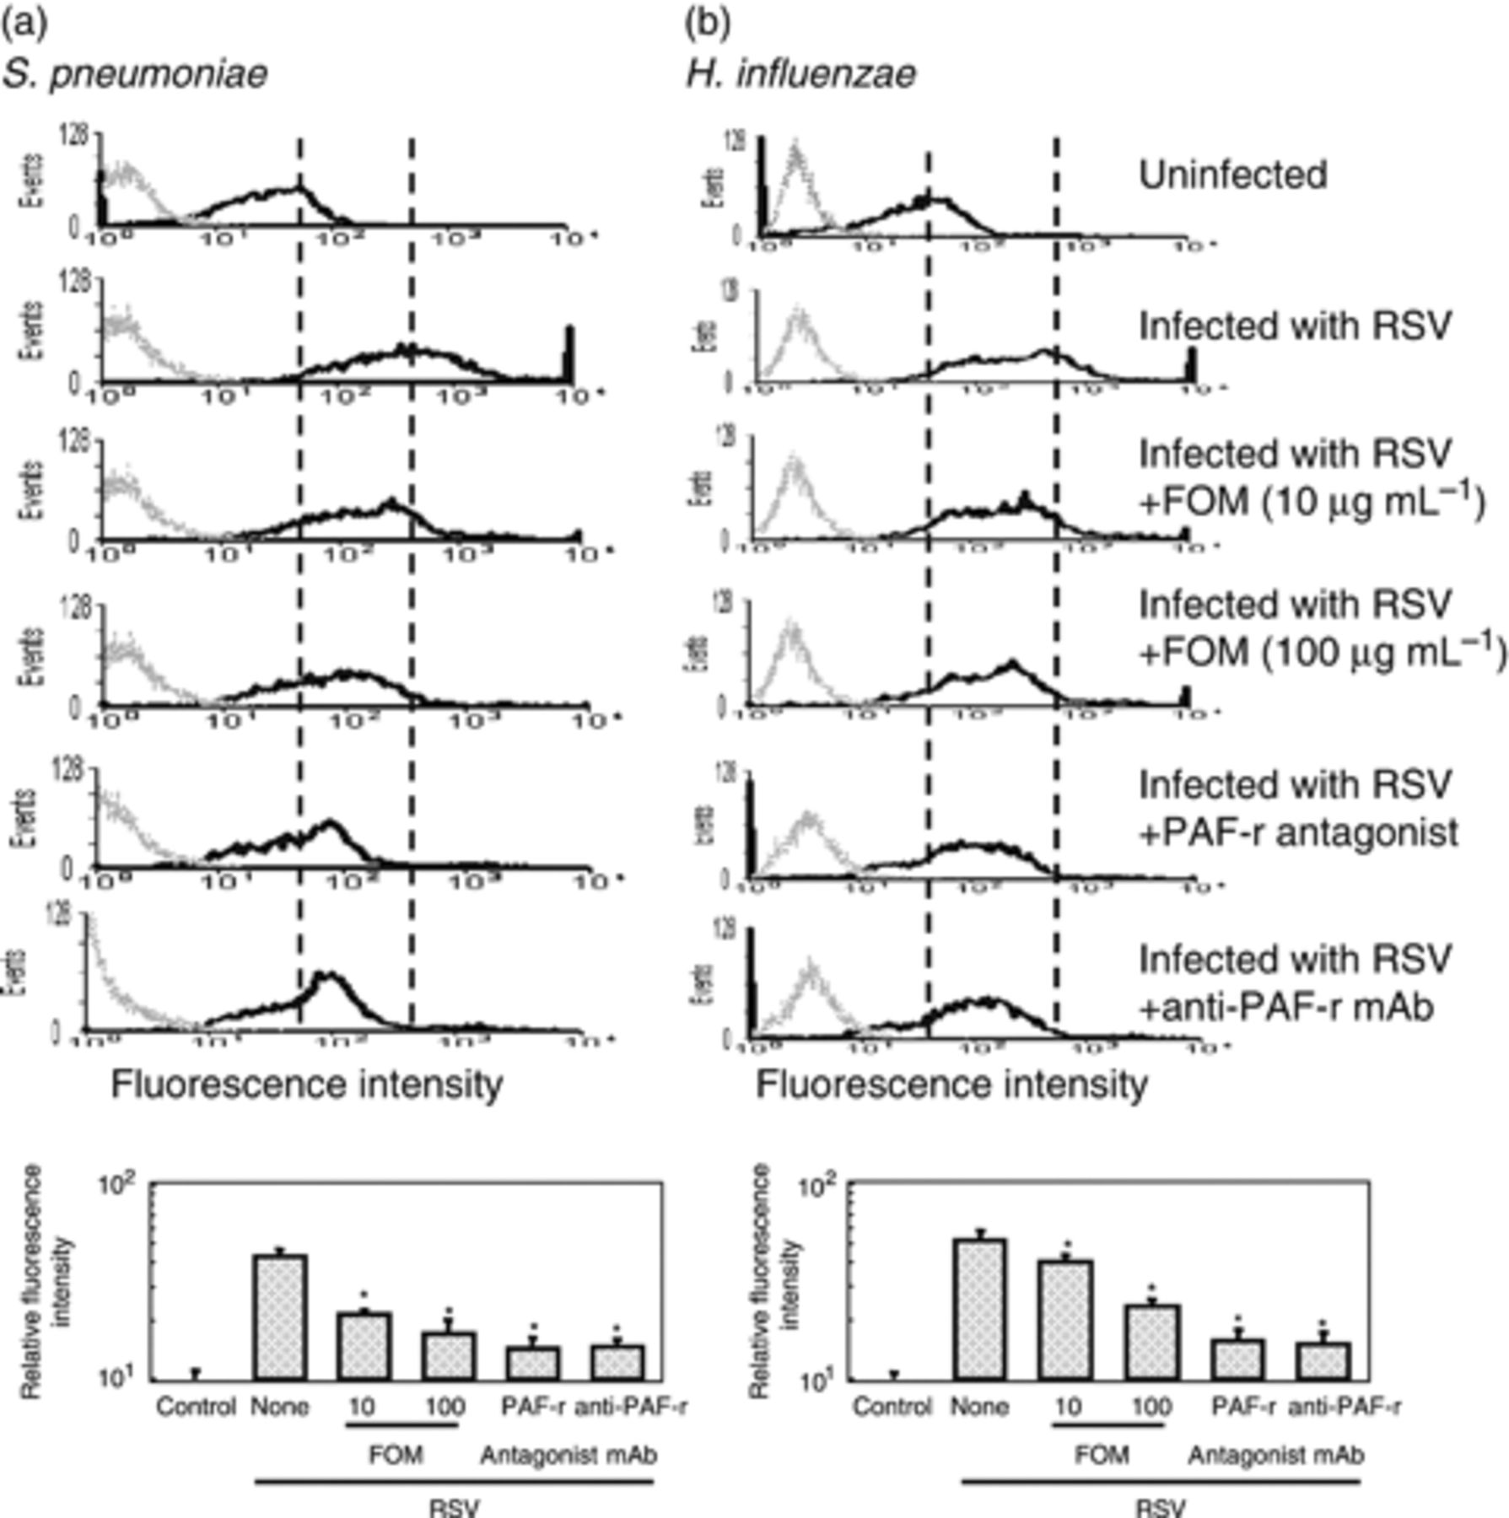
3 Suppression by fosfomycin (FOM) of RSV-induced adhesion to A549 cells of FITC-labeled Streptococcus ...
Notes:
3 Suppression by fosfomycin (FOM) of RSV-induced adhesion to A549 cells of FITC-labeled Streptococcus pneumoniae (a) and Haemophilus influenzae (b), as determined by flow cytometry. Two hours before RSV infection, FOM (10 or 100 μg mL−1), PAF receptor (PAF-r) antagonist (20 μg mL−1), or anti-PAF-r monoclonal antibody (10 μg mL−1) was added to cultured A549 cells. The cells were infected with RSV strain Long at MOI 1. After a 24-h infection, FITC-labeled bacterial cells were added to the cell monolayer at MOI 10, and incubation was continued at 37°C for 30 min. The adhered labeled bacteria were detected by flow cytometry (black lines). Gray lines indicate cells incubated with unlabeled bacteria. Each experiment was performed in triplicate. The mean fluorescence intensity was estimated and the relative value to the mean fluorescence intensity of RSV-uninfected cells incubated with FITC-labeled bacteria was calculated. Graph presents the mean of relative fluorescence intensity±SD. *Statistically significant (P <0.01) from RSV-infected cells without the addition of any inhibitory agents (none).
Unless provided in the caption above, the following copyright applies to the content of this slide: © 2010 Federation of European Microbiological Societies Published by Blackwell Publishing Ltd. All rights reserved

Slide 4
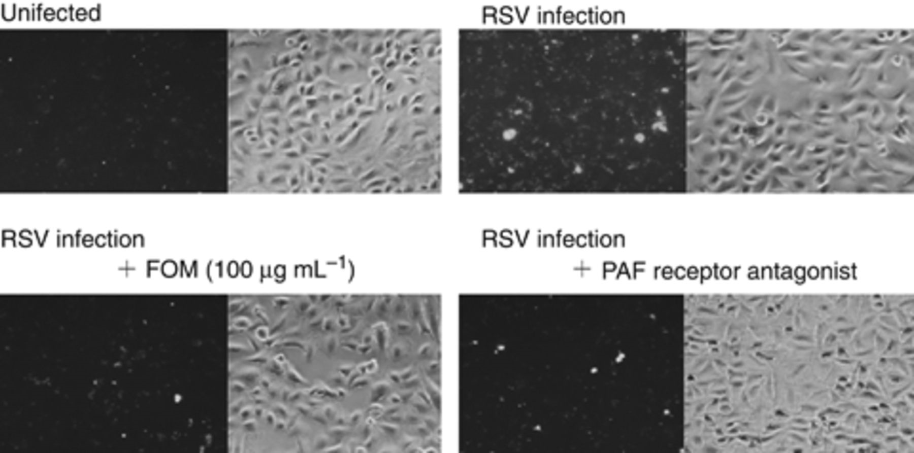
4 Suppression by fosfomycin (FOM) of RSV-induced adhesion to A549 cells of FITC-labeled Streptococcus ...
Notes:
4 Suppression by fosfomycin (FOM) of RSV-induced adhesion to A549 cells of FITC-labeled Streptococcus pneumoniae adhesion, as observed by fluorescence microscopy. RSV infection, treatment with inhibitors, and incubation with FITC-labeled bacteria were the same as in Fig. 3. Bacteria adhering to the A549 cell monolayer were visualized by fluorescence microscopy. Left photo in each image pair, fluorescence microscopy; right photo, phase-contrast microscopy.
Unless provided in the caption above, the following copyright applies to the content of this slide: © 2010 Federation of European Microbiological Societies Published by Blackwell Publishing Ltd. All rights reserved

Slide 5
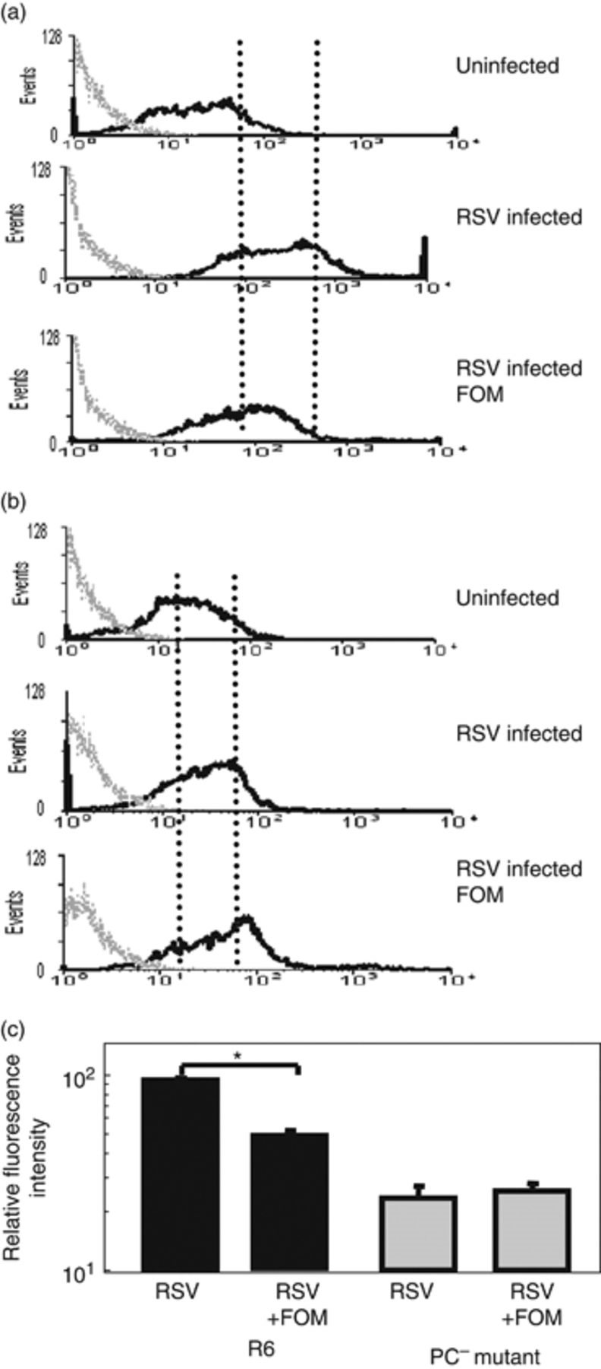
5 Effect of fosfomycin (FOM) of RSV-induced adhesion to A549 cells of FITC-labeled Streptococcus pneumoniae ...
Notes:
5 Effect of fosfomycin (FOM) of RSV-induced adhesion to A549 cells of FITC-labeled Streptococcus pneumoniae cells of strain R6 (a) and its phosphocholine-deficient (PC−) mutant, as determined by flow cytometry. Two hours before RSV infection, FOM (100 μg mL−1) was added to cultured A549 cells. The cells were infected with RSV strain Long at MOI 1. After a 24-h infection, FITC-labeled bacterial cells were added to the cell monolayer at MOI 10, and incubation was continued at 37°C for 30 min. The adhered labeled bacteria were detected by flow cytometry (black lines). Gray lines indicate cells incubated with unlabeled bacteria. Each experiment was performed in triplicate. The mean fluorescence intensity was estimated and the relative value to the mean fluorescence intensity of RSV-uninfected cells incubated with FITC-labeled bacteria was calculated. Graph presents the mean of relative fluorescence intensity±SD. *P <0.01.
Unless provided in the caption above, the following copyright applies to the content of this slide: © 2010 Federation of European Microbiological Societies Published by Blackwell Publishing Ltd. All rights reserved

Slide 6
6 Suppression by fosfomycin (FOM) of RSV-induced adhesion to A549 cells of FITC-labeled cells of Streptococcus ...
Notes:
6 Suppression by fosfomycin (FOM) of RSV-induced adhesion to A549 cells of FITC-labeled cells of Streptococcus pneumoniae (strain SR4 and DR22) (a) and Haemophilus influenzae (strain SRI2 and SRI68) (b) clinical isolates, as determined by flow cytometry. Two hours before RSV infection, FOM (100 μg mL−1) or the PAF receptor (PAF-r) antagonist (20 μg mL−1) was added to cultured A549 cells. The cells were infected with RSV strain Long at MOI 1. After a 24-h infection, FITC-labeled bacterial cells were added to the cell monolayer at MOI 10, and incubation was continued at 37°C for 30 min. The adhered labeled bacteria were detected by flow cytometry (black lines). Gray lines indicate cells incubated with unlabeled bacteria. Each experiment was performed in triplicate. The mean fluorescence intensity was estimated and the relative value to the mean fluorescence intensity of RSV-uninfected cells incubated with FITC-labeled bacteria was calculated. Figure shows the mean of relative fluorescence intensity±SD. *Statistically significant (P <0.01) from RSV-infected cells without the addition of any inhibitory agents (none).
Unless provided in the caption above, the following copyright applies to the content of this slide: © 2010 Federation of European Microbiological Societies Published by Blackwell Publishing Ltd. All rights reserved

