Slide 1
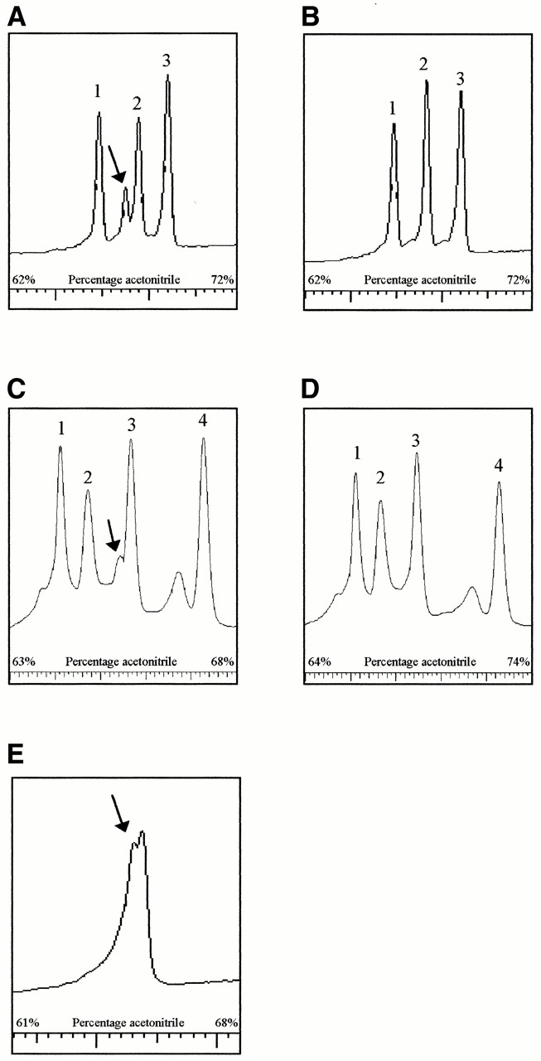
Figure 4. DHPLC analysis of fragments 2 and 7 of three patients with unknown mutations. Fragment 2 of patient ...
Notes:
Figure 4. DHPLC analysis of fragments 2 and 7 of three patients with unknown mutations. Fragment 2 of patient 1 (A) was compared with the wild-type fragment 2 (B), showing three homoduplex peaks at 55°C representing the 382 (peak 1), 460 (peak 2) and 527 bp (peak 3) products. Patient 1 showed heteroduplexes in peak 2 (460 bp) as indicated by the arrow. Sequence analysis revealed the presence of an A3302G substitution. Fragment 2 of patient 2 showed a shoulder in peak 3 (460 bp) (C), as indicated by the arrow, compared to the wild-type at 58°C (D). The four peaks represent the 295 (peak 1), 382 (peak 2), 460 (peak 3) and 527 bp (peak 4) fragments. In these two samples the polymorphic restriction site, seen in the other patients, was absent, showing the fragment of 295 bp as the fourth peak. Sequence analysis revealed the presence of a T3271C substitution. Patient 3 showed heteroduplexes in the 867 bp digestion product of fragment 7 (E) as indicated by the arrow. No similar wild-type fragment was available because of a TaqI polymorphism. Sequence analysis revealed the presence of a T9176G substitution.
Unless provided in the caption above, the following copyright applies to the content of this slide:

Slide 2
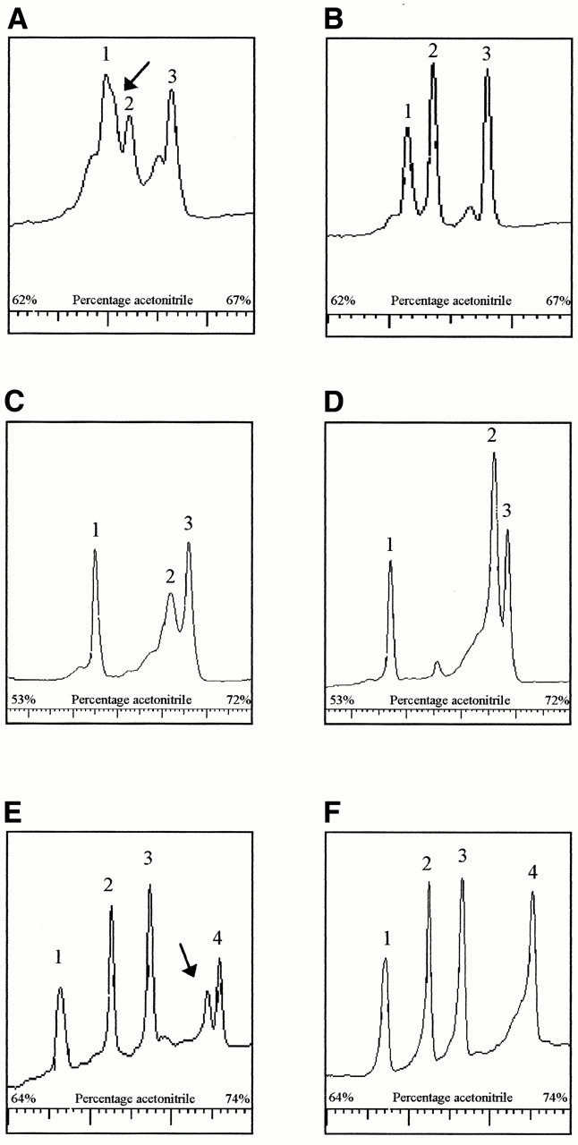
Figure 3. DHPLC analysis of known mutations in digestion products compared with wild-types. The A3243G ...
Notes:
Figure 3. DHPLC analysis of known mutations in digestion products compared with wild-types. The A3243G mutation (55% heteroplasmy) in tRNALeu(UUR) (A) is compared with the wild-type fragment (B), representing the 382 (peak 1), 460 (peak 2) and 527 bp (peak 3) digestion products of fragment 2 at 58°C. The mutation is present in peak 2, which decreases in intensity. The arrow indicates the heteroduplexes merging into peak 1. The A8344G mutation (7% heteroplasmy) in tRNALys (C) is compared with the wild-type fragment 6 (D), representing the 229 (peak 1), 434 (peak 2) and 377 bp (peak 3) products of fragment 6 at 57°C. The mutation is present in peak 2, which decreases in intensity and broadens, whereas the size of peaks 1 and 3 remains the same. The 14787delTTAA (60% heteroplasmy) in cytochrome b (E) is compared with the wild-type fragment 12 (F), showing four homoduplex peaks at 57°C representing the 191 (peak 1), 235 (peak 2), 297 (peak 3) and 472 bp (peak 4) products. The mutation is present in peak 4. The arrow indicates the heteroduplexes.
Unless provided in the caption above, the following copyright applies to the content of this slide:

Slide 3
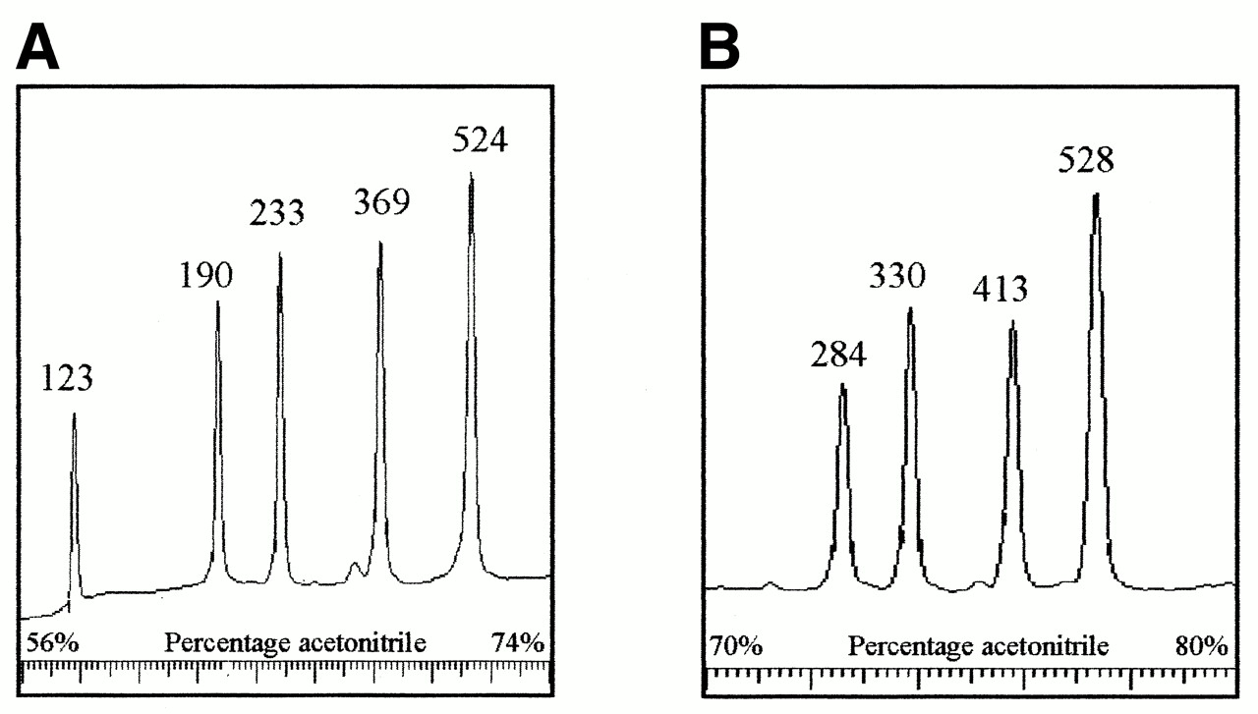
Figure 2. DHPLC analysis of fragments 4 and 9 after digestion with HaeIII and HphI, respectively. Fragment 4 ...
Notes:
Figure 2. DHPLC analysis of fragments 4 and 9 after digestion with HaeIII and HphI, respectively. Fragment 4 is cleaved into fragments of 123, 190, 233, 369 and 524 bp (A) and fragment 9 into fragments of 284, 330, 413 and 528 bp (B). Intensities of the elution peaks are an indication of the size of the fragment. In case of ambiguity, additional digestion reactions were performed to determine which fragment each of the peaks represents. Fragments 4 and 9 are representative for all other fragments.
Unless provided in the caption above, the following copyright applies to the content of this slide:

Slide 4
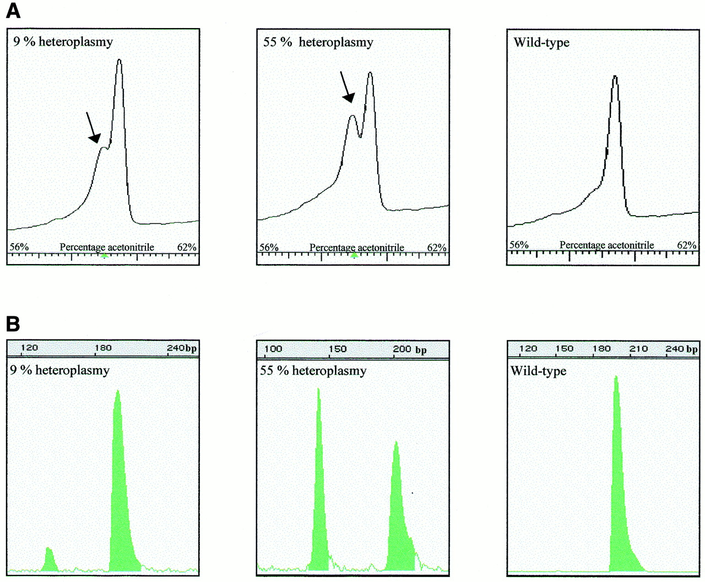
Figure 1. DHPLC analysis of two known mutations with different amounts of mutated mtDNA. (A and C) DHPLC ...
Notes:
Figure 1. DHPLC analysis of two known mutations with different amounts of mutated mtDNA. (A and C) DHPLC elution peaks of characterized percentages of the A3243G and A8344G mutation (B and D) using increasing amounts of acetonitrile (x-axis). The y-axis represents the intensity of the peaks. The arrow indicates the heteroduplexes. (B and D) The same samples using last-cycle PCR followed by restriction digestion to determine the exact percentage of the mutation. On the x-axis the length of the fragments after digestion is displayed.
Unless provided in the caption above, the following copyright applies to the content of this slide:

Slide 5
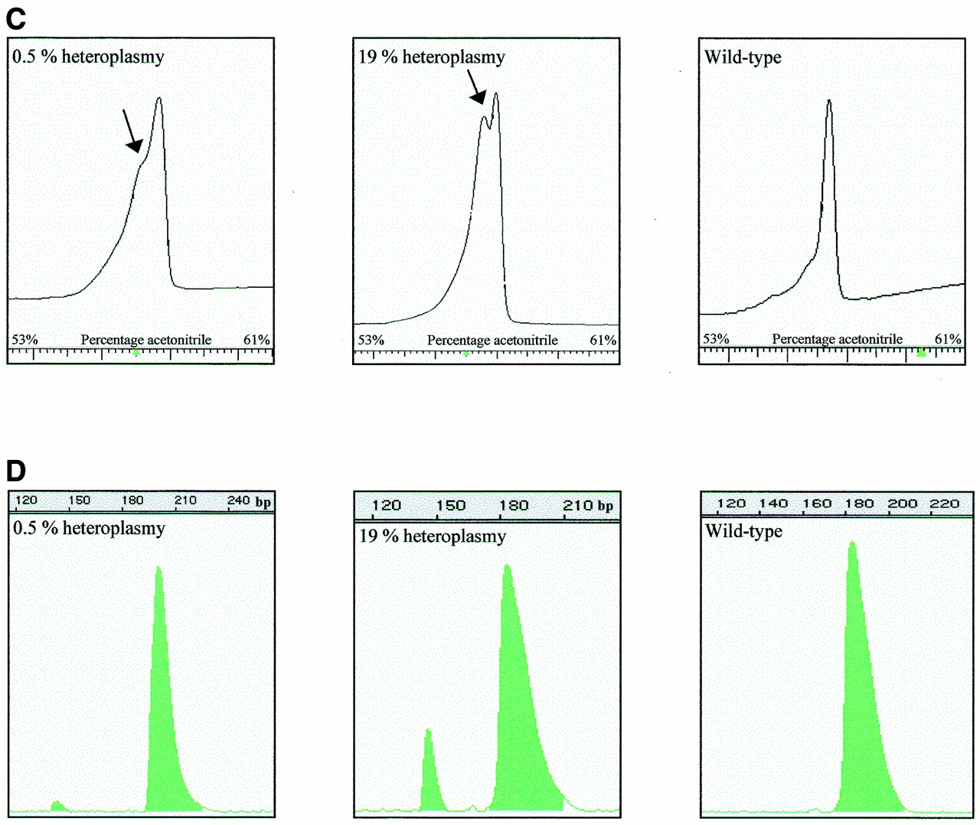
Figure 1. DHPLC analysis of two known mutations with different amounts of mutated mtDNA. (A and C) DHPLC ...
Notes:
Figure 1. DHPLC analysis of two known mutations with different amounts of mutated mtDNA. (A and C) DHPLC elution peaks of characterized percentages of the A3243G and A8344G mutation (B and D) using increasing amounts of acetonitrile (x-axis). The y-axis represents the intensity of the peaks. The arrow indicates the heteroduplexes. (B and D) The same samples using last-cycle PCR followed by restriction digestion to determine the exact percentage of the mutation. On the x-axis the length of the fragments after digestion is displayed.
Unless provided in the caption above, the following copyright applies to the content of this slide:

