Slide 1
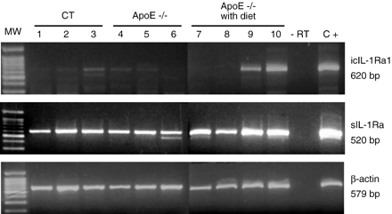
Fig. 4 The presence of IL-1Ra mRNA isoforms in aortic roots with and without atherosclerotic lesions. Aortic roots ...
Notes:
Fig. 4 The presence of IL-1Ra mRNA isoforms in aortic roots with and without atherosclerotic lesions. Aortic roots were dissected from wild-type (lanes 1 to 3) and ApoE −/− mice (lanes 4 to 6) fed with chow diet and ApoE −/− mice fed for 10 weeks with cholesterol-rich diet (lanes 7 to 10). Total RNA was prepared and examined by RT-PCR by using specific primers for icIL-1Ra1, sIL-1Ra, and β-actin mRNA. The PCR products were analyzed by ethidium bromide/agarose gel electrophoresis. Total RNA treated without RT (−RT, lane 11) and thymus total RNA from mice treated with lipopolysaccharide (C+, lane 12) were used as negative and positive controls, respectively. MW represents molecular weight markers.
Unless provided in the caption above, the following copyright applies to the content of this slide: Copyright © 2005, European Society of Cardiology

Slide 2
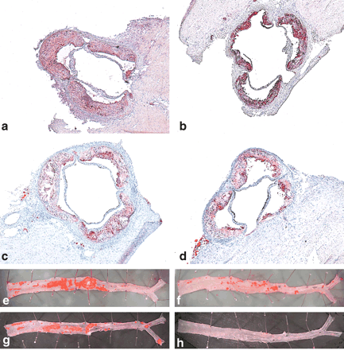
Fig. 1 Representative photographs of atherosclerotic lesions in the aortic roots and thoracoabdominal aortas. ApoE ...
Notes:
Fig. 1 Representative photographs of atherosclerotic lesions in the aortic roots and thoracoabdominal aortas. ApoE −/− sIL-1Ra Tg mice (b, f), their littermate ApoE −/− controls (a, e), ApoE −/− icIL-1Ra1 Tg mice (d, h), and their littermate ApoE −/− controls (c, g), were fed a cholesterol-rich diet for 10 weeks. Representative specimens of aortic lesions stained for lipid deposition with Sudan IV (staining represented in red) within aortic roots (a through d, original magnification × 25) and thoracoabdominal aortas (e through h) are shown.
Unless provided in the caption above, the following copyright applies to the content of this slide: Copyright © 2005, European Society of Cardiology

Slide 3
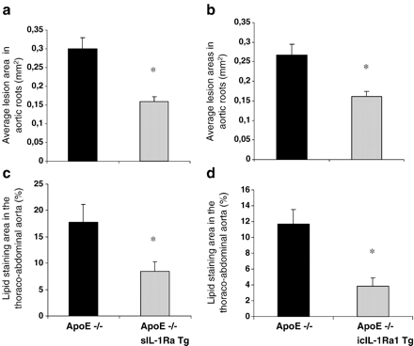
Fig. 2 Quantitative analysis of atherosclerotic lesion areas in aortic roots and thoracoabdominal aortas. After 10 ...
Notes:
Fig. 2 Quantitative analysis of atherosclerotic lesion areas in aortic roots and thoracoabdominal aortas. After 10 weeks of cholesterol-rich diet, the extent of atherosclerotic lesions was analyzed by computer-assisted image quantification within aortic roots (a, b) and thoracoabdominal aortas (c, d). Data represent mean values ± S.E.M. of ApoE −/− sIL-1Ra Tg mice (n=6), their littermate ApoE −/− controls (n=6) (a and c), ApoE −/− icIL-1Ra1 Tg mice (n=9), and their littermate ApoE −/− controls (n=10) (b and d).
Unless provided in the caption above, the following copyright applies to the content of this slide: Copyright © 2005, European Society of Cardiology

Slide 4
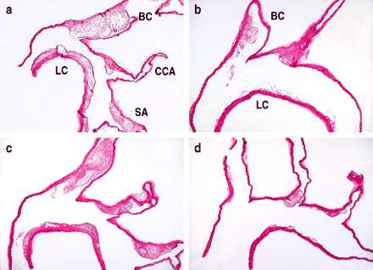
Fig. 3 Atherosclerotic lesions in the aortic arches. Representative photographs of hematoxylin–eosin stained aortic ...
Notes:
Fig. 3 Atherosclerotic lesions in the aortic arches. Representative photographs of hematoxylin–eosin stained aortic arch sections from ApoE −/− sIL-1Ra Tg mice (b), their littermate ApoE −/− controls (a), ApoE −/− icIL-1Ra1 Tg mice (d), and their littermate ApoE −/− controls (c) fed with cholesterol-rich diet for 10 weeks (a through d, original magnification × 25). LC, lesser curvature; BC, brachiocephalic artery; CCA, common carotid artery; SA, subclavian artery.
Unless provided in the caption above, the following copyright applies to the content of this slide: Copyright © 2005, European Society of Cardiology

Slide 5
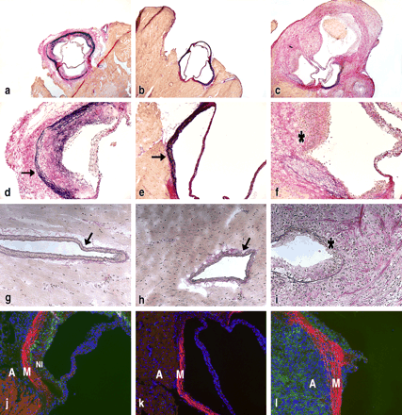
Fig. 6 Histological examination of inflammation in aortic roots and coronary arteries. ApoE −/− IL-1Ra +/+ (a, d, g, ...
Notes:
Fig. 6 Histological examination of inflammation in aortic roots and coronary arteries. ApoE −/− IL-1Ra +/+ (a, d, g, j), ApoE +/+ IL-1Ra −/− (b, e, h, k), and ApoE −/− IL-1Ra −/− (c, f, i, l) mice were fed a cholesterol-rich diet for 7 weeks. Van-Gieson Miller staining (determination of collagen or fibrotic tissue in red and elastin areas in purple) shows a complete destruction of elastic lamina and presence of fibrotic tissue in aortic valves (c, f) and coronary arteries (i) of ApoE −/− IL-1Ra −/− mice as compared to aortic valves (a, d) and coronary arteries (g) of ApoE −/− IL-1Ra +/+ and ApoE +/+ IL-1Ra −/− mice (b, e and h). Arrow indicates the elastic lamina and * indicates the destruction of the elastic lamina. CD68 staining (j, k, and l) shows massive infiltration of macrophages (FITC green signal) in the adventitia of aortic valves of ApoE −/− IL-1Ra −/− mice (l) and in the neointima of aortic valves of ApoE −/− IL-1Ra +/+ (j) but not in ApoE +/+ IL-1Ra −/− mice (k). Sections are counterstained with Evans blue (red signal) and DAPI (blue nuclear signal). Original magnifications × 25 (a through c); × 100 (d through f and j through l); and × 200 (g through i). A, adventitia; M, media; and NI, neointima.
Unless provided in the caption above, the following copyright applies to the content of this slide: Copyright © 2005, European Society of Cardiology

Slide 6
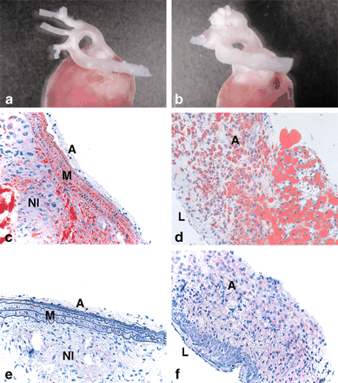
Fig. 5 Macroscopic and histological examination of hearts and aortic arches. ApoE −/− IL-1Ra +/+ (a, c, e) and ApoE ...
Notes:
Fig. 5 Macroscopic and histological examination of hearts and aortic arches. ApoE −/− IL-1Ra +/+ (a, c, e) and ApoE −/− IL-1Ra −/− (b, d, f) mice were fed with cholesterol-rich diet for 7 weeks. Mice were sacrificed and heart and aortic arches were taken for macroscopic and histological examination. The results show representative photographs of heart and aortic arches (a and b), representative photographs of 5 μm sections of aortic arches stained in red with Sudan IV for lipid deposition (original magnification × 200) (c and d), and representative photographs of immunostaining for Mac-1 (macrophages) in the brachiocephalic arteries of aortic arches (original magnification × 200) (e and f). A, adventitia; L, lumen; M, media; NI, neointima.
Unless provided in the caption above, the following copyright applies to the content of this slide: Copyright © 2005, European Society of Cardiology

