Slide 1
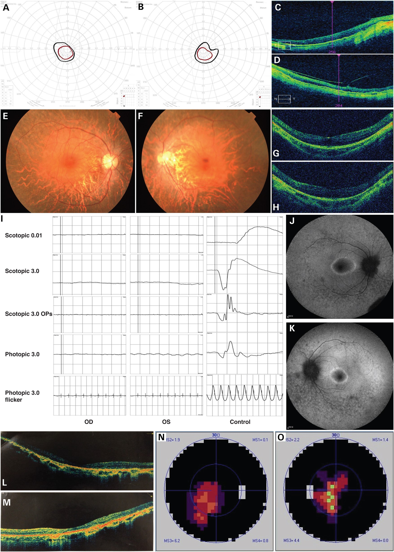
Figure 1. Clinical findings of non-syndromic RP patients in this study. Visual field test results of MOGL2064, right ...
Notes:
Figure 1. Clinical findings of non-syndromic RP patients in this study. Visual field test results of MOGL2064, right eye (A) and left eye (B), showing restricted visual field in both eyes. OCT images of MOGL2064, right eye (C) and left eye (D), featuring chorioretinal atrophy, retinal thinning with absent IS/OS junctions. Fundus images of SRF1105, right eye (E) and left eye (F), showing the tigroid appearance, thinning of mid-peripheral RPE and loss of choroid-capillaries. OCT images of SRF1105, right eye (G) and left eye (H), showing thinning of outer retinal layer with preserved foveal photoreceptors. (I) ERG results of SRF1105, showing no detectable ERG signals. Fluorescein angiography results of SRF1105, right eye (J) and left eye (K), showing oval shaped hypofluorescence with a hyperfluorescent ring in the macular and mottled hypofluorescence area in the peripheral retina. OCT images of SRF1630, right eye (L) and left eye (M), showing thinning of whole retina layers, a flat fovea and disappearance of IS/OS (right eye more severe than left eye). Visual field test results of patient SRF1630, right eye (N) and left eye (O), showing tunnel vision in both eyes.
Unless provided in the caption above, the following copyright applies to the content of this slide: © The Author 2016. Published by Oxford University Press. All rights reserved. For Permissions, please email: journals.permissions@oup.com

Slide 2
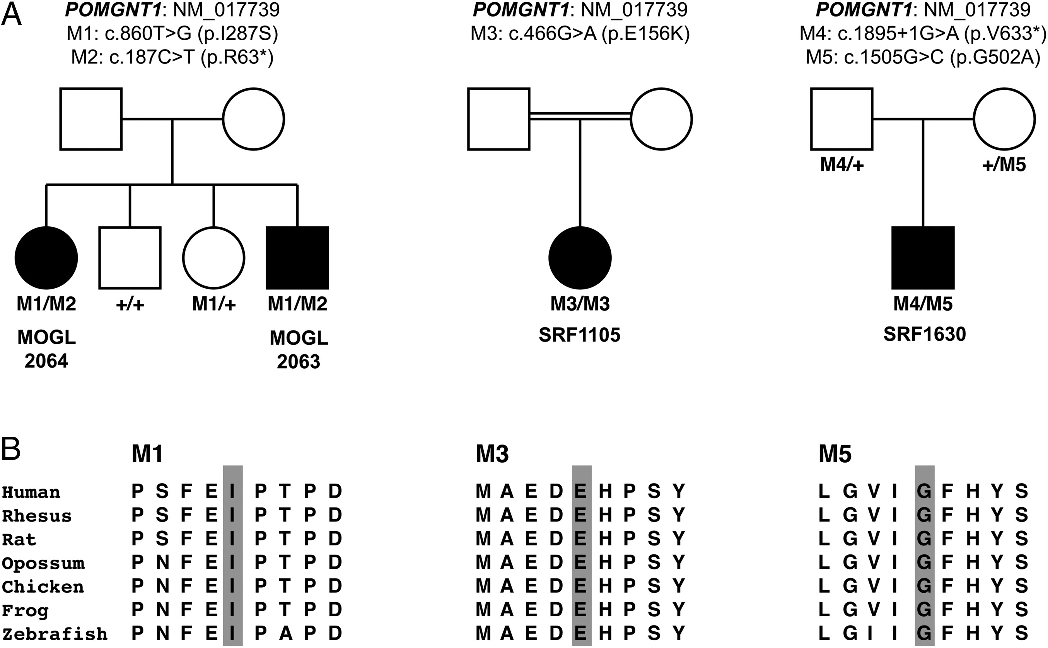
Figure 2. Genetic findings of non-syndromic RP patients in this study. (A) Four non-syndromic RP patients from three ...
Notes:
Figure 2. Genetic findings of non-syndromic RP patients in this study. (A) Four non-syndromic RP patients from three unrelated families with POMGNT1 biallelic variants were identified. Genotypes (cDNA and protein changes based on reference cDNA sequence NM_017739) are labeled for each family. (B) POMGNT1 protein sequence alignment among selected vertebrates at the loci of POMGNT1 missense variants identified in our study. All the disrupted amino acids are highly conserved in vertebrates.
Unless provided in the caption above, the following copyright applies to the content of this slide: © The Author 2016. Published by Oxford University Press. All rights reserved. For Permissions, please email: journals.permissions@oup.com

Slide 3
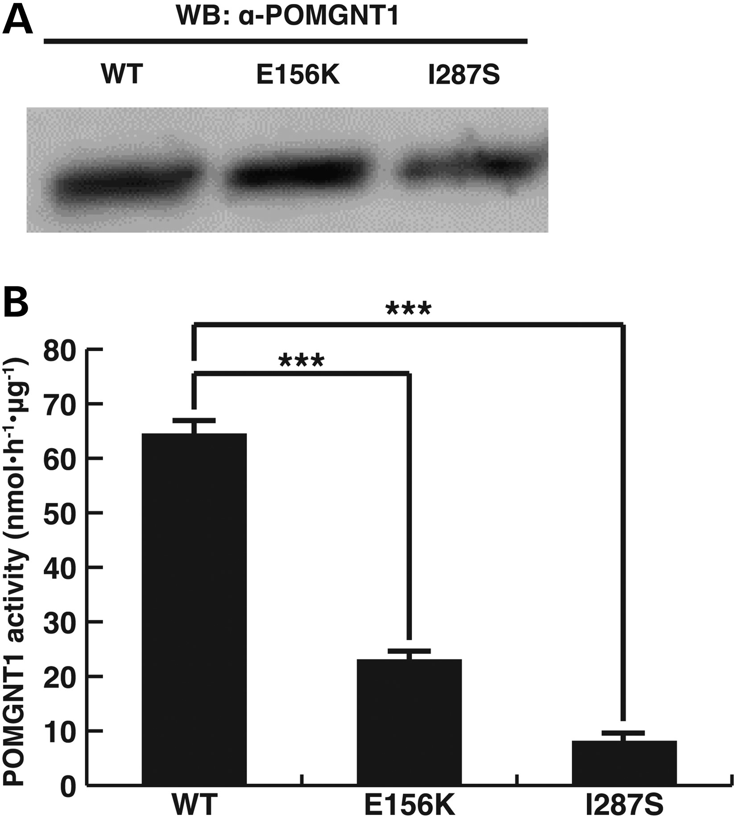
Figure 3. Biochemical studies to test the pathogenicity of two POMGNT1 missense variants. (A) Western blot analysis of ...
Notes:
Figure 3. Biochemical studies to test the pathogenicity of two POMGNT1 missense variants. (A) Western blot analysis of POMGNT1 WT and mutant proteins, showing their expression and approximately equal molecular weights. (B) Enzymatic activity of POMGNT1 WT and mutant proteins. Both mutants retained significantly lower activity compared with the WT level. Two-tailed Welch's t-test. ***P < 10−5. Error bars indicate sample standard deviations.
Unless provided in the caption above, the following copyright applies to the content of this slide: © The Author 2016. Published by Oxford University Press. All rights reserved. For Permissions, please email: journals.permissions@oup.com

Slide 4
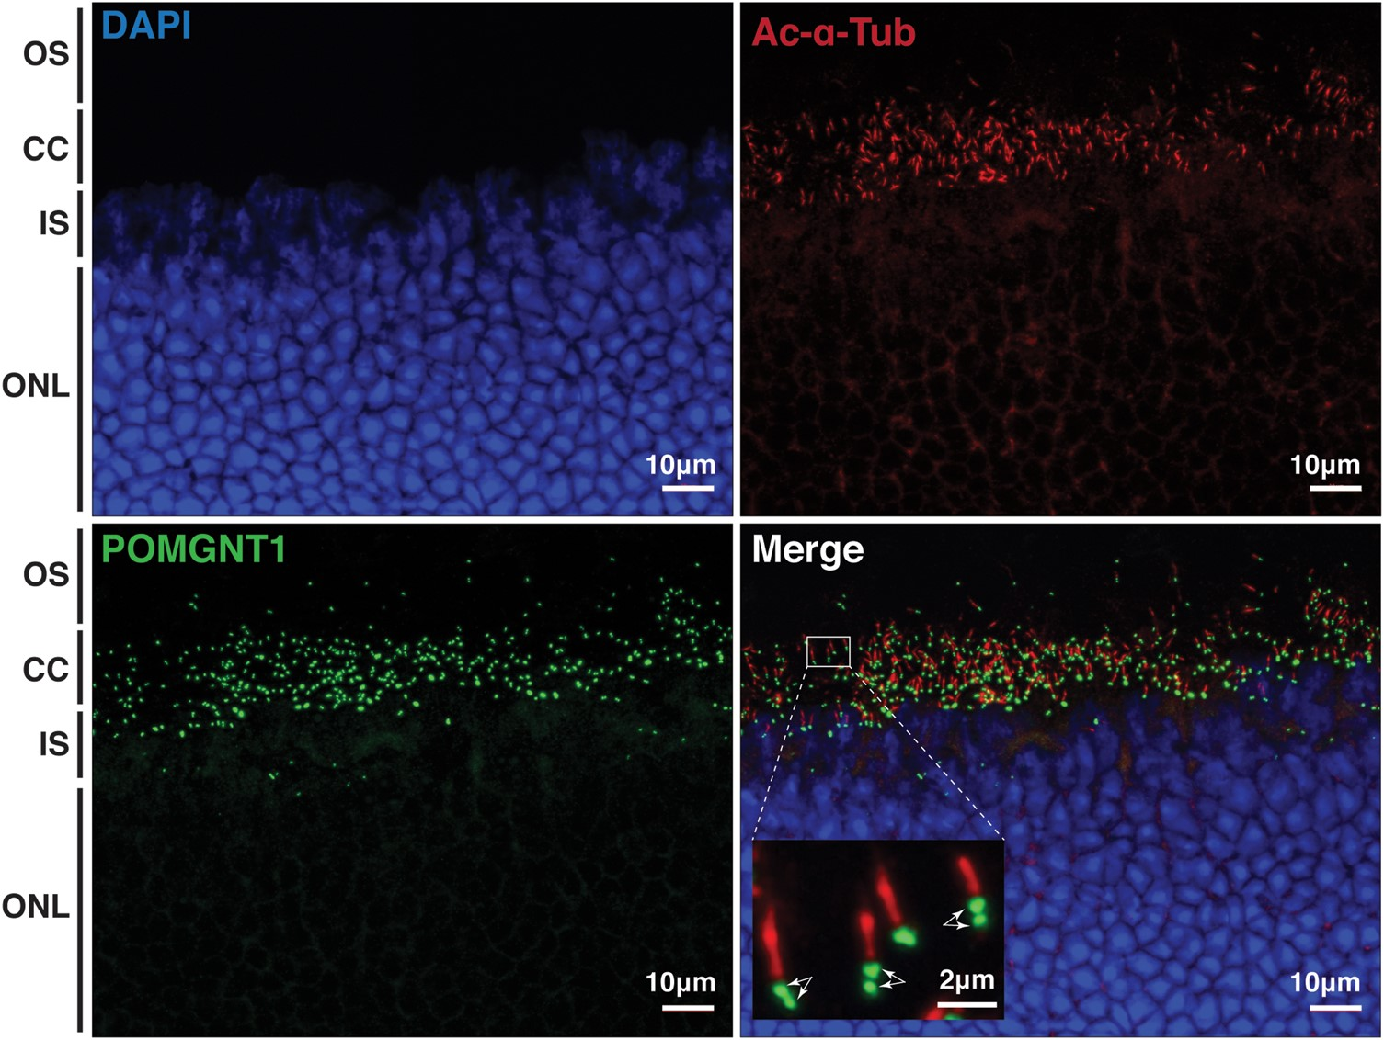
Figure 4. POMGNT1 is expressed in photoreceptor cells. For each individual photoreceptor, the POMGNT1 signal is next to ...
Notes:
Figure 4. POMGNT1 is expressed in photoreceptor cells. For each individual photoreceptor, the POMGNT1 signal is next to the cilia marker (acetylated-α-tubulin) signal. Two-dot pattern (labeled by double arrows) indicates the localization of POMGNT1 at both the basal body and the daughter centriole of photoreceptor cells. Ac-α-Tub, acetylated-α-tubulin; OS, outer segments; CC, connecting cilium; IS, inner segments; ONL, outer nuclear layer.
Unless provided in the caption above, the following copyright applies to the content of this slide: © The Author 2016. Published by Oxford University Press. All rights reserved. For Permissions, please email: journals.permissions@oup.com

