Slide 1
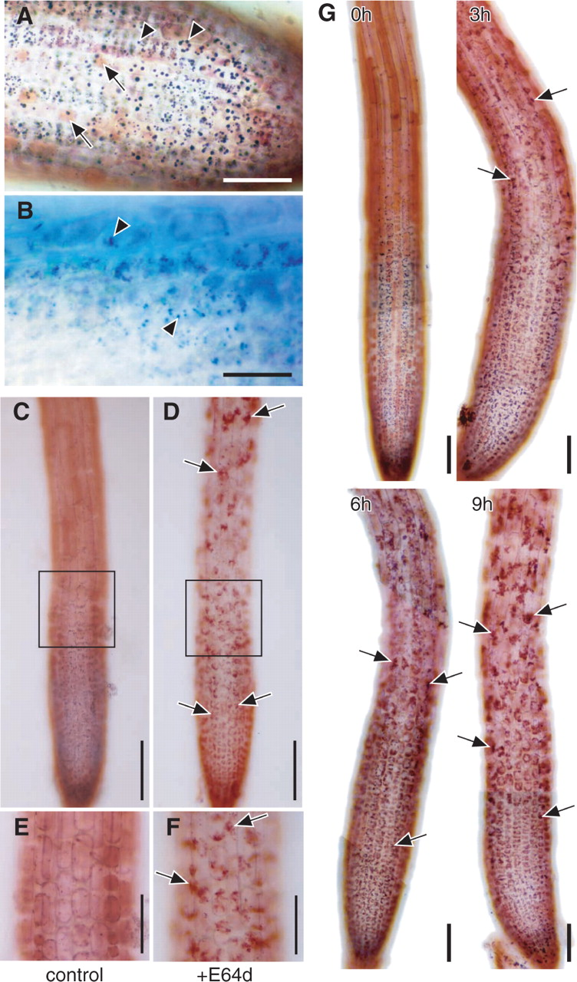
Fig. 1 Effect of the membrane-permeable cysteine protease inhibitor E-64d on the morphology of Arabidopsis root ...
Notes:
Fig. 1 Effect of the membrane-permeable cysteine protease inhibitor E-64d on the morphology of Arabidopsis root tips. Root tips were excised from the seedlings of Arabidopsis (Landsberg in A and B, and Columbia in C–G) grown under nutrient-sufficient conditions. (A and B) Immediately after excision, root tips were stained with neutral red (A) or with toluidine blue (B). Arrows in A, central vacuole stained with neutral red; arrowheads in A, spherical structures stained with neutral red; arrows in B, spherical structures stained with toluidine blue. Bar in A = 50 μm; bar in B = 25 μm. (C–F). Root tips were incubated in the culture medium containing 100 μM E-64d (D and F) or 1% (v/v) methanol as a solvent control of E-64d addition (C and E) for 1 d. They were stained with neutral red and observed by light microcopy. E and F are magnified images of parts of the images C and D, respectively. Arrows in D and F point to vacuolar inclusions. Bars in C and D = 100 μm; bars in E and F = 50 μm. (G) Root tips were incubated in the culture medium containing 100 μM E-64d for various times indicated in each image, and stained with neutral red. Arrows point to vacuolar inclusions. Bar = 50 μm.
Unless provided in the caption above, the following copyright applies to the content of this slide: © The Author 2006. Published by Oxford University Press on behalf of Japanese Society of Plant Physiologists. All rights reserved. For permissions, please email: journals.permissions@oxfordjournals.org

Slide 2
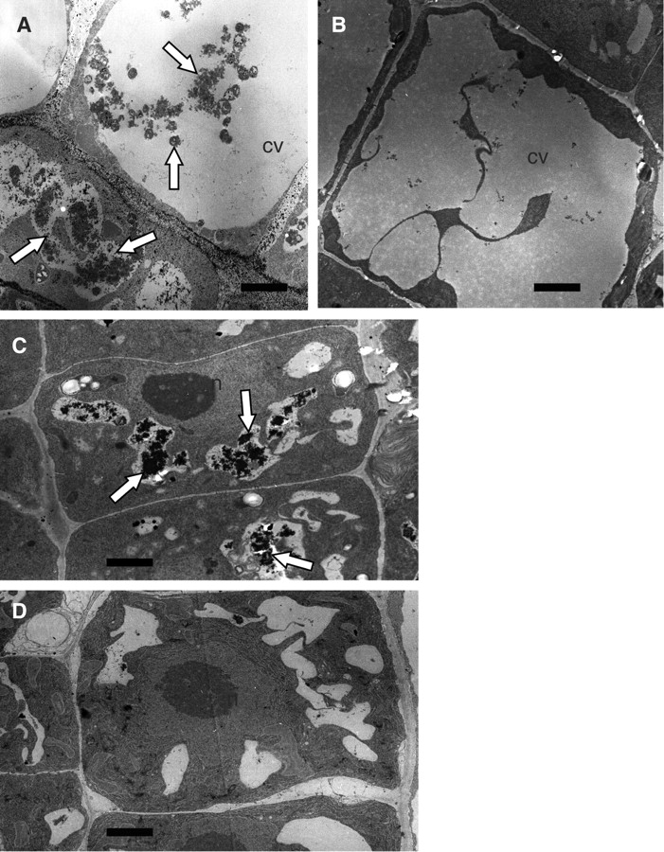
Fig. 2 Electron micrographs of the cells of Arabidopsis root tips cultured in the presence of E-64d. Root tips were ...
Notes:
Fig. 2 Electron micrographs of the cells of Arabidopsis root tips cultured in the presence of E-64d. Root tips were excised from the seedlings of Arabidopsis (Landsberg) grown under nutrient-sufficient conditions and incubated in the culture medium containing sucrose in the presence (A and C) or absence (B and D) of E-64d for 1 d. They were fixed and embedded in plastic blocks. Sections made from these blocks were stained with uranyl acetate and lead nitrate, and observed by electron microscopy. Images of relatively young root tip cells (C and D) and mature vacuolated cells (A and B) are shown. Arrows point to vacuolar inclusions. CV, the central vacuoles; n, nucleus. Bar = 2 μm.
Unless provided in the caption above, the following copyright applies to the content of this slide: © The Author 2006. Published by Oxford University Press on behalf of Japanese Society of Plant Physiologists. All rights reserved. For permissions, please email: journals.permissions@oxfordjournals.org

Slide 3
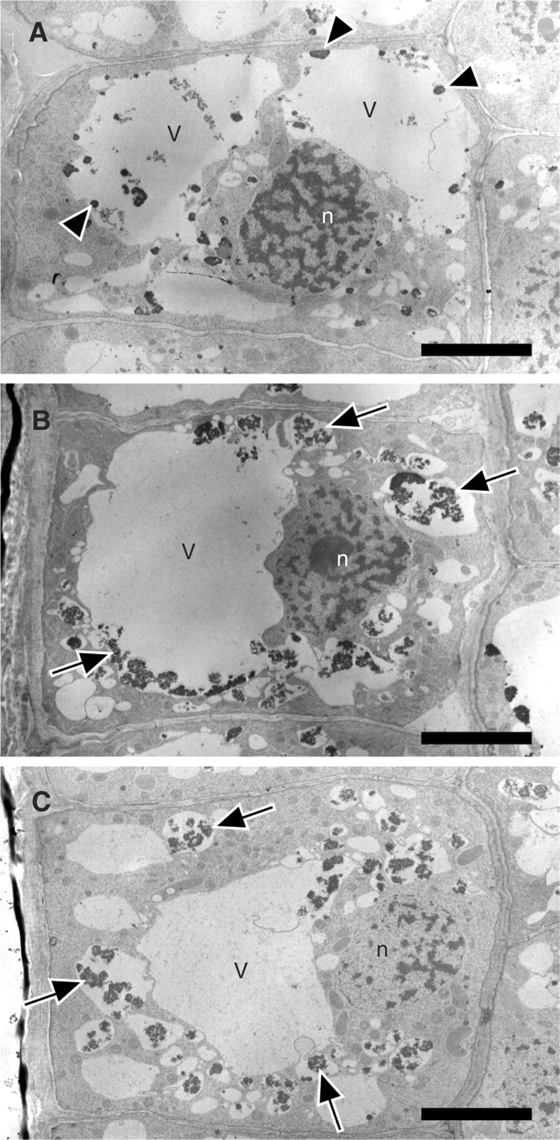
Fig. 3 Electron micrograph of the relatively mature cells of barley root tips cultured in the presence of E-64d. ...
Notes:
Fig. 3 Electron micrograph of the relatively mature cells of barley root tips cultured in the presence of E-64d. Barley root tips were kept in the culture medium containing 3% (w/v) sucrose in the presence of 100 μM E-64d for 4 h (B) or 8 h (C), or in the presence of only methanol for 8 h (A). They were then fixed with glutaraldehyde and embedded in the blocks of Spurr's resin. Sections made from these blocks were stained with KMnO 4 and uranyl acetate, and observed by electron microscopy. Arrows point to vacuolar inclusions. Some central vacuoles of the control cells (A) also contain several electron-dense particles (A, arrowheads). The surfaces of these particles were smooth and were different from those in autolysosomes (B and C, arrows). V, vacuole; n, nucleus. Bar = 5 μm.
Unless provided in the caption above, the following copyright applies to the content of this slide: © The Author 2006. Published by Oxford University Press on behalf of Japanese Society of Plant Physiologists. All rights reserved. For permissions, please email: journals.permissions@oxfordjournals.org

Slide 4
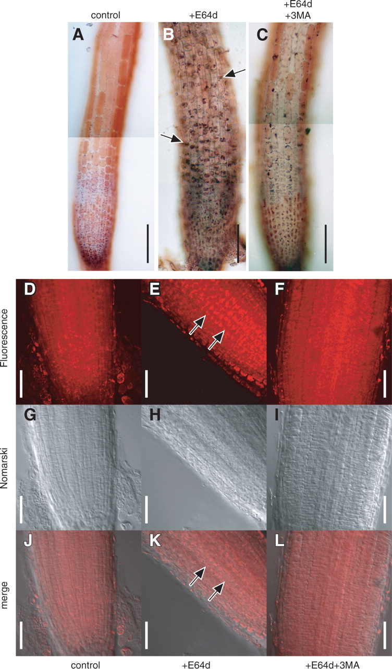
Fig. 4 Effect of 3-MA on the accumulation of vacuolar inclusions in the cells of Arabidopsis root tips cultured in ...
Notes:
Fig. 4 Effect of 3-MA on the accumulation of vacuolar inclusions in the cells of Arabidopsis root tips cultured in the presence of E-64d. (A–C) Root tips were excised from the seedlings of Arabidopsis (Columbia), and cultured in the culture medium containing 1% (v/v) methanol and 5% (v/v) water (A), 100 μM E-64d and 5% (v/v) water (B) or 100 μM E-64d and 5 mM 3-MA (C) for 1 d. Root tips were stained with neutral red and their bright field images were obtained by light microscopy. Arrows in B point to the accumulation of vacuolar inclusions. Bar = 100 μm. (D–L) Root tips cultured in the presence of 1% (v/v) methanol and 5% (v/v) water (D, G and J), 100 μM E-64d and 5% (v/v) water (E, H and K) or 100 μM E-64d and 5 mM 3-MA (F, I and L) were stained with LysoTracker Red and fixed with formaldehyde. They were then observed with a confocal laser microscope, and the fluorescence images of LysoTracker Red (D, E and F) and Nomarski images (G, H and I) were obtained. Images J, K and L are merges of the images D, E and F, and the images G, H and I, respectively. Arrows in E and K point to the accumulation of vacuolar inclusions. Bar = 50 μm.
Unless provided in the caption above, the following copyright applies to the content of this slide: © The Author 2006. Published by Oxford University Press on behalf of Japanese Society of Plant Physiologists. All rights reserved. For permissions, please email: journals.permissions@oxfordjournals.org

Slide 5
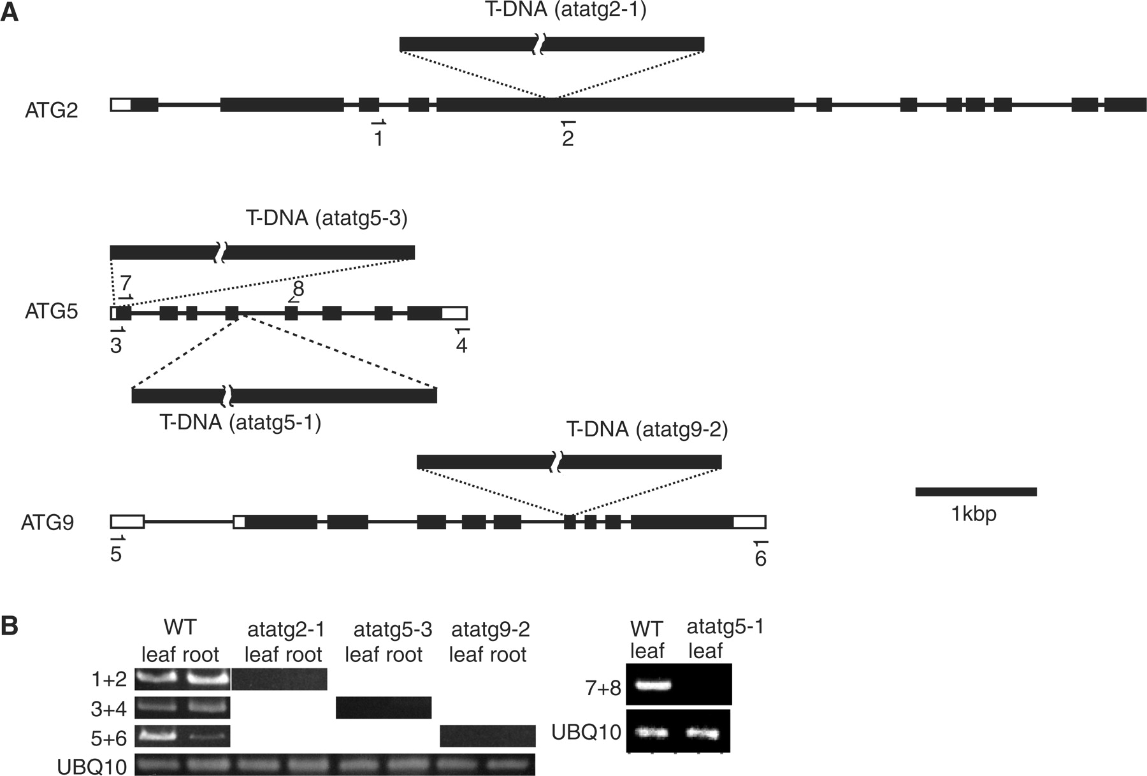
Fig. 5 Expression of AtATG genes in atatg mutants used in this study. (A) Diagrams of AtATG2, AtATG5 and AtATG9 ...
Notes:
Fig. 5 Expression of AtATG genes in atatg mutants used in this study. (A) Diagrams of AtATG2, AtATG5 and AtATG9 genes. Exons and introns in each gene are shown by boxes and lines, respectively. The sites into which T-DNA is inserted in AtATG2, AtATG5 and AtATG9 genes are shown in atatg2-1, atatg5-3, atatg5-1 and atatg9-2 mutants. Arrows show the priming sites in RT–PCR analysis. (B) RT–PCR analysis of atatg2-1, atatg5-3, atatg9-2 and atatg5-1 mutants. Total RNAs were extracted from the leaves and roots of the wild type (WT), atatg2-1, atatg5-3 and atatg9-2 plants and were subjected to RT–PCR using one of the UBQ10 primer pairs (see Materials and Methods) and either the primers 1 and 2 (1 + 2), the primers 3 and 4 (3 + 4) or the primers 5 and 6 (5 + 6). The total RNAs of the atatg5-1 and WT plants were extracted from leaves in separate experiments. They were subjected to RT–PCR using the other UBQ10 primer pairs (see Materials and Methods) and the primers 7 and 8 (7 + 8). The products of PCR were separated on agarose gels and stained with ethidium bromide.
Unless provided in the caption above, the following copyright applies to the content of this slide: © The Author 2006. Published by Oxford University Press on behalf of Japanese Society of Plant Physiologists. All rights reserved. For permissions, please email: journals.permissions@oxfordjournals.org

Slide 6
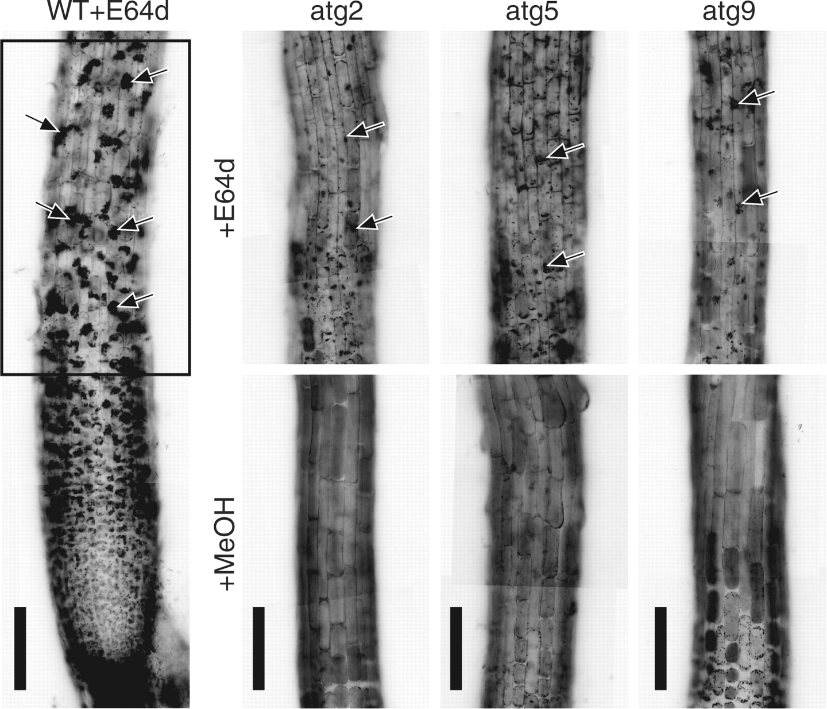
Fig. 6 Involvement of AtATG genes in autophagy in Arabidopsis root tips. Root tips excised from the wild-type ...
Notes:
Fig. 6 Involvement of AtATG genes in autophagy in Arabidopsis root tips. Root tips excised from the wild-type Columbia ecotype and atatg2-1, atatg5-3 and atatg9-2 mutant seedlings were incubated in medium containing 100 μM E-64d (+E64d) or 1% (v/v) methanol (+MeOH) for 1 d. They were stained with neutral red and observed by light microscopy. The same parts as enclosed by a rectangle in the root tip of the wild-type seedling (WT+E64d) are shown in atatg2-1 (atg2), atatg5-3 (atg5) and atatg9-2 (atg9) mutants. Arrows point to vacuolar inclusions. Bar = 100 μm.
Unless provided in the caption above, the following copyright applies to the content of this slide: © The Author 2006. Published by Oxford University Press on behalf of Japanese Society of Plant Physiologists. All rights reserved. For permissions, please email: journals.permissions@oxfordjournals.org

Slide 7
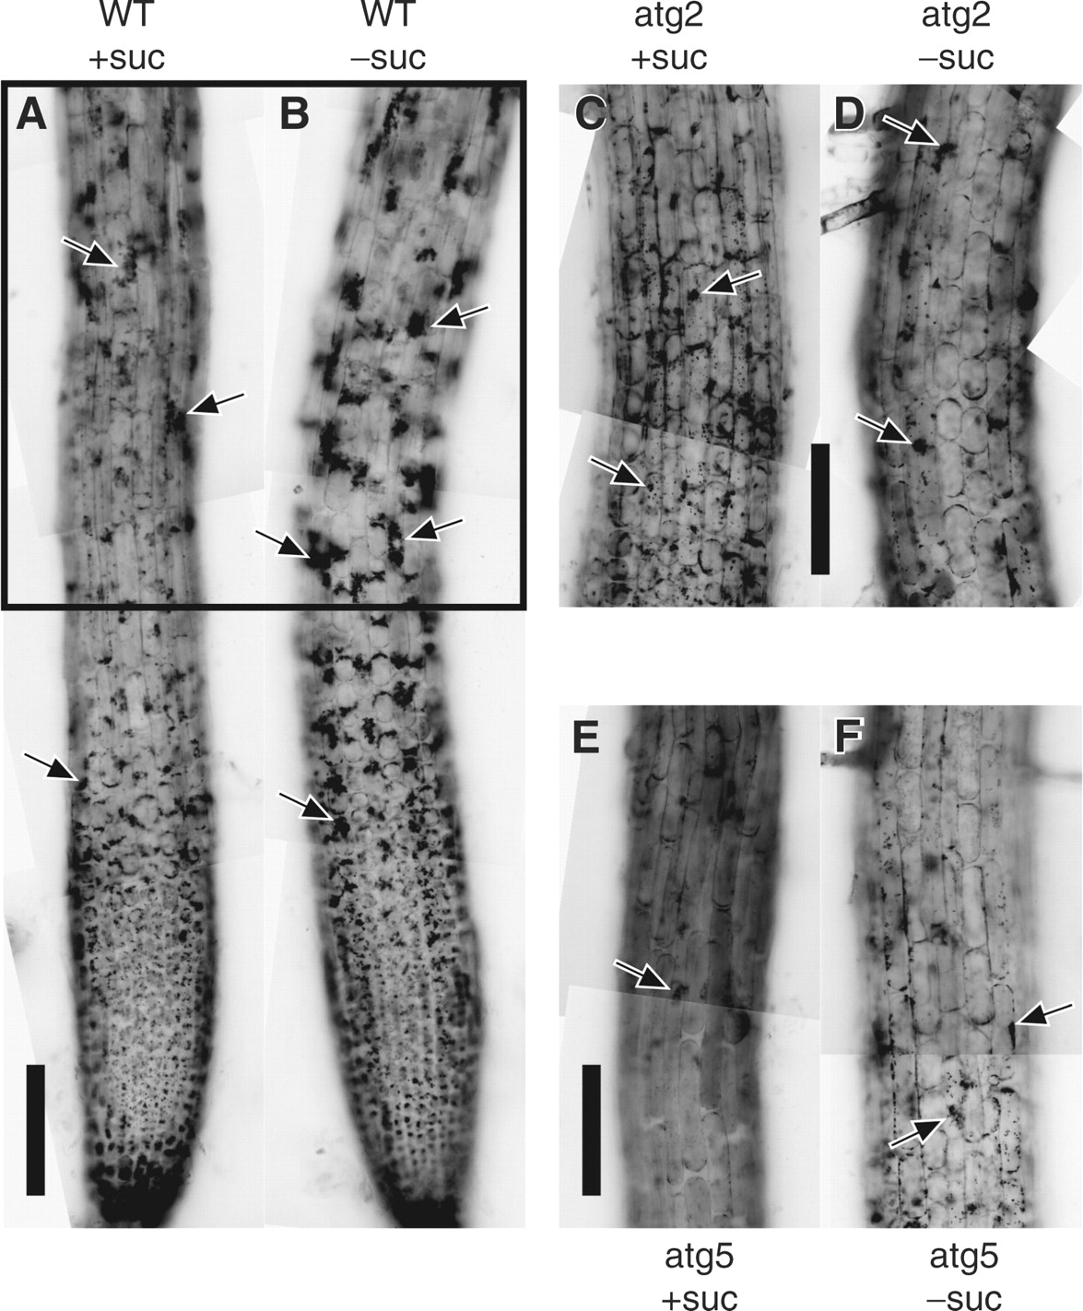
Fig. 7 Activation of autophagy in Arabidopsis root tips by sucrose deprivation. Root tips from the wild-type of the ...
Notes:
Fig. 7 Activation of autophagy in Arabidopsis root tips by sucrose deprivation. Root tips from the wild-type of the Columbia ecotype (WT) and atatg2-1 (atg2) and atatg5-3 (atg5) mutant seedlings of Arabidopsis were incubated in culture medium containing (+suc) or lacking (−suc) sucrose in the presence of E-64d for 1 d. They were stained with neutral red and observed. The parts corresponding to that enclosed by a rectangle in the WT are shown in the mutants. Arrows point to vacuolar inclusions. Bar = 100 μm.
Unless provided in the caption above, the following copyright applies to the content of this slide: © The Author 2006. Published by Oxford University Press on behalf of Japanese Society of Plant Physiologists. All rights reserved. For permissions, please email: journals.permissions@oxfordjournals.org

Slide 8
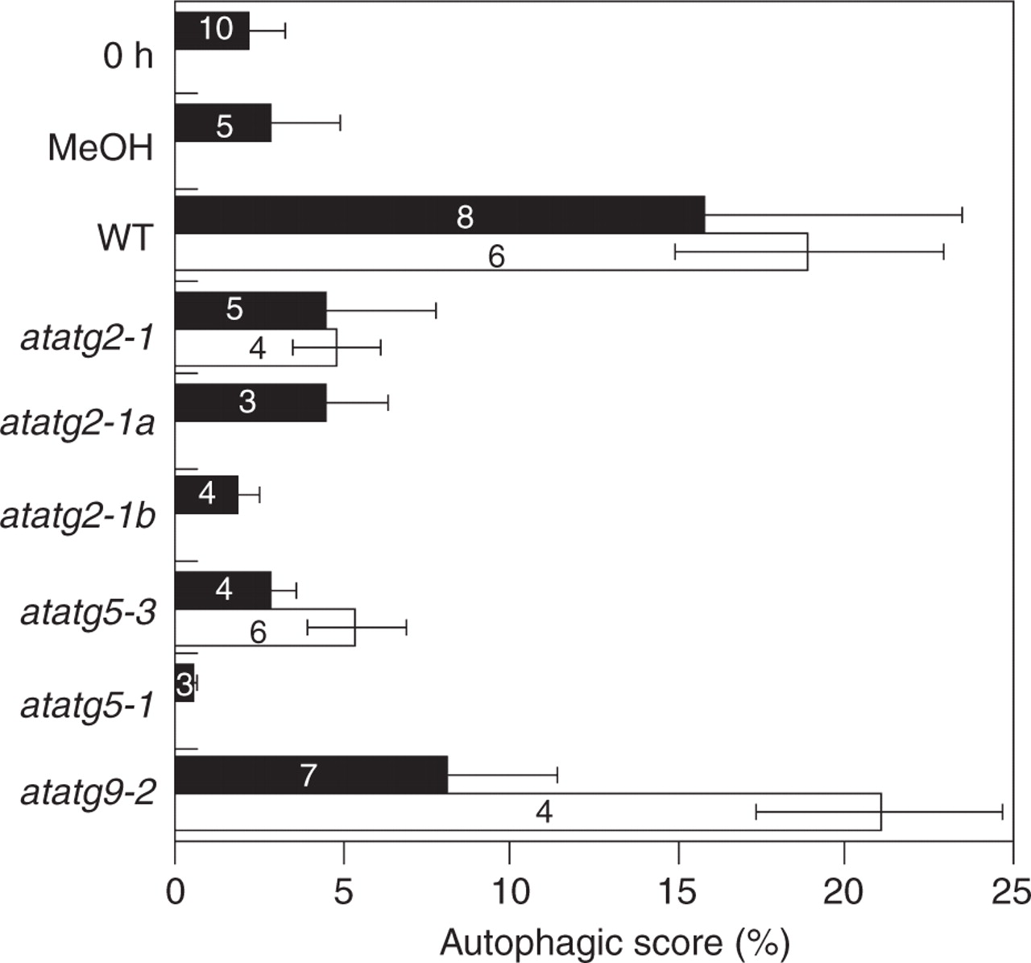
Fig. 8 Image analysis on the accumulation of cytoplasmic materials in the vacuoles of Arabidopsis root cells. Root ...
Notes:
Fig. 8 Image analysis on the accumulation of cytoplasmic materials in the vacuoles of Arabidopsis root cells. Root tips from the wild-type seedlings of the Columbia ecotype (WT) and atatg2, atatg5 and atatg9 mutant seedlings of Arabidopsis were incubated in culture medium containing (filled bar) or lacking (open bar) sucrose in the presence of E-64d for 1 d. They were stained with neutral red and photographed. As control experiments, root tips of the wild type were stained with neutral red immediately after excision (0 h, filled bar), or after incubation for 1 d in culture medium containing sucrose in the absence of E-64d (MeOH, filled bar). Autophagic scores were obtained as described in Materials and Methods. Numbers in the bars show the numbers of root tips examined in each treatment.
Unless provided in the caption above, the following copyright applies to the content of this slide: © The Author 2006. Published by Oxford University Press on behalf of Japanese Society of Plant Physiologists. All rights reserved. For permissions, please email: journals.permissions@oxfordjournals.org

