Slide 1
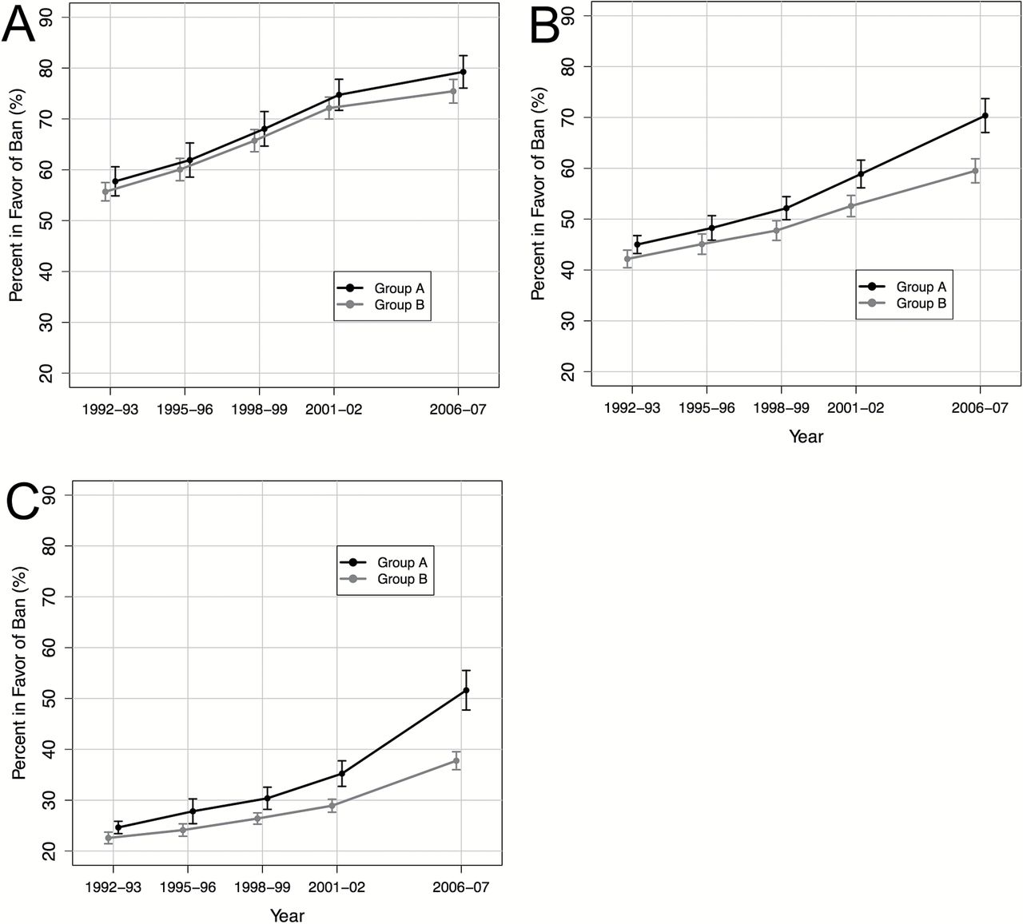
Figure 1. Support for total smoke-free indoor (A) work areas, (B) restaurants, and (C) bars and cocktail lounges among ...
Notes:
Figure 1. Support for total smoke-free indoor (A) work areas, (B) restaurants, and (C) bars and cocktail lounges among states that implemented comprehensive smoke-free laws in the period between 2002 and January 2007, inclusive, (group A) and among states that did not have comprehensive smoke-free laws until after January 2007 (group B).aa Confidence intervals computed by normal approximation are shown for each survey wave. Group A and B trends are shifted slightly to either side of the survey year for better visibility.
Unless provided in the caption above, the following copyright applies to the content of this slide: © The Author 2014. Published by Oxford University Press on behalf of the Society for Research on Nicotine and Tobacco. All rights reserved. For permissions, please e-mail: journals.permissions@oup.com.

