Slide 1
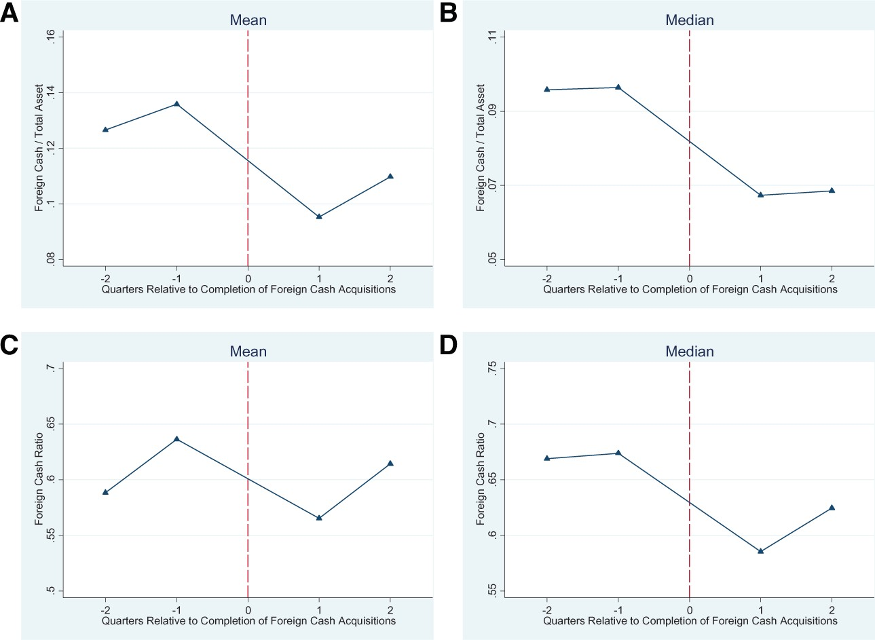
Figure 1 Changes of foreign cash around foreign acquisitions The figures plot the trend of firms’ quarterly foreign ...
Notes:
Figure 1 Changes of foreign cash around foreign acquisitions The figures plot the trend of firms’ quarterly foreign cash holdings surrounding the completion dates of their foreign acquisitions. Date 0 is the completion date of the acquisition and falls between quarter $-1$ and quarter 1.
Unless provided in the caption above, the following copyright applies to the content of this slide: © The Author 2017. Published by Oxford University Press on behalf of The Society for Financial Studies. All rights reserved. For Permissions, please e-mail: journals.permissions@oup.com.

