Slide 1
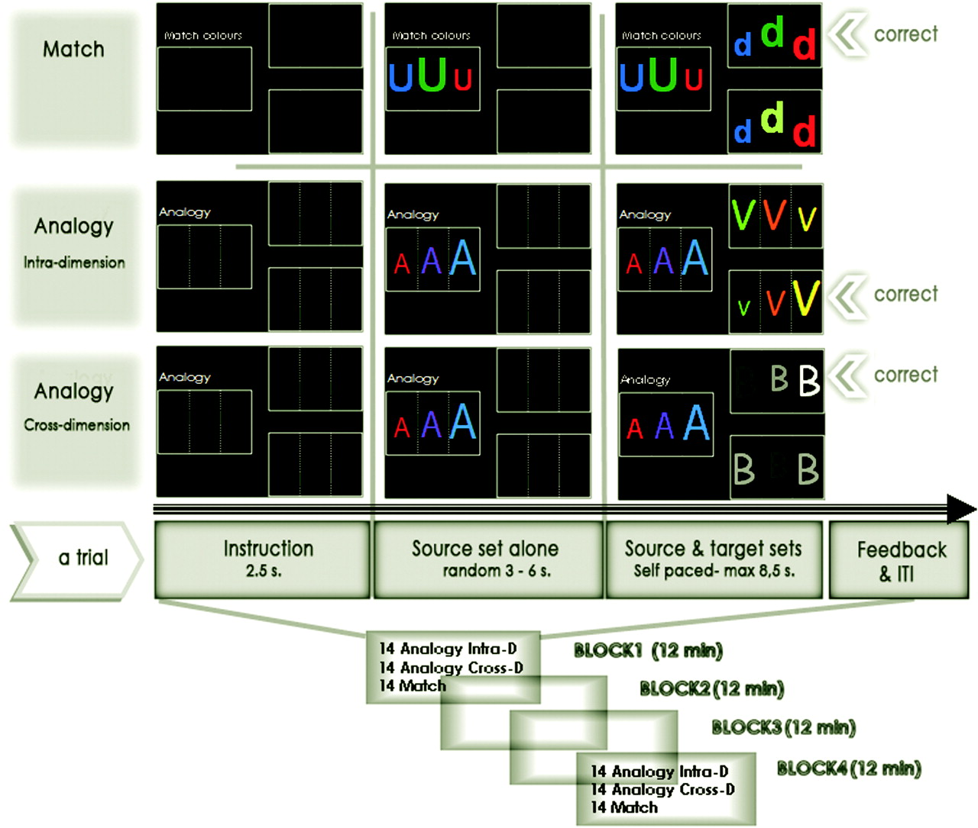
Figure 1. Experimental design and tasks. Experimental design consisted of 2 different tasks: Match and Analogy, with ...
Notes:
Figure 1. Experimental design and tasks. Experimental design consisted of 2 different tasks: Match and Analogy, with the latter subdivided into crossdimension and intradimension conditions.
Unless provided in the caption above, the following copyright applies to the content of this slide: © The Authors 2010. Published by Oxford University Press.This is an Open Access article distributed under the terms of the Creative Commons Attribution Non-Commercial License (http://creativecommons.org/licenses/by-nc/2.5), which permits unrestricted non-commercial use, distribution, and reproduction in any medium, provided the original work is properly cited.

Slide 2
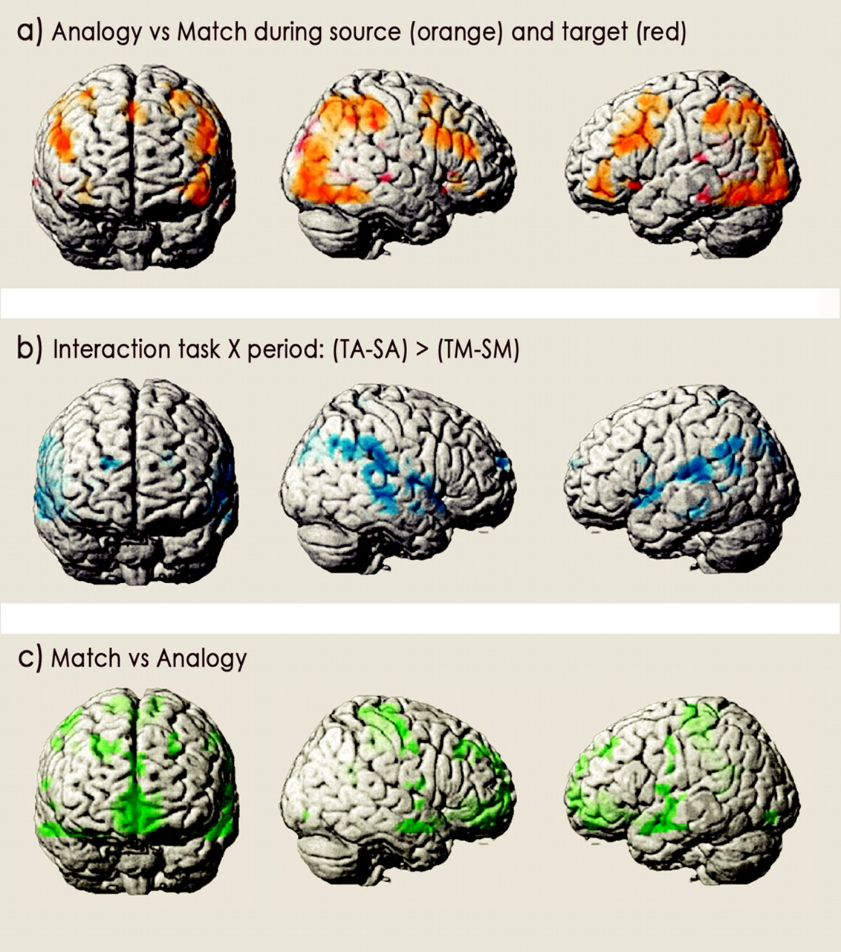
Figure 2. Significant signal change between conditions in 4 distinct analyses (P < 0.001 uncorrected, minimum extent: ...
Notes:
Figure 2. Significant signal change between conditions in 4 distinct analyses (P < 0.001 uncorrected, minimum extent: 10 voxels): (a) the contrast “analogy versus match” during source (in orange) is superimposed with the contrast analogy versus match during target (in red); (b) greater period effect (target–source) in the analogy than in the match task (obtained from a task by period interaction with exclusion of regions more activated in match than analogy task); and (c) the contrast match versus analogy.
Unless provided in the caption above, the following copyright applies to the content of this slide: © The Authors 2010. Published by Oxford University Press.This is an Open Access article distributed under the terms of the Creative Commons Attribution Non-Commercial License (http://creativecommons.org/licenses/by-nc/2.5), which permits unrestricted non-commercial use, distribution, and reproduction in any medium, provided the original work is properly cited.

Slide 3
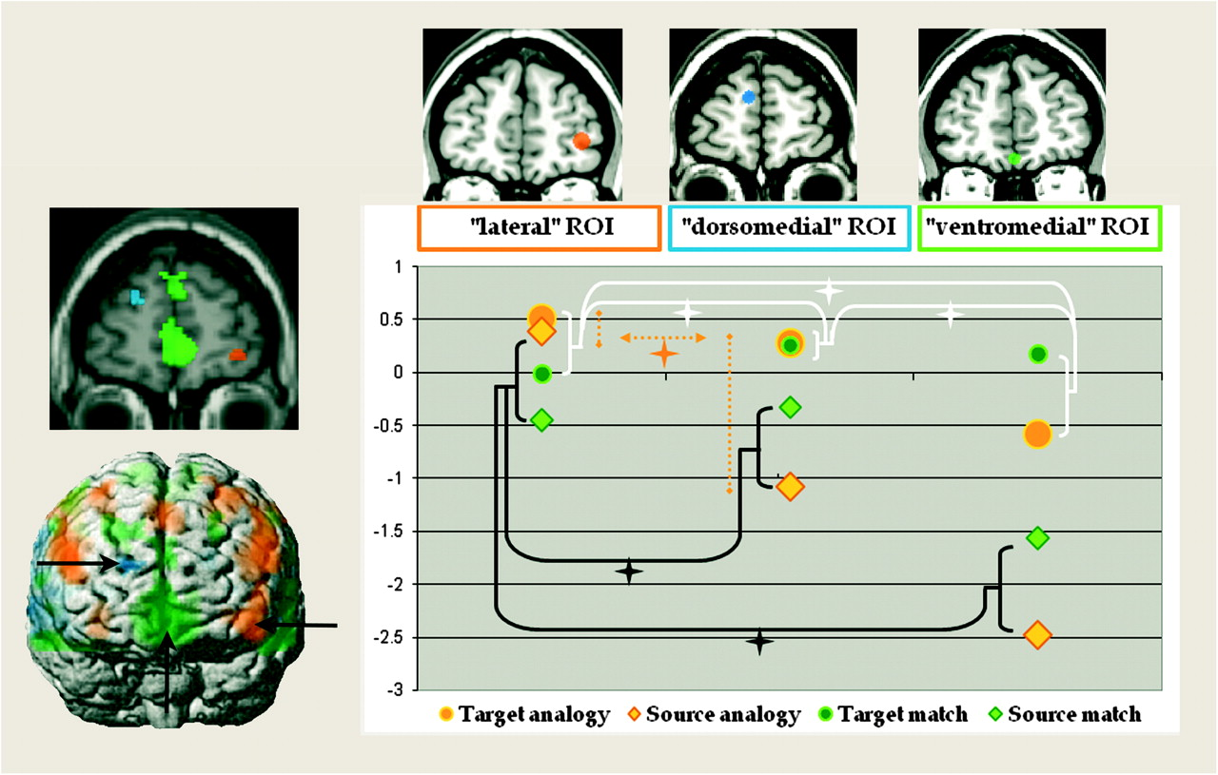
Figure 3. Differential activities within the rostral PFC for 3 identified subregions. On the left, activation obtained ...
Notes:
Figure 3. Differential activities within the rostral PFC for 3 identified subregions. On the left, activation obtained in the whole-brain analyses is superimposed on a frontal slice (y = 58) on a standard MRI brain and on a canonical surface brain in the MNI space. In orange: analogy versus match activating the lateral rostral PFC (maxima = −44, 50, −4); in blue: task by period interaction, activating a more dorsal and medial part of the rostral PFC (maxima = 18, 62, and 22); in green: match versus analogy, activating a ventral and medial frontopolar subregion (maxima = 0, 44, −16). On the right, graphs represent parameter estimates for the rostral prefrontal ROIs defined independently from the whole-brain analysis: lateral ROI (MNI coordinates = −39, 50, 2), dorsomedial ROI (MNI coordinates = 8, 59, 19), and ventromedial ROI (MNI coordinates = 0, 48, −16). A schematic representation of each of these ROIs is shown on frontal slices of a standard brain (ch2.nii template provided by MRIcron in the MNI space), at the upper part of the figure. Parameter estimates were extracted for each task (analogy and match) and period (source and target) and averaged between subjects. On the y axis are the values of the mean parameter estimates across subjects and trials. This shows qualitative differences in activation profile of the 3 rostral prefrontal regions. Stars represent significant condition by ROI interactions. In black are schematized the condition by ROI interaction for the “source analogy” versus “source match” conditions. In white are schematized the condition by ROI interaction for the “target analogy” versus “target match” conditions. In orange is schematized the condition by ROI interaction for the “target analogy” versus “source analogy” conditions.
Unless provided in the caption above, the following copyright applies to the content of this slide: © The Authors 2010. Published by Oxford University Press.This is an Open Access article distributed under the terms of the Creative Commons Attribution Non-Commercial License (http://creativecommons.org/licenses/by-nc/2.5), which permits unrestricted non-commercial use, distribution, and reproduction in any medium, provided the original work is properly cited.

