Slide 1
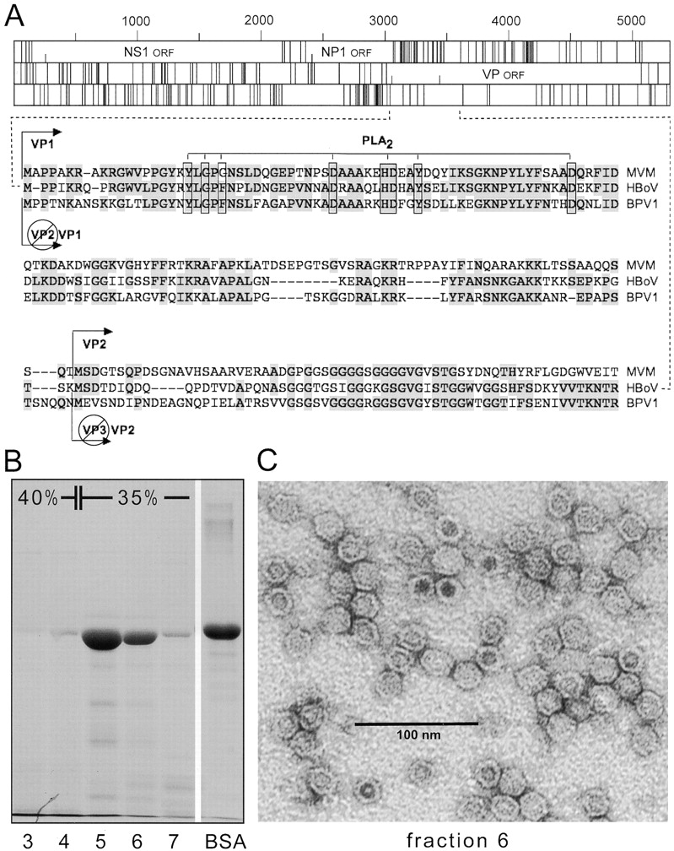
Figure 1. A, Genomic organization of the human bocavirus (HBoV) genome and identification of the VP2 gene. The open ...
Notes:
Figure 1. A, Genomic organization of the human bocavirus (HBoV) genome and identification of the VP2 gene. The open reading frame (ORF) map (for all 3 reading frames) for the predicted sense strand of the HBoV ST2 genome (GenBank accession no. DQ000496) is displayed at the top of the panel. Alignment of the amino acid sequence of the VP1 gene of minute virus of mice (MVM; GenBank accession no. J02275), HBoV, and bovine parvovirus (BPV1; GenBank accession no. DQ335247) is shown at the bottom of the panel. Shaded amino acid residues are conserved among the 3 parvoviruses. The PLA2 domain is indicated. The putative start of the VP2 gene is shown. The VP2 cassette, beginning at the putative initiation codon of the VP2 gene, was cloned and used for the production of HBoV virus-like particles (VLPs). B, Purification of HBoV VLPs. Supernatants of recombinant baculovirus– expressing HBoV VP2–infected cells were centrifuged in an iodixanol gradient. Aliquots of each fraction were analyzed by SDS-PAGE. Bovine serum albumin (BSA; 10 µg) was used as a concentration standard. C, Electron micrograph of HBoV VLPs negatively stained with uranyl acetate.
Unless provided in the caption above, the following copyright applies to the content of this slide: © 2008 by the Infectious Diseases Society of America.

Slide 2
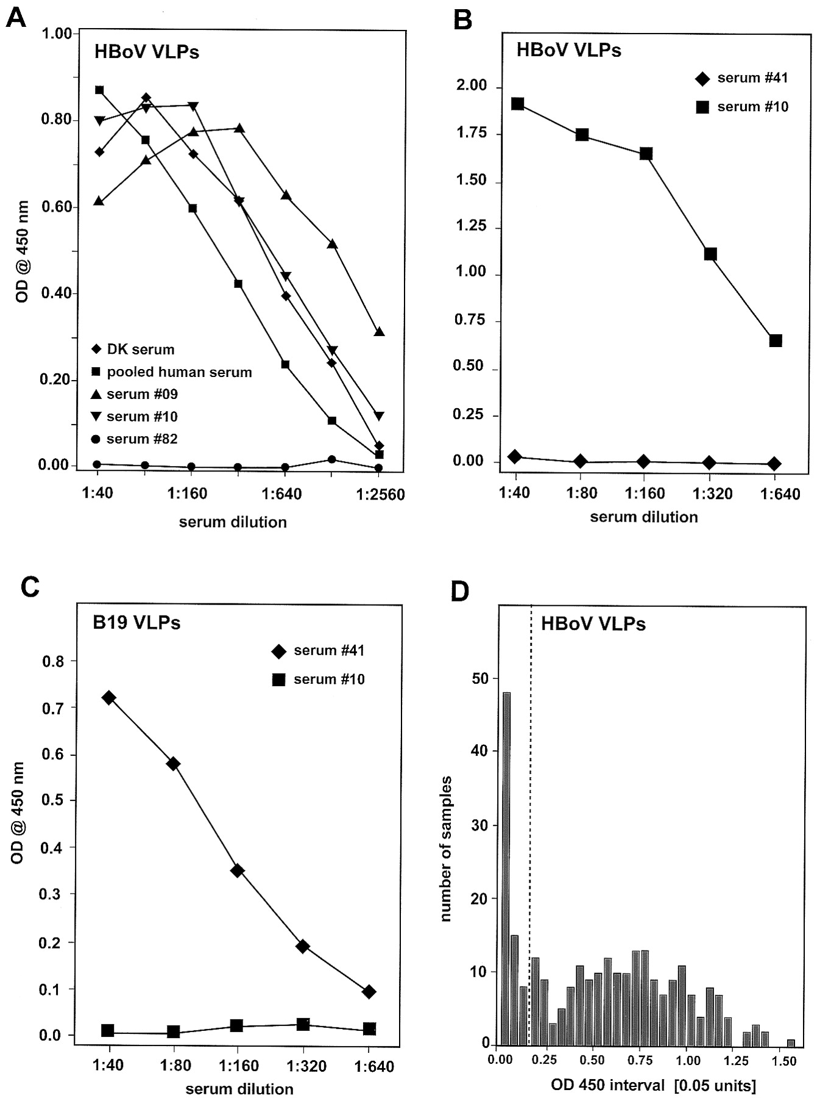
Figure 5. Screening of human serum for human bocavirus (HBoV)–specific antibodies using an ELISA based on HBoV ...
Notes:
Figure 5. Screening of human serum for human bocavirus (HBoV)–specific antibodies using an ELISA based on HBoV virus-like particles (VLPs). In panel A, HBoV VLPs (100 ng/mL) were used as antigens in the ELISA. Results are displayed for several human serum samples, including a pool of 24 specimens. A representative negative specimen (serum specimen 82) is included. In panels B and C, ELISAs were performed with human serum specimens. Serum specimen 10 is positive for HBoV and negative for B19, whereas specimen 41 is negative for HBoV and positive for B19. Panel D shows the distribution of optical density (OD) values (measured at 450 nm) for the HBoV VLP ELISA for all 270 serum samples tested. Values are the average for each sample assayed in duplicate, and the dotted line indicates an OD450 value of 0.15.
Unless provided in the caption above, the following copyright applies to the content of this slide: © 2008 by the Infectious Diseases Society of America.

Slide 3
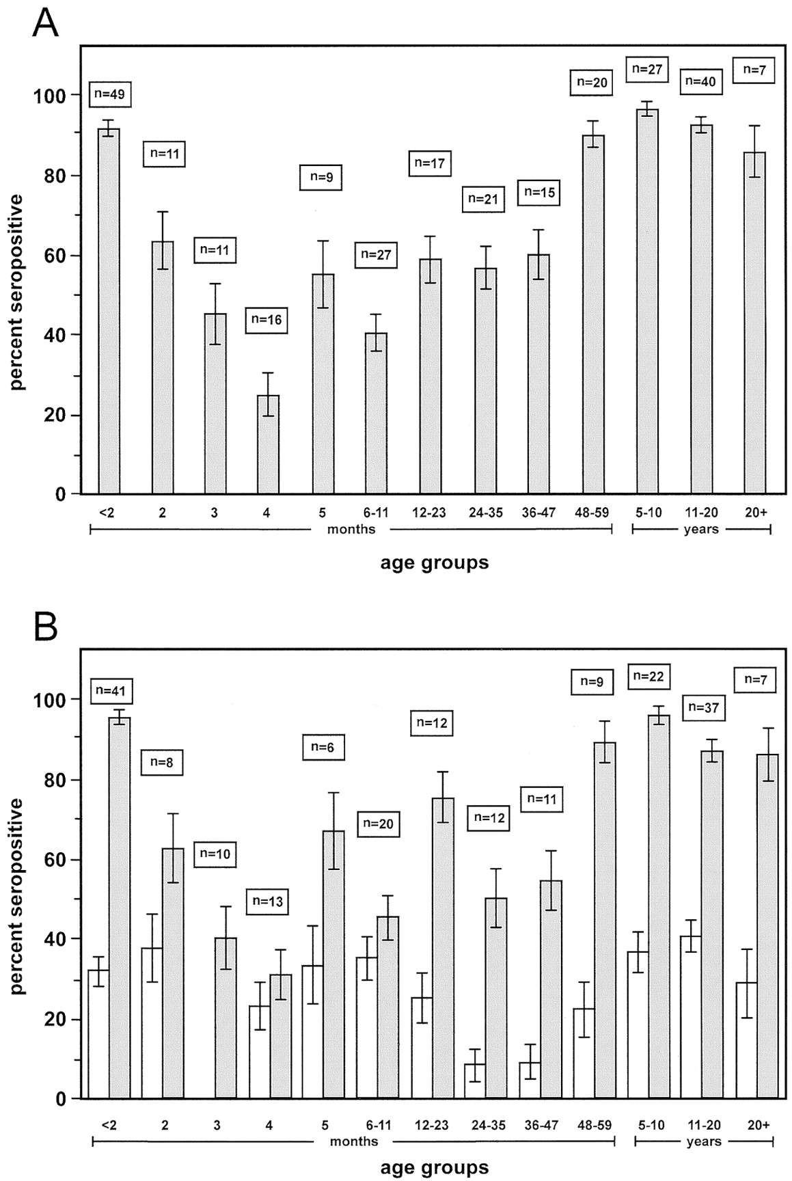
Figure 6. Age distribution of individuals seropositive for human bocavirus (HBoV) and B19 on the basis of virus-like ...
Notes:
Figure 6. Age distribution of individuals seropositive for human bocavirus (HBoV) and B19 on the basis of virus-like particle ELISAs. Serum samples from 270 individuals were screened for HBoV-specific antibodies (A), and a subset of 208 were also screened for B19-specific antibodies (B). The no. of serum samples screened and the percentage of seropositive individuals are shown for each age group; bars indicate SEs.
Unless provided in the caption above, the following copyright applies to the content of this slide: © 2008 by the Infectious Diseases Society of America.

Slide 4
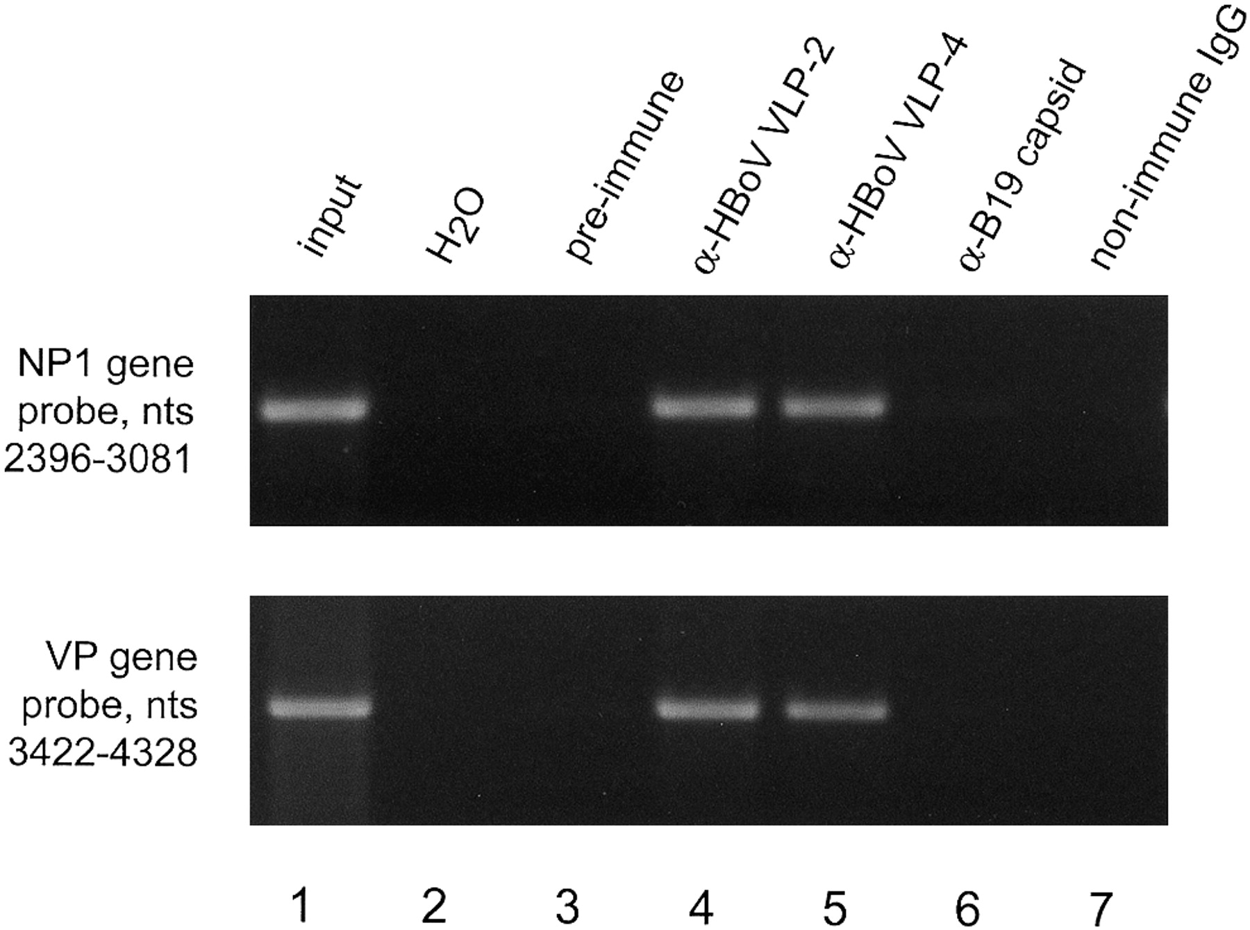
Figure 2. Immunoprecipitation of authentic human bocavirus (HBoV) by anti–virus-like particle (VLP) antibodies. HBoV ...
Notes:
Figure 2. Immunoprecipitation of authentic human bocavirus (HBoV) by anti–virus-like particle (VLP) antibodies. HBoV NP1–specific (top) and VP-specific (bottom) polymerase chain reaction (PCR) products were generated from pooled patient respiratory tract samples precipitated with preimmune rabbit serum (lane 3) or rabbit serum after 2 (lane 4) or 4 (lane 5) months of serial immunization with purified HBoV VLPs. Lane 1 shows PCR products from the input sample before immunoprecipitation, and lane 2 (H2O) shows products in the absence of target DNA. Lanes 6 and 7 show the results of immunoprecipitation with anti-B19 immune rabbit antiserum or control nonimmune serum, respectively.
Unless provided in the caption above, the following copyright applies to the content of this slide: © 2008 by the Infectious Diseases Society of America.

Slide 5
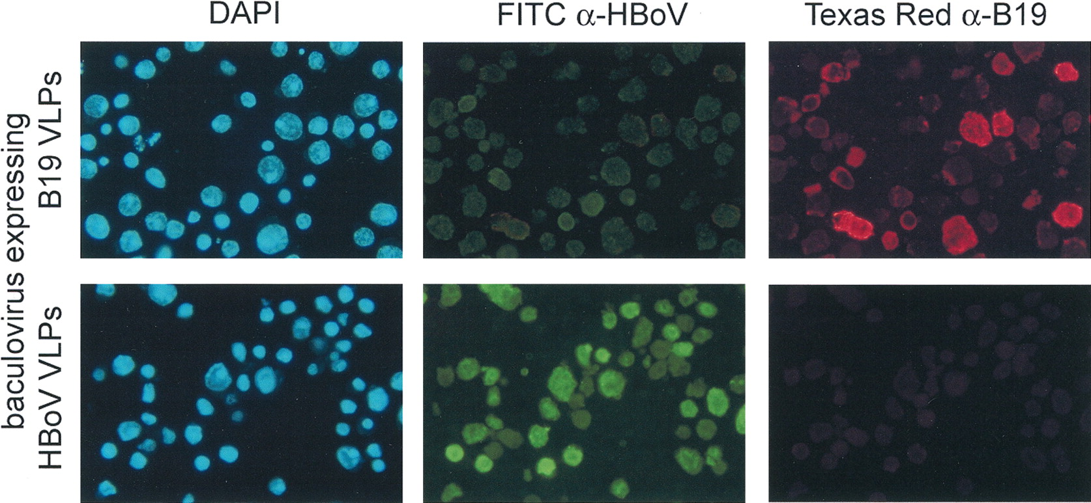
Figure 3. Antigenic distinctness of the human parvoviruses human bocavirus (HBoV) and B19, as demonstrated by ...
Notes:
Figure 3. Antigenic distinctness of the human parvoviruses human bocavirus (HBoV) and B19, as demonstrated by immunofluorescence. Sf9 insect cells infected with recombinant baculovirus expressing either HBoV virus-like particles (VLPs) or B19 VLPs were stained with rabbit antiserum specific for HBoV VLPs, detected with fluorescein isothiocyanate (FITC)–conjugated secondary antibody, or with murine monoclonal antibody specific for B19 particles, detected with a Texas red– conjugated secondary antibody. For each recombinant baculovirus–infected cell culture, the same field is shown. The nuclei of all cells were stained with 4'-6-diamidino-2-phenylindole (DAPI). Original magnification, ×40.
Unless provided in the caption above, the following copyright applies to the content of this slide: © 2008 by the Infectious Diseases Society of America.

Slide 6
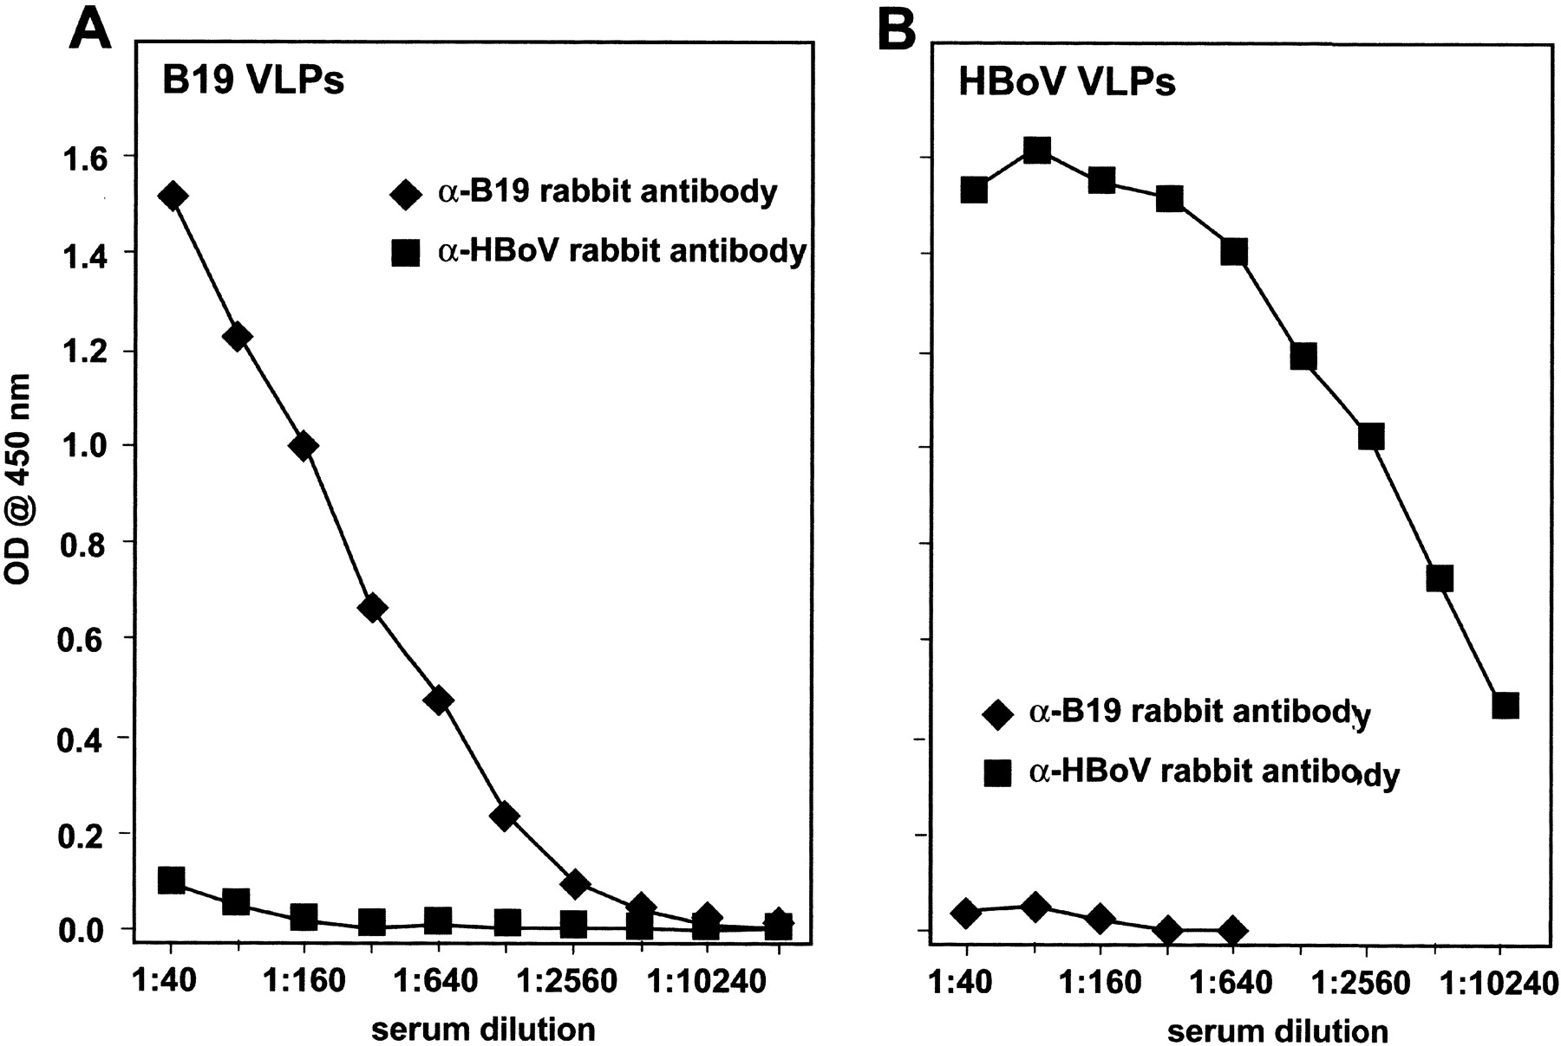
Figure 4. Antigenic distinctness of the human parvoviruses human bocavirus (HBoV) and B19, as demonstrated by ELISA. ...
Notes:
Figure 4. Antigenic distinctness of the human parvoviruses human bocavirus (HBoV) and B19, as demonstrated by ELISA. B19 (A) and HBoV (B) virus-like particle (VLP)-based ELISAs were performed with experimental rabbit antisera, as described in Methods.
Unless provided in the caption above, the following copyright applies to the content of this slide: © 2008 by the Infectious Diseases Society of America.

