Slide 1
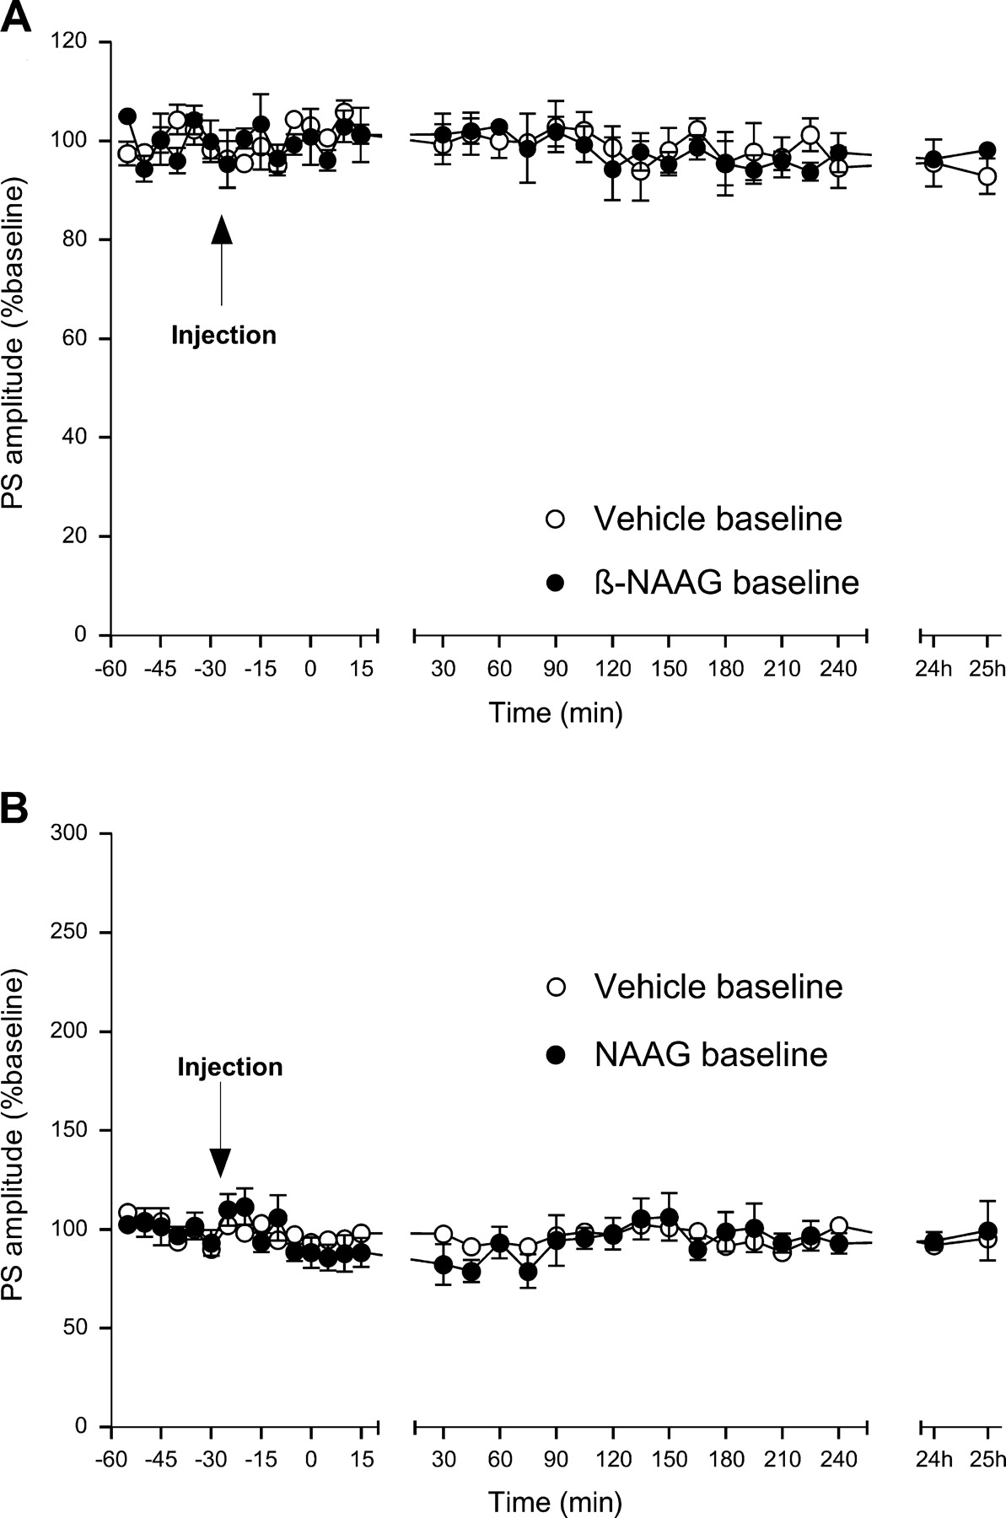
Figure 1. Basal transmission in the dentate gyrus in vivo is not affected by drug injection. (A) Application of 61 μg ...
Notes:
Figure 1. Basal transmission in the dentate gyrus in vivo is not affected by drug injection. (A) Application of 61 μg of the selective mGliuR3 antagonist β-NAAG (n = 4) results in an unchanged basal synaptic transmission compared with vehicle treated controls (n = 4). (B) Injection of 3 μg of the selective mGluR3 agonist NAAG (n = 6) does not affect basal synaptic transmission compared with controls (n = 6). Data are shown for PS values. Line breaks indicate change in time-scale.
Unless provided in the caption above, the following copyright applies to the content of this slide: © Oxford University Press 2005; all rights reserved

Slide 2
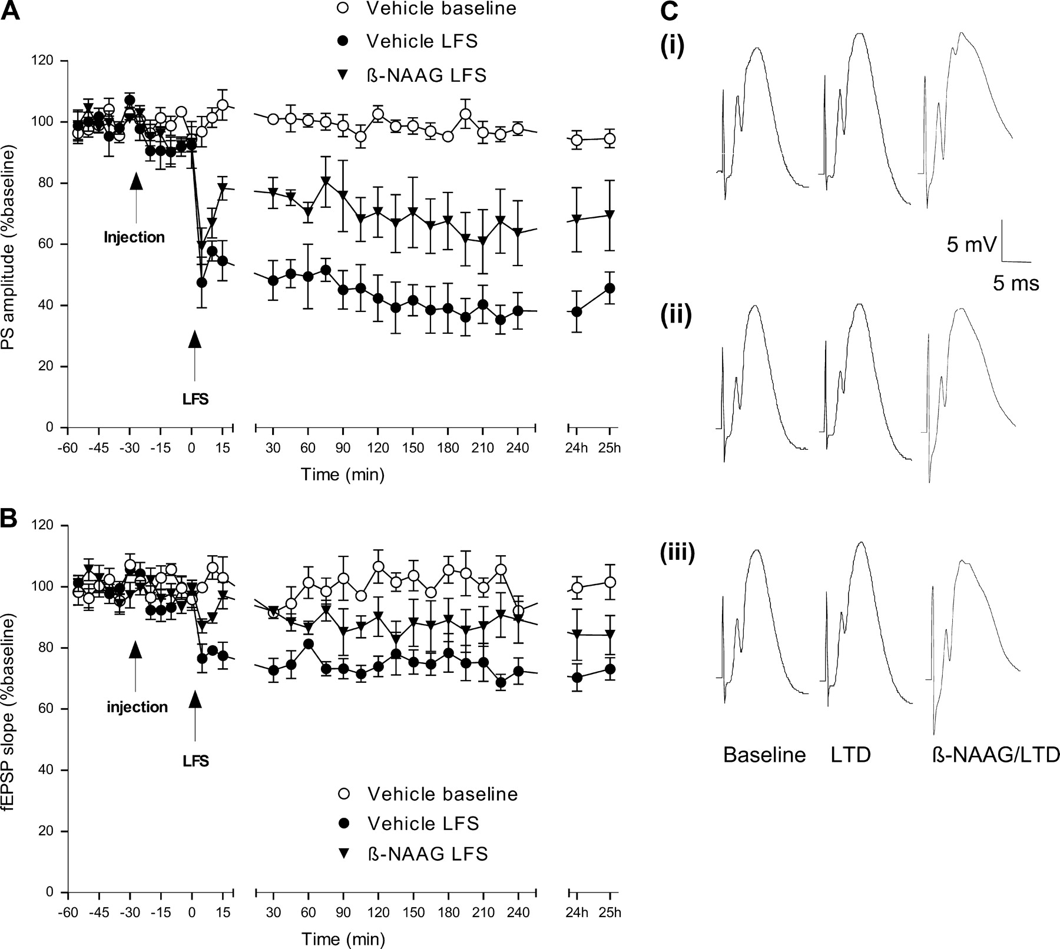
Figure 2. LTD in the dentate gyrus in vivo is dependent on mGluR3 receptor activation. (A, B) The mGluR3 antagonist ...
Notes:
Figure 2. LTD in the dentate gyrus in vivo is dependent on mGluR3 receptor activation. (A, B) The mGluR3 antagonist β-NAAG (61 μg) significantly inhibits the expression of LTD (n = 5) compared with vehicle injected controls (n = 5). This applies for PS amplitude (A) as well as fEPSP slope (B). (C) Original analogue traces showing evoked responses in the dentate gyrus at three time points: (i) preinjection, (ii) t = 5 min and (iii) t = 24 h post-LFS. Analogues from vehicle baseline, vehicle LFS and β-NAAG LFS experiments are compared.
Unless provided in the caption above, the following copyright applies to the content of this slide: © Oxford University Press 2005; all rights reserved

Slide 3
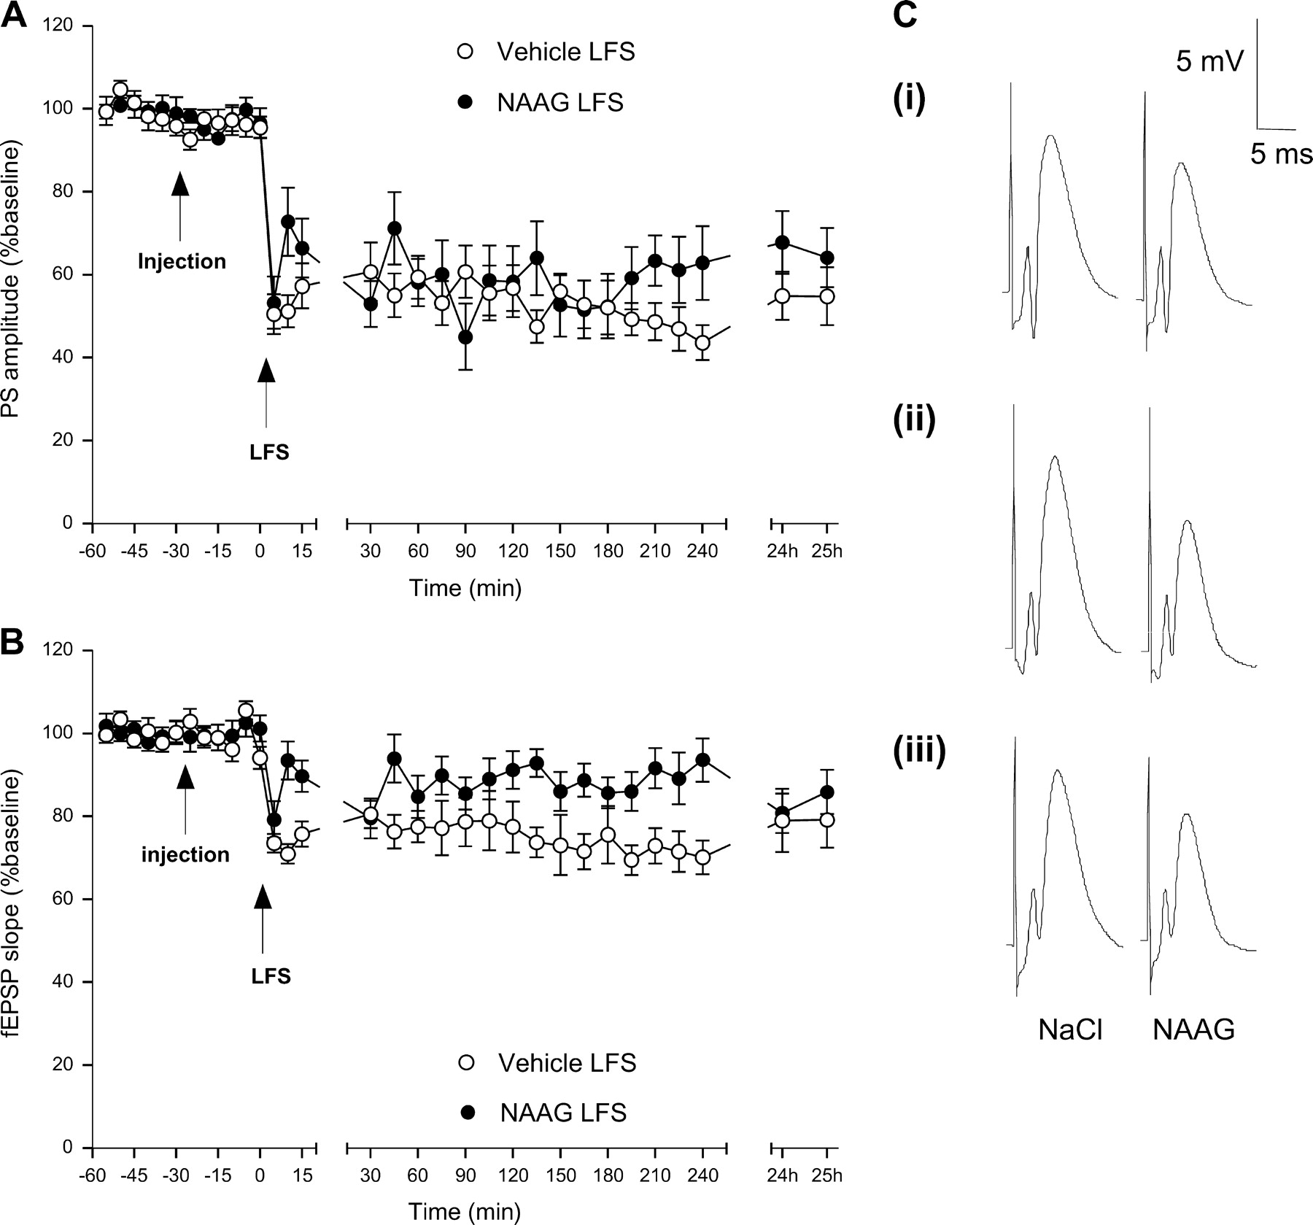
Figure 3. LTD in the dentate gyrus in vivo is inhibited by the mGluR3 agonist NAAG. (A, B) The mGluR3 agonist NAAG (3 ...
Notes:
Figure 3. LTD in the dentate gyrus in vivo is inhibited by the mGluR3 agonist NAAG. (A, B) The mGluR3 agonist NAAG (3 μg) significantly inhibits LTD of PS amplitude (A) and fEPSP slope (B) (n = 10) compared with vehicle treated controls (n = 10). Inhibition affects exclusively the intermediate phase of LTD expression. (C) Original analogue traces showing evoked responses in the dentate gyrus at three time points: (i) preinjection, (ii) t = 5 min and (iii) t = 24 h post-LFS. Analogues from vehicle LFS and NAAG LFS experiments are compared.
Unless provided in the caption above, the following copyright applies to the content of this slide: © Oxford University Press 2005; all rights reserved

Slide 4
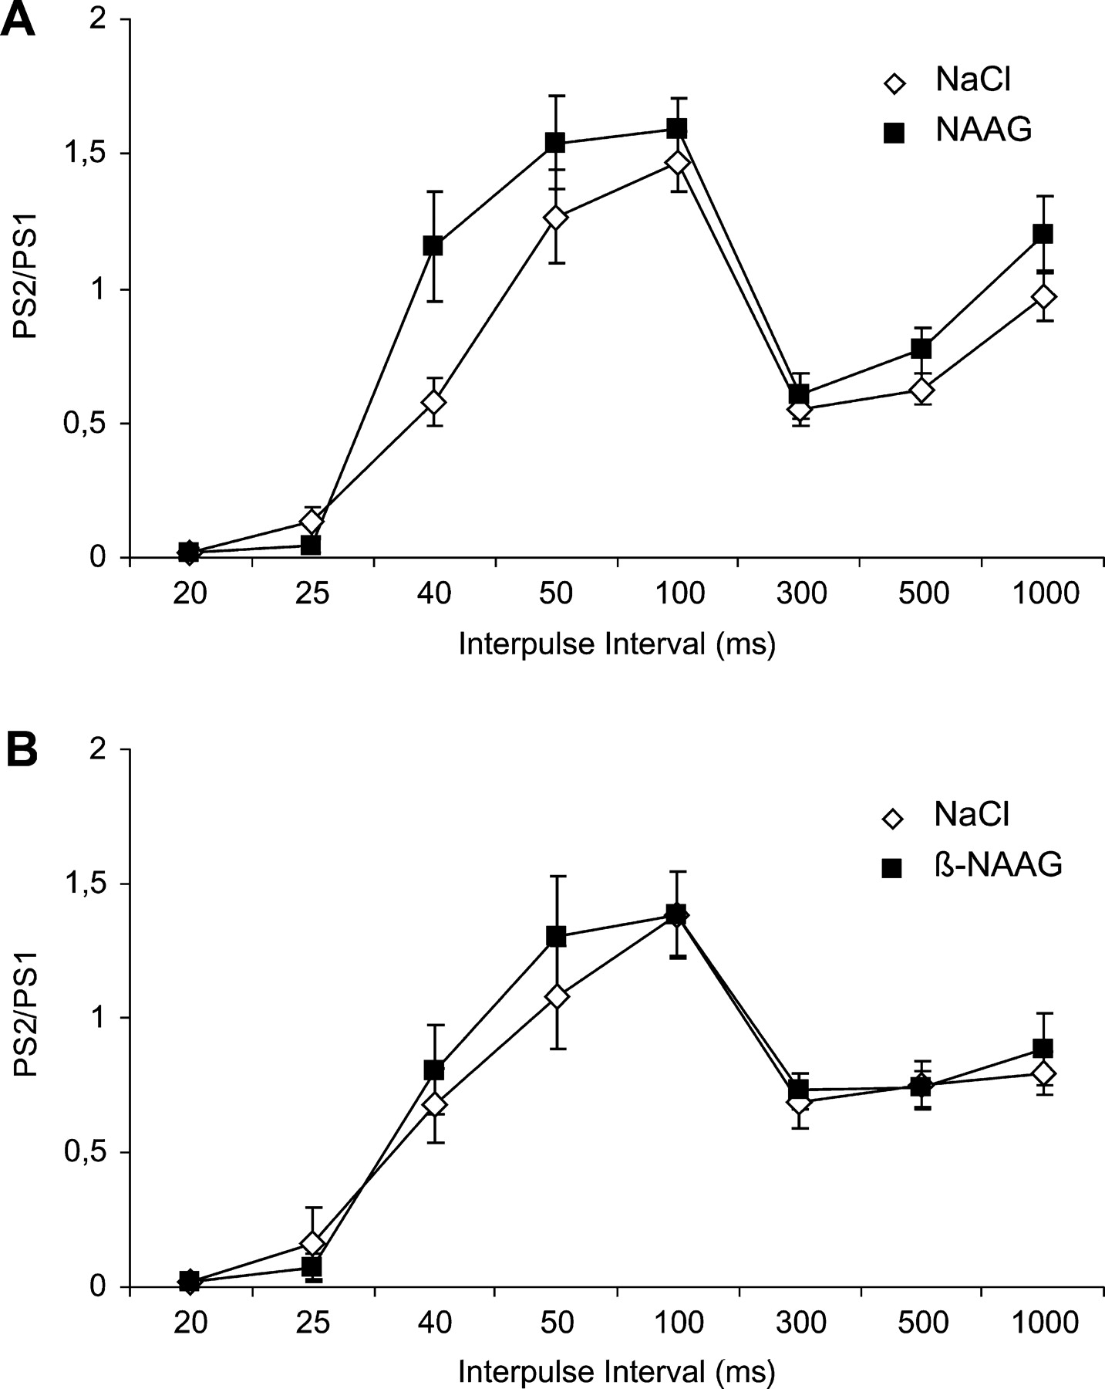
Figure 4. Paired-pulse depression is inhibited by mGluR3 receptor activation. (A) The mGluR3 agonist NAAG (3 μg) ...
Notes:
Figure 4. Paired-pulse depression is inhibited by mGluR3 receptor activation. (A) The mGluR3 agonist NAAG (3 μg) significantly inhibits PP depression at an interpulse interval of 40 ms (n = 20). (B) Paired-pulse expression is not affected by application of the mGluR3 antagonist β-NAAG (61 μg) (n = 11).
Unless provided in the caption above, the following copyright applies to the content of this slide: © Oxford University Press 2005; all rights reserved

Slide 5
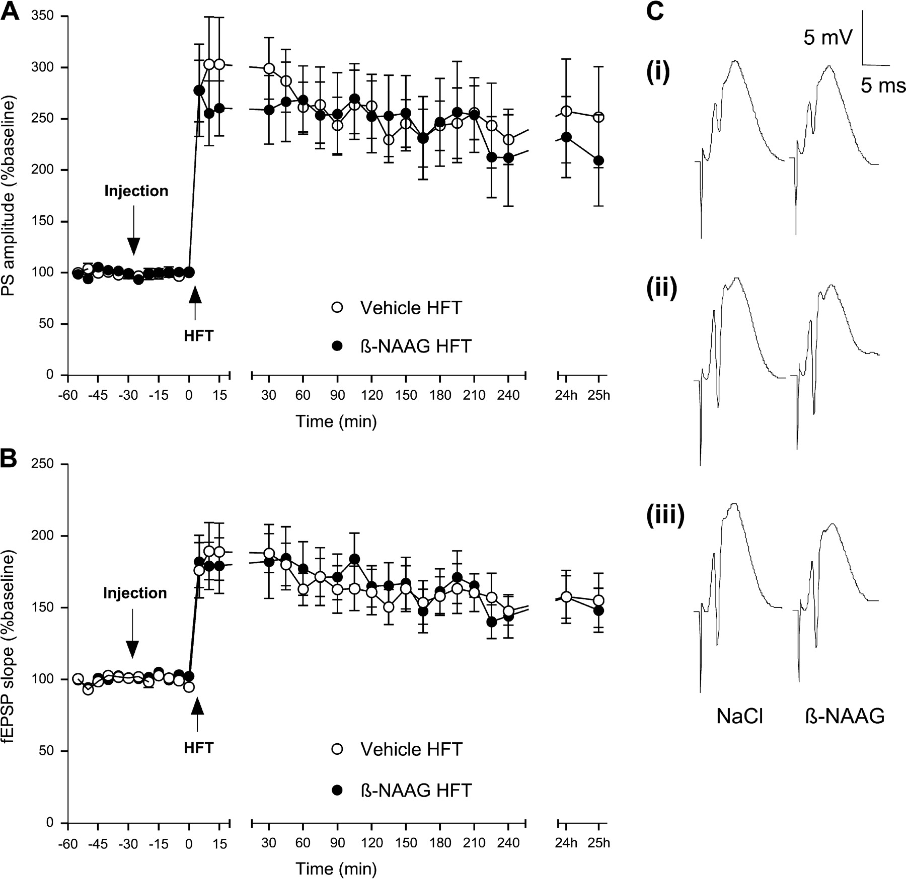
Figure 5. LTP in the dentate gyrus in vivo is not affected by the mGluR3 antagonist β-NAAG. (A, B) The mGluR3 ...
Notes:
Figure 5. LTP in the dentate gyrus in vivo is not affected by the mGluR3 antagonist β-NAAG. (A, B) The mGluR3 antagonist β-NAAG (61 μg) has no effect on LTP of either (A) PS amplitude or (B) fEPSP slope. (C) Original analogue traces showing evoked responses in the dentate gyrus at three time points: (i) preinjection, (ii) t = 5 min and (iii) t = 24 h post-LFS. Analogues from vehicle baseline, vehicle LFS and β-NAAG LFS experiments are compared.
Unless provided in the caption above, the following copyright applies to the content of this slide: © Oxford University Press 2005; all rights reserved

Slide 6
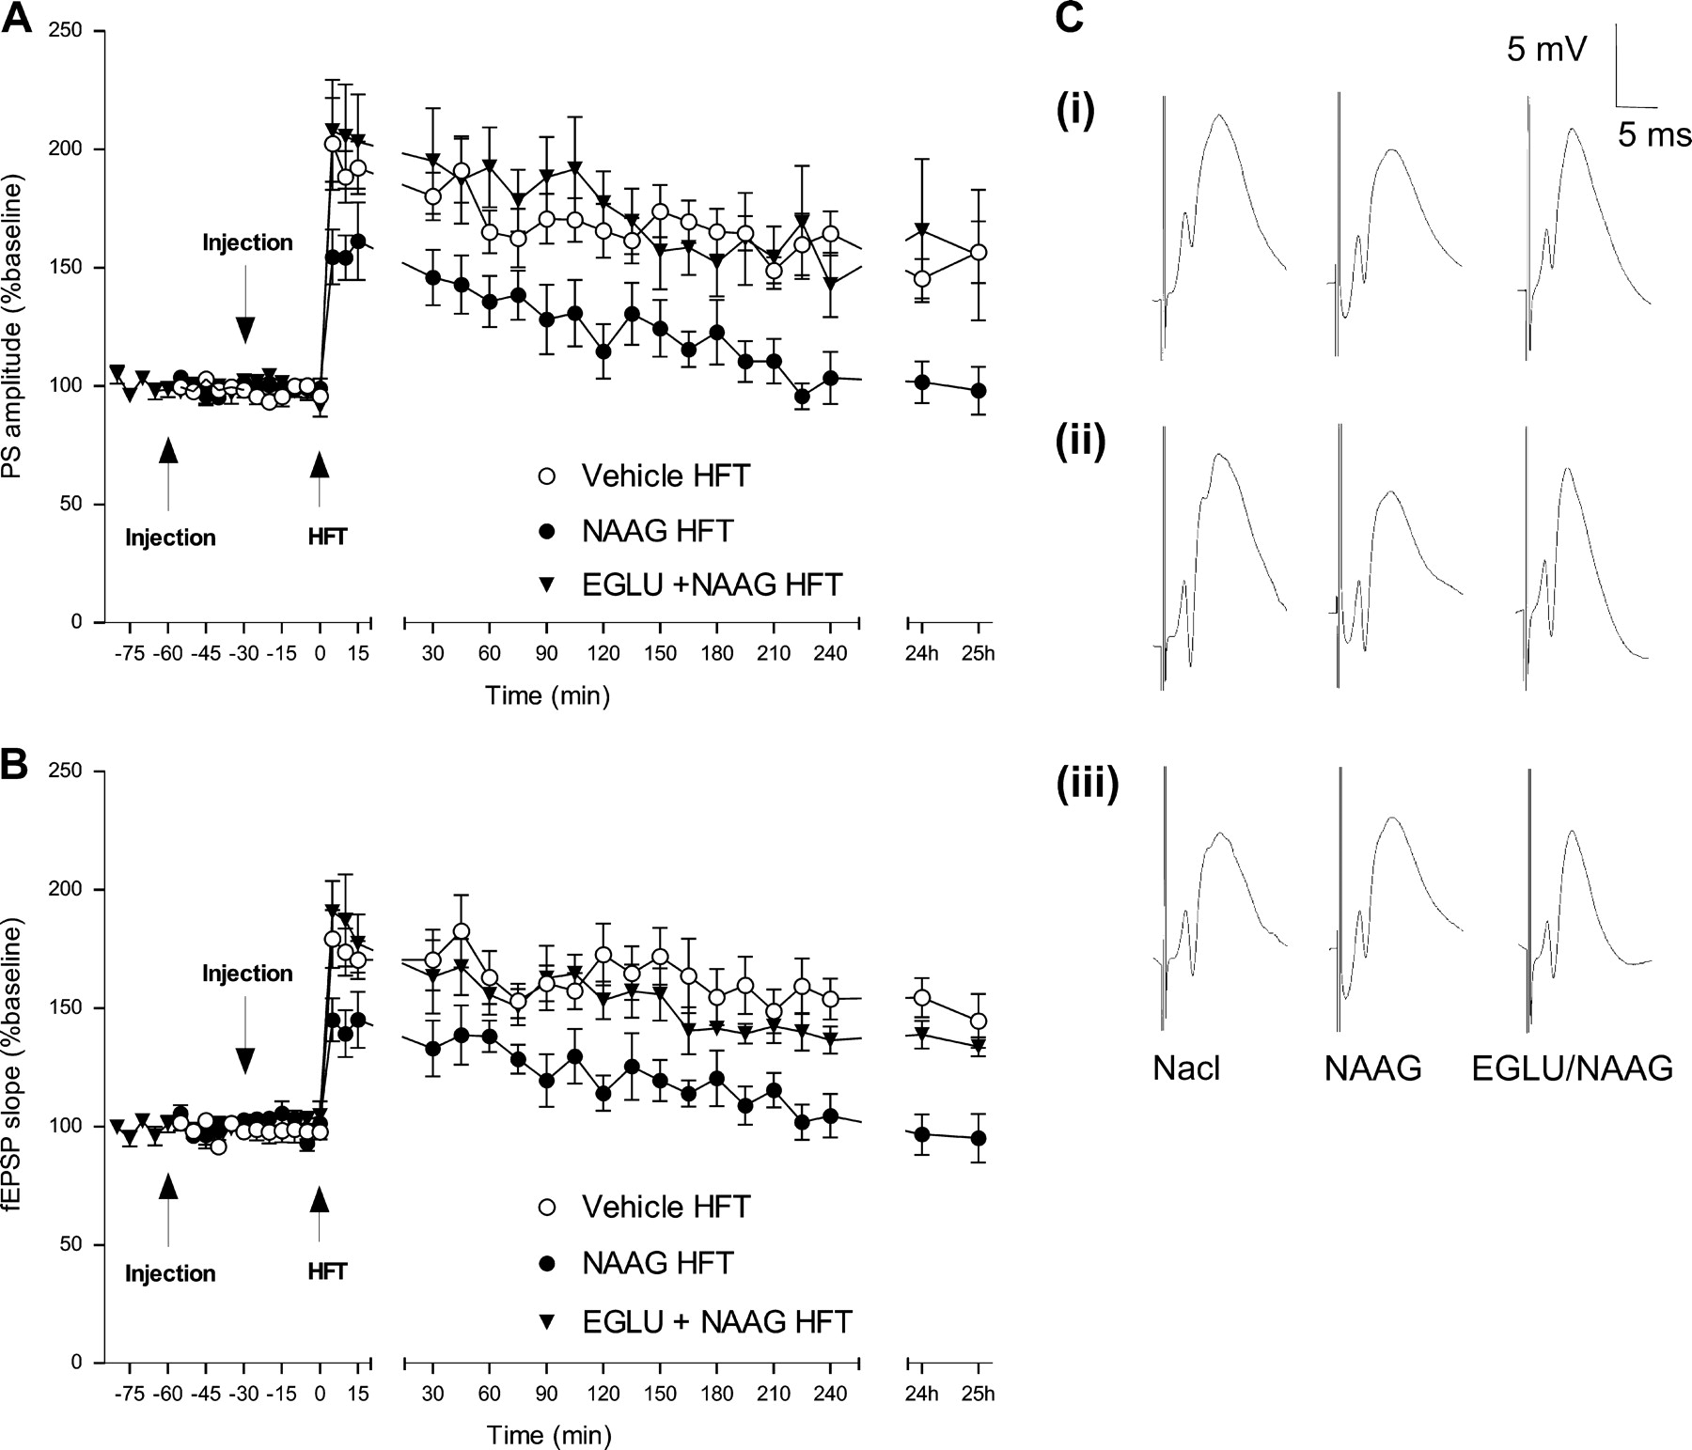
Figure 6. LTP in the dentate gyrus in vivo is modulated by mGluR3 receptor activation. (A, B) The mGluR3 agonist NAAG ...
Notes:
Figure 6. LTP in the dentate gyrus in vivo is modulated by mGluR3 receptor activation. (A, B) The mGluR3 agonist NAAG (3 μg) significantly inhibits the expression of LTP (n = 7) compared with vehicle injected controls (n = 11). The selective group II mGLuR antagonist EGLU (100 nmol) prevents the inhibitory effects of NAAG (3 μg) on LTP (n = 8). This is true for PS amplitude (A) and fEPSP slope (B). (C) Original analogue traces showing LTP responses in the dentate gyrus at three time points: (i) preinjection, (ii) t = 5 min and (iii) t = 24 h post-LFS. Analogues from vehicle baseline, vehicle LFS and β-NAAG LFS experiments are compared.
Unless provided in the caption above, the following copyright applies to the content of this slide: © Oxford University Press 2005; all rights reserved

