Slide 1
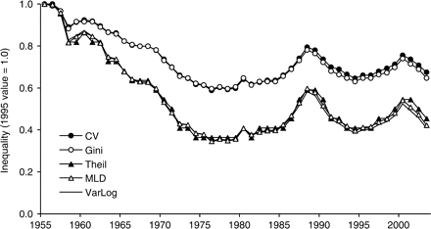
Figure 1. State per capita income inequality by CV, Gini coefficient, Theil index, MLD and VarLog, 1955–2003. To see ...
Notes:
Figure 1. State per capita income inequality by CV, Gini coefficient, Theil index, MLD and VarLog, 1955–2003. To see relative differences among the indices, each index is normalized to its 1955 value.
Unless provided in the caption above, the following copyright applies to the content of this slide: © The Author (2007). Published by Oxford University Press. All rights reserved. For Permissions, please email: journals.permissions@oxfordjournals.org

Slide 2
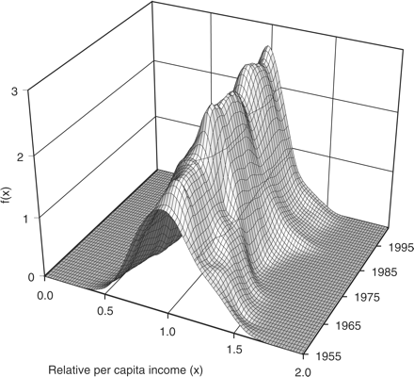
Figure 2. Distributional evolution of state per capita income, 1955–2003. Horizontal axis shows relative per capita ...
Notes:
Figure 2. Distributional evolution of state per capita income, 1955–2003. Horizontal axis shows relative per capita income (state per capita income divided by the mean of all state per capita incomes) for a given year, and the vertical axis shows its probability density.
Unless provided in the caption above, the following copyright applies to the content of this slide: © The Author (2007). Published by Oxford University Press. All rights reserved. For Permissions, please email: journals.permissions@oxfordjournals.org

Slide 3
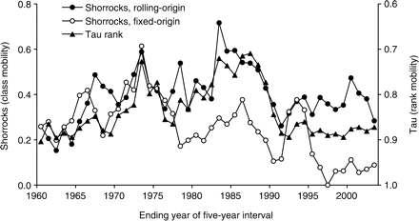
Figure 3. Mobilities of state income in Shorrocks (class mobility) and Tau (rank mobility) indices, 1955–2003, at ...
Notes:
Figure 3. Mobilities of state income in Shorrocks (class mobility) and Tau (rank mobility) indices, 1955–2003, at five-year intervals.
Unless provided in the caption above, the following copyright applies to the content of this slide: © The Author (2007). Published by Oxford University Press. All rights reserved. For Permissions, please email: journals.permissions@oxfordjournals.org

Slide 4
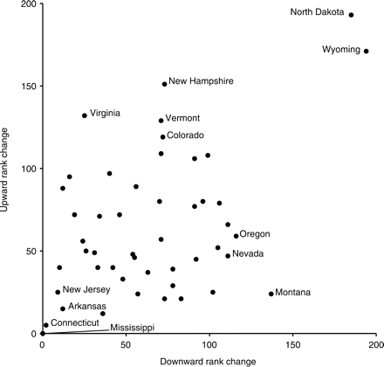
Figure 4. Cumulative per capita income rank changes for US states, 1955–2003. The value indicates the sum of a state's ...
Notes:
Figure 4. Cumulative per capita income rank changes for US states, 1955–2003. The value indicates the sum of a state's per capita income rank changes, either upward (on vertical axis) or downward (on horizontal axis), at rolling five-year intervals.
Unless provided in the caption above, the following copyright applies to the content of this slide: © The Author (2007). Published by Oxford University Press. All rights reserved. For Permissions, please email: journals.permissions@oxfordjournals.org

Slide 5
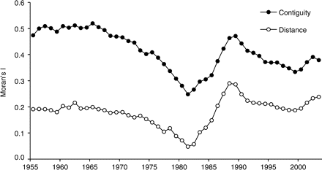
Figure 5. Spatial autocorrelation (Moran's I) of state per capita income based on two spatial weight matrices ...
Notes:
Figure 5. Spatial autocorrelation (Moran's I) of state per capita income based on two spatial weight matrices (contiguity and distance), 1955–2001.
Unless provided in the caption above, the following copyright applies to the content of this slide: © The Author (2007). Published by Oxford University Press. All rights reserved. For Permissions, please email: journals.permissions@oxfordjournals.org

Slide 6
Figure 6. Spatial income inequality at four scales in coefficient of variation and Theil index, 1955–2003.
Notes:
Figure 6. Spatial income inequality at four scales in coefficient of variation and Theil index, 1955–2003.
Unless provided in the caption above, the following copyright applies to the content of this slide: © The Author (2007). Published by Oxford University Press. All rights reserved. For Permissions, please email: journals.permissions@oxfordjournals.org

Slide 7
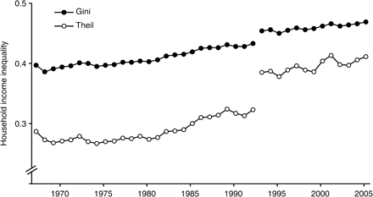
Figure 7. Household scale income inequality in the USA, 1967–2005. Direct comparisons of data before and after 1993 are ...
Notes:
Figure 7. Household scale income inequality in the USA, 1967–2005. Direct comparisons of data before and after 1993 are not recommended because of substantial methodological changes in the 1994 Annual Social and Economic Supplements (U.S. Census Bureau, 2006, p. 8). Source: U.S. Census Bureau (2006).
Unless provided in the caption above, the following copyright applies to the content of this slide: © The Author (2007). Published by Oxford University Press. All rights reserved. For Permissions, please email: journals.permissions@oxfordjournals.org

Slide 8
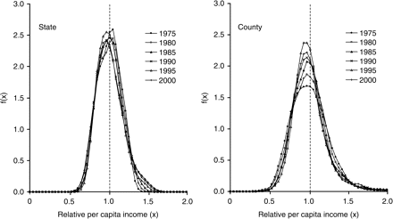
Figure 8. Distributional evolution of per capita income at state and county scales, 1957–2005. Probability density ...
Notes:
Figure 8. Distributional evolution of per capita income at state and county scales, 1957–2005. Probability density curves are shown for relative per capita income level at five-year intervals.
Unless provided in the caption above, the following copyright applies to the content of this slide: © The Author (2007). Published by Oxford University Press. All rights reserved. For Permissions, please email: journals.permissions@oxfordjournals.org

Slide 9
Figure 9. Mobilities of regional incomes at county, economic area and state scales in Shorrocks (class mobility) and ...
Notes:
Figure 9. Mobilities of regional incomes at county, economic area and state scales in Shorrocks (class mobility) and Tau (rank mobility) indices, 1955–2003, at five-year intervals.
Unless provided in the caption above, the following copyright applies to the content of this slide: © The Author (2007). Published by Oxford University Press. All rights reserved. For Permissions, please email: journals.permissions@oxfordjournals.org

Slide 10
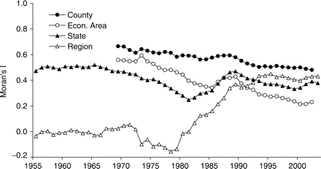
Figure 10. Spatial autocorrelation (Moran's I) of per capita income at four scales, 1955–2003.
Notes:
Figure 10. Spatial autocorrelation (Moran's I) of per capita income at four scales, 1955–2003.
Unless provided in the caption above, the following copyright applies to the content of this slide: © The Author (2007). Published by Oxford University Press. All rights reserved. For Permissions, please email: journals.permissions@oxfordjournals.org

Slide 11
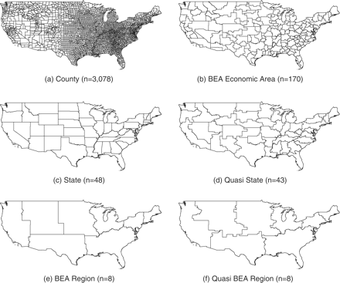
Figure 11. Hierarchical scalar structure in the USA for scale variance analysis. Counties, BEA economic areas, ...
Notes:
Figure 11. Hierarchical scalar structure in the USA for scale variance analysis. Counties, BEA economic areas, Quasi-states and Quasi-BEA regions are completely nested in their upper-level scales.
Unless provided in the caption above, the following copyright applies to the content of this slide: © The Author (2007). Published by Oxford University Press. All rights reserved. For Permissions, please email: journals.permissions@oxfordjournals.org

Slide 12
Figure 12. Scale variances and percent sums of squares based on per capita income at four spatial scales, 1969–2002.
Notes:
Figure 12. Scale variances and percent sums of squares based on per capita income at four spatial scales, 1969–2002.
Unless provided in the caption above, the following copyright applies to the content of this slide: © The Author (2007). Published by Oxford University Press. All rights reserved. For Permissions, please email: journals.permissions@oxfordjournals.org

Slide 13
Figure 13. Scale variances and percent sums of squares based on per capita income at five spatial scales, 1969–2002.
Notes:
Figure 13. Scale variances and percent sums of squares based on per capita income at five spatial scales, 1969–2002.
Unless provided in the caption above, the following copyright applies to the content of this slide: © The Author (2007). Published by Oxford University Press. All rights reserved. For Permissions, please email: journals.permissions@oxfordjournals.org

