Slide 1
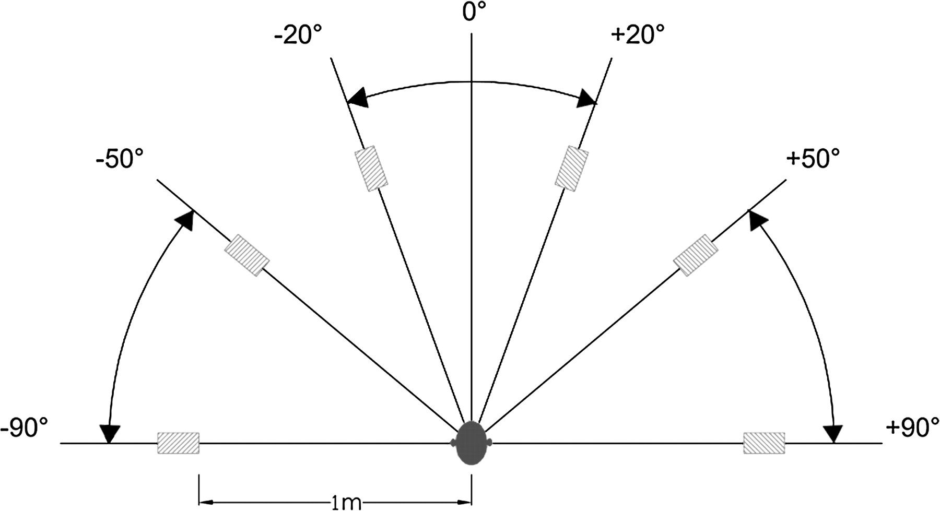
Figure 1. Stimuli are delivered from 5 different spatial locations: the vertical head-centered meridian (0°), the right ...
Notes:
Figure 1. Stimuli are delivered from 5 different spatial locations: the vertical head-centered meridian (0°), the right angles to the meridian axis on both sides (left −90°, right +90°), and 40° to the vertical head-centered meridian (left −50°, right +50).
Unless provided in the caption above, the following copyright applies to the content of this slide: © The Author 2007. Published by Oxford University Press. All rights reserved. For permissions, please e-mail: journals.permissions@oxfordjournals.org

Slide 2
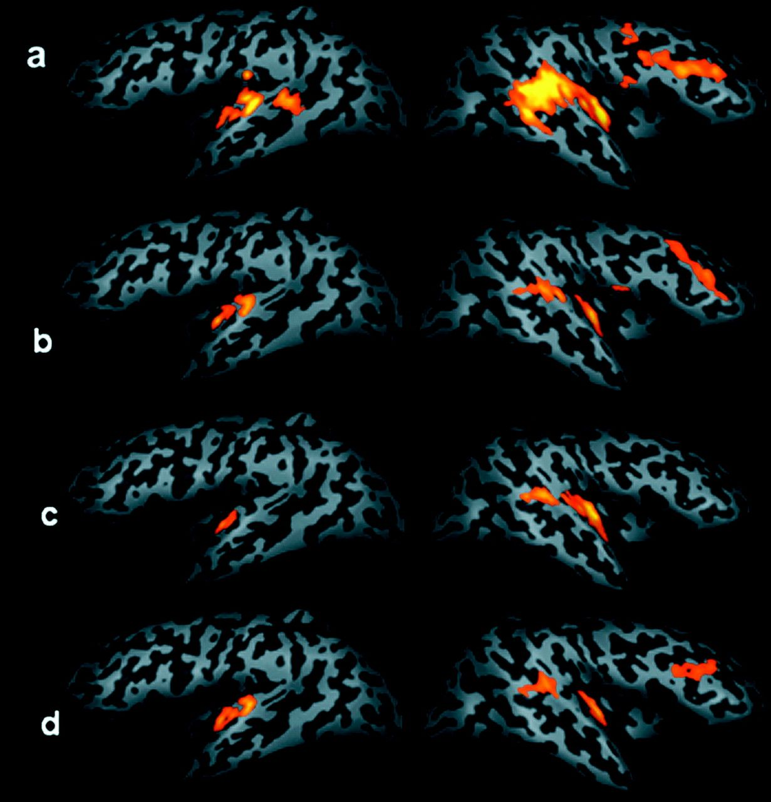
Figure 2. Results from the group analysis (P < 0.05, corrected) superimposed on the inflated cortex of a representative ...
Notes:
Figure 2. Results from the group analysis (P < 0.05, corrected) superimposed on the inflated cortex of a representative subject: activated areas during auditory stimulation in the 4 conditions: MIXED (a), RIGHT (b) LEFT (c), and CENTRAL (d). In the MIXED condition, activation in the bilateral Heschl's gyrus and in the right PSTg was more extended than in the other conditions. The PSTg activation extends dorsally (y = −55 in the right hemisphere). A right activation in the IPL is also observable. Activation in the PFC in the right hemisphere is present in the MIXED, RIGHT, and CENTRAL conditions (note that the group statistical maps shows activation in the right frontal cortex in these 3 conditions, whereas the individual subject analysis shows the same region activated also during the LEFT condition [see Fig. 3]).
Unless provided in the caption above, the following copyright applies to the content of this slide: © The Author 2007. Published by Oxford University Press. All rights reserved. For permissions, please e-mail: journals.permissions@oxfordjournals.org

Slide 3
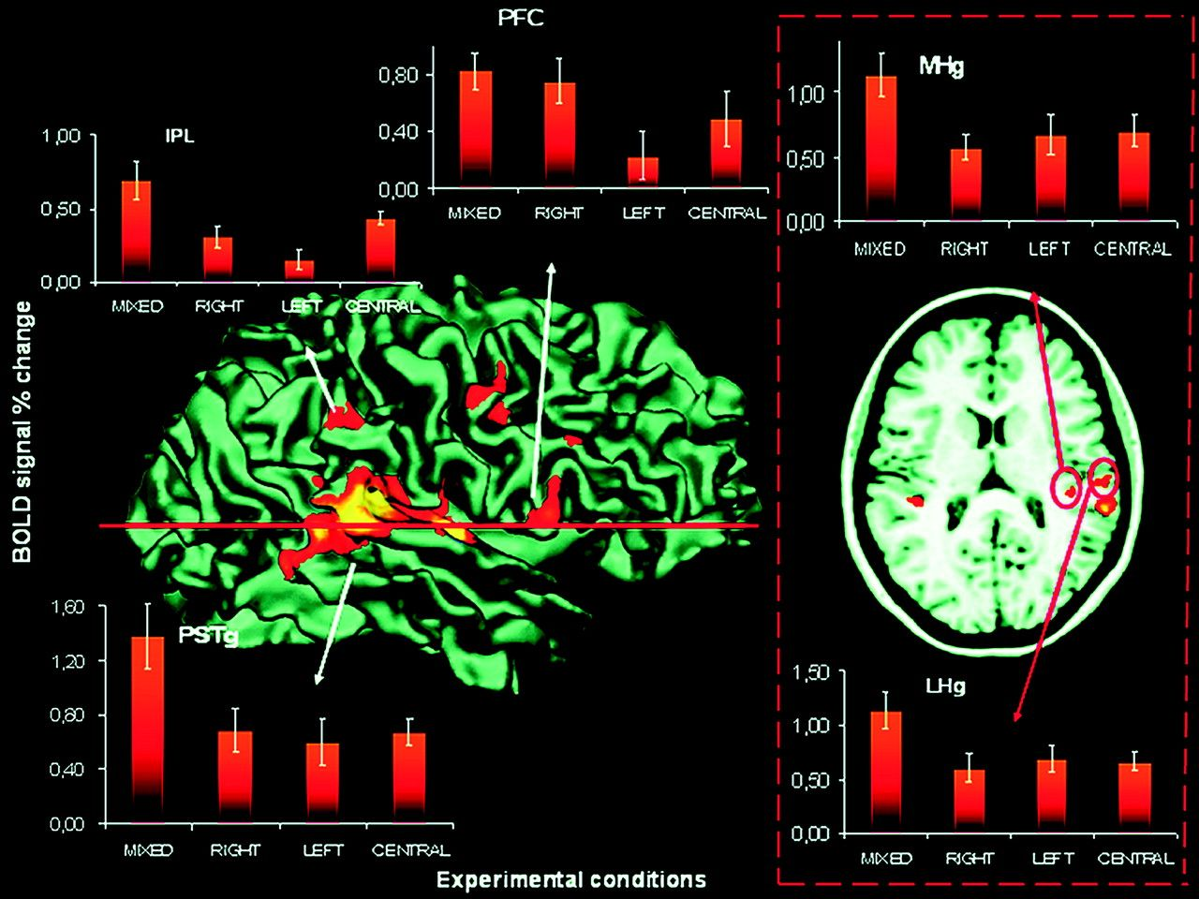
Figure 3. Activated areas in subject n°5 during MIXED condition. Activation map is superimposed on the segmented cortex ...
Notes:
Figure 3. Activated areas in subject n°5 during MIXED condition. Activation map is superimposed on the segmented cortex (we decided to show the activation during the MIXED condition just for a representative purpose). In the box on the right side, activation map is superimposed on an axial section passing through supratemporal plane. View graphics: relative variation of the BOLD signal and standard error in the LHg and MHg, in the PSTg, in the supramarginal gyrus (IPL), and in the PFC across the 4 experimental conditions. The ANOVA analysis shows that the relative variation of the BOLD signal is higher in the MIXED condition than in the other conditions (see also table 2).
Unless provided in the caption above, the following copyright applies to the content of this slide: © The Author 2007. Published by Oxford University Press. All rights reserved. For permissions, please e-mail: journals.permissions@oxfordjournals.org

Slide 4
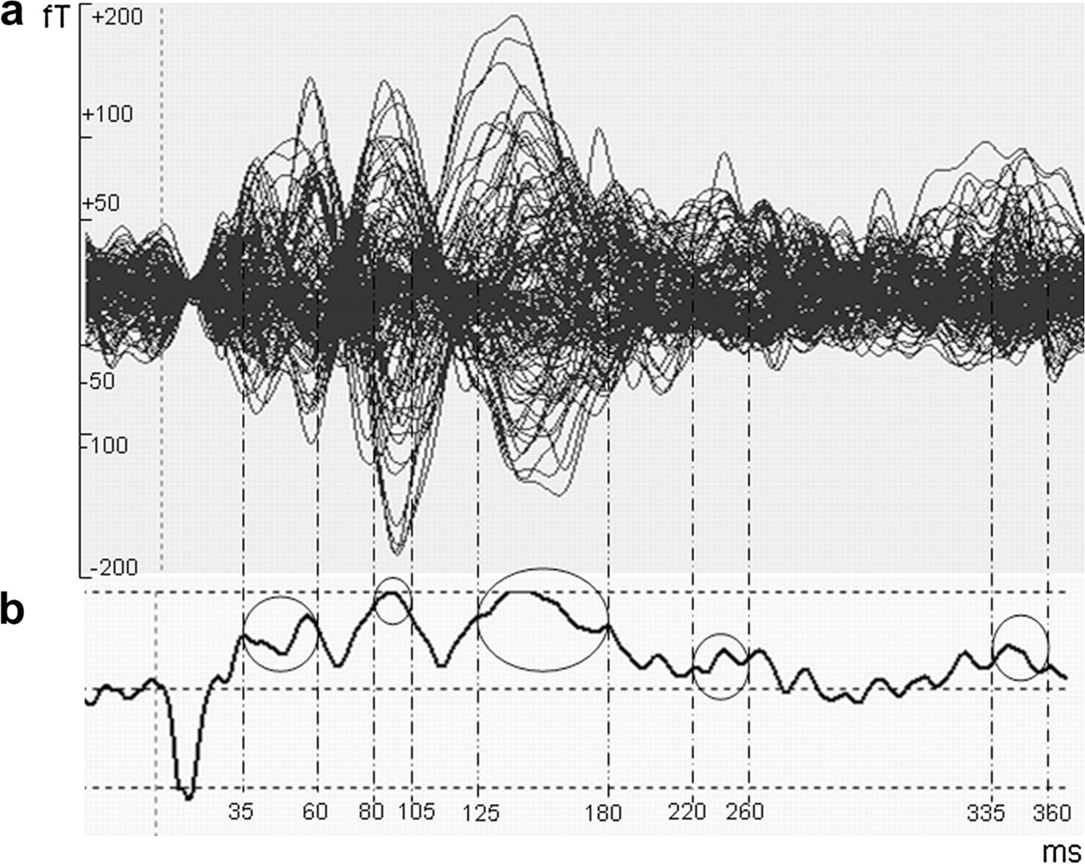
Figure 4. Butterfly plot of the evoked signals (a) and the global field power (b) for a representative subject. Time ...
Notes:
Figure 4. Butterfly plot of the evoked signals (a) and the global field power (b) for a representative subject. Time intervals used for dipole fit are shown. See also table 3 for further details.
Unless provided in the caption above, the following copyright applies to the content of this slide: © The Author 2007. Published by Oxford University Press. All rights reserved. For permissions, please e-mail: journals.permissions@oxfordjournals.org

Slide 5
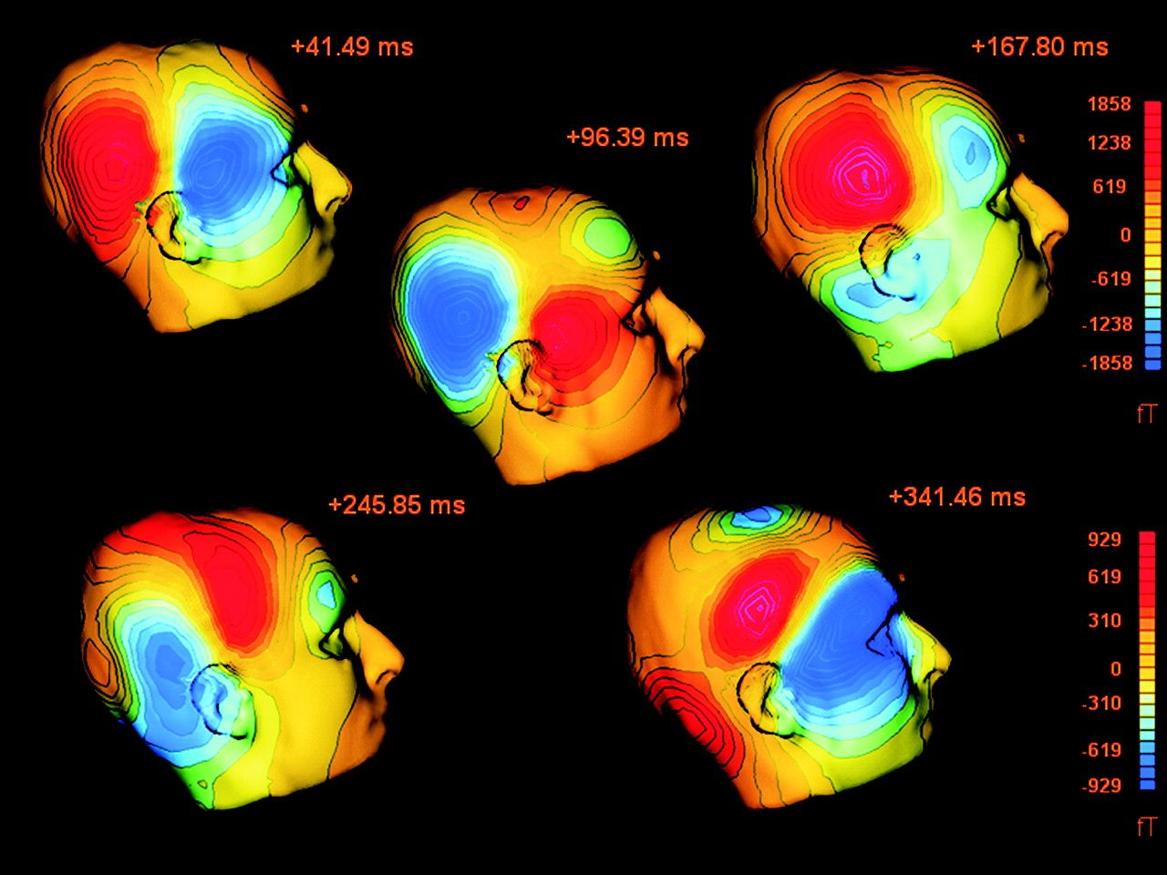
Figure 5. Field maps and isofield contours for a representative subject.
Notes:
Figure 5. Field maps and isofield contours for a representative subject.
Unless provided in the caption above, the following copyright applies to the content of this slide: © The Author 2007. Published by Oxford University Press. All rights reserved. For permissions, please e-mail: journals.permissions@oxfordjournals.org

Slide 6
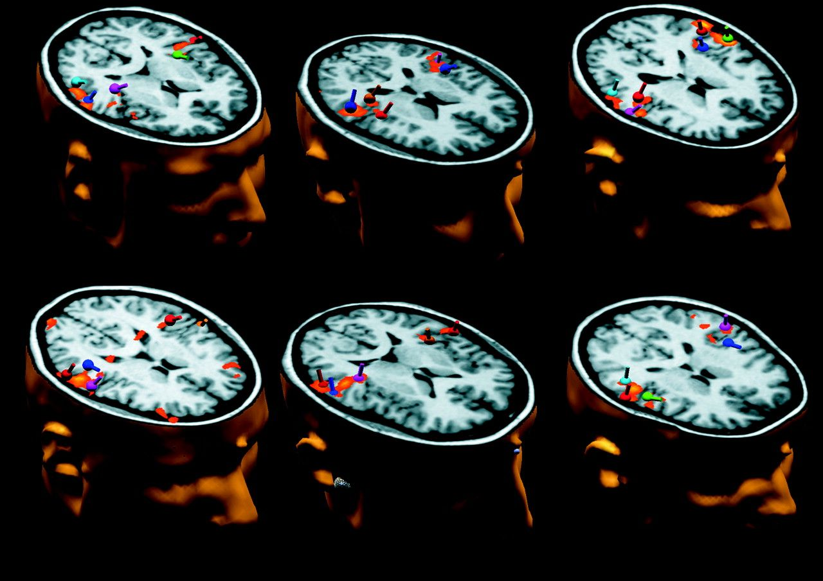
Figure 6. Individual dipole positions superimposed on the individual fMRI maps for the MIXED condition are shown for ...
Notes:
Figure 6. Individual dipole positions superimposed on the individual fMRI maps for the MIXED condition are shown for each subject.
Unless provided in the caption above, the following copyright applies to the content of this slide: © The Author 2007. Published by Oxford University Press. All rights reserved. For permissions, please e-mail: journals.permissions@oxfordjournals.org

Slide 7
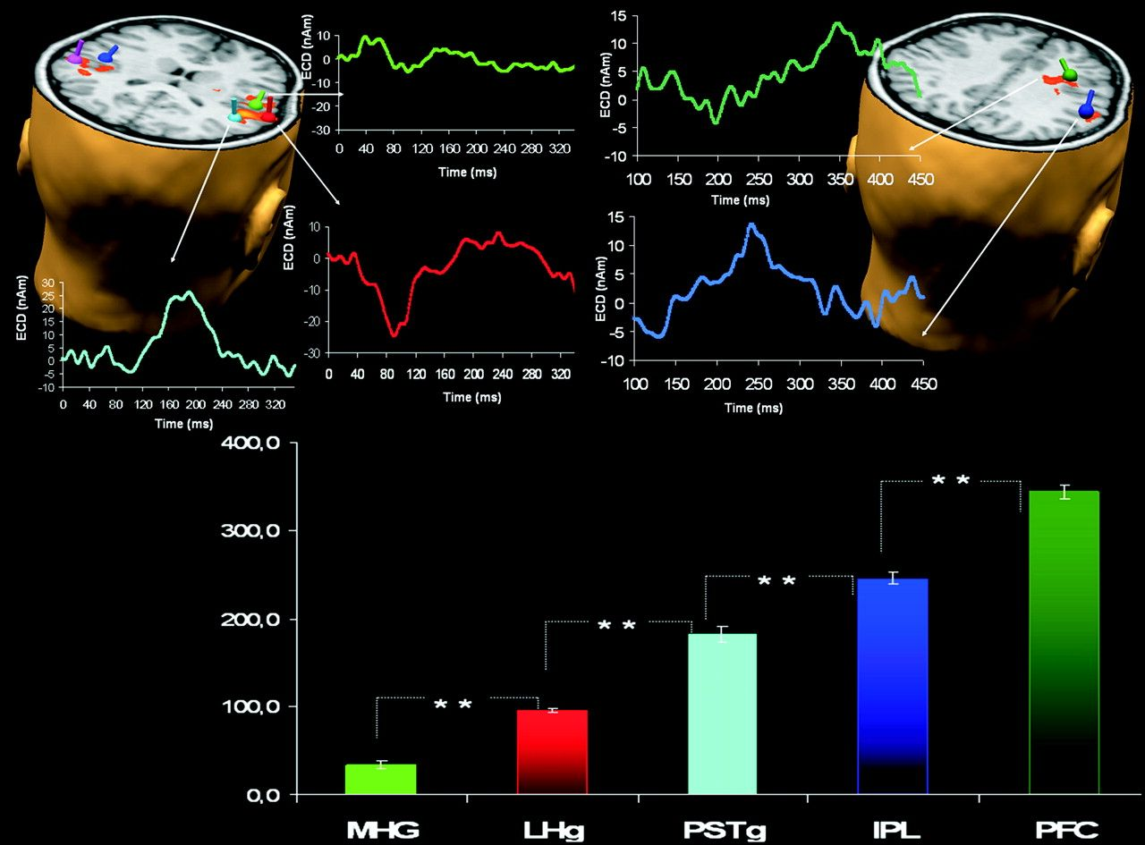
Figure 7. Upper: The seven ECDs modeling the evoked field are superimposed on the individual structural MRI—left side: ...
Notes:
Figure 7. Upper: The seven ECDs modeling the evoked field are superimposed on the individual structural MRI—left side: 3 sources in the supratemporal plane and the grand average of the waveform of the 3 sources in the right hemisphere; right side: 2 sources in the supramarginal gyrus and in the PFC and the grand average of the waveform of the 2 sources in the right hemisphere (the waveform color corresponds to the dipoles color). Lower: Mean latencies and standard error of the 5 sources in the right hemisphere: MHg and LHg, PSTg, supramarginal gyrus (in the IPL), and PFC. The ANOVA revealed a significant difference between the latencies of the 5 sources in the right hemisphere, with P < 0.01.
Unless provided in the caption above, the following copyright applies to the content of this slide: © The Author 2007. Published by Oxford University Press. All rights reserved. For permissions, please e-mail: journals.permissions@oxfordjournals.org

