Slide 1
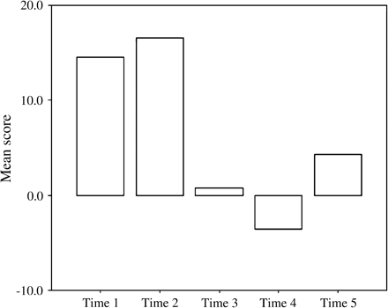
Figure 1 Mean scores for the Profile of Mood State overall mood disturbance measure.
Notes:
Figure 1 Mean scores for the Profile of Mood State overall mood disturbance measure.
Unless provided in the caption above, the following copyright applies to the content of this slide: © The Author 2006. Published by Oxford University Press. All rights reserved. For Permissions, please email: journals.permissions@oxfordjournals.org

Slide 2
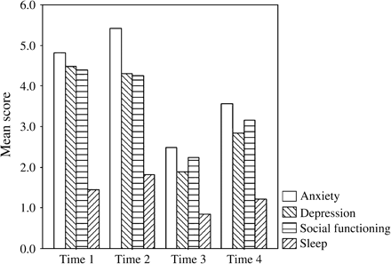
Figure 2 Mean scores for the General Health Questionnaire subscales over time.
Notes:
Figure 2 Mean scores for the General Health Questionnaire subscales over time.
Unless provided in the caption above, the following copyright applies to the content of this slide: © The Author 2006. Published by Oxford University Press. All rights reserved. For Permissions, please email: journals.permissions@oxfordjournals.org

Slide 3
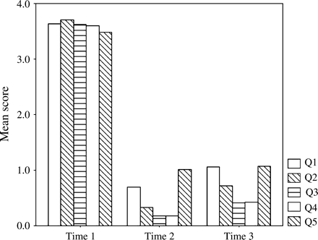
Figure 3 Mean ratings given to Hearing Dog Questionnaire Questions 1–5, relating to difficulty in responding to ...
Notes:
Figure 3 Mean ratings given to Hearing Dog Questionnaire Questions 1–5, relating to difficulty in responding to environmental sounds. Q1: Do you have difficulty responding to the environmental sounds of daily life? Q2: Do you have difficulty responding to the sound of the Alarm Clock? Q3: Do you have difficulty responding to the sound of the Doorbell/Door knock? Q4: Do you have difficulty responding to the sounds of the Smoke Alarm? Q5: Do you have difficulty responding to someone calling your name?
Unless provided in the caption above, the following copyright applies to the content of this slide: © The Author 2006. Published by Oxford University Press. All rights reserved. For Permissions, please email: journals.permissions@oxfordjournals.org

Slide 4
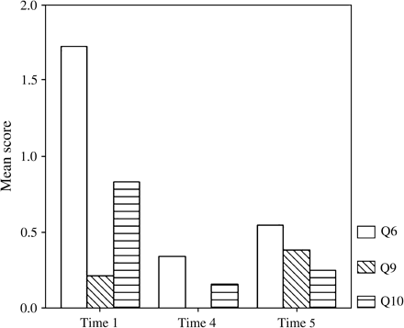
Figure 4 Mean ratings given to Hearing Dog Questionnaire Questions 6, 9, and 10, relating to fearfulness. Q6: Do you ...
Notes:
Figure 4 Mean ratings given to Hearing Dog Questionnaire Questions 6, 9, and 10, relating to fearfulness. Q6: Do you feel unsafe when you are alone? Q9: Are you fearful of leaving your home? Q10: Are you fearful of cars when walking outdoors?
Unless provided in the caption above, the following copyright applies to the content of this slide: © The Author 2006. Published by Oxford University Press. All rights reserved. For Permissions, please email: journals.permissions@oxfordjournals.org

Slide 5
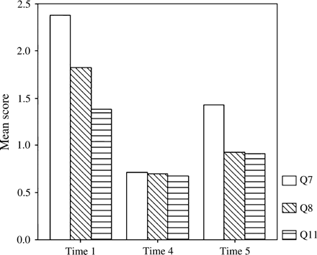
Figure 5 Mean ratings given to Hearing Dog Questionnaire Questions 7, 8, and 11, relating to feelings of social ...
Notes:
Figure 5 Mean ratings given to Hearing Dog Questionnaire Questions 7, 8, and 11, relating to feelings of social isolation. Q7: Are you dependent on others, parents, family members etc as your ears? Q8: Do you avoid interactions with other people? Q11: How much of the time do you feel lonely?
Unless provided in the caption above, the following copyright applies to the content of this slide: © The Author 2006. Published by Oxford University Press. All rights reserved. For Permissions, please email: journals.permissions@oxfordjournals.org

