Slide 1
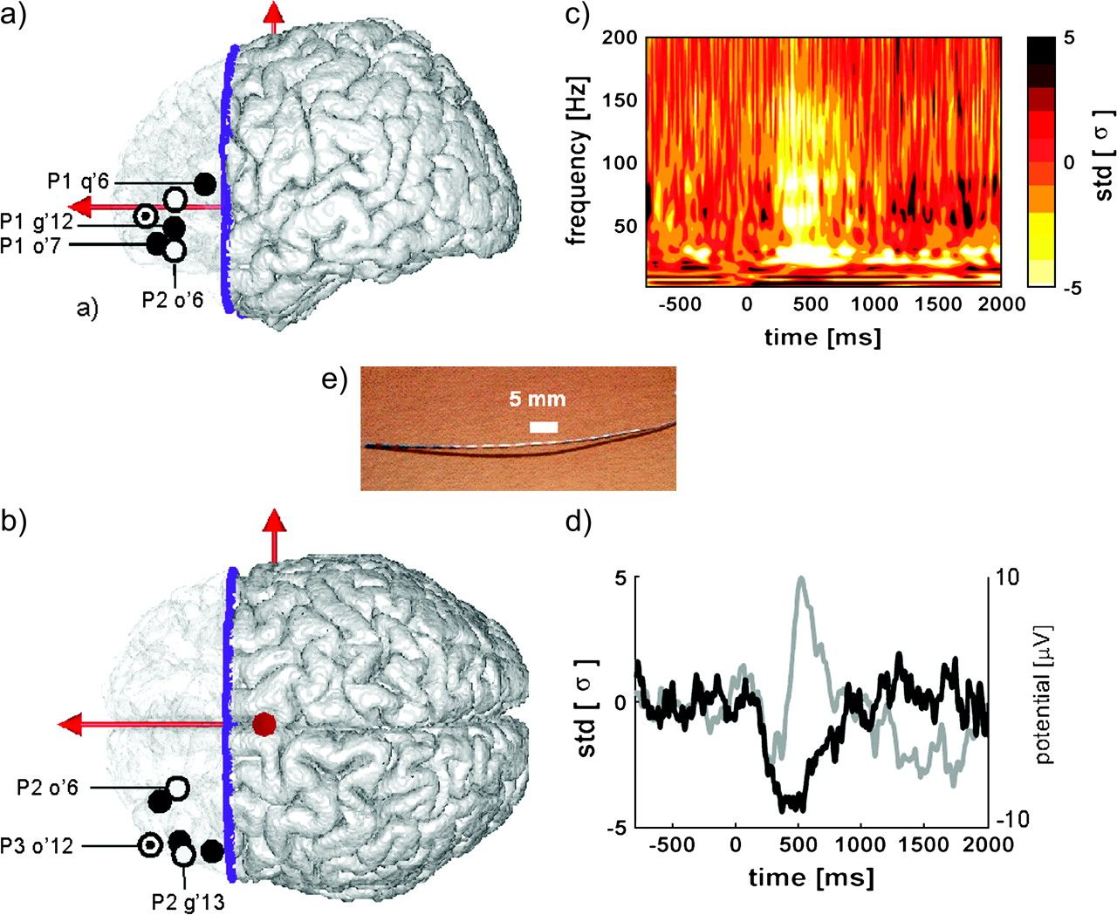
Figure 1. Transient deactivation in the ventral lateral prefrontal cortex during single word reading. Left panels show ...
Notes:
Figure 1. Transient deactivation in the ventral lateral prefrontal cortex during single word reading. Left panels show the localization of the 5 VLPFC sites showing stimulus-induced deactivations in the STRINGS experiment, projected onto the lateral and top view of a 3D reconstruction of the Montreal Neurological Institute single-subject magnetic resonance imaging. Patients are coded by colored symbols; the site names refer to Table 1. The figure also shows site q′6, in Broca area of patient P1, where a stimulus-induced activation was found. (c) TF representation of the energy modulation induced in site o′7 (P1) by words in the STRINGS experiment (semantic condition); for each frequency, the energy is expressed in units of the standard deviation of the (−200:−100 ms) prestimulus period. (d) Time course of the evoked potentials (in gray) and the energy modulation (in black) in the (20–150 Hz) frequency band (in standard deviation of the [−200:−100 ms] prestimulus period), same site and condition as in (c). Note that the deactivation can only be seen in the energy profile not in the evoked potential. (e) Multisites depth electrode.
Unless provided in the caption above, the following copyright applies to the content of this slide: © The Author 2007. Published by Oxford University Press. All rights reserved. For permissions, please e-mail: journals.permissions@oxfordjournals.org

Slide 2
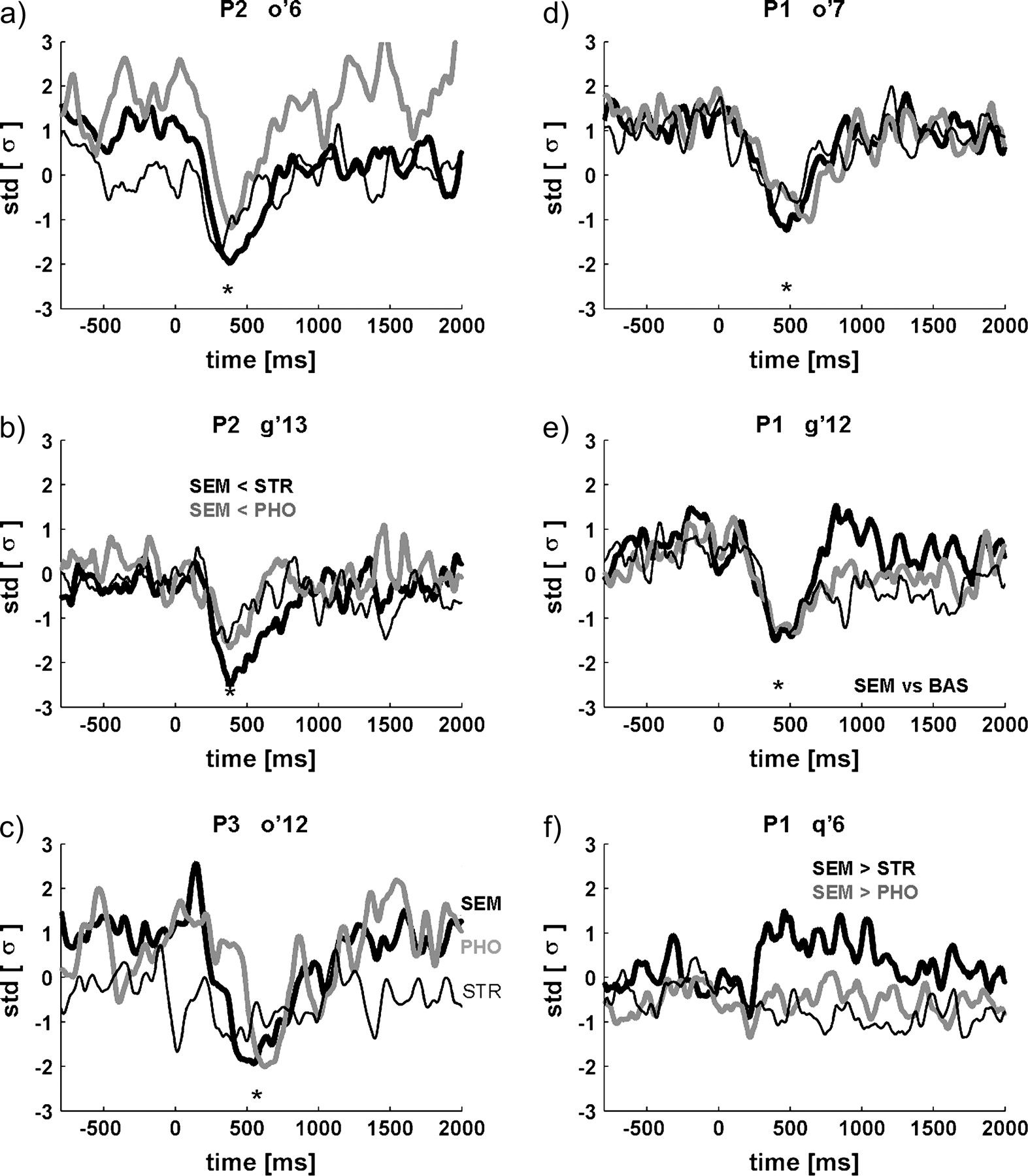
Figure 2. Deactivations in response to letter strings presentation in the STRINGS experiment. Each plot represents the ...
Notes:
Figure 2. Deactivations in response to letter strings presentation in the STRINGS experiment. Each plot represents the time course of the energy recorded in the (20–150 Hz) frequency band in one of the 3 experimental conditions (bold black: semantic; black: orthographic; bold gray: phonological), the energy is expressed in standard deviations from the energy level recorded during a 3-min rest period that followed the experiment, and the zero value corresponds to the mean energy at rest. Stars signal significant negative peaks in the 3 conditions (Wilcoxon comparison with [−200 ms:−100 ms] prestimulus energy level). In graph (b), this negative peak was significantly stronger in the semantic condition than in the orthographic and phonologic conditions (standard error of mean (SEM) < STR, SEM < PHO, Kruskal–Wallis comparison). For comparison purpose with these deactivations, graph (f) shows a significant energy increase observed in the same frequency band in a slightly posterior site in the inferior frontal gyrus, in Broca's area pars triangularis (P1, q′6; [50, +23, +11]); this increase occurred only in the semantic condition.
Unless provided in the caption above, the following copyright applies to the content of this slide: © The Author 2007. Published by Oxford University Press. All rights reserved. For permissions, please e-mail: journals.permissions@oxfordjournals.org

Slide 3
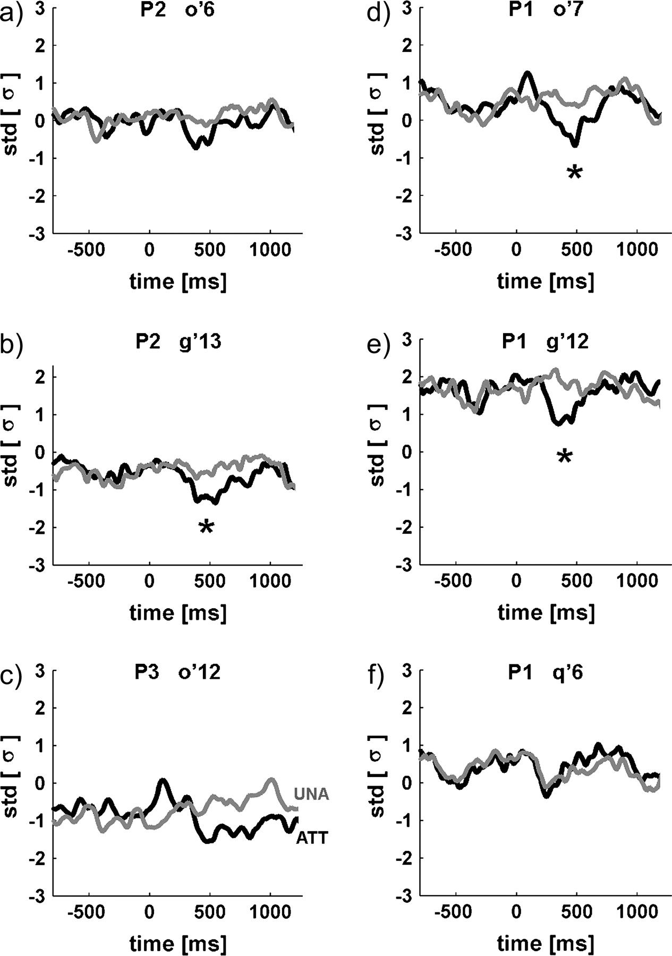
Figure 3. Effect of attention on the VLPFC responses in the STORIES experiment. Same presentation as in Figure 2 but ...
Notes:
Figure 3. Effect of attention on the VLPFC responses in the STORIES experiment. Same presentation as in Figure 2 but for responses to attended (black) and unattended (gray) words in the STORY experiment. Each plot represents the time course of the energy recorded in the (20–150 Hz) frequency band. Stars signal significant peaks of deactivation relative to the (−200:−100 ms) prestimulus period (Wilcoxon test) for attended words. Unattended words induced no significant deactivation, and at all latencies indicated by star signs, energy was significantly lower for attended versus unattended words (Kruskal–Wallis comparison). Figure (f) shows the response to attended and unattended words in Broca's pars triangularis (P1, q′6), with no significant deactivation or difference between the 2 conditions.
Unless provided in the caption above, the following copyright applies to the content of this slide: © The Author 2007. Published by Oxford University Press. All rights reserved. For permissions, please e-mail: journals.permissions@oxfordjournals.org

