Slide 1
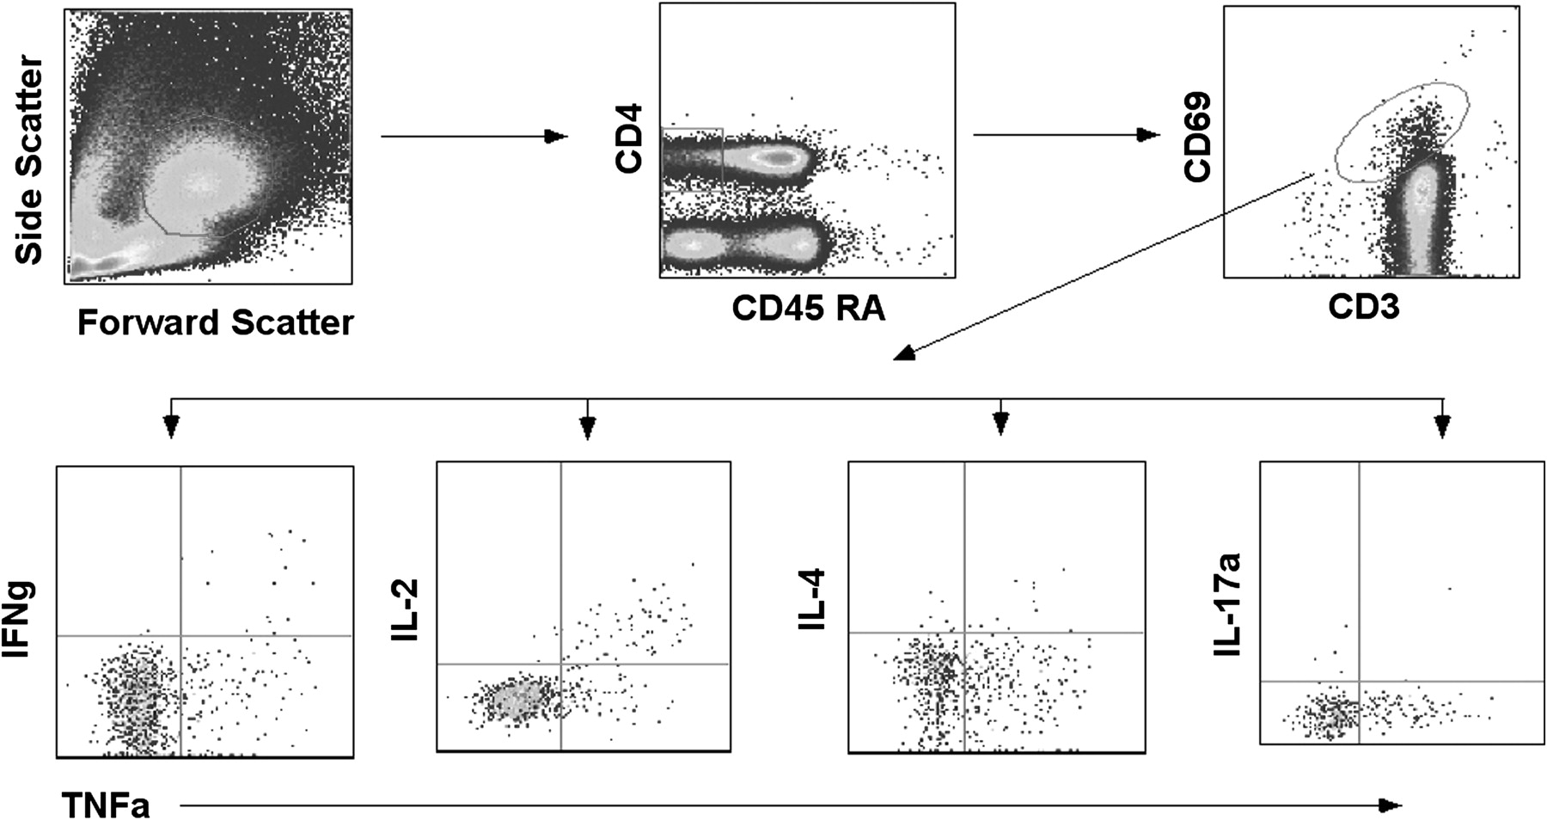
Figure 1. Gating strategy for enumerating cytokine-specific memory CD4⁺ T cells among children. To exclude ...
Notes:
Figure 1. Gating strategy for enumerating cytokine-specific memory CD4+ T cells among children. To exclude cell debris and clumps, cells were first gated on the basis of their forward- and side-scatter properties followed by sequential gating on CD4+ CD45RALow T cells and then to CD3+CD69+ cytokine positive cells before gating on to tumor necrosis factor (TNF)–α versus other cytokines. Low-frequency responders were confirmed by excessive back-gating. Preliminarily, the whole assay was standardized and compared with multiplex bead array (CBA; BD Biosciences) for the detection of CD4+ T-cell cytokine profiles.
Unless provided in the caption above, the following copyright applies to the content of this slide: © The Author 2011. Published by Oxford University Press on behalf of the Infectious Diseases Society of America. All rights reserved. For Permissions, please e-mail: journals.permissions@oup.com

Slide 2
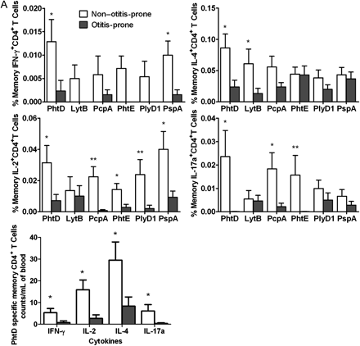
Figure 2. A, percentage frequencies of memory CD4⁺ T-cell subsets producing various cytokines (interferon ...
Notes:
Figure 2. A, percentage frequencies of memory CD4+ T-cell subsets producing various cytokines (interferon [IFN]–γ, interleukin [IL]–4, IL-2, and IL-17a) against 6 pneumococcal antigens in the circulation of non–otitis-prone and otitis-prone children, whereas unstimulated cells serve as a negative control. Bar graphs represent normalized mean percentages of CD69+ CD4+ T cells gated on CD45RALow following stimulation. Absolute blood counts were calculated for the cytokine-producing cells in case of PhtD antigen. Error bars represent the standard error of the mean; P values were calculated using the Mann–Whitney U test. *P < .05; **P < .005. B, frequencies of memory CD4+ T-cell subsets producing various cytokines in response to 3 NTHi antigens (P6, OMP26, and Protein D) in the circulation of non–otitis-prone and otitis-prone children. Bar graphs represent mean percentage values of CD69+ CD4+ T cells that were CD45RALow following antigen stimulations. *P < .05. C, peripheral blood mononuclear cell samples from non–otitis-prone and otitis-prone children were stimulated with staphylococcal enterotoxin B, and cytokine production was observed in the CD45RALow CD4+ T-cell population (P > .5).
Unless provided in the caption above, the following copyright applies to the content of this slide: © The Author 2011. Published by Oxford University Press on behalf of the Infectious Diseases Society of America. All rights reserved. For Permissions, please e-mail: journals.permissions@oup.com

Slide 3
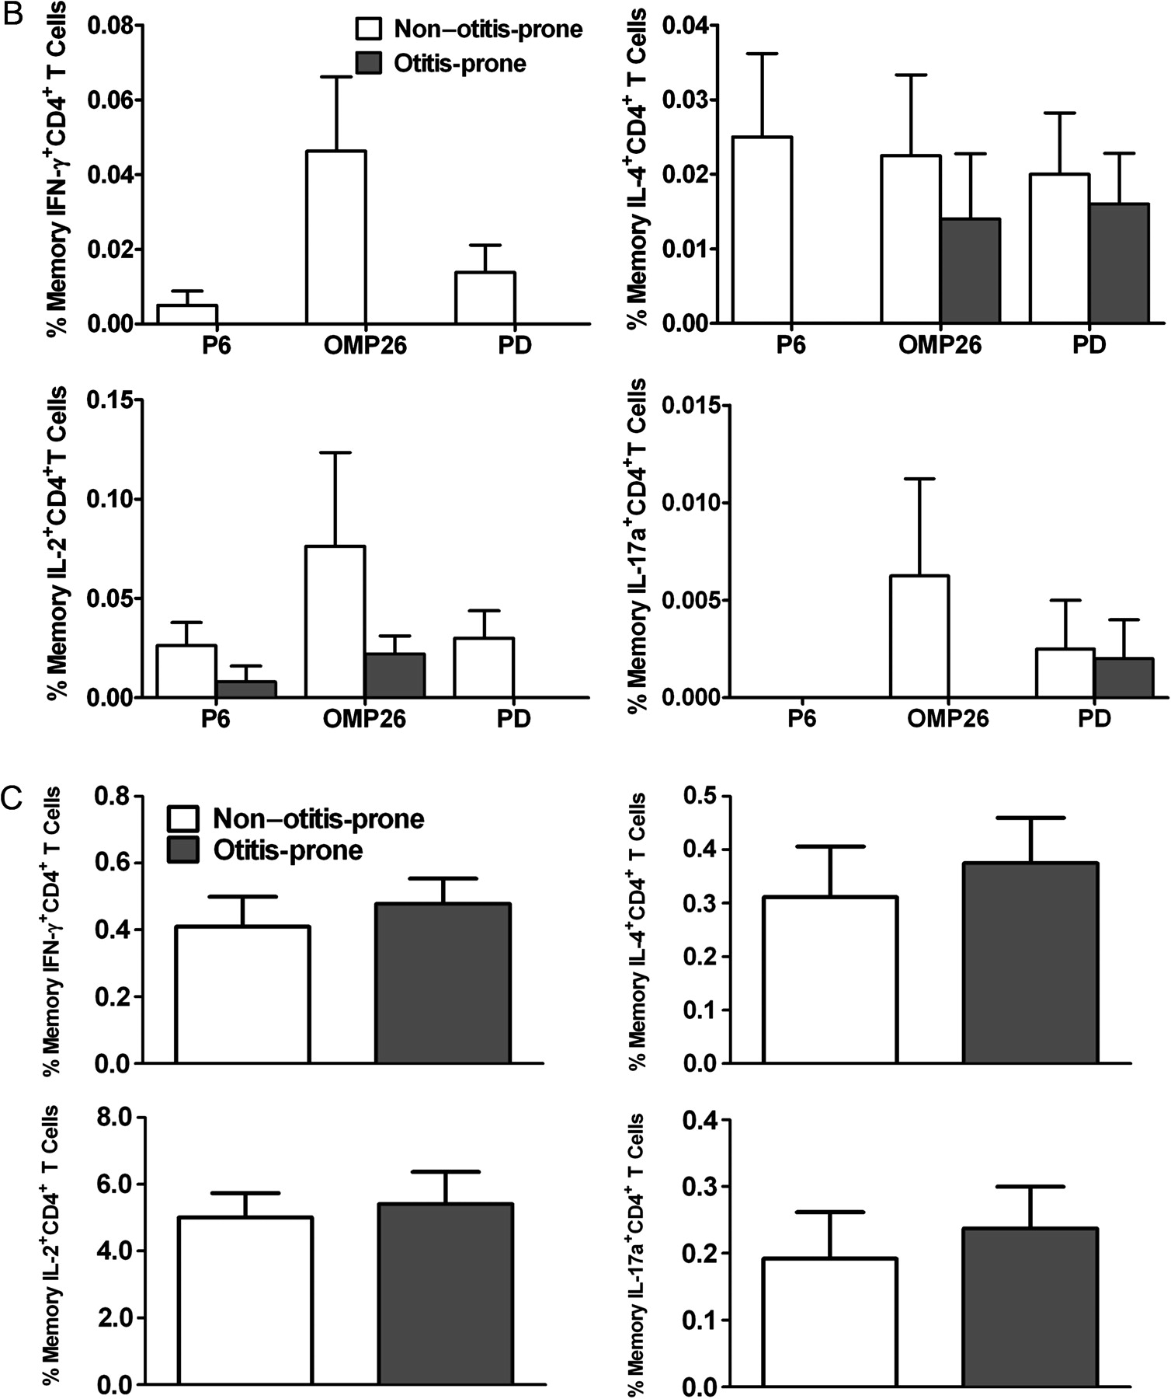
Figure 2. A, percentage frequencies of memory CD4⁺ T-cell subsets producing various cytokines (interferon ...
Notes:
Figure 2. A, percentage frequencies of memory CD4+ T-cell subsets producing various cytokines (interferon [IFN]–γ, interleukin [IL]–4, IL-2, and IL-17a) against 6 pneumococcal antigens in the circulation of non–otitis-prone and otitis-prone children, whereas unstimulated cells serve as a negative control. Bar graphs represent normalized mean percentages of CD69+ CD4+ T cells gated on CD45RALow following stimulation. Absolute blood counts were calculated for the cytokine-producing cells in case of PhtD antigen. Error bars represent the standard error of the mean; P values were calculated using the Mann–Whitney U test. *P < .05; **P < .005. B, frequencies of memory CD4+ T-cell subsets producing various cytokines in response to 3 NTHi antigens (P6, OMP26, and Protein D) in the circulation of non–otitis-prone and otitis-prone children. Bar graphs represent mean percentage values of CD69+ CD4+ T cells that were CD45RALow following antigen stimulations. *P < .05. C, peripheral blood mononuclear cell samples from non–otitis-prone and otitis-prone children were stimulated with staphylococcal enterotoxin B, and cytokine production was observed in the CD45RALow CD4+ T-cell population (P > .5).
Unless provided in the caption above, the following copyright applies to the content of this slide: © The Author 2011. Published by Oxford University Press on behalf of the Infectious Diseases Society of America. All rights reserved. For Permissions, please e-mail: journals.permissions@oup.com

Slide 4
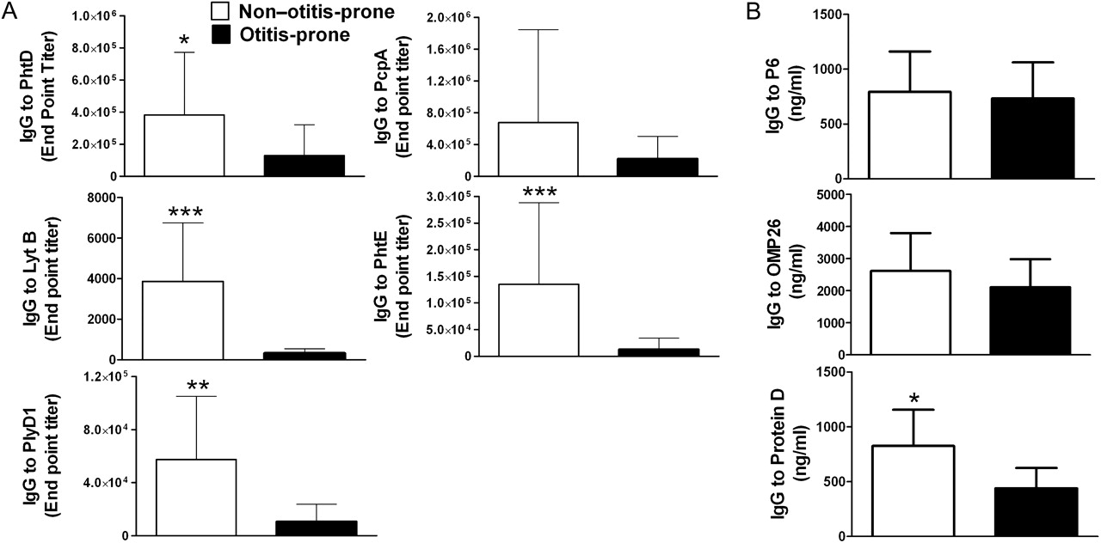
Figure 3. A, comparison of immunoglobulin (Ig) G responses to 5 pneumococcal protein antigens (Phtd, LytB, PcpA, PhtE, ...
Notes:
Figure 3. A, comparison of immunoglobulin (Ig) G responses to 5 pneumococcal protein antigens (Phtd, LytB, PcpA, PhtE, and PlyD1) in the serum samples of 2 cohorts of non–otitis-prone and otitis-prone children. *P < .05; **P < .005; ***P < .001. Y-axis represents geometric mean titers, and error bars are upper 95% confidence intervals. B, IgG responses to NTHi protein antigens (P6, OMP26 and Protein D) were also observed in the serum samples of two cohorts of non-otitis-prone and otitis-prone children. *P < .05. Y-axis represents geometric mean titers, and error bars are upper 95% confidence intervals.
Unless provided in the caption above, the following copyright applies to the content of this slide: © The Author 2011. Published by Oxford University Press on behalf of the Infectious Diseases Society of America. All rights reserved. For Permissions, please e-mail: journals.permissions@oup.com

