Slide 1
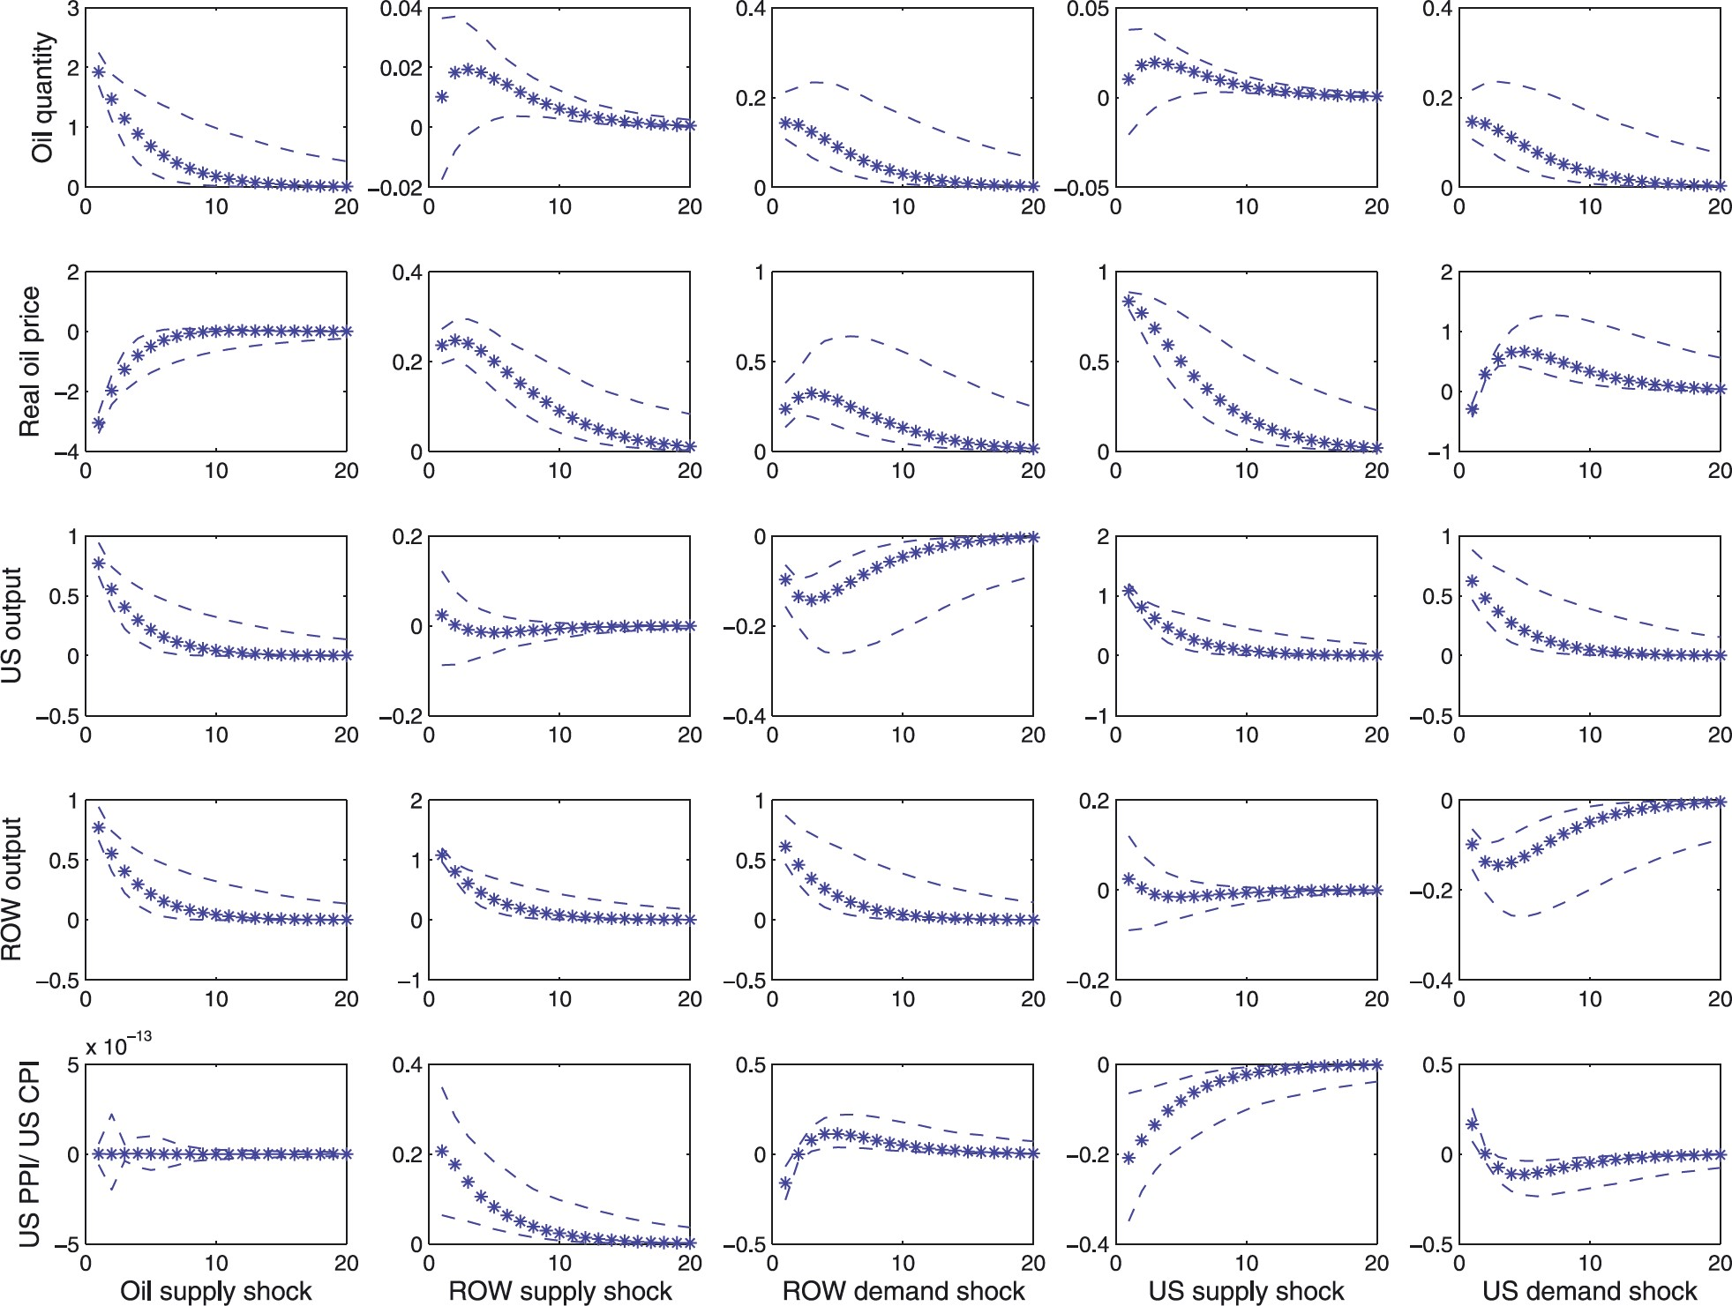
Figure 1 Dynamic effect of each structural shock in the model economy. The figure plots the 5th (dashed), 50th (thick) ...
Notes:
Figure 1 Dynamic effect of each structural shock in the model economy. The figure plots the 5th (dashed), 50th (thick) and 95th (dashed) percentiles of the distribution of the responses of each variable to the indicated structural shock at different monthly horizons. The responses are computed by carrying out a Monte Carlo simulation on the parameters of the theoretical model. The simulation is based on 1,000 draws. The model parameters are allowed to vary over the ranges reported in Table 1. “Real oil price” is the ratio between the oil price and the US CPI.
Unless provided in the caption above, the following copyright applies to the content of this slide: © 2012 by the European Economic Association

Slide 2
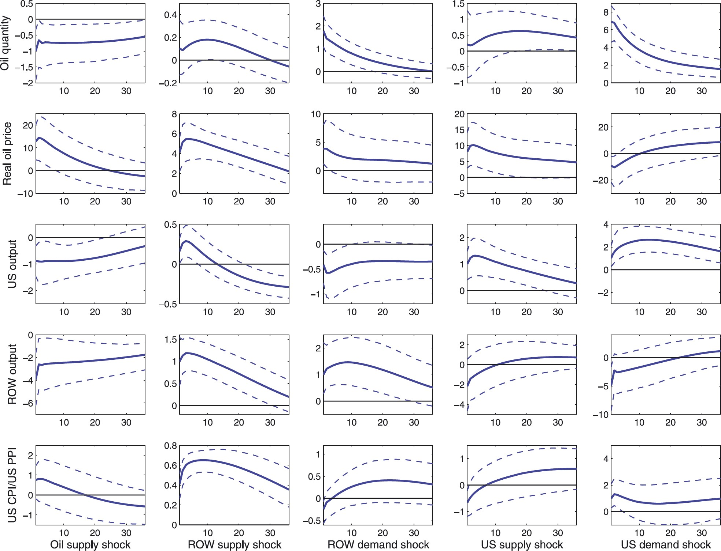
Figure 2 Estimated effects of fundamental shocks. The figure plots the 16th (dashed), 50th (thick), and 84th (dashed) ...
Notes:
Figure 2 Estimated effects of fundamental shocks. The figure plots the 16th (dashed), 50th (thick), and 84th (dashed) percentiles of the distribution of responses at each monthly horizon. The “Real oil price” is the ratio between the oil price and the US CPI.
Unless provided in the caption above, the following copyright applies to the content of this slide: © 2012 by the European Economic Association

Slide 3
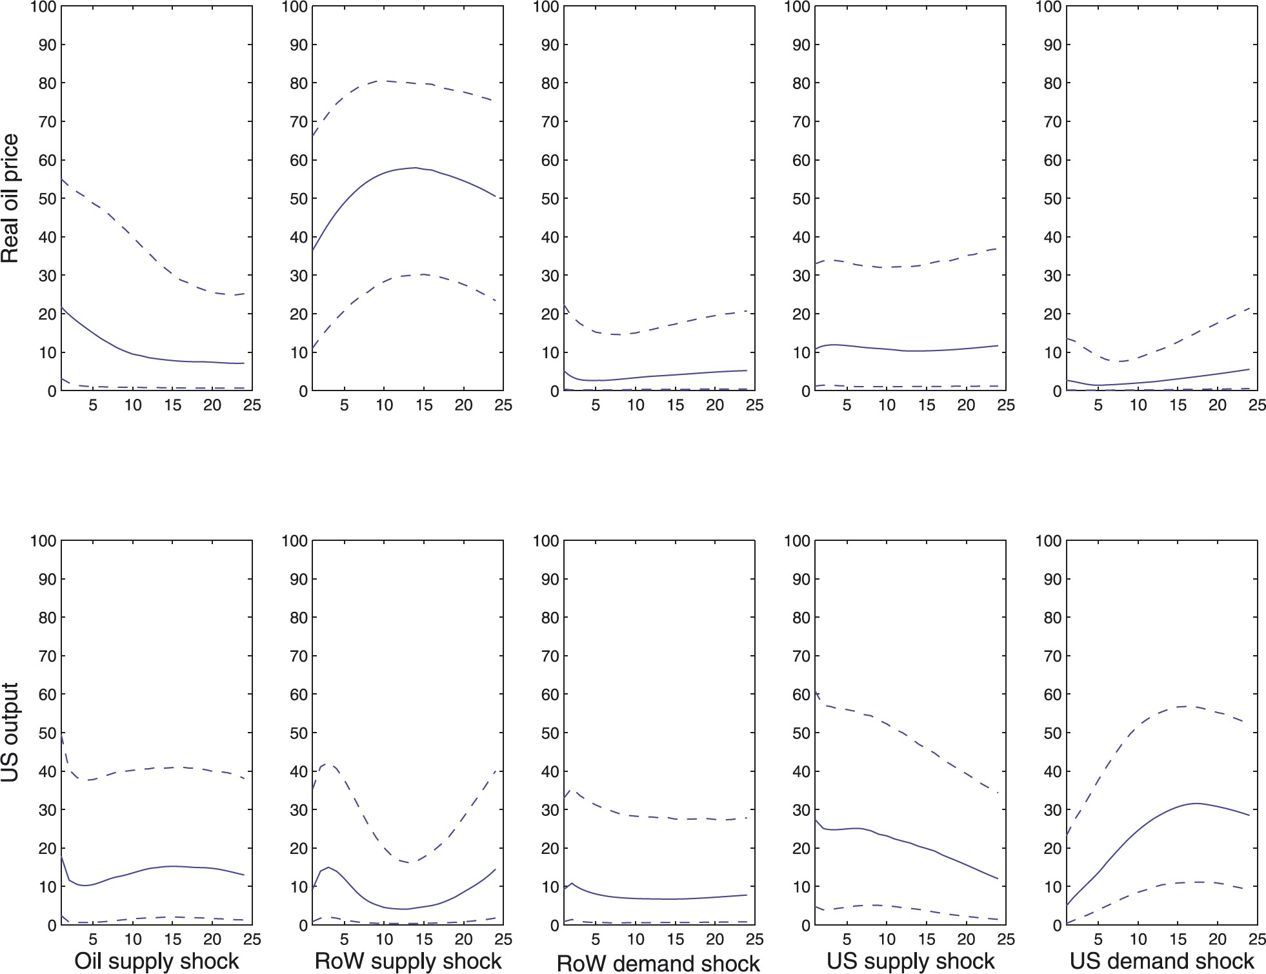
Figure 3 Variance decomposition. The figure plots the 16th (dashed), 50th (solid) and 84th (dashed) percentiles of the ...
Notes:
Figure 3 Variance decomposition. The figure plots the 16th (dashed), 50th (solid) and 84th (dashed) percentiles of the distribution of the variance explained by each structural shock at each monthly horizon. The “Real oil price” is the ratio between the oil price and the US CPI.
Unless provided in the caption above, the following copyright applies to the content of this slide: © 2012 by the European Economic Association

Slide 4
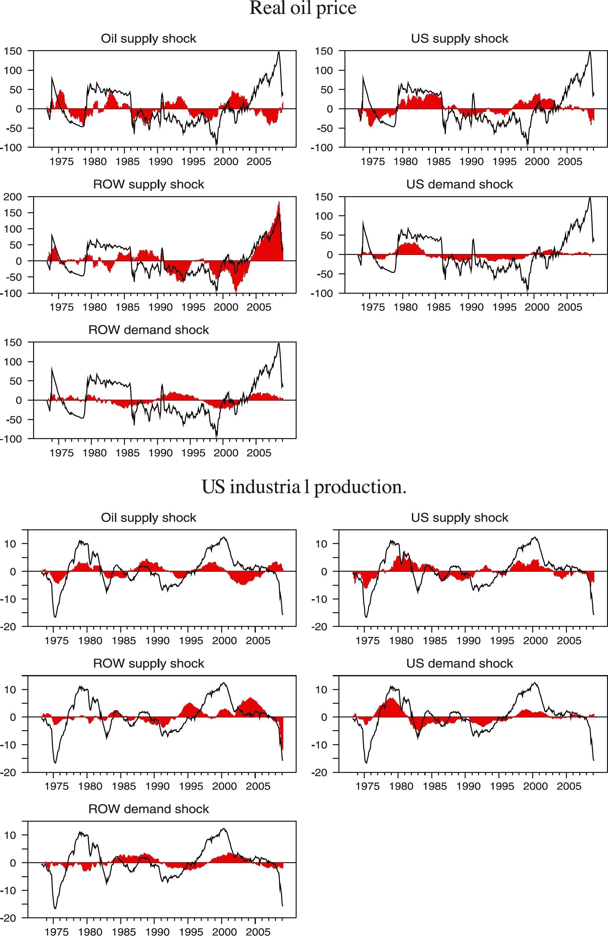
Figure 4 Historical decomposition. The thin line denotes the real oil price (or the US industrial production), in ...
Notes:
Figure 4 Historical decomposition. The thin line denotes the real oil price (or the US industrial production), in deviation from the baseline. The bars in each panel denote the component of the series accounted for by each structural shock. The “Real oil price” is the ratio between the oil price and the US CPI.
Unless provided in the caption above, the following copyright applies to the content of this slide: © 2012 by the European Economic Association

Slide 5
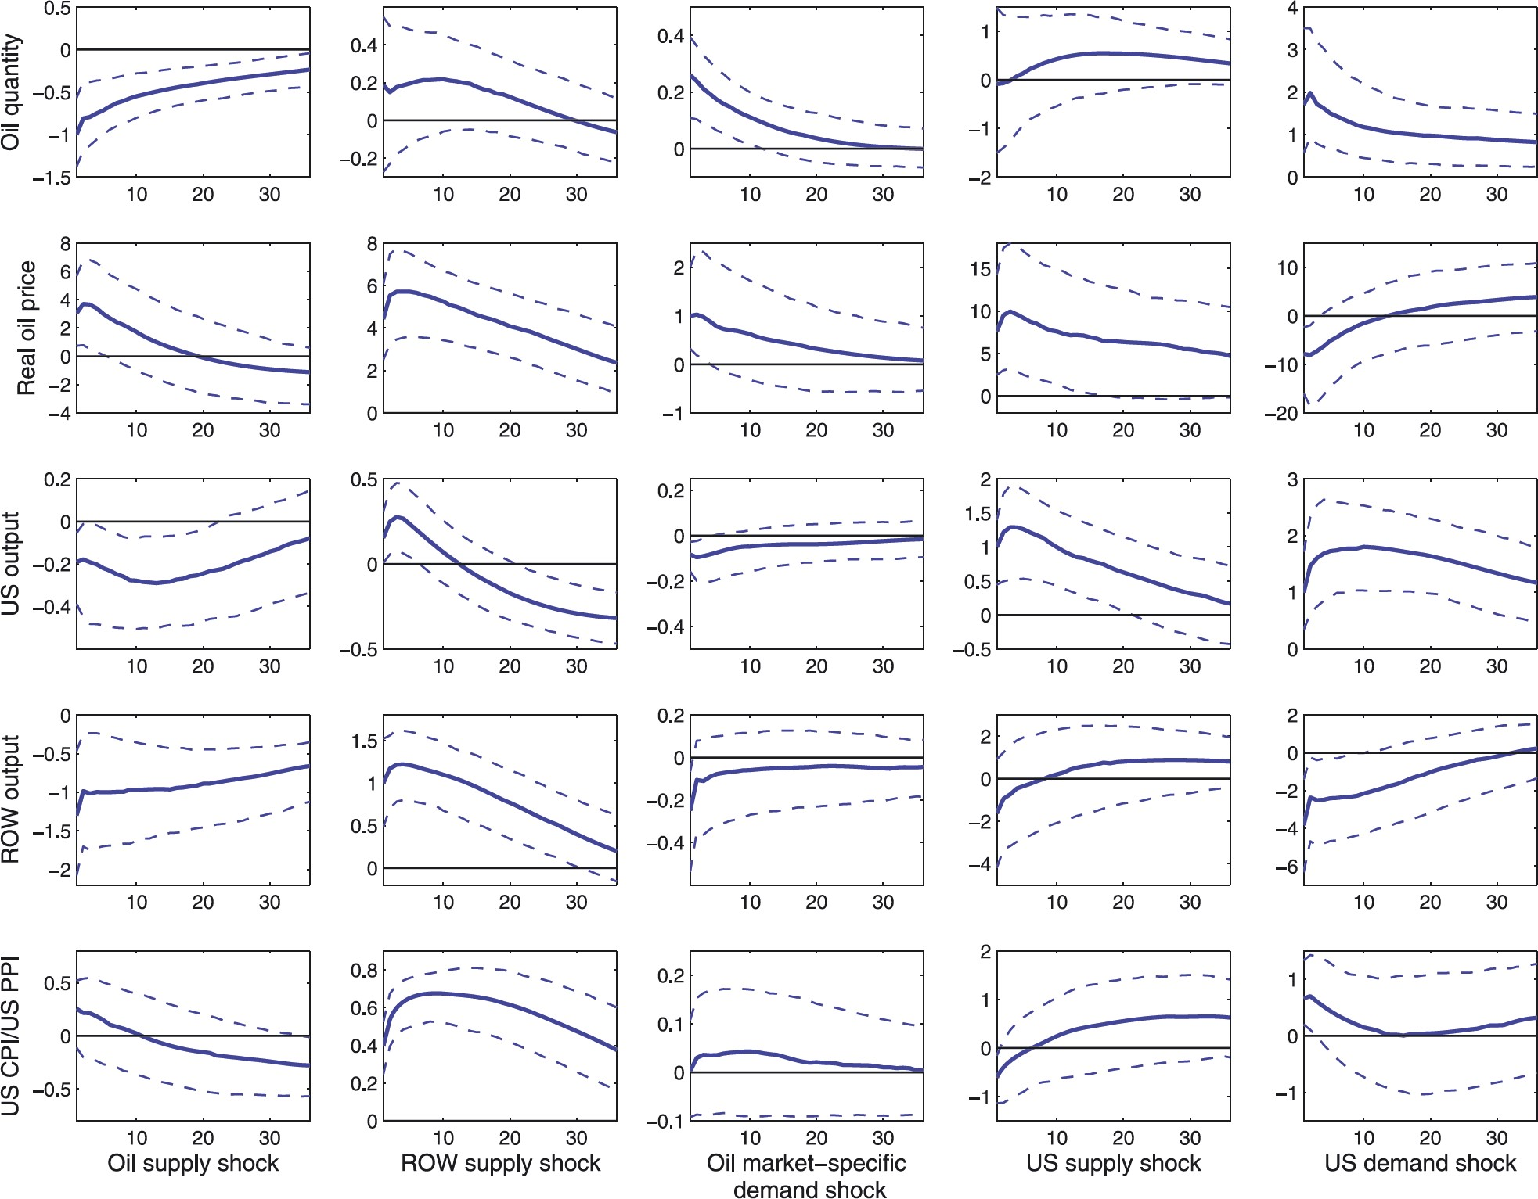
Figure 5 Impulse response in a scheme that allows for oil-market-specific demand shocks, showing the 16th (dashed), ...
Notes:
Figure 5 Impulse response in a scheme that allows for oil-market-specific demand shocks, showing the 16th (dashed), 50th (solid), and 84th (dashed) percentiles of the IRFs distribution. The “Real oil price” is the ratio between the oil price and the US CPI.
Unless provided in the caption above, the following copyright applies to the content of this slide: © 2012 by the European Economic Association

