Slide 1
Fig. 1. The mention of ‘P54’ was found that potentially refers to a gene. The mention of a human lymphoma cell line, ...
Notes:
Fig. 1. The mention of ‘P54’ was found that potentially refers to a gene. The mention of a human lymphoma cell line, RC-K8, points towards the species human, so we can concentrate on finding the correct gene there. ‘P54’ is a name shared by five human genes (DDX6, ETS1, FKBP5, NONO and SFRS11). Only two of these genes can be found on band 23 of chromosome 11 (DDX6 and ETS1). Additionally, only the DDX6 protein has a length of 483aa. Looking at the Gene Ontology (GO) terms annotated for DDX6, we find that DDX6 has ‘RNA helicase activity’, which is also mentioned in the second sentence.
Unless provided in the caption above, the following copyright applies to the content of this slide: © The Author 2008. Published by Oxford University Press. All rights reserved. For Permissions, please email: journals.permissions@oxfordjournals.org

Slide 2
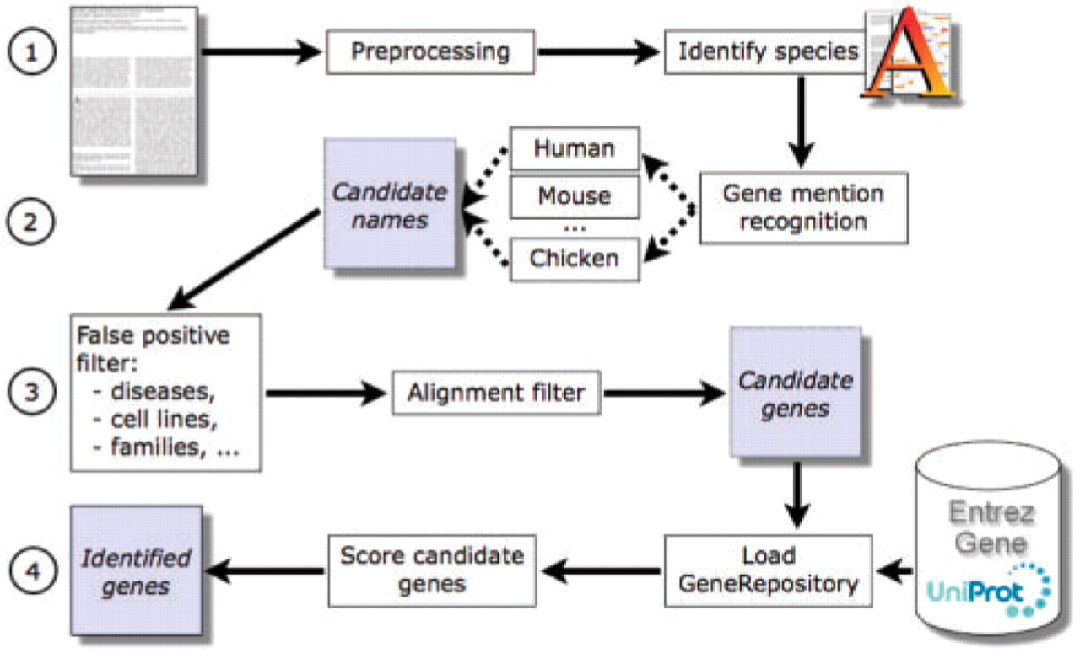
Fig. 2. Data processing in GNAT can be divided into four stages. (1) After pre-processing a text, we search for ...
Notes:
Fig. 2. Data processing in GNAT can be divided into four stages. (1) After pre-processing a text, we search for species using AliBaba. (2) For each species that is referenced in the text, a dictionary is loaded and we annotate names of genes in the text. (3) Filters remove false positives, for example, names of gene families and diseases. (4) Remaining candidate genes are ranked using context profiles stored in a repository created from EntrezGene and UniProt annotations.
Unless provided in the caption above, the following copyright applies to the content of this slide: © The Author 2008. Published by Oxford University Press. All rights reserved. For Permissions, please email: journals.permissions@oxfordjournals.org

Slide 3
Fig. 3. Examples of references to species (printed in italics) as they typically appear in abstracts; PubMed IDs ...
Notes:
Fig. 3. Examples of references to species (printed in italics) as they typically appear in abstracts; PubMed IDs given in brackets.
Unless provided in the caption above, the following copyright applies to the content of this slide: © The Author 2008. Published by Oxford University Press. All rights reserved. For Permissions, please email: journals.permissions@oxfordjournals.org

Slide 4
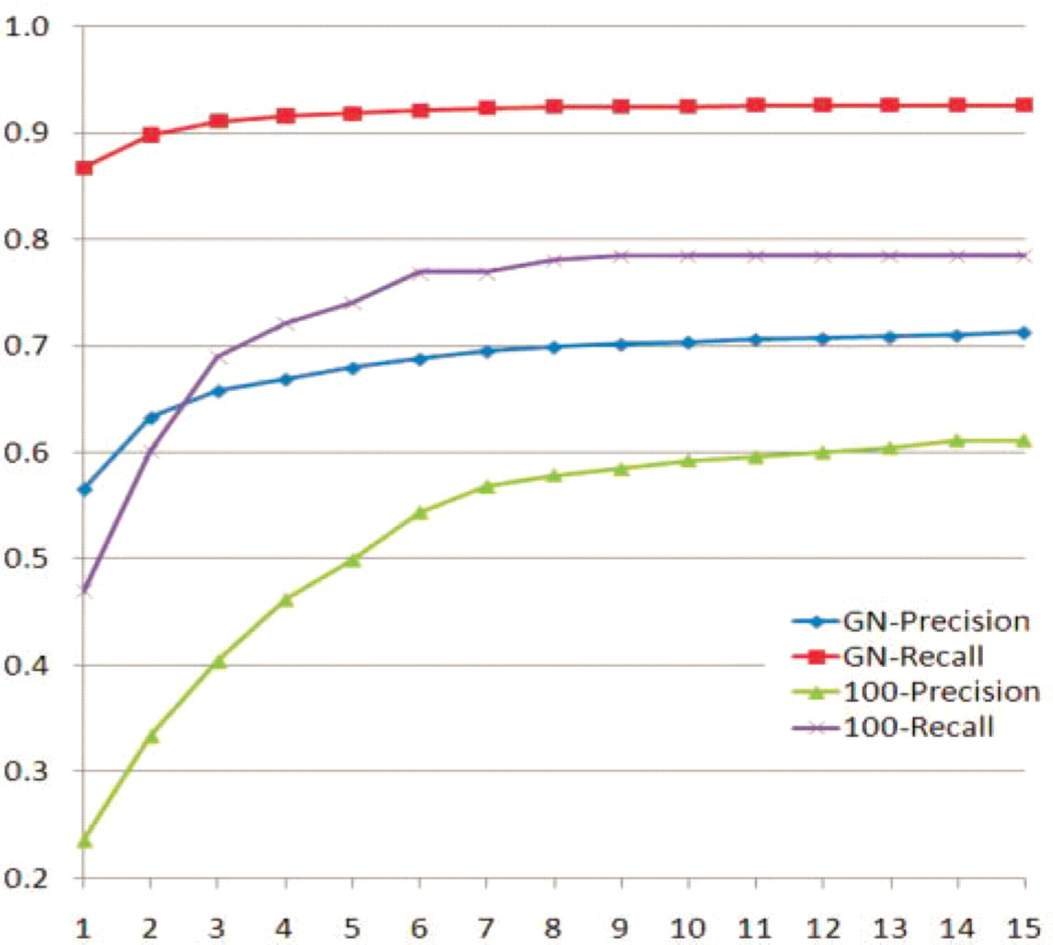
Fig. 4. Predictions of named entity recognition by BANNER and TD*IDF string similarity to assign candidate genes; ...
Notes:
Fig. 4. Predictions of named entity recognition by BANNER and TD*IDF string similarity to assign candidate genes; evaluated on human GN test data and our inter-species set (100). A prediction at rank 3 (horizontal axis) would include the predictions from before, assuming a perfect resolution to species and disambiguation of genes.
Unless provided in the caption above, the following copyright applies to the content of this slide: © The Author 2008. Published by Oxford University Press. All rights reserved. For Permissions, please email: journals.permissions@oxfordjournals.org

