Slide 1
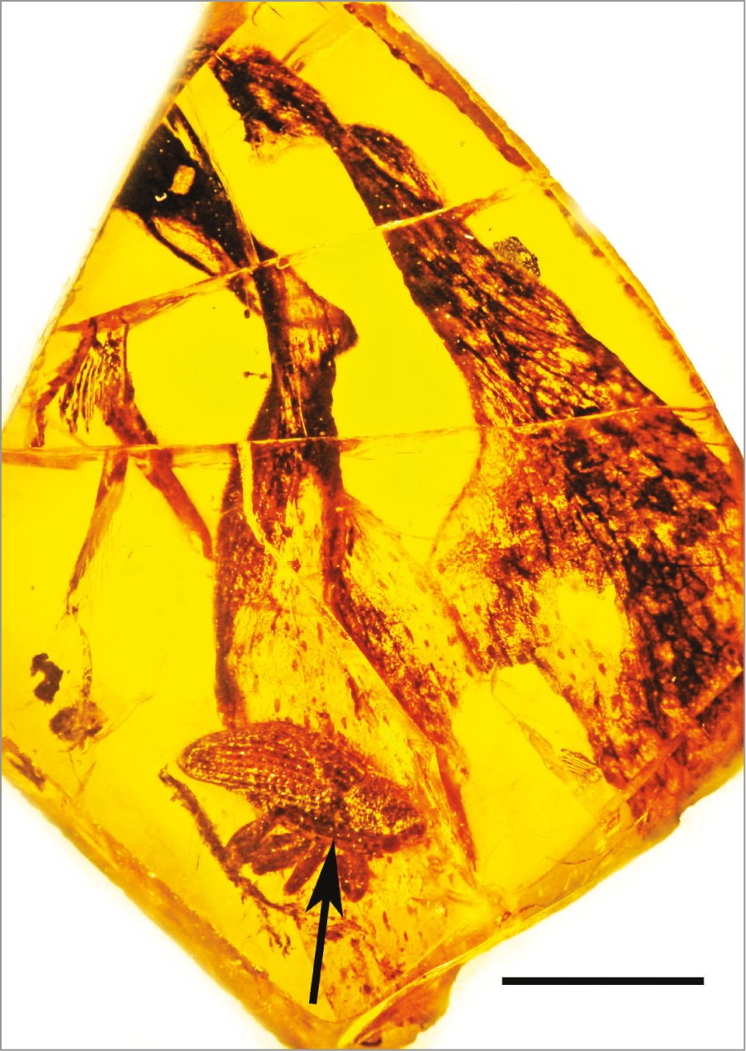
Fig. 1. Dominican amber cryptorhynchid weevil with attached pollinarium (arrow) of Cylindrocites browni gen. n., sp. ...
Notes:
Fig. 1. Dominican amber cryptorhynchid weevil with attached pollinarium (arrow) of Cylindrocites browni gen. n., sp. n. Floral remains in background. Scale = 3.0 mm.
Unless provided in the caption above, the following copyright applies to the content of this slide: © The Authors 2016. Published by Oxford University Press on behalf of Entomological Society of America. All rights reserved. For Permissions, please email: journals.permissions@oup.com

Slide 2
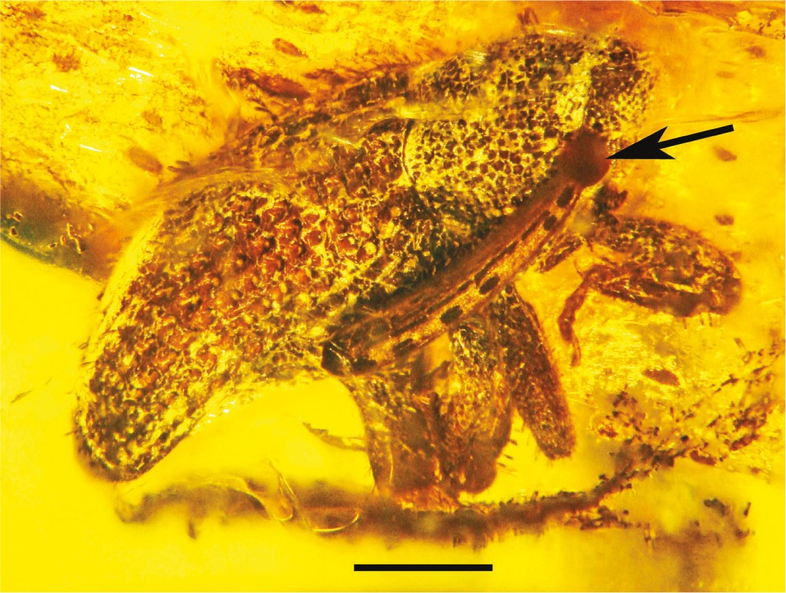
Fig. 2. Lateral view of weevil with attached pollinarium of Cylindrocites browni gen. n., sp. n. Arrow shows ...
Notes:
Fig. 2. Lateral view of weevil with attached pollinarium of Cylindrocites browni gen. n., sp. n. Arrow shows viscidium. Scale = 0.8 mm.
Unless provided in the caption above, the following copyright applies to the content of this slide: © The Authors 2016. Published by Oxford University Press on behalf of Entomological Society of America. All rights reserved. For Permissions, please email: journals.permissions@oup.com

Slide 3
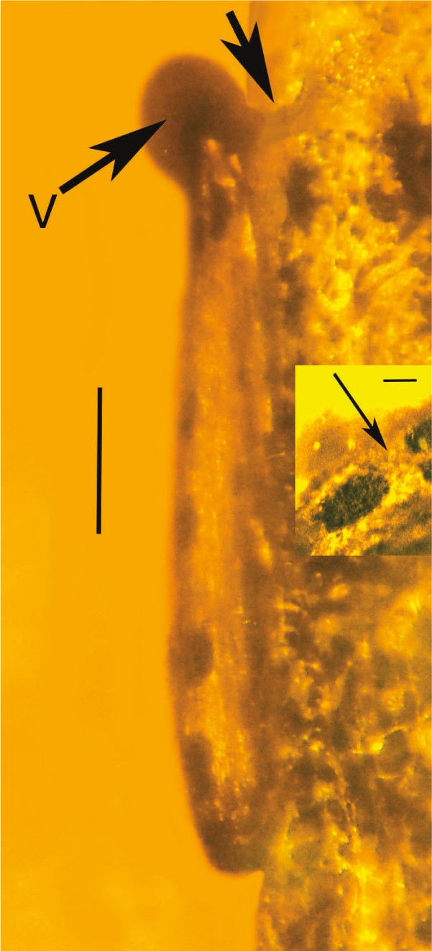
Fig. 3. Lateral view of pollinarium of Cylindrocites browni gen. n., sp. n. attached to weevil. V = viscidium. Top ...
Notes:
Fig. 3. Lateral view of pollinarium of Cylindrocites browni gen. n., sp. n. attached to weevil. V = viscidium. Top arrow shows mucoid connection between viscidium and weevil. Bar = 0.4 mm. Insert shows pollen tetrads (arrow) inside pollinium. Scale = 60 μm.
Unless provided in the caption above, the following copyright applies to the content of this slide: © The Authors 2016. Published by Oxford University Press on behalf of Entomological Society of America. All rights reserved. For Permissions, please email: journals.permissions@oup.com

Slide 4
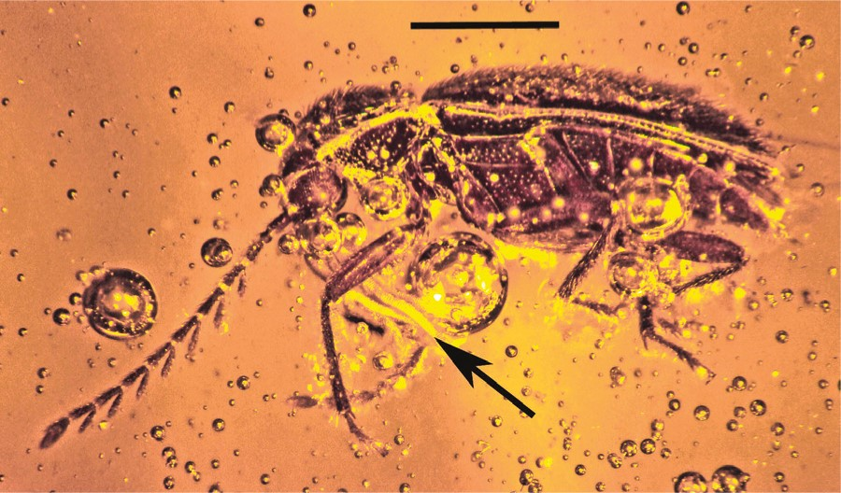
Fig. 4. Mexican amber ptilodactyline beetle with attached pollinium of Annulites mexicana gen. n., sp. n. (arrow). ...
Notes:
Fig. 4. Mexican amber ptilodactyline beetle with attached pollinium of Annulites mexicana gen. n., sp. n. (arrow). Scale = 0.4 mm.
Unless provided in the caption above, the following copyright applies to the content of this slide: © The Authors 2016. Published by Oxford University Press on behalf of Entomological Society of America. All rights reserved. For Permissions, please email: journals.permissions@oup.com

Slide 5
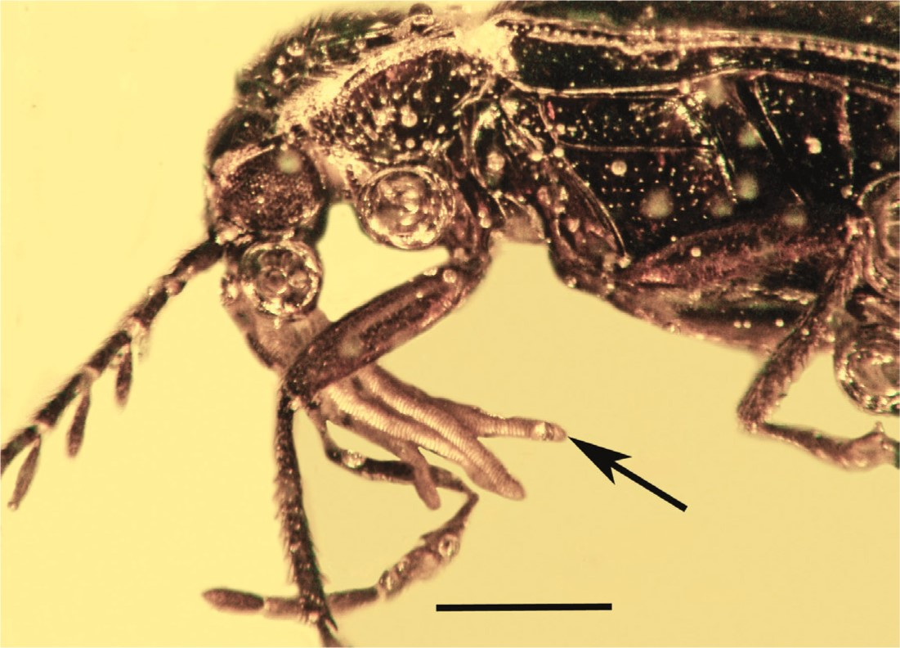
Fig. 5. Pollinium (arrow) of Annulites mexicana gen. n., sp. n. attached to the mouthparts of a ptilodactyline beetle ...
Notes:
Fig. 5. Pollinium (arrow) of Annulites mexicana gen. n., sp. n. attached to the mouthparts of a ptilodactyline beetle in Mexican amber. Scale = 0.3 mm.
Unless provided in the caption above, the following copyright applies to the content of this slide: © The Authors 2016. Published by Oxford University Press on behalf of Entomological Society of America. All rights reserved. For Permissions, please email: journals.permissions@oup.com

Slide 6
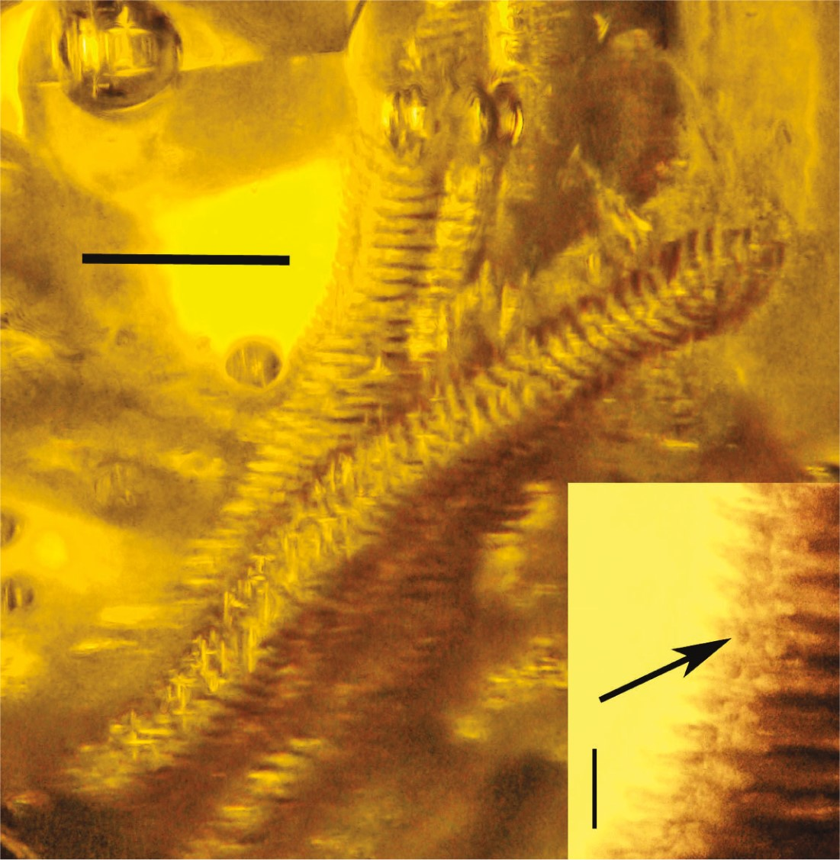
Fig. 6. Detail of annulated pollinia of Annulites mexicana gen. n., sp. n. Scale = 0.9 mm. Insert shows pollen ...
Notes:
Fig. 6. Detail of annulated pollinia of Annulites mexicana gen. n., sp. n. Scale = 0.9 mm. Insert shows pollen tetrads (arrow) between segments. Scale = 80 μm.
Unless provided in the caption above, the following copyright applies to the content of this slide: © The Authors 2016. Published by Oxford University Press on behalf of Entomological Society of America. All rights reserved. For Permissions, please email: journals.permissions@oup.com

Slide 7
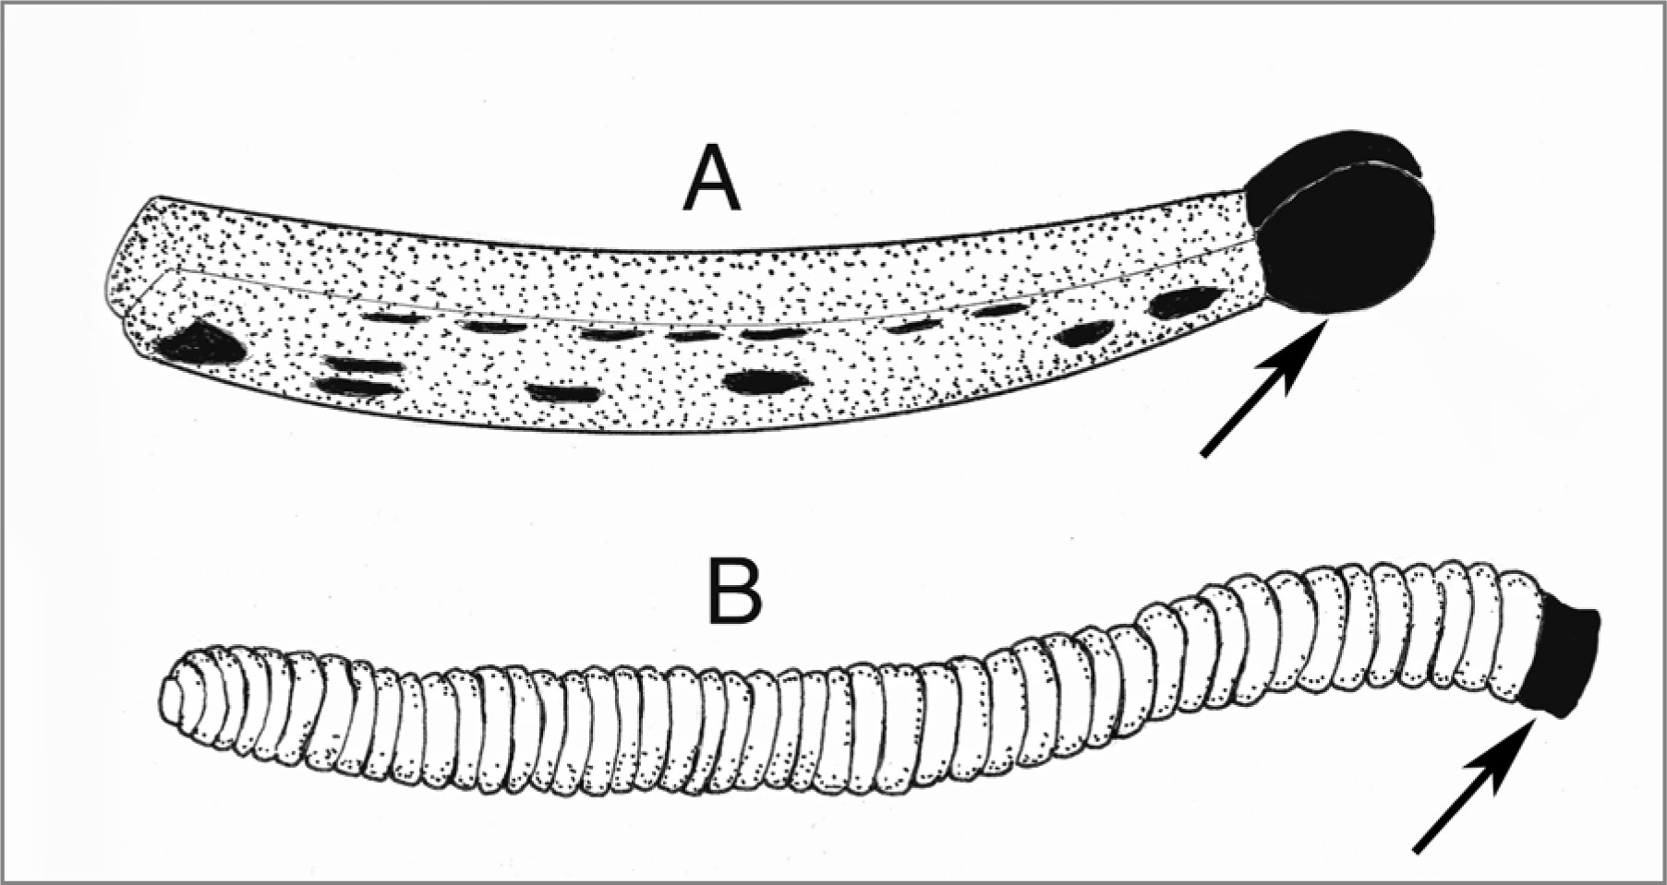
Fig. 7. Outlines of pollinaria of Cylindrocites browni gen. n., sp. n. (A) and Annulites mexicana gen. n., sp. n. ...
Notes:
Fig. 7. Outlines of pollinaria of Cylindrocites browni gen. n., sp. n. (A) and Annulites mexicana gen. n., sp. n. (B). Arrows show viscidia.
Unless provided in the caption above, the following copyright applies to the content of this slide: © The Authors 2016. Published by Oxford University Press on behalf of Entomological Society of America. All rights reserved. For Permissions, please email: journals.permissions@oup.com

