Slide 1
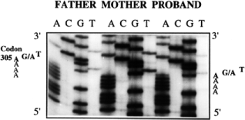
Figure 1 Identification of a missense mutation (S305N) in exon 4 of the EDNRB gene. Nucleotide sequence analysis of ...
Notes:
Figure 1 Identification of a missense mutation (S305N) in exon 4 of the EDNRB gene. Nucleotide sequence analysis of exon 4 PCR products from proband 20's family. Both the father and the affected son are heterozygous for a G→A transition in codon 305 (shown in bold characters to the side). Sequence analysis of the mother's sample appears normal.
Unless provided in the caption above, the following copyright applies to the content of this slide: © 1996 Oxford University Press

Slide 2
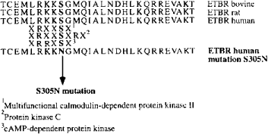
Figure 2 Amino acid structure of the EDNRB third cytoplasmic loop. Alignment of the amino acid sequence of the human ...
Notes:
Figure 2 Amino acid structure of the EDNRB third cytoplasmic loop. Alignment of the amino acid sequence of the human EDNRB third amino acid loop with the corresponding sequence of the rat and bovine orthologues, with three serine-threonine protein kinases recognition motifs and with the S305N mutated receptor.
Unless provided in the caption above, the following copyright applies to the content of this slide: © 1996 Oxford University Press

Slide 3
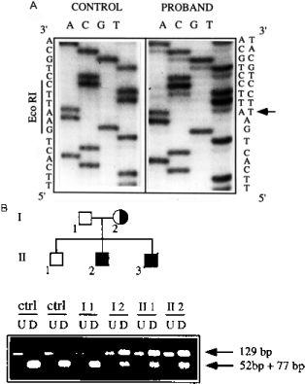
Figure 3 Identification of a single nucleotide deletion in exon 6 of the EDNRB gene. (A) Nucleotide sequence analysis ...
Notes:
Figure 3 Identification of a single nucleotide deletion in exon 6 of the EDNRB gene. (A) Nucleotide sequence analysis of exon 6 PCR products from a control individual (left) and from proband 18 (right). An EcoRI recognition site is indicated on the left. Arrow on the right part of the picture indicates the deletion's position; from the arrow on, the abnormal allele sequence is clearly one nucleotide behind the normal allele. (B) EcoRI digestion pattern of exon 6 PCR products from two controls (ctrl) and from proband 18's family (II-2, solid square). ‘U’ lanes contain undigested samples; ‘D’ lanes contain digested samples. Arrows on the right indicate position of the fragment corresponding to the deleted uncut allele (129 bp) and to the normal allele (52 + 77 bp).
Unless provided in the caption above, the following copyright applies to the content of this slide: © 1996 Oxford University Press

