Slide 1
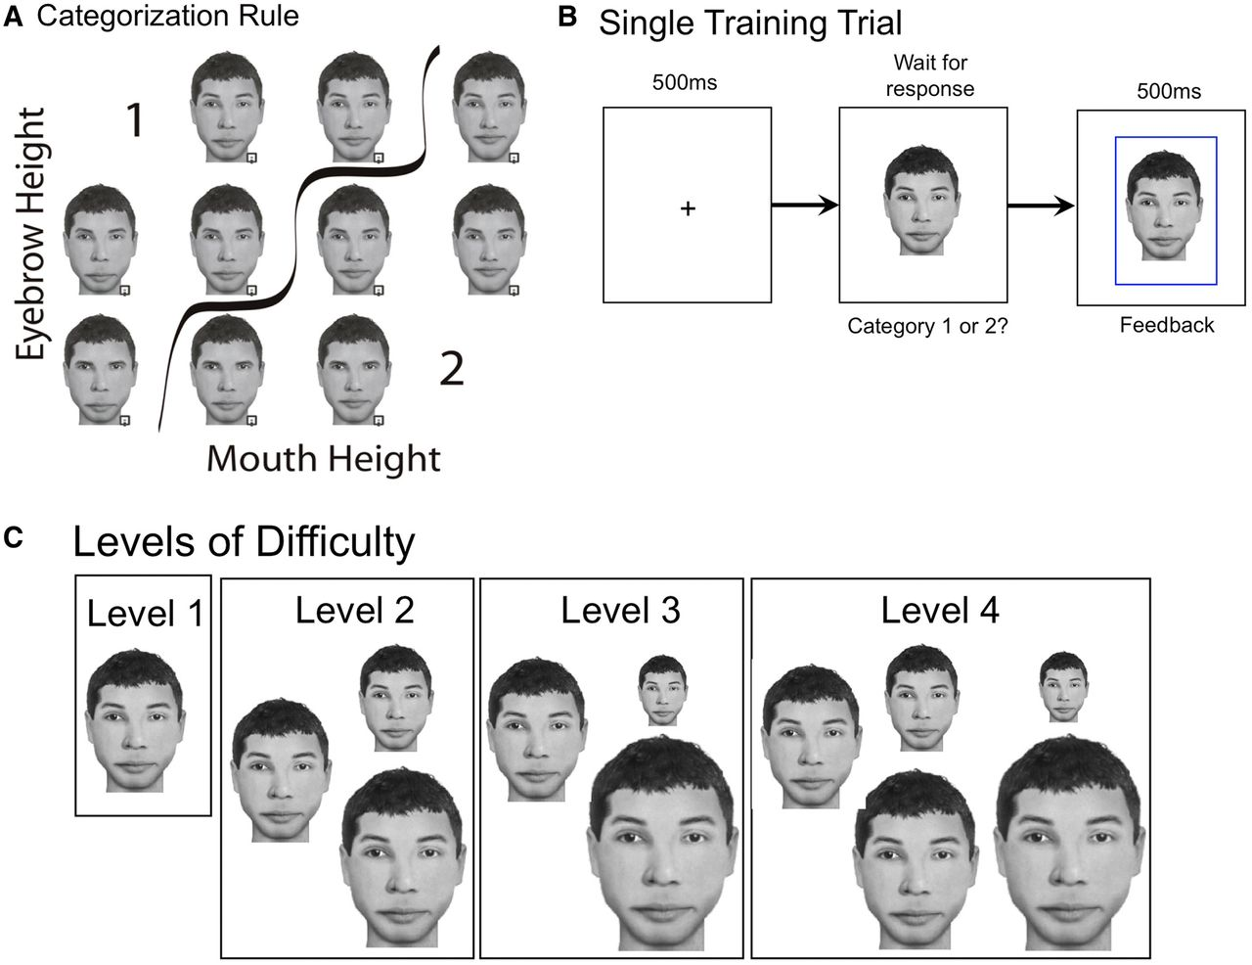
Figure 1 Examples of stimuli from the training task. (A) A matrix image of one template training face depicting the ...
Notes:
Figure 1 Examples of stimuli from the training task. (A) A matrix image of one template training face depicting the categorization rule: faces with higher eyebrows and lower mouths are in Category 1 and those with lower eyebrows and higher mouths are in Category 2. (B) Example of a single self-paced training trial with feedback indicating the trial was correct. (C) The face stimuli sizes used in each different difficulty level of training. Level 1 included faces 3.5° × 5.2° in size (100% size). Level 2 included one-third of the stimuli at 100%, one-third at 2.6° × 3.9° (75%), and one-third at 4.4° × 6.6° (125%). Level 3 included one-third of the stimuli at 100%, one-third of the stimuli at a visual angle of 1.8° × 2.6° (50%), and one-third of the stimuli at a visual angle of 5.3° × 7.9° (150%). Level 4 included all five previous stimulus sizes distributed equally.
Unless provided in the caption above, the following copyright applies to the content of this slide: © The Author (2014). Published by Oxford University Press on behalf of the Guarantors of Brain. All rights reserved. For Permissions, please email: journals.permissions@oup.com

Slide 2
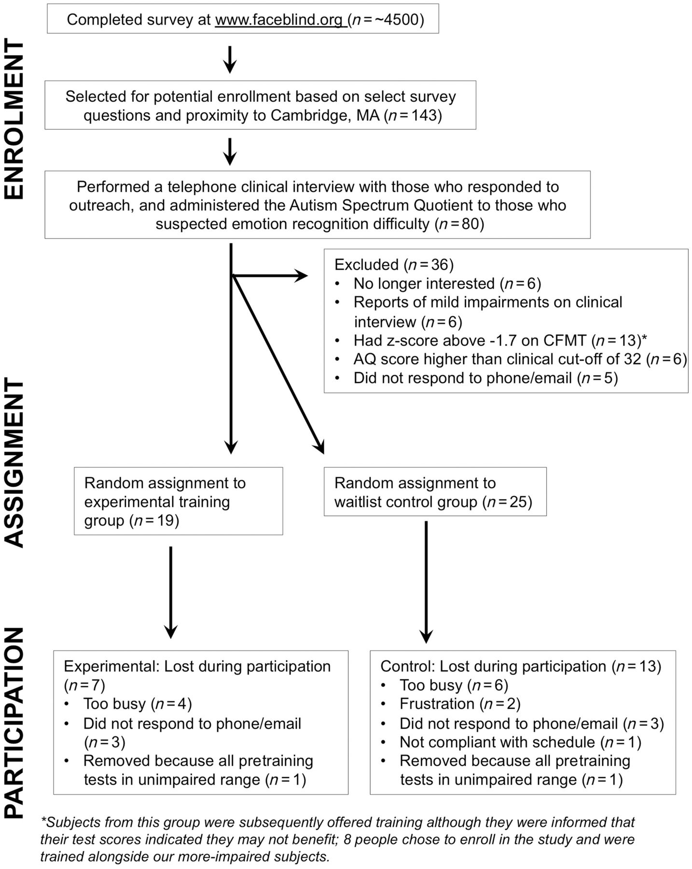
Figure 2 Diagram showing the process of recruitment, enrollment, subject assignment and participation.
Notes:
Figure 2 Diagram showing the process of recruitment, enrollment, subject assignment and participation.
Unless provided in the caption above, the following copyright applies to the content of this slide: © The Author (2014). Published by Oxford University Press on behalf of the Guarantors of Brain. All rights reserved. For Permissions, please email: journals.permissions@oup.com

Slide 3
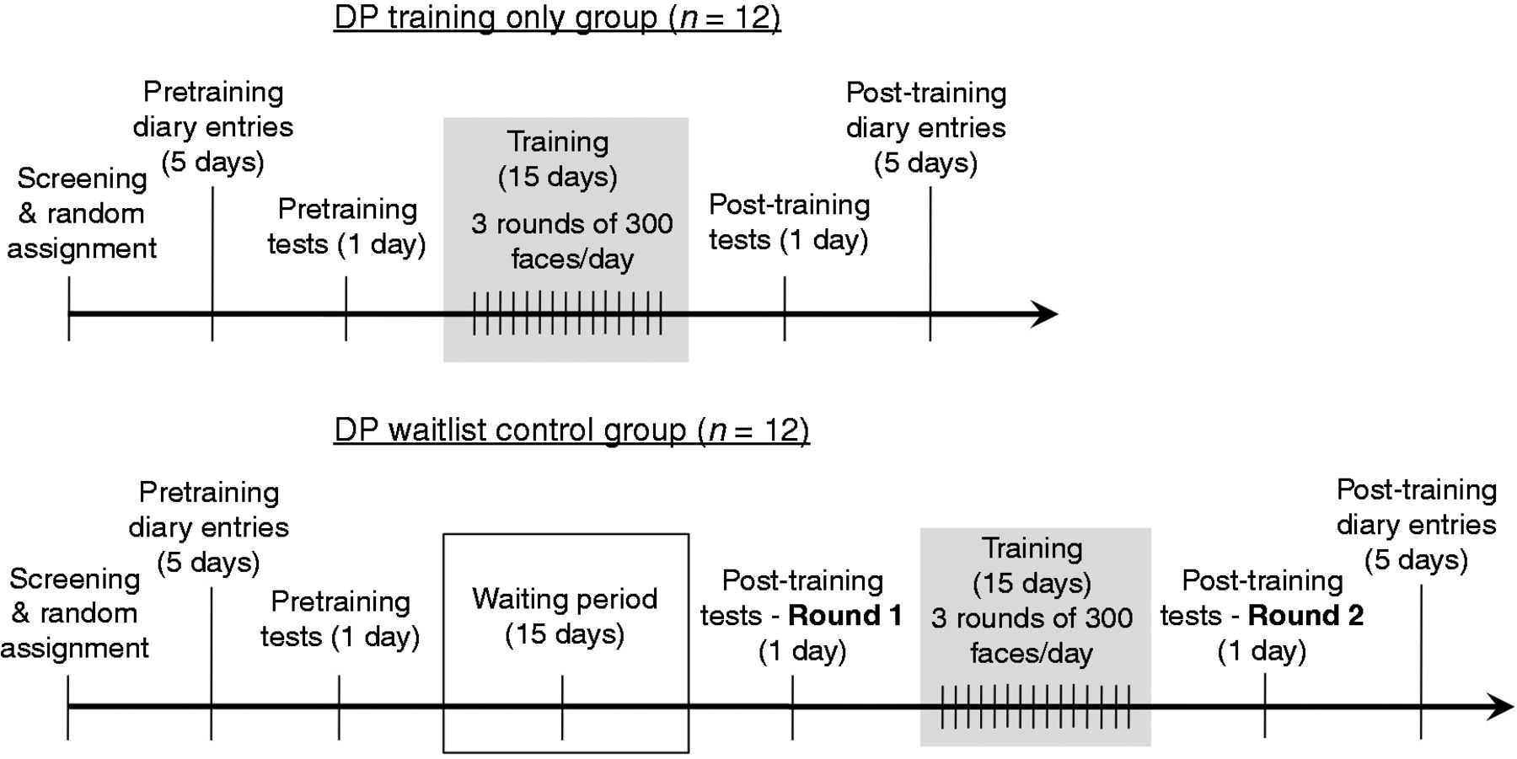
Figure 3 The training timeline for the training only and waiting list control groups. DP = developmental ...
Notes:
Figure 3 The training timeline for the training only and waiting list control groups. DP = developmental prosopagnosia.
Unless provided in the caption above, the following copyright applies to the content of this slide: © The Author (2014). Published by Oxford University Press on behalf of the Guarantors of Brain. All rights reserved. For Permissions, please email: journals.permissions@oup.com

Slide 4
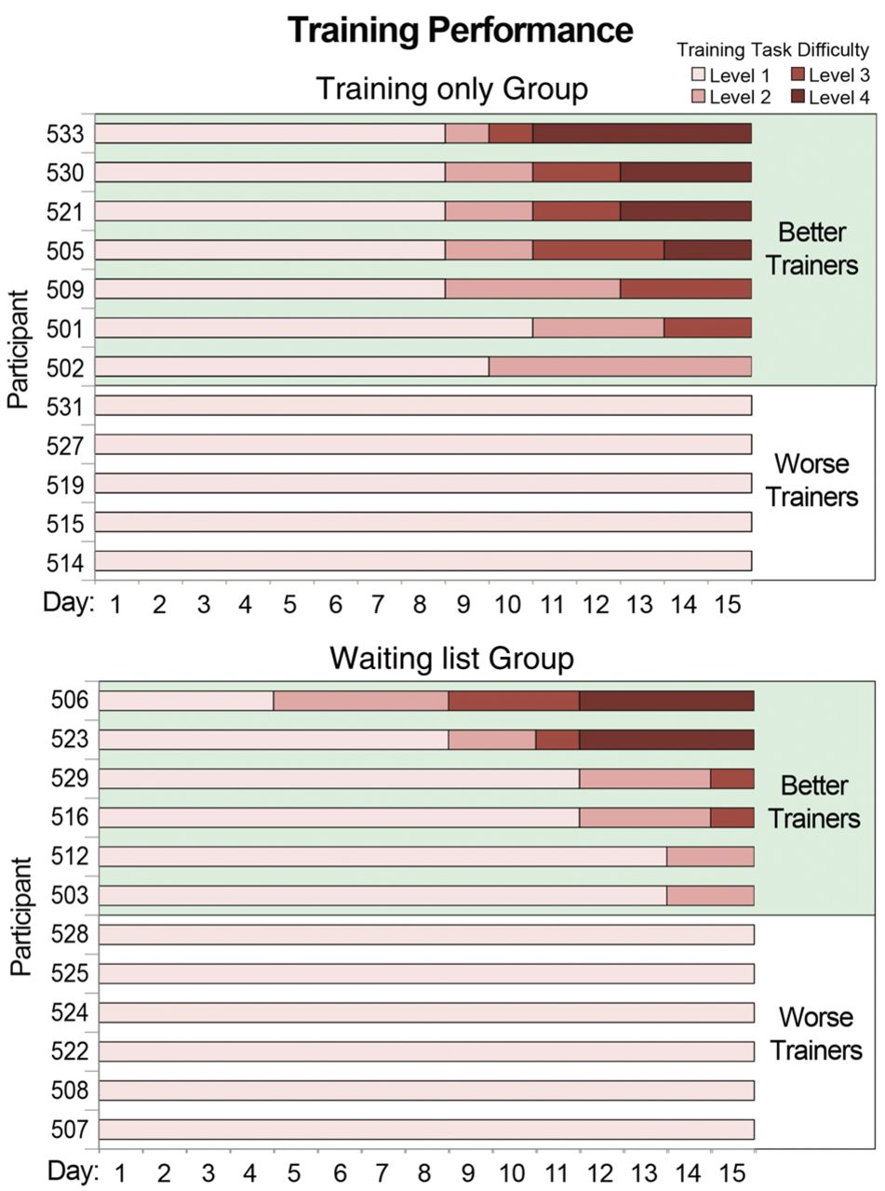
Figure 4 Individual subject data showing levels of difficulty reached over the 15 days of training for the ...
Notes:
Figure 4 Individual subject data showing levels of difficulty reached over the 15 days of training for the training-only and waiting list groups. We designate those who advanced past the first difficulty level (achieving >93% accuracy and <1 s reaction times on three training rounds in a row) as ‘better’ trainees and those who did not as ‘worse’ trainees.
Unless provided in the caption above, the following copyright applies to the content of this slide: © The Author (2014). Published by Oxford University Press on behalf of the Guarantors of Brain. All rights reserved. For Permissions, please email: journals.permissions@oup.com

Slide 5
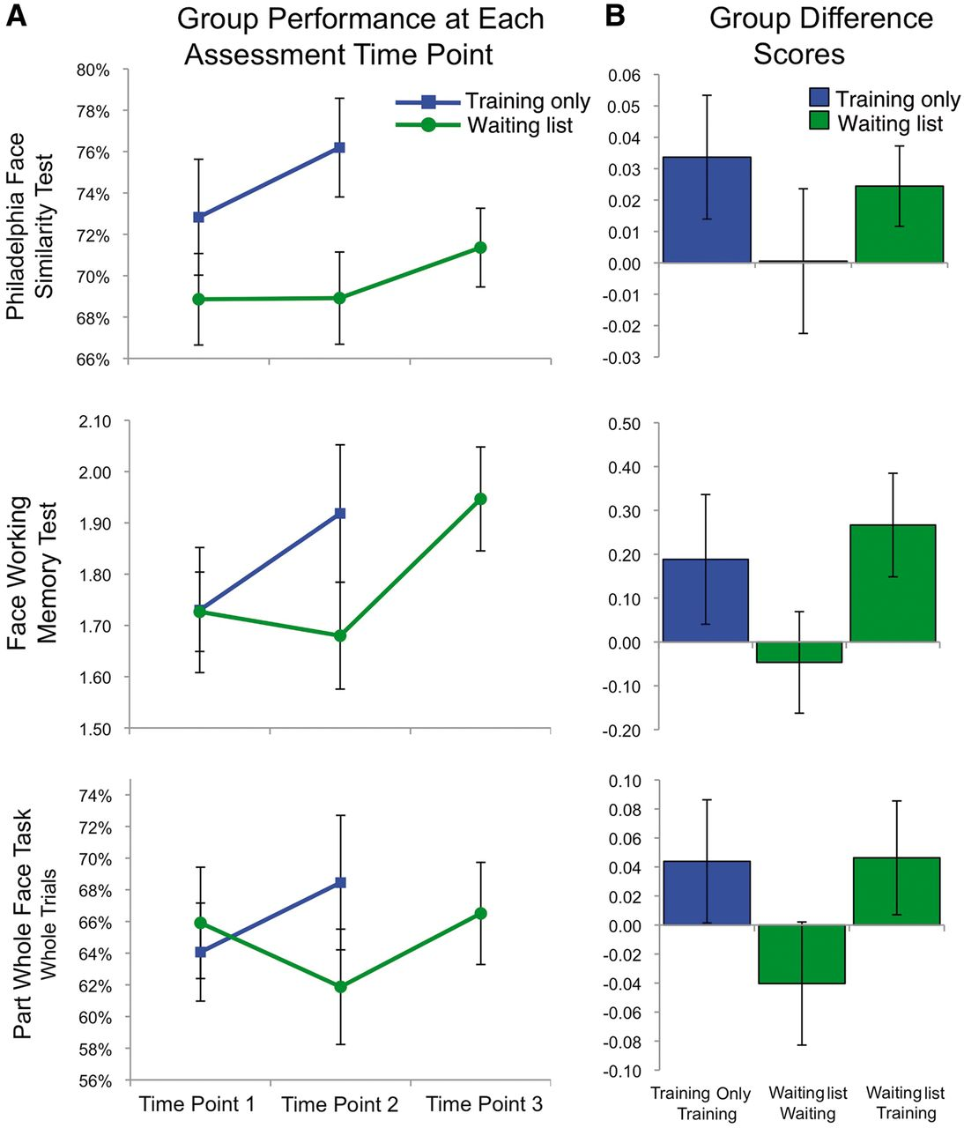
Figure 5 (A) Scores for the training only (blue) and the waiting list (green) groups on the three front-view face ...
Notes:
Figure 5 (A) Scores for the training only (blue) and the waiting list (green) groups on the three front-view face perception tests. Time point 1 indicates before training/waiting for both groups. Time point 2 is after training for the training only group, and after waiting for the waiting list group. Time point 3 is after training for the waiting list group. Error bars indicate the standard error of the mean. (B) Group difference scores on the three front-view face perception tests for training only group (time point 2 − 1), waiting list waiting period (time point 2 − 1), and waiting list training period (time point 3 − 2). Error bars indicate the standard error of the difference scores.
Unless provided in the caption above, the following copyright applies to the content of this slide: © The Author (2014). Published by Oxford University Press on behalf of the Guarantors of Brain. All rights reserved. For Permissions, please email: journals.permissions@oup.com

Slide 6
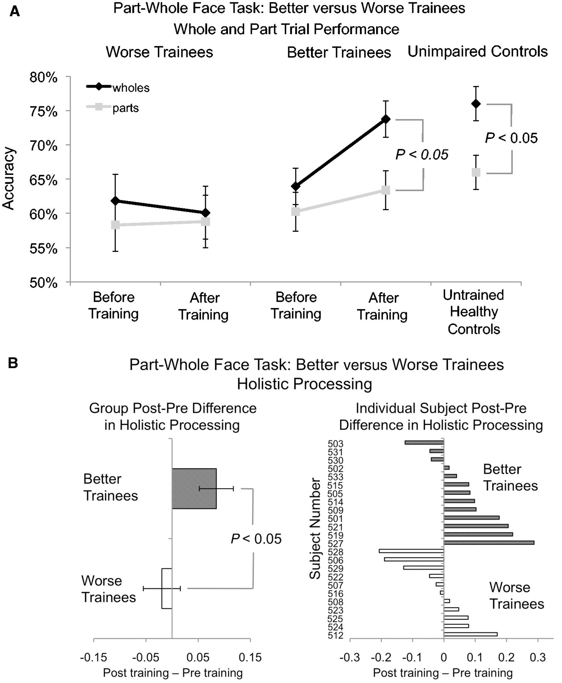
Figure 6 (A) Whole (black) and part (grey) trial accuracy for better and worse trainees before and after training ...
Notes:
Figure 6 (A) Whole (black) and part (grey) trial accuracy for better and worse trainees before and after training compared to unimpaired controls. Error bars indicate the standard error of the mean for each condition. (B) Holistic processing measured by regression for better and worse trainees before and after training. Error bars indicate the standard error of the post minus pretraining difference scores.
Unless provided in the caption above, the following copyright applies to the content of this slide: © The Author (2014). Published by Oxford University Press on behalf of the Guarantors of Brain. All rights reserved. For Permissions, please email: journals.permissions@oup.com

Slide 7
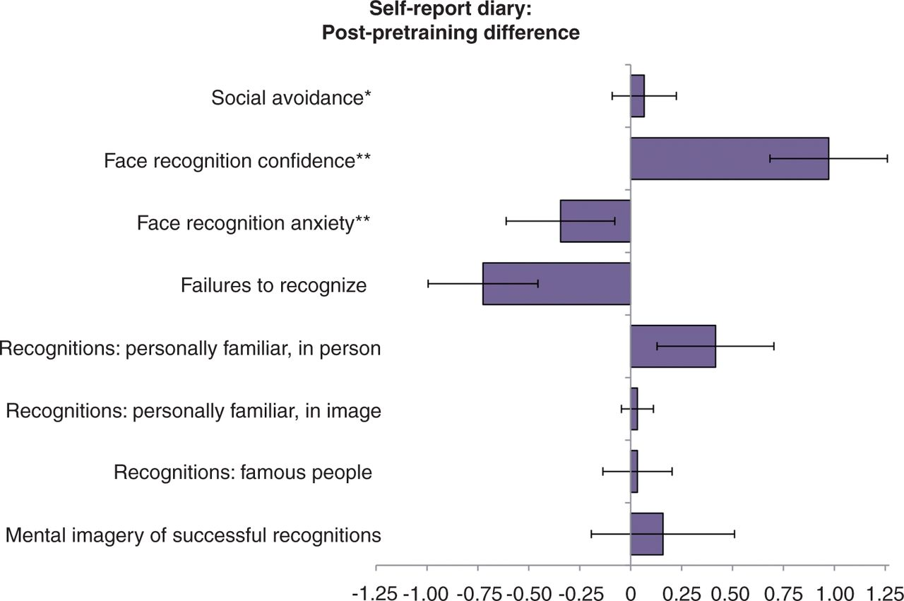
Figure 7 Pre/post difference scores for quantitative items in the self-report diary. Error bars indicate the standard ...
Notes:
Figure 7 Pre/post difference scores for quantitative items in the self-report diary. Error bars indicate the standard error of the mean of the difference scores. *Social avoidance was measured on the following scale: N/A, not at all, somewhat, yes, very much. This was transferred to a numerical scale from 0 to 3, respectively.**Confidence and anxiety were rated on a scale from 1 to 10. All other measures listed were open-ended numerical responses. See Supplementary material for the full diary form.
Unless provided in the caption above, the following copyright applies to the content of this slide: © The Author (2014). Published by Oxford University Press on behalf of the Guarantors of Brain. All rights reserved. For Permissions, please email: journals.permissions@oup.com

