Slide 1
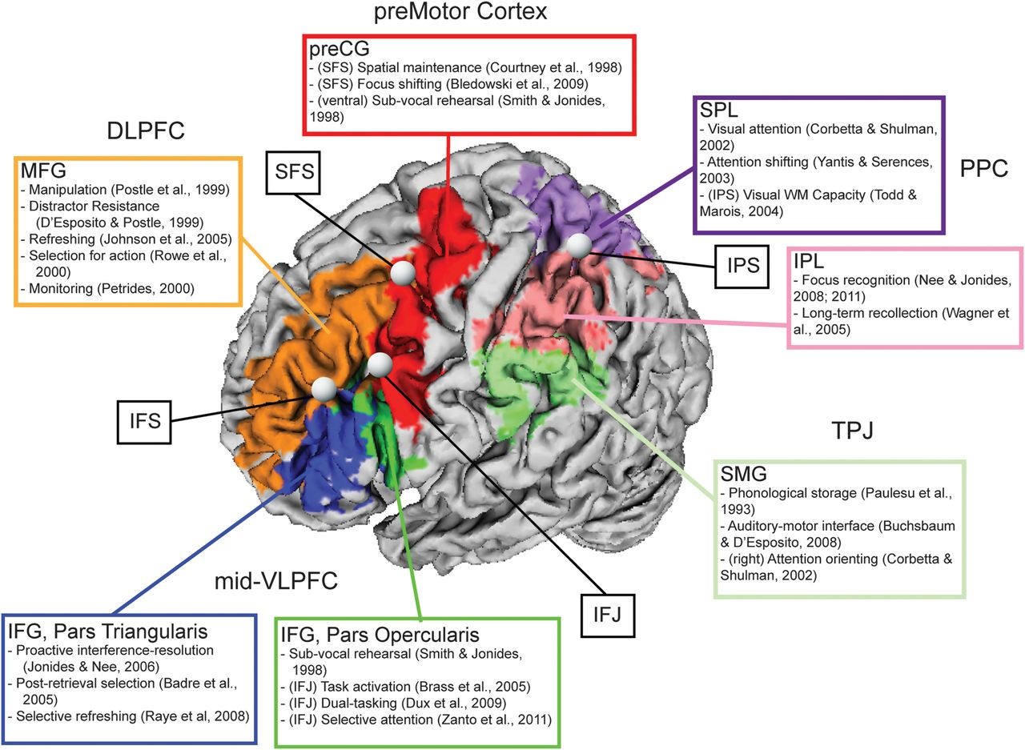
Figure 1. Renderings of regions related to executive processes of WM. Colors denote gyral definitions derived from the ...
Notes:
Figure 1. Renderings of regions related to executive processes of WM. Colors denote gyral definitions derived from the AAL atlas (Tzourio-Mazoyer et al. 2002). Prominent sulcal and gyral regions are denoted with bubbles. Literature associated with each region is listed. More general anatomical labels are associated with one or more gyri: midventrolateral prefrontal cortex (VLPFC) = inferior frontal gyrus (IFG), pars triangularis and IFG, pars opercularis; dorsolateral PFC (DLPFC) = middle frontal gyrus (MFG); premotor cortex = precentral gyrus (preCG); posterior parietal cortex (PPC) = superior parietal lobule (SPL) and inferior parietal lobule (IPL); temporalparietal junction (TPJ) = supramarginal gyrus (SMG). Other abbreviations: inferior frontal sulcus (IFS); inferior frontal junction (IFJ); superior frontal sulcus (SFS); intraparietal sulcus (IPS).
Unless provided in the caption above, the following copyright applies to the content of this slide: © The Author 2012. Published by Oxford University Press. All rights reserved. For permissions, please e-mail: journals.permissions@oup.com

Slide 2
Figure 2. ALE map of all experiments combined. The sample included 36 experiments with 461 activation foci. Results are ...
Notes:
Figure 2. ALE map of all experiments combined. The sample included 36 experiments with 461 activation foci. Results are threshold at P < 0.05, corrected for multiple comparisons using false discovery rate and a 25 voxel extent criterion. Higher ALE values are depicted in yellow.
Unless provided in the caption above, the following copyright applies to the content of this slide: © The Author 2012. Published by Oxford University Press. All rights reserved. For permissions, please e-mail: journals.permissions@oup.com

Slide 3
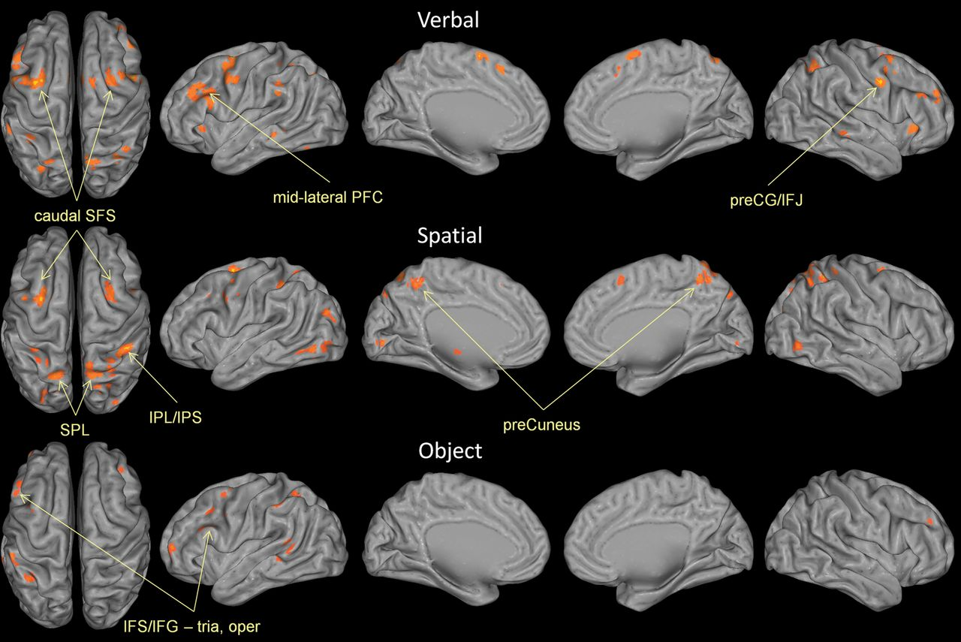
Figure 3. ALE maps by content. Top: ALE map of all experiments using verbal content (letters, words, digits). Middle: ...
Notes:
Figure 3. ALE maps by content. Top: ALE map of all experiments using verbal content (letters, words, digits). Middle: ALE map of all experiments using spatial content (locations, movement vectors). Bottom: ALE map of all experiments using object content (faces, scenes, houses, drawings, colors, unnamable objects). Results are threshold at P < 0.05, corrected for multiple comparisons using false discovery rate and a 25 voxel extent criterion. Higher ALE values are depicted in yellow.
Unless provided in the caption above, the following copyright applies to the content of this slide: © The Author 2012. Published by Oxford University Press. All rights reserved. For permissions, please e-mail: journals.permissions@oup.com

Slide 4
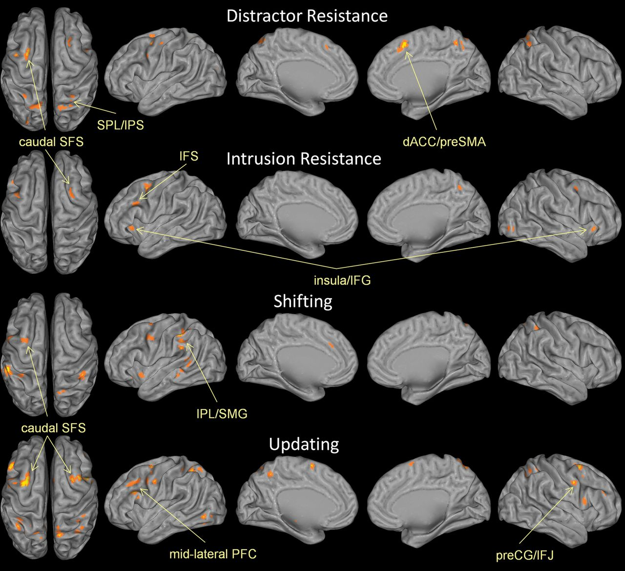
Figure 4. ALE maps by function. Distractor resistance involves preventing irrelevant external content from disrupting ...
Notes:
Figure 4. ALE maps by function. Distractor resistance involves preventing irrelevant external content from disrupting WM. Intrusion resistance involves preventing irrelevant memories from disrupting WM. Shifting involves changing the focus of attention within WM. Updating involves changing the content of what is stored in WM. See Materials and Methods for further details. Results are threshold at P < 0.05, corrected for multiple comparisons using false discovery rate and a 25 voxel extent criterion. Higher ALE values are depicted in yellow.
Unless provided in the caption above, the following copyright applies to the content of this slide: © The Author 2012. Published by Oxford University Press. All rights reserved. For permissions, please e-mail: journals.permissions@oup.com

Slide 5
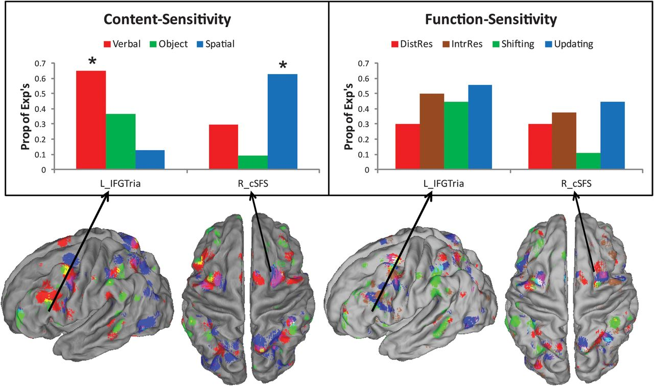
Figure 5. Content sensitivity and functional generality of the left IFG, pars triangularis, and right caudal SFS. Top: ...
Notes:
Figure 5. Content sensitivity and functional generality of the left IFG, pars triangularis, and right caudal SFS. Top: Proportion of experiments reporting significant activation in the left IFG, pars triangularis (L_IFGTria), and right caudal SFS (R_cSFS) grouped by content (left) and function (right). Significant difference by content were found in both the left IFG, pars triangularis (χ2 = 6.42, P < 0.05) and right caudal SFS (χ2 = 6.25, P < 0.05). Follow-up logistic regression tests revealed that verbal content predicted activation in the left IFG, pars triangularis (t34 = 2.25, P < 0.05) while spatial content predicted activation in the right caudal SFS (t34 = 2.10, P 0.1). Bottom: Renderings by content (left) and function (right). Results are thresholded at P < 0.01 uncorrected for depiction of overlap and subthreshold convergence. Content key: red—verbal, green—object, blue—spatial, overlap—mix. Function key: red—distractor resistance, sienna—intrusion resistance, green—shifting, blue—updating, overlap—mix.
Unless provided in the caption above, the following copyright applies to the content of this slide: © The Author 2012. Published by Oxford University Press. All rights reserved. For permissions, please e-mail: journals.permissions@oup.com

Slide 6
Figure 6. Plots of individual activation foci by selection demands. Activation foci from experiments requiring ...
Notes:
Figure 6. Plots of individual activation foci by selection demands. Activation foci from experiments requiring selection amidst competition (red; high selection) and selection without competition (green: low selection). Prominent clustering from experiments involving high selection can be seen in the left midlateral PFC along the IFS as well as in dorsal posterior parietal regions. Experiments involving low selection cluster prominently around inferior parietal cortex.
Unless provided in the caption above, the following copyright applies to the content of this slide: © The Author 2012. Published by Oxford University Press. All rights reserved. For permissions, please e-mail: journals.permissions@oup.com

