Slide 1
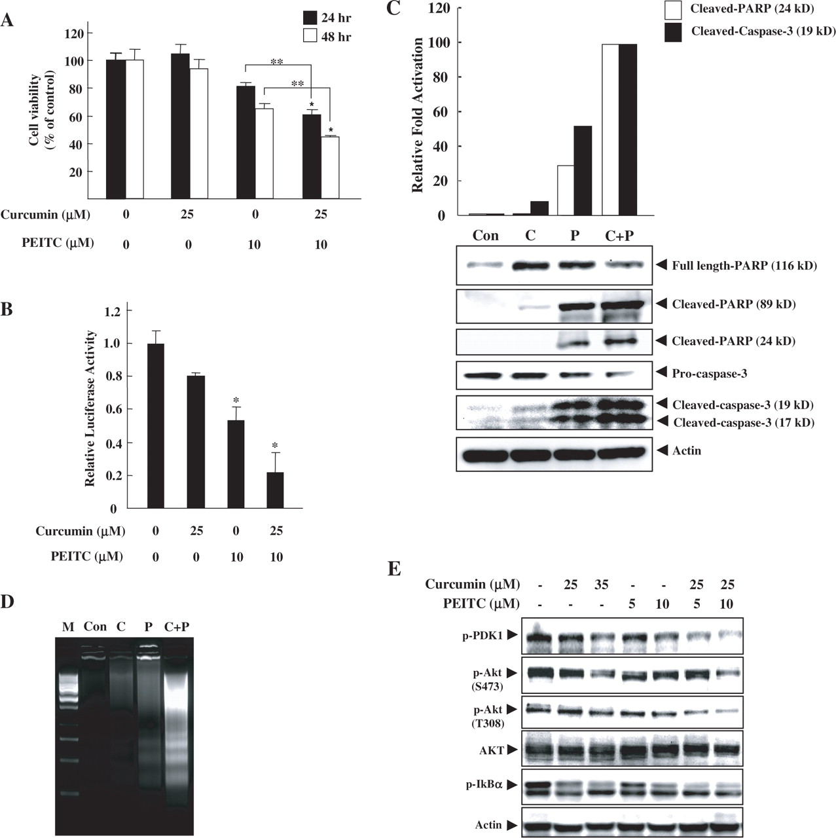
Fig. 1. Combined effects of PEITC and curcumin on cell death and NF-κB signaling pathways in PC-3 human prostate ...
Notes:
Fig. 1. Combined effects of PEITC and curcumin on cell death and NF-κB signaling pathways in PC-3 human prostate cancer cells. ( A ) Cell viability of PC-3 C4 cells was measured by MTT assay after treatment with curcumin, PEITC or a combination of both for 24 or 48 h. Data are shown as mean ± SD ( n = 3). For t -tests, *P < 0.05 compared with control; **P < 0.05 compared with two groups. ( B ) NF-κB luciferase activity was measured after treatment of PC-3 C4 cells with curcumin, PEITC or combination for 24 h. Data are shown as mean ± SD ( n = 3). For t -tests, *P < 0.05 compared with control (0.2% DMSO). Cleavage of PARP and caspase 3 ( C ) and DNA fragmentation ( D ) as apoptotic markers, were measured by western blot analysis and DNA electrophoresis, respectively, after 24 h treatment of PC-3 C4 cells with curcumin, PEITC or a combination (lower panel in C and D). The upper panel in C shows the relative fold activation of cleaved PARP or cleaved caspase 3 by densitometry. The results are presented as mean ± SD ( n = 3). M, DNA marker; Con, control; C, curcumin; P, PEITC. ( E ) PC-3 C4 cells were treated with different concentrations of curcumin and PEITC in serum-free media for 1 h. Activation levels of Akt signaling proteins (PDK1 and Akt) and NF-κB signaling protein (IκBα) were measured using their phospho-specific antibodies by western blotting. Actin was used to ensure equal protein loading. All experiments in this study were performed at least three times.
Unless provided in the caption above, the following copyright applies to the content of this slide: Carcinogenesis vol.27 no.3 © Oxford University Press 2005; all rights reserved.

Slide 2
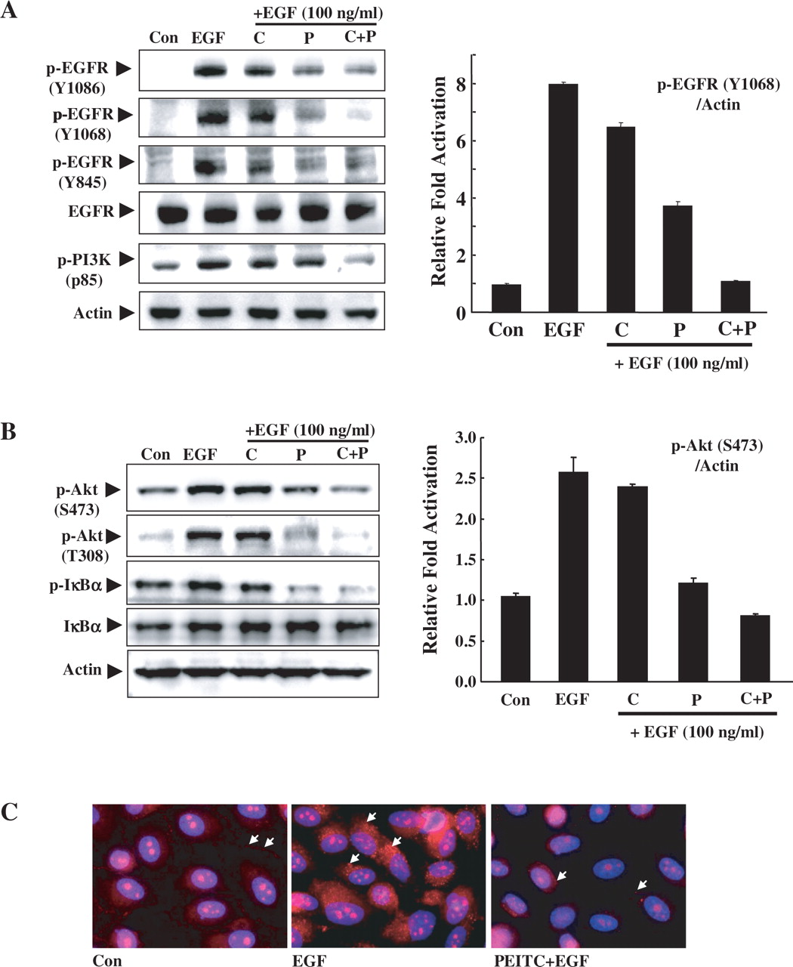
Fig. 4. Additive inhibition of EGFR signaling in PC-3 parental cells by combination of PEITC and curcumin. ( A ) ...
Notes:
Fig. 4. Additive inhibition of EGFR signaling in PC-3 parental cells by combination of PEITC and curcumin. ( A ) PC-3 cells were pretreated with compounds (curcumin, 25 μM; PEITC, 10 μM; or their combination) for 5 min and then stimulated with EGF (100 ng/ml). For evaluation of the EGFR signaling proteins, phospho-specific antibodies against the phosphorylated tyrosine residues (Y845, Y992 and Y1068) of EGFR were used. Phospho-p85, a subunit PI3K, was detected using a specific antibody, which can detect p-YXXM motif (Y, tyrosine; X, amino acid; M, methionine). Actin was used as an equal loading control. Relative fold of activation of p-EGFR (Y1068) was measured by densitometry analysis (right). Con, control; C, curcumin; P, PEITC. ( B ) PC-3 cells were pretreated with compounds for 5 min and then incubated with EGF (100 ng/ml) for 2 h. Phosphorylation of Akt was measured using specific antibody detecting phosphorylation of S473 or T308, by western blotting. Relative fold activation of p-Akt was measured by densitometry (right). Total protein levels of Akt and actin were used for the Akt expression level and protein equal loading controls, respectively. Phosphorylation of IκBα was also measured by western blotting using a phospho-specific antibody. Con, control; C, curcumin; P, PEITC. ( C ) PC-3 cells were treated with 0.2% DMSO or 10 μM PEITC for 5 min followed by a 10 min incubation with EGF (100 ng/ml). Phosphorylated EGFR (red) and nuclei (blue) were detected by immunofluorescence analysis using anti-p-EGFR (Y1086) and DAPI dye, respectively. Pictures with red and blue color were merged. Magnitude: 400-fold; Con, control.
Unless provided in the caption above, the following copyright applies to the content of this slide: Carcinogenesis vol.27 no.3 © Oxford University Press 2005; all rights reserved.

Slide 3
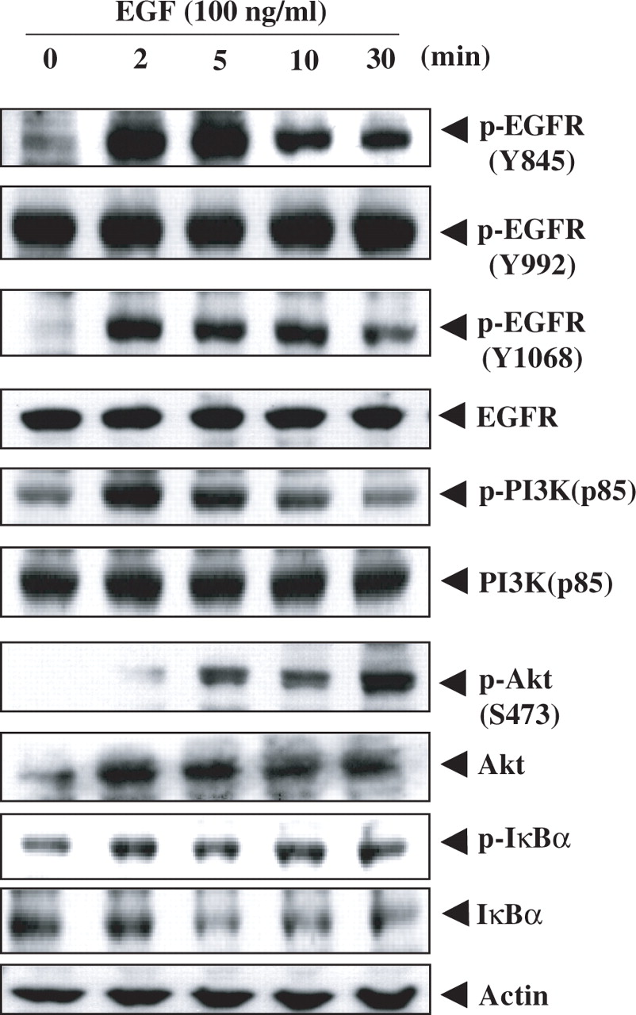
Fig. 2. Effects of EGF on EGFR signaling in PC-3 C4 cells. PC-3 C4 cells were incubated with EGF (100 ng/ml) in ...
Notes:
Fig. 2. Effects of EGF on EGFR signaling in PC-3 C4 cells. PC-3 C4 cells were incubated with EGF (100 ng/ml) in serum-free media for the indicated times. Representative EGFR signaling proteins (p-EGFR, p-PI3K (p85), p-Akt and p-IκBα) were measured using phospho-specific antibodies, which detect phosphorylation at specific residue. Anti-EGFR, anti-PI3K (p85), anti-Akt and anti-IκBα antibodies were used to determine the total expression levels of each protein. Actin was used to ensure equal protein loading.
Unless provided in the caption above, the following copyright applies to the content of this slide: Carcinogenesis vol.27 no.3 © Oxford University Press 2005; all rights reserved.

Slide 4
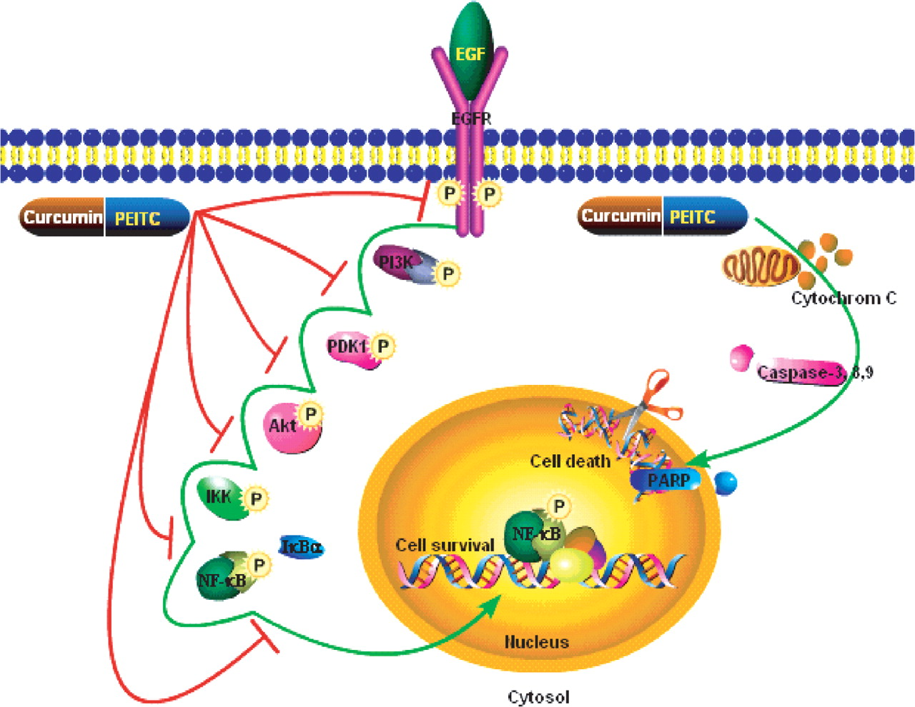
Fig. 5. A schematic representation of possible mechanisms for the combined effect of PEITC and curcumin on EGFR ...
Notes:
Fig. 5. A schematic representation of possible mechanisms for the combined effect of PEITC and curcumin on EGFR signaling and apoptosis in PC-3 cells. Signaling pathways and blocking mechanisms are indicated with green and red colored line, respectively.
Unless provided in the caption above, the following copyright applies to the content of this slide: Carcinogenesis vol.27 no.3 © Oxford University Press 2005; all rights reserved.

Slide 5
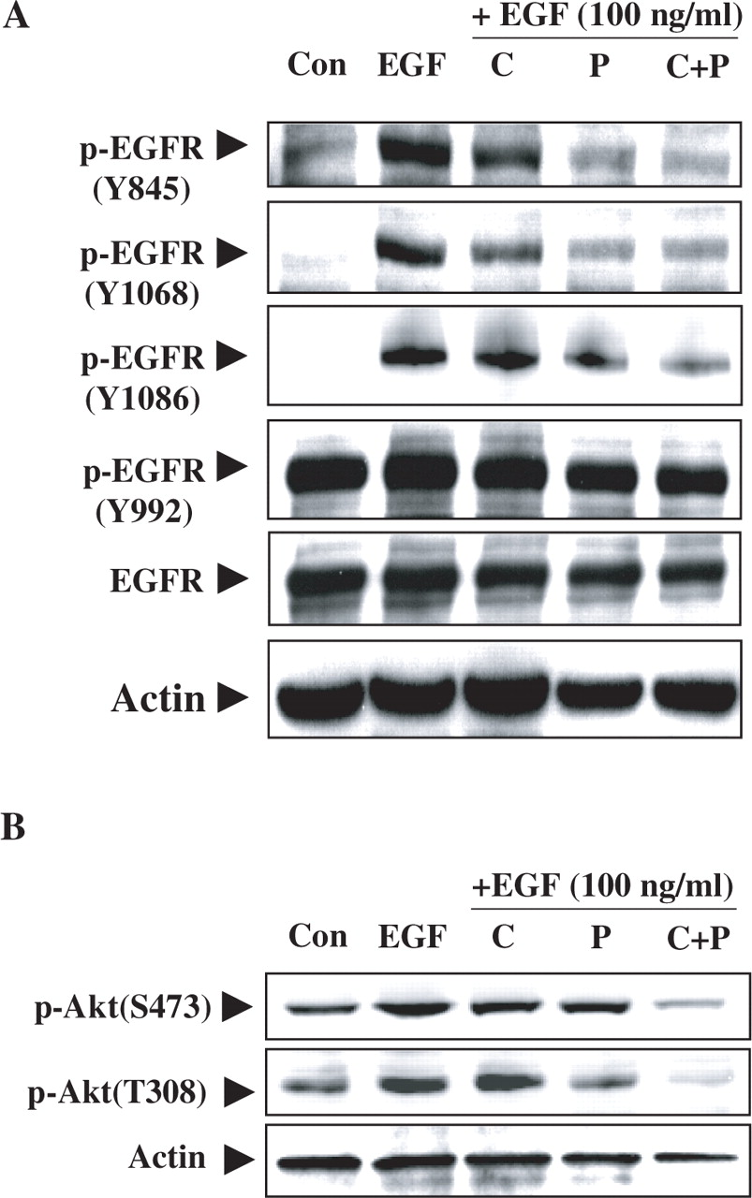
Fig. 3. Inhibition of EGFR phosphorylation by PEITC, curcumin, and their combination after stimulation of PC-3 C4 ...
Notes:
Fig. 3. Inhibition of EGFR phosphorylation by PEITC, curcumin, and their combination after stimulation of PC-3 C4 cells with EGF. ( A ) PC-3 C4 cells were stimulated with EGF (100 ng/ml) for 10 min after a 5 min pretreatment with compounds (curcumin, 25 μM; PEITC, 10 μM; or their combination) in serum-free media. Activated EGFR proteins were measured using four different types of phospho-specific antibodies, which recognize specific phosphorylation sites on tyrosine residues, by western blotting. Con, control; C, curcumin; P, PEITC. ( B ) PC-3 C4 cells were pretreated with compounds (curcumin, 25 μM; PEITC, 10 μM; or their combination) for 5 min and then challenged with EGF (100 ng/ml) for 1 h in serum-free media. Activated Akt proteins were measured by western blotting using phospho-specific antibodies that detect specific phosphorylation sites in Akt. Actin was used to ensure equal protein loading. Con, control; C, curcumin; P, PEITC.
Unless provided in the caption above, the following copyright applies to the content of this slide: Carcinogenesis vol.27 no.3 © Oxford University Press 2005; all rights reserved.

