Slide 1
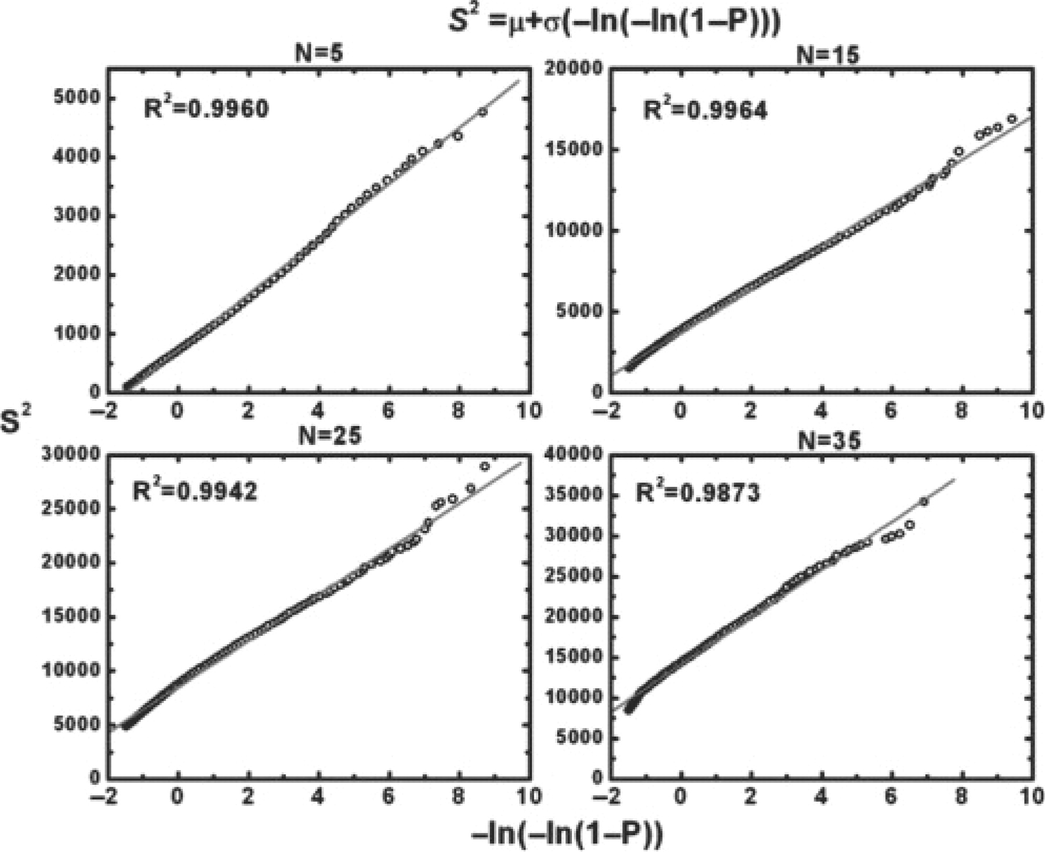
Fig. 1. Fitting of the square of the SOIPPA raw scores to an extreme value distribution (EVD) for alignment lengths N ...
Notes:
Fig. 1. Fitting of the square of the SOIPPA raw scores to an extreme value distribution (EVD) for alignment lengths N of 5, 15, 25 and 35, respectively. The EVD is determined by two parameters μ and σ, which are estimated from linear regression of the rearrangement of Equations 4 and 5 (see text and Fig. 2) as S2 = μ + σ(–ln(–ln(1−-P))).
Unless provided in the caption above, the following copyright applies to the content of this slide: © 2009 The Author(s)This is an Open Access article distributed under the terms of the Creative Commons Attribution Non-Commercial License (http://creativecommons.org/licenses/by-nc/2.0/uk/) which permits unrestricted non-commercial use, distribution, and reproduction in any medium, provided the original work is properly cited.

Slide 2
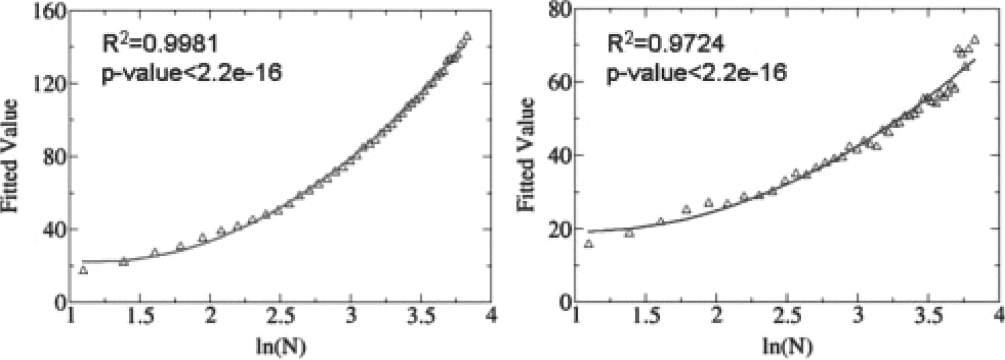
Fig. 2. The derived parameters μ and σ that determine a unique extreme value distribution (EVD) for a specific ...
Notes:
Fig. 2. The derived parameters μ and σ that determine a unique extreme value distribution (EVD) for a specific alignment length can be fitted to a quadratic function based on the logarithm of alignment length.
Unless provided in the caption above, the following copyright applies to the content of this slide: © 2009 The Author(s)This is an Open Access article distributed under the terms of the Creative Commons Attribution Non-Commercial License (http://creativecommons.org/licenses/by-nc/2.0/uk/) which permits unrestricted non-commercial use, distribution, and reproduction in any medium, provided the original work is properly cited.

Slide 3
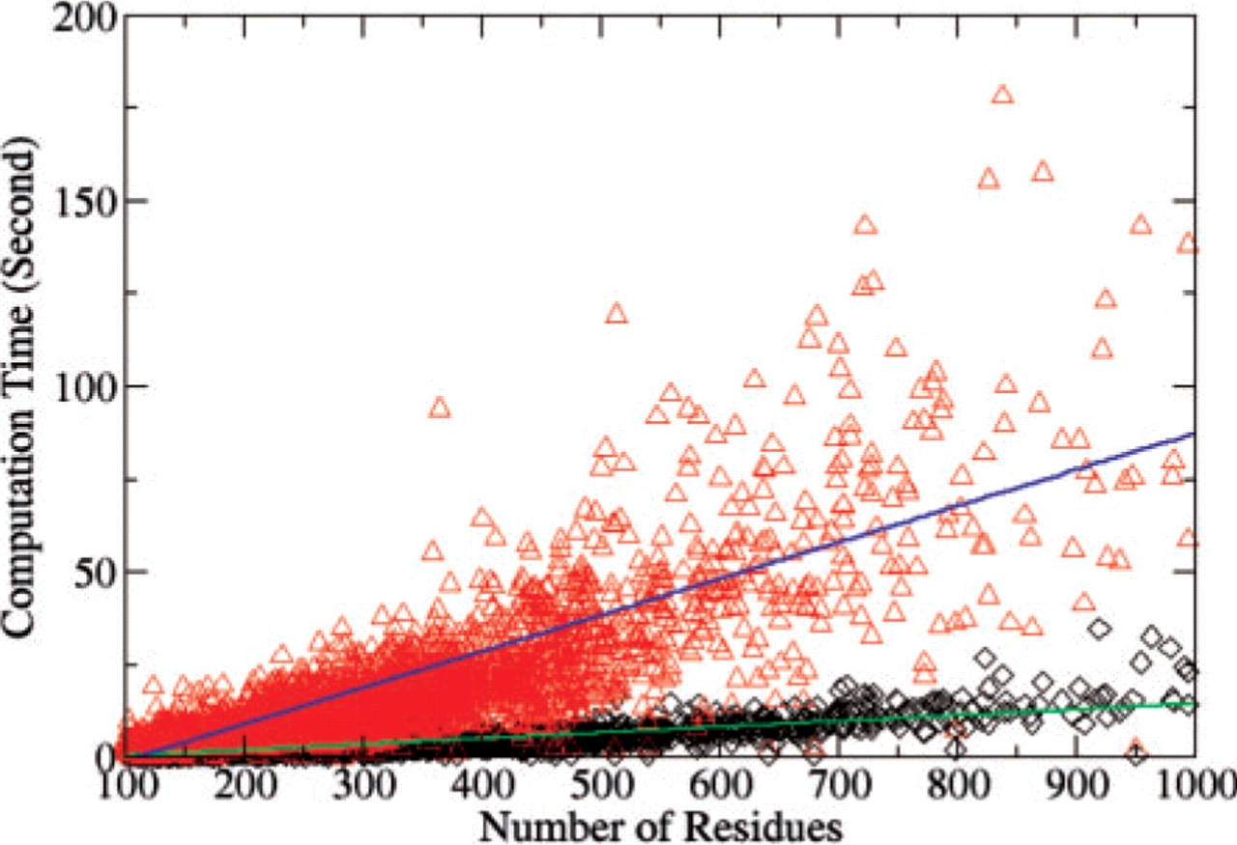
Fig. 3. Computational time for 5000 randomly selected non-redundant chains searched against two structures with chain ...
Notes:
Fig. 3. Computational time for 5000 randomly selected non-redundant chains searched against two structures with chain lengths of 564 (red triangle) and 166 (black diamond), respectively.
Unless provided in the caption above, the following copyright applies to the content of this slide: © 2009 The Author(s)This is an Open Access article distributed under the terms of the Creative Commons Attribution Non-Commercial License (http://creativecommons.org/licenses/by-nc/2.0/uk/) which permits unrestricted non-commercial use, distribution, and reproduction in any medium, provided the original work is properly cited.

Slide 4
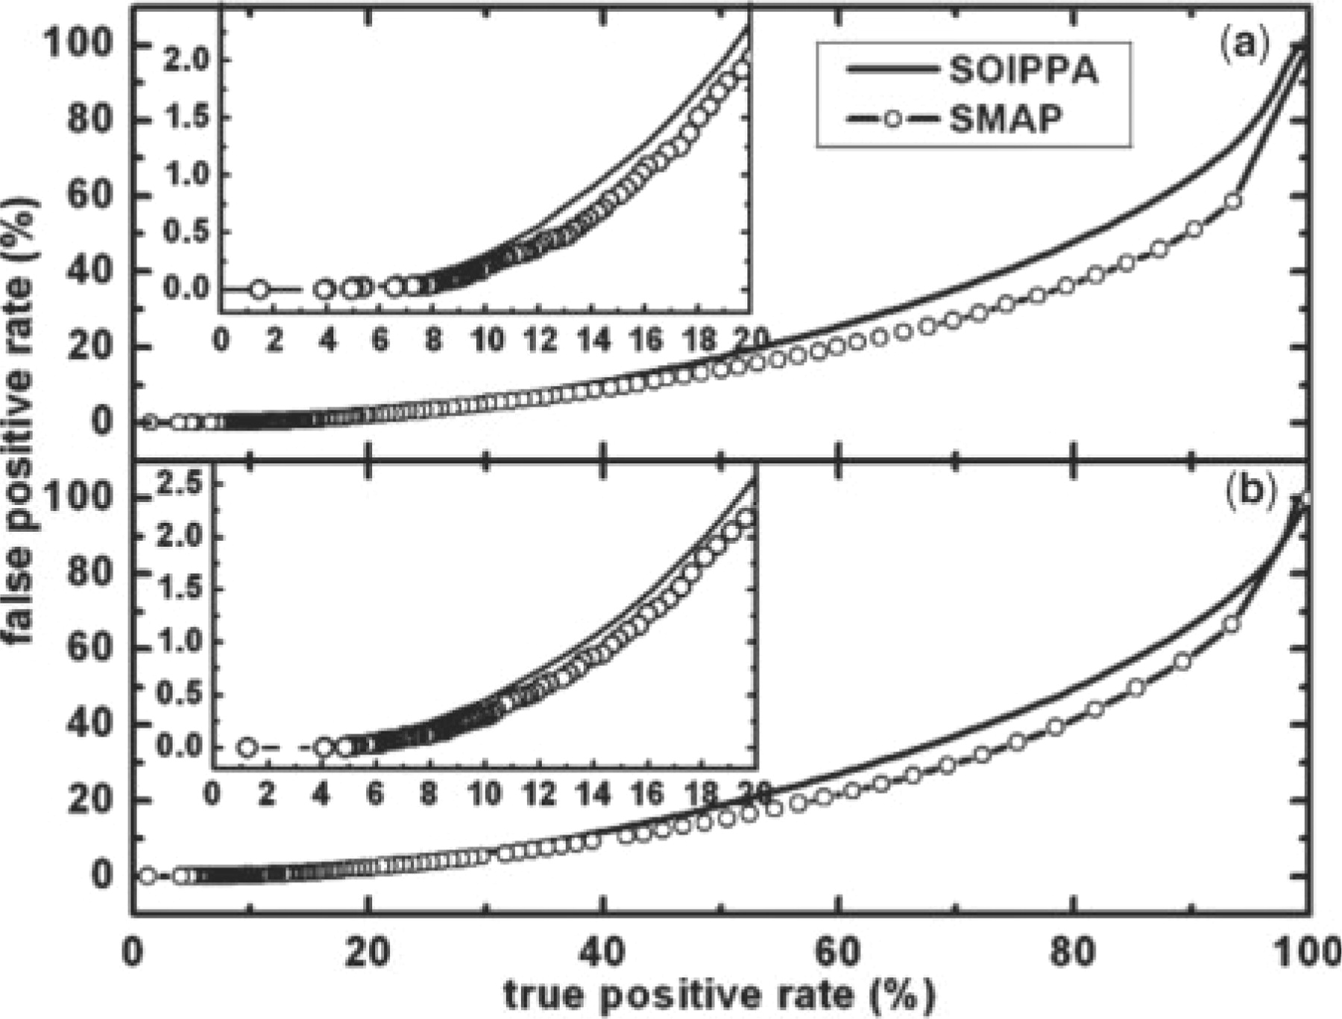
Fig. 4. Percentage of false positive rate versus true positive rate for the original SOIPPA algorithm (Xie and ...
Notes:
Fig. 4. Percentage of false positive rate versus true positive rate for the original SOIPPA algorithm (Xie and Bourne, 2008) (solid) and the improved SMAP implementation (dashed with circles) using (a) BLOSUM45 and (b) McLachlan substitution matrices. The details of the benchmark used are given in the method section.
Unless provided in the caption above, the following copyright applies to the content of this slide: © 2009 The Author(s)This is an Open Access article distributed under the terms of the Creative Commons Attribution Non-Commercial License (http://creativecommons.org/licenses/by-nc/2.0/uk/) which permits unrestricted non-commercial use, distribution, and reproduction in any medium, provided the original work is properly cited.

Slide 5
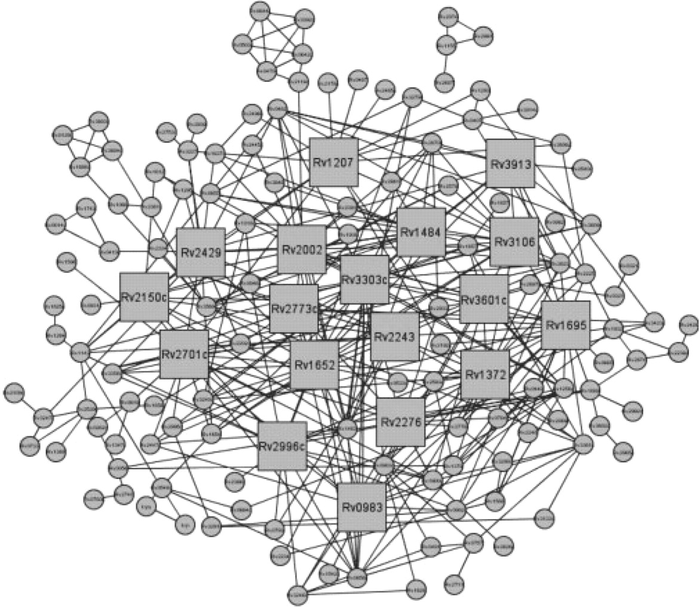
Fig. 5. Predicted protein–ligand interaction network of M. tuberculosis. Proteins that are predicted to have similar ...
Notes:
Fig. 5. Predicted protein–ligand interaction network of M. tuberculosis. Proteins that are predicted to have similar binding sites are connected. Squares represent the top 18 most connected proteins.
Unless provided in the caption above, the following copyright applies to the content of this slide: © 2009 The Author(s)This is an Open Access article distributed under the terms of the Creative Commons Attribution Non-Commercial License (http://creativecommons.org/licenses/by-nc/2.0/uk/) which permits unrestricted non-commercial use, distribution, and reproduction in any medium, provided the original work is properly cited.

