Slide 1
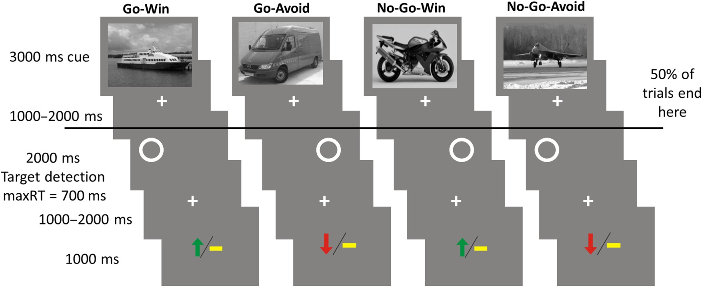
Figure 1. Experimental paradigm performed in the scanner. Subjects were presented 80 trials in each of 4 consecutive ...
Notes:
Figure 1. Experimental paradigm performed in the scanner. Subjects were presented 80 trials in each of 4 consecutive blocks. In each trial, a trial-unique image from 1 of 4 categories (randomized across participants) informed subjects about the 2 factors: Whether to respond by indicating the position of a circle with an either left or right button press or to omit a response entirely (Go or No-Go); whether they could win a reward or avoid a loss by performing a correct action or inaction (Win or Avoid). On Win trials, subjects could win £1 if they performed correctly, or gain £0 if they performed incorrectly. On Avoid trials, subjects could gain £0 instead of losing £1 by performing correctly. The outcomes after a correct response were 70% probabilistic. To disassociate anticipation from actual performance, half of the trials ended after the cue image and were directly followed by a new cue image. Subjects were trained extensively with a different set of images that were not trial unique before entering the scanner.
Unless provided in the caption above, the following copyright applies to the content of this slide: © The Author 2015. Published by Oxford University PressThis is an Open Access article distributed under the terms of the Creative Commons Attribution License (http://creativecommons.org/licenses/by/4.0/), which permits unrestricted reuse, distribution, and reproduction in any medium, provided the original work is properly cited.

Slide 2
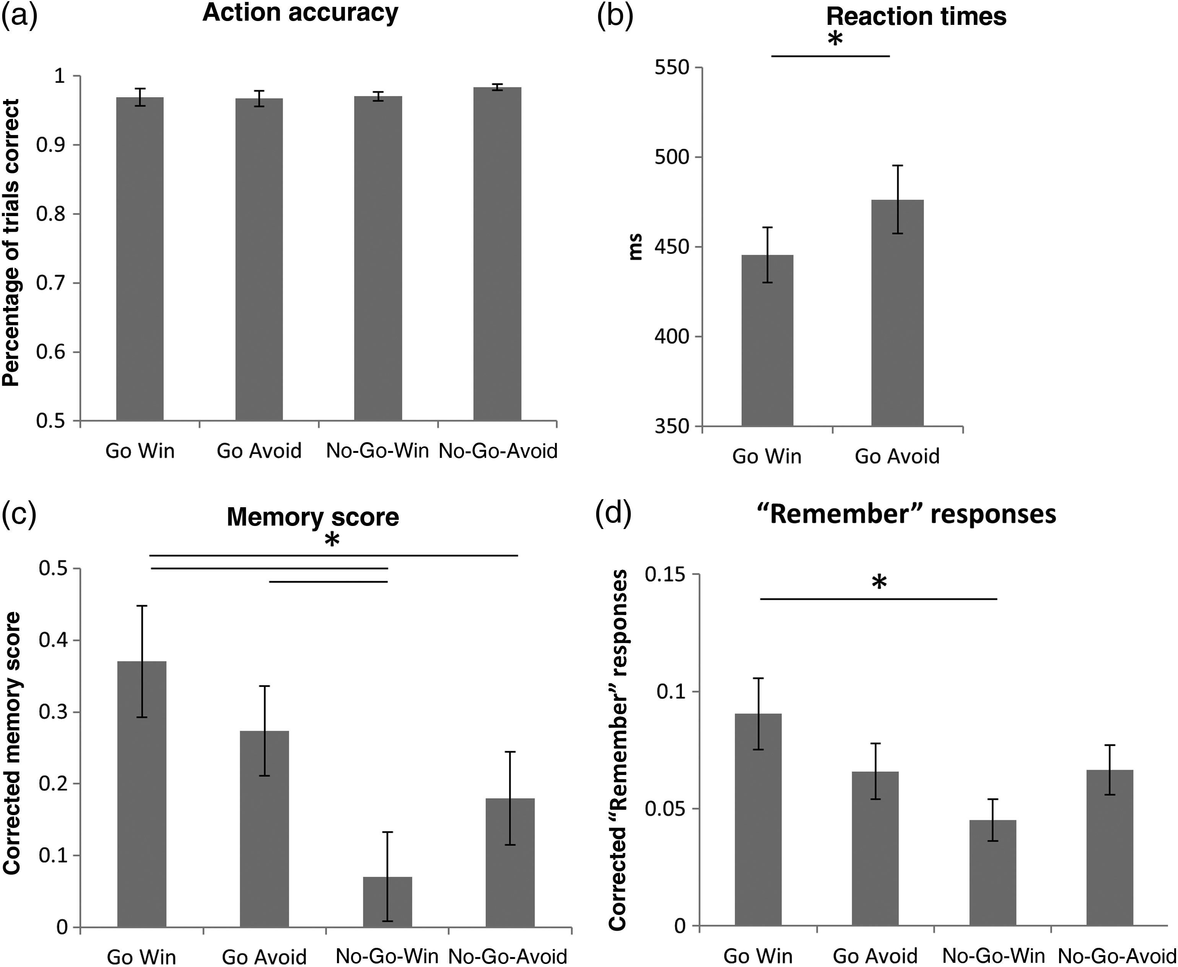
Figure 2. (a) Action accuracy (correctly performing Go or No-Go) did not differ across conditions. (b) Subjects' ...
Notes:
Figure 2. (a) Action accuracy (correctly performing Go or No-Go) did not differ across conditions. (b) Subjects' responses were faster for Go Win than for Go Avoid trials. (c) The memory score (correct vs. incorrect recognition weighted by confidence) differs across conditions, showing both an enhancement of action and an interaction of action and valence. (d) The “Remember” responses follow the same pattern as the memory score. Post hoc tests were performed by means of paired t-test. Significant differences (P < 0.05) are marked by an asterisk. Error bars represent standard error of the mean.
Unless provided in the caption above, the following copyright applies to the content of this slide: © The Author 2015. Published by Oxford University PressThis is an Open Access article distributed under the terms of the Creative Commons Attribution License (http://creativecommons.org/licenses/by/4.0/), which permits unrestricted reuse, distribution, and reproduction in any medium, provided the original work is properly cited.

Slide 3
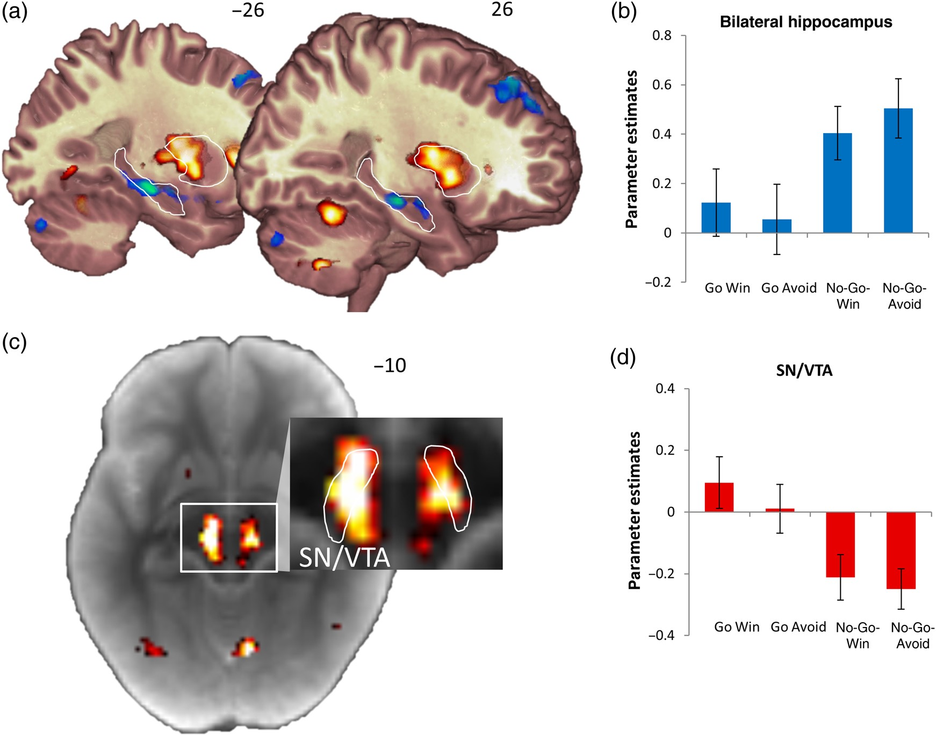
Figure 3. (a) The main effects of action (red) and inaction (blue) on cue activity. The bilateral hippocampus and ...
Notes:
Figure 3. (a) The main effects of action (red) and inaction (blue) on cue activity. The bilateral hippocampus and putamen are outlined for display purposes. (b) The bilateral hippocampus shows increased activation during the anticipation of inaction. (c) To localize the activity in the midbrain, the statistical map of the main effect of action was displayed on the average magnetization transfer weighted image of the subjects. The SN/VTA is within the outlined hyperintense stripe (Duzel et al. 2009). The contrast of the magnified display is optimized to differentiate midbrain structures. (d) The activation of the midbrain cluster shows a main effect of action. All activations are thresholded at P < 0.001 uncorrected. Error bars represent standard error of the mean.
Unless provided in the caption above, the following copyright applies to the content of this slide: © The Author 2015. Published by Oxford University PressThis is an Open Access article distributed under the terms of the Creative Commons Attribution License (http://creativecommons.org/licenses/by/4.0/), which permits unrestricted reuse, distribution, and reproduction in any medium, provided the original work is properly cited.

Slide 4
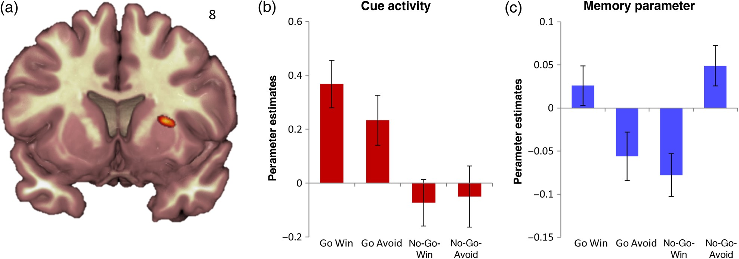
Figure 4. (a) The interaction of action and valence of the memory parameter is displayed at P < 0.001 uncorrected. The ...
Notes:
Figure 4. (a) The interaction of action and valence of the memory parameter is displayed at P < 0.001 uncorrected. The betas of the putamen cluster for cue activity (b) and the memory parameter (c) were extracted. Error bars represent standard error of the mean. The interaction effect shows a Pavlovian congruence effect favoring action for reward and inaction for avoidance of loss.
Unless provided in the caption above, the following copyright applies to the content of this slide: © The Author 2015. Published by Oxford University PressThis is an Open Access article distributed under the terms of the Creative Commons Attribution License (http://creativecommons.org/licenses/by/4.0/), which permits unrestricted reuse, distribution, and reproduction in any medium, provided the original work is properly cited.

