Slide 1
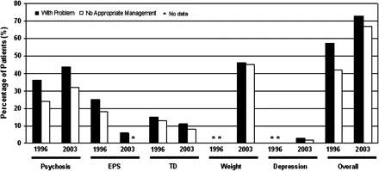
Fig. 1. Comparing the prevalence of clinical problems and lack of appropriate treatment between this study and ...
Notes:
Fig. 1. Comparing the prevalence of clinical problems and lack of appropriate treatment between this study and results from 1996.
Unless provided in the caption above, the following copyright applies to the content of this slide: Published by Oxford University Press on behalf of the Maryland Psychiatric Research Center 2008.

