Slide 1
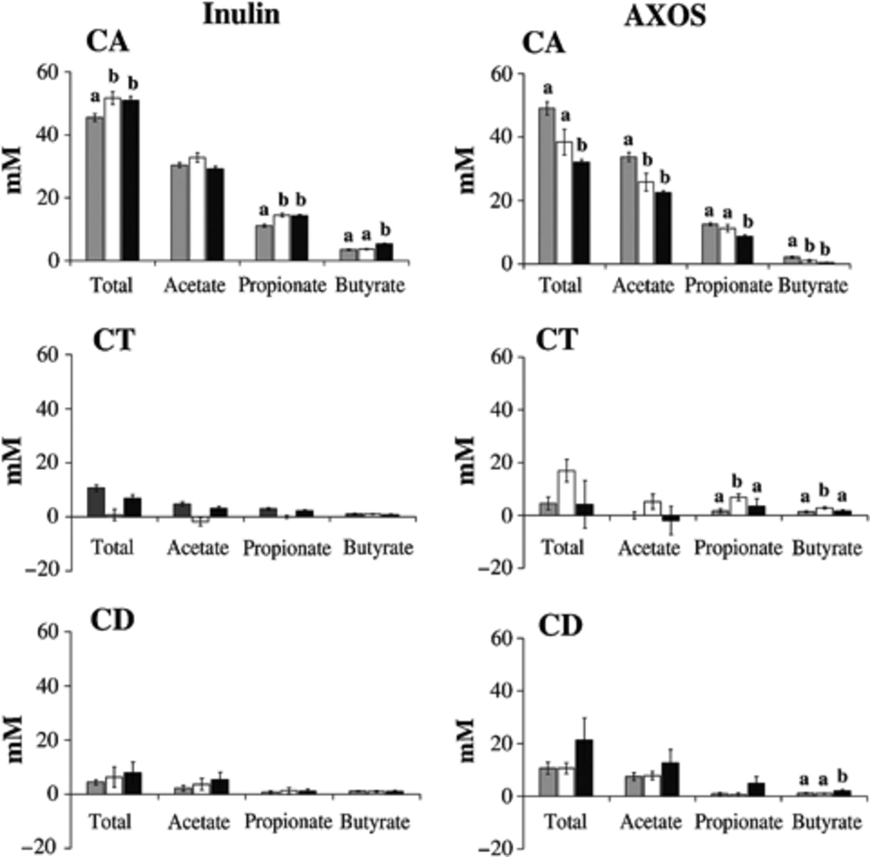
1 Average net SFCA production during the Twin-SHIME run. For both inulin- (left panels) and AXOS (right ...
Notes:
1 Average net SFCA production during the Twin-SHIME run. For both inulin- (left panels) and AXOS (right panels)-treated SHIMEs, different colon compartments (CA, CT and CD for ascending, transverse and descending colon, respectively) and different periods (grey bars for basal, white bars for treatment and black bars for washout period) are presented. Indices above data bars represent significant differences within one colon compartment in function of time. Different letters indicate significantly different results (P<0.05).
Unless provided in the caption above, the following copyright applies to the content of this slide: © 2009 Federation of European Microbiological Societies. Published by Blackwell Publishing Ltd. All rights reserved

Slide 2
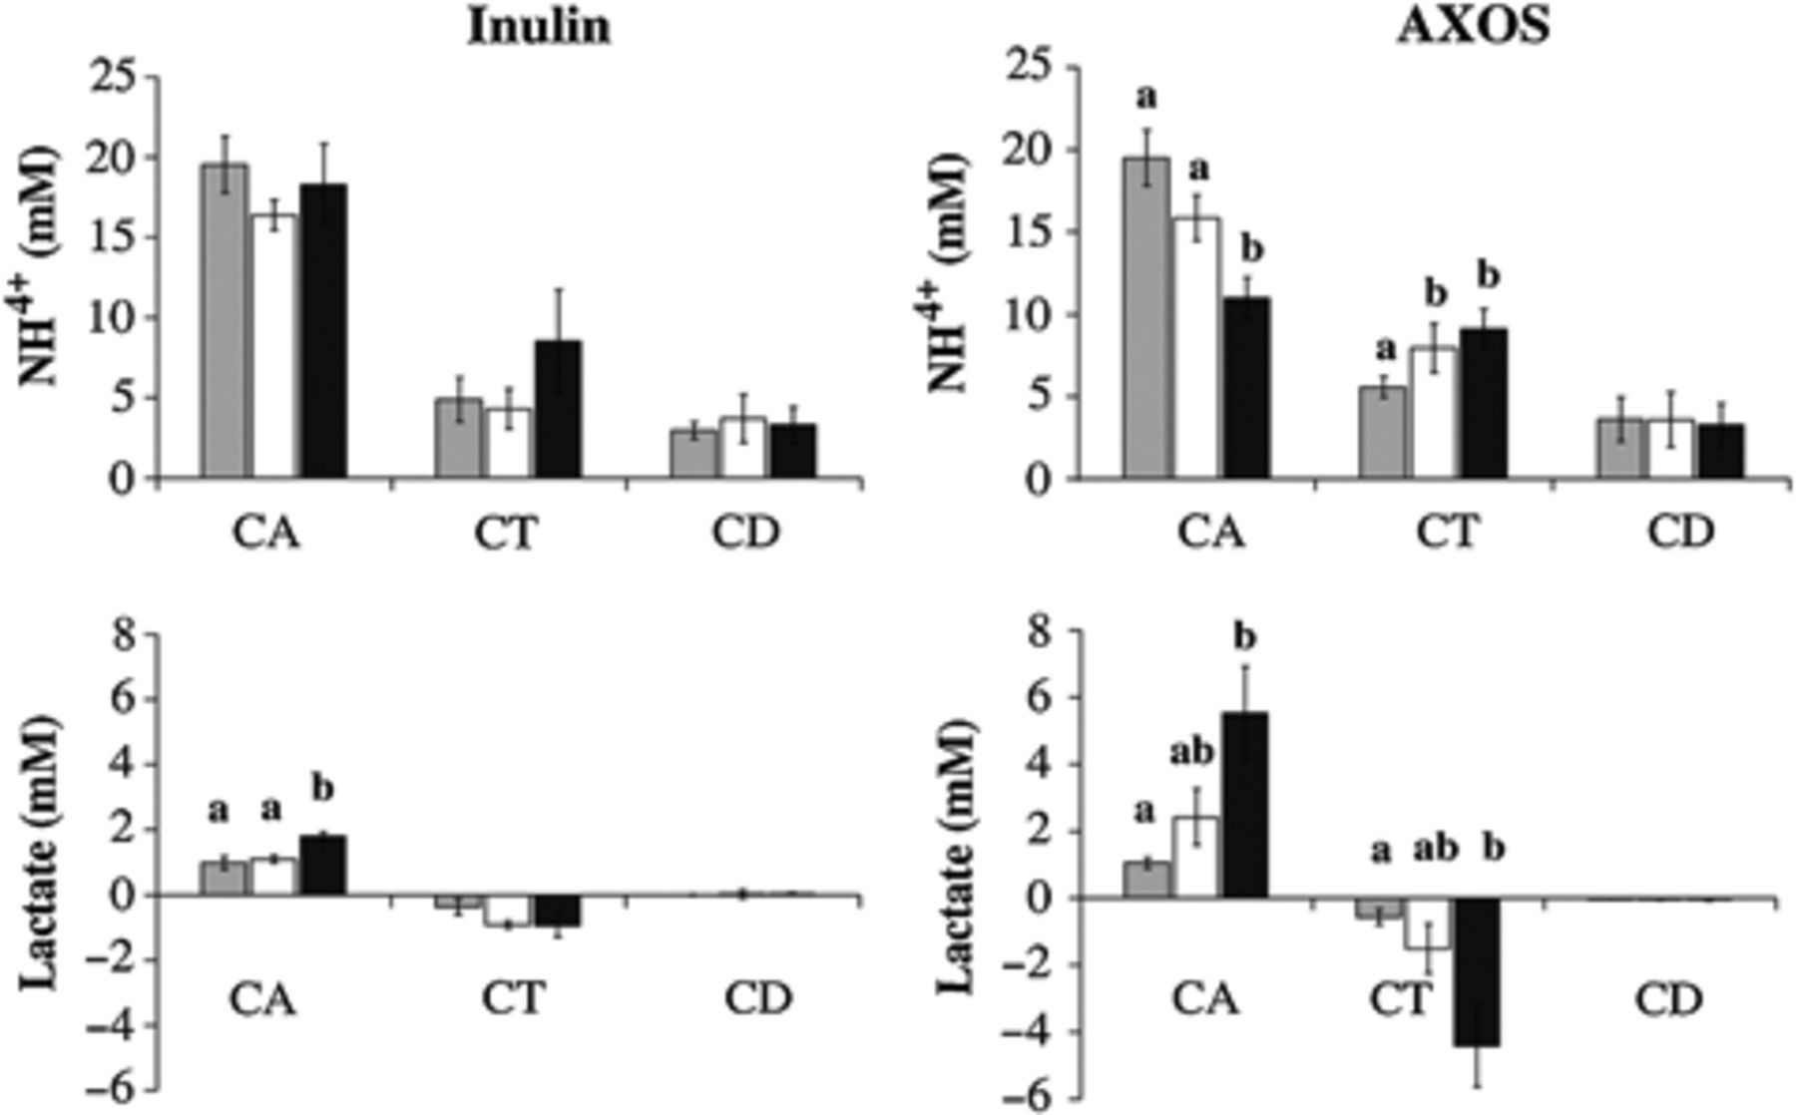
2 Average net ammonium ion production (upper panels) and net lactate (lower panels) production during the ...
Notes:
2 Average net ammonium ion production (upper panels) and net lactate (lower panels) production during the Twin-SHIME run. For both inulin- (left panels) and AXOS (right panels)-treated SHIMEs, the different colon compartments (CA, CT and CD for ascending, transverse and descending colon, respectively) and the different periods (grey bars for basal, white bars for treatment and black bars for washout period) are presented. Indices above data bars represent significant differences within one colon compartment in function of time. Different letters indicate significantly different results (P<0.05).
Unless provided in the caption above, the following copyright applies to the content of this slide: © 2009 Federation of European Microbiological Societies. Published by Blackwell Publishing Ltd. All rights reserved

Slide 3
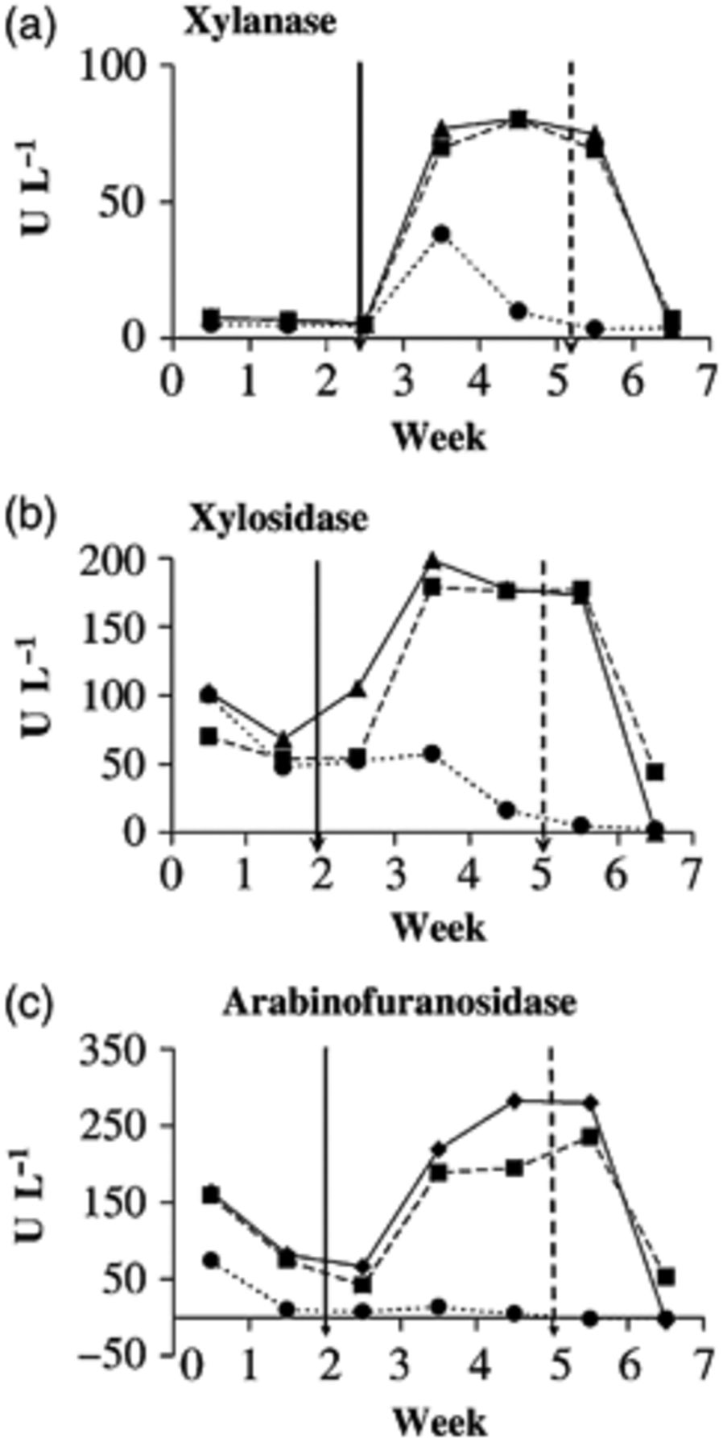
3 Enzymatic activities during the Twin-SHIME run. AXON-degrading enzymes, such as xylanase (a), xylosidase (b), ...
Notes:
3 Enzymatic activities during the Twin-SHIME run. AXON-degrading enzymes, such as xylanase (a), xylosidase (b), and arabinofuranosidase (c) were measured in the ascending (circle symbols), transverse (triangle symbols) and descending colon compartments (square symbols) for the AXOS-treated SHIME. The full-line arrow and dotted-line arrow indicate the beginning and end of the treatment period, respectively. Different letters indicate significantly different results (P<0.05).
Unless provided in the caption above, the following copyright applies to the content of this slide: © 2009 Federation of European Microbiological Societies. Published by Blackwell Publishing Ltd. All rights reserved

Slide 4
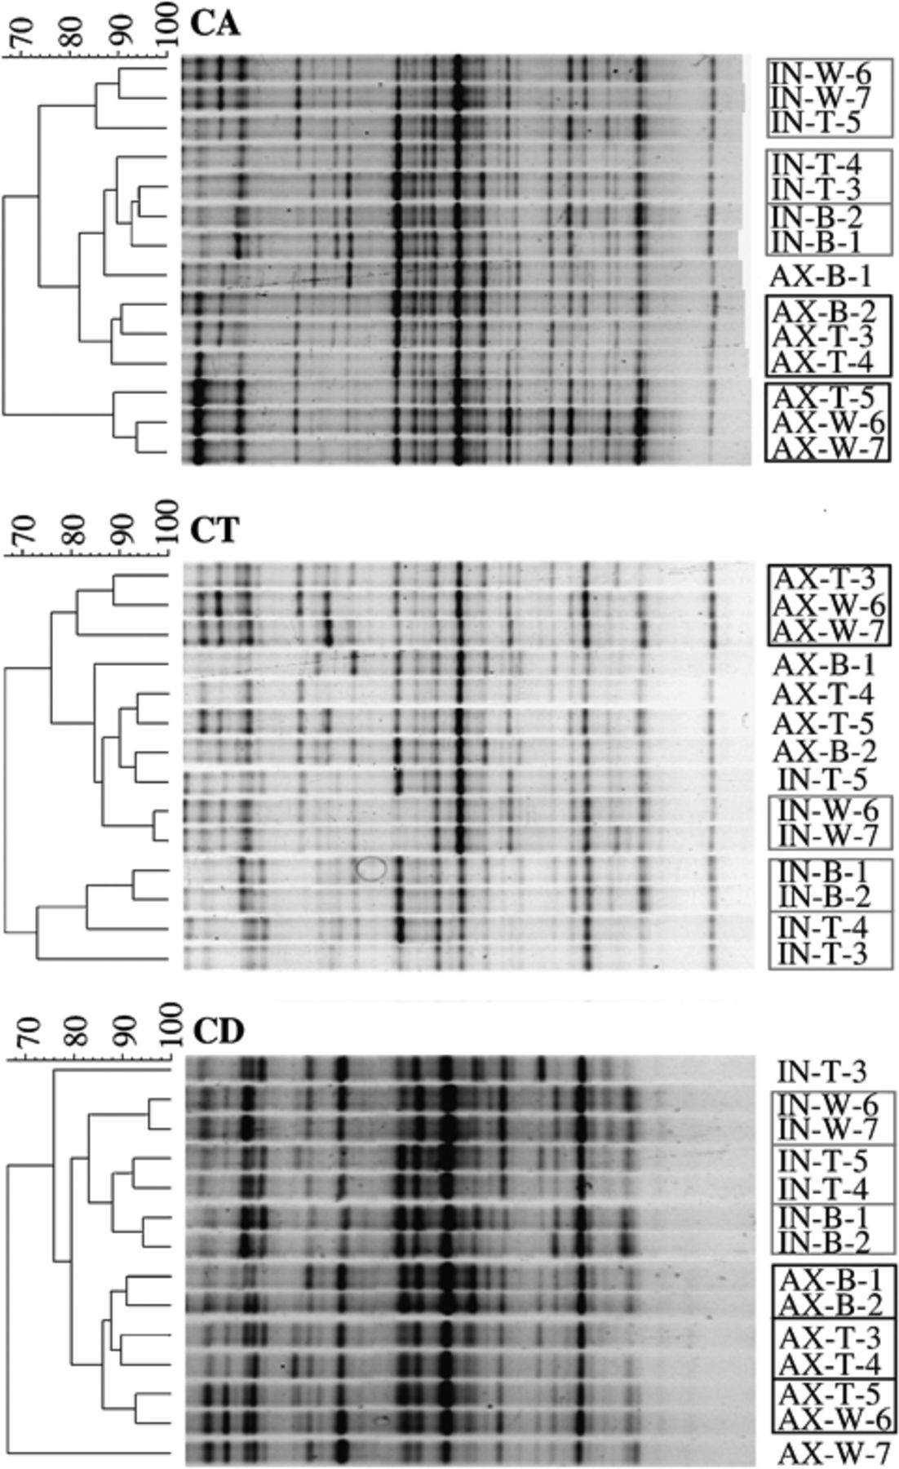
4 Clustering of the DGGE profiles during the Twin-SHIME run. The clustering was based on the Pearson ...
Notes:
4 Clustering of the DGGE profiles during the Twin-SHIME run. The clustering was based on the Pearson correlation coefficient. CA, CT and CD refer to the ascending transverse and descending colon compartments, respectively. IN and AX in the names of the lanes refer to the inulin and AXOS treatment, respectively; the letters B, T and W refer to the basal, treatment and washout periods, respectively; and the numbers 1–7 refer to the corresponding week of the SHIME-run. Different letters indicate significantly different results (P<0.05).
Unless provided in the caption above, the following copyright applies to the content of this slide: © 2009 Federation of European Microbiological Societies. Published by Blackwell Publishing Ltd. All rights reserved

Slide 5
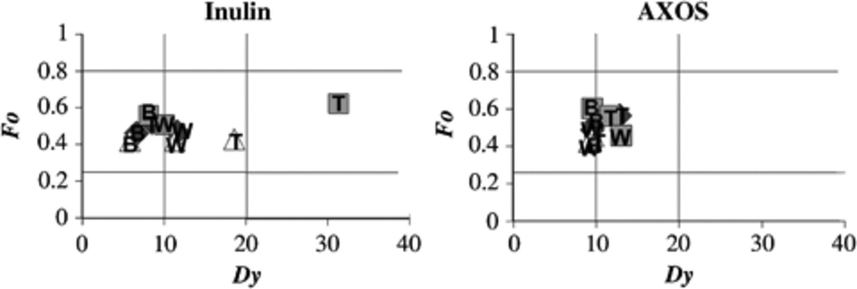
5 2D-Plot of the functional organization (Fo) in function of the dynamics (Dy), as proposed by Marzorati et al. ...
Notes:
5 2D-Plot of the functional organization (Fo) in function of the dynamics (Dy), as proposed by Marzorati et al. (2008). In this graph, the indication of the range-weighted richness was not included, because all the values were classified as high. Instead, indications of the colon vessels (dark squares, light squares and white triangles for the ascending, transverse and descending colon, respectively) are presented. The letters B, T and W refer to the basal, treatment and washout period, respectively. Different letters indicate significantly different results (P<0.05).
Unless provided in the caption above, the following copyright applies to the content of this slide: © 2009 Federation of European Microbiological Societies. Published by Blackwell Publishing Ltd. All rights reserved

